Slide 1
Designing Scientific Investigations
Module 7

Slide 2

UNDERSTANDING THE ENGINEERING DESIGN PROCESS
A Step-by-Step Guide for K-12 Students

Slide 3
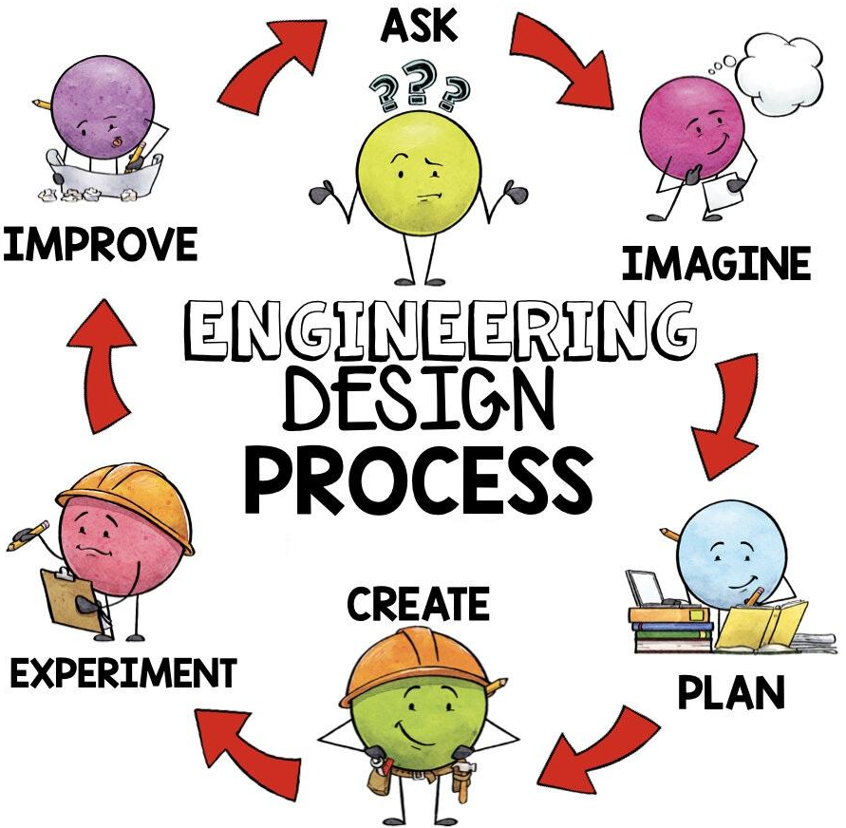
WHAT IS THE ENGINEERING DESIGN PROCESS?
The Engineering Design Process is a series of steps engineers follow to solve problems and create new things. It's like a map that helps guide us from an idea to a final product

Slide 4

STEP 1: ASK
What is the problem we are trying to solve?
Who is it for?
What are the requirements or limitations?
Example: If we want our plants to grow healthy, we might ask: “How can we check if the soil is too dry or if the temperature is too hot for the plants?

Slide 5
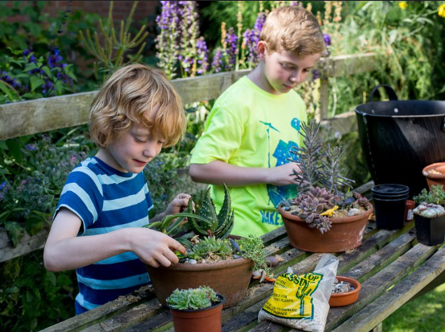
STEP 2: IMAGINE
Next, we brainstorm ideas. We think about different ways we can solve the problem
What can we create?
What would work best?
  Example: Imagine using a Micro:bit to measure temperature or soil moisture. Could it light up or show a message when the plant needs water? Should we use a sound to remind us to water it?

Slide 6
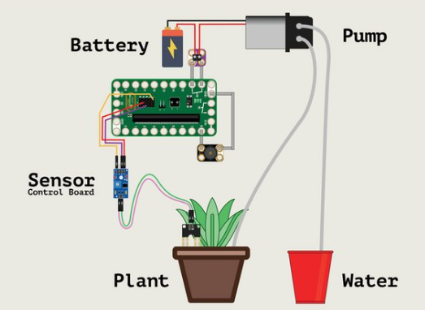
STEP 3: PLAN
Now we make a plan. We choose the best idea and think about how to build it.
What materials will we need?
What steps will we take to make it happen?
  Example: We plan to use a Micro:bit, a soil moisture sensor, and a buzzer. We’ll write code that checks if the soil is dry and plays a sound to remind us to water the plant
Notes:
https://learn.browndoggadgets.com/Guide/Plant+Watering+System+(Resistive)/326
Auto watering system: https://www.instructables.com/Automatic-Plant-Watering-System-Using-a-Microbit/

Slide 7
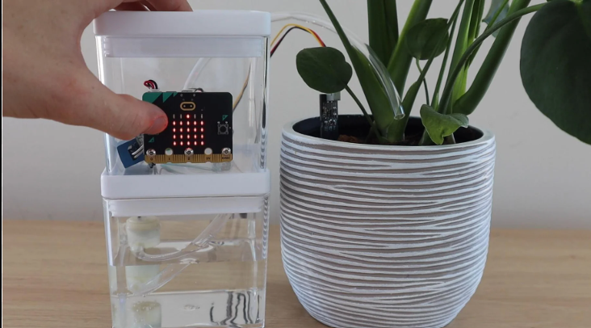
STEP 4: CREATE
We build our design! This is where we turn our plan into reality.
Build a prototype or a model.
Make sure everything fits and works together
We connect the soil moisture sensor to the Micro:bit and test the code to make sure it sends an alert when the soil is dry

Slide 8
STEP 5: EXPERIMENT (TEST)
Testing is super important! We check if our design works as expected.
Does it solve the problem?
Are there any problems with the design?
We test the system by placing it in a dry plant pot to see if it gives a warning. Then we water the plant and see if the alert stops

Slide 9
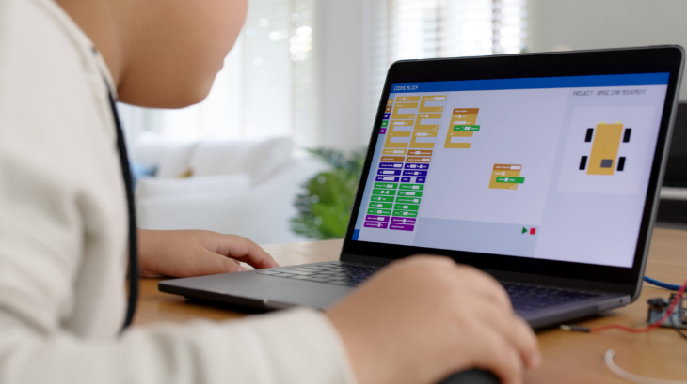
STEP 6: IMPROVE
Based on the testing, we make improvements. Maybe something needs to be stronger or more efficient.
What can be fixed?
How can we make it better?
  If the alert is too quiet or delayed, we can add a brighter light or make the buzzer louder. We could even add temperature monitoring to make the system smarter

Slide 10
Greenhouse Sensors – Work done so far!
Using micro:bit, we have obtained data using the air temperature and humidity (AHT) sensor and light sensor:
  Independent variable:
    Time
  Dependent variable:
    Air temperature (Using AHT sensor)
    Humidity (Using AHT sensor)
    Light (Using Light sensor)
We also tried to transfer the data from the micro:bit to the graphing site to create graphs

Slide 11
Now let’s try some CHALLENGES!
You may ask for a mini-heater, a mini-humidifier, and/ or another fan

Slide 12
Challenge 1
Try to maintain low humidity (around 50%) and high temperature (around 35°C) in the greenhouse at least for 3 minutes.
  While doing this, always keep the heater ON.
  Also explain what changes you made in the greenhouse in order to achieve this challenge!
  Log the data of temperature and humidity with the data logging element of the micro:bit and then create graphs.
  Use these graphs to show that your experiment is successful!
Notes:
Constraints:

Slide 13
Challenge 2
Try to maintain high humidity (78-80%) and high temperature (33-35°C) in the greenhouse at least for 3 minutes.
  While doing this, always keep the heater ON.
  Also explain what changes you made in the greenhouse in order to achieve this challenge!
  Log the data of temperature and humidity with the data logging element of the micro:bit and then create graphs.
  Use these graphs to show that your experiment is successful!
Notes:
Constraints:

Slide 14
Challenge 3
How fast can you go from 35°C to 30°C with 2 fans?
  While doing this, always keep the heater ON.
  Also explain what changes you made in the greenhouse in order to achieve this challenge!
  Log the data of temperature and humidity with the data logging element of the micro:bit and then create graphs.
  Use these graphs to show that your experiment is successful!
Notes:
Constraints:

Slide 15
Challenge 4
How can you go from 35°C to 30°C in 2 minutes?
  While doing this, always keep the heater ON.
  Also explain what changes you made in the greenhouse in order to achieve this challenge!
  Log the data of temperature and humidity with the data logging element of the micro:bit and then create graphs.
  Use these graphs to show that your experiment is successful!
Notes:
Constraints:

Slide 16
Challenge 5
How can you maintain your greenhouse at 30°C temperature and 50% humidity at the lowest cost?
  While doing this, always keep the heater ON.
  You cannot open more than 1 window. All other windows have to be closed.
  Log the data of temperature and humidity with the data logging element of the micro:bit and then create graphs.
  Use these graphs to show that your experiment is successful!
Cost of 1 fan = $10 | Cost of 1 relay = $15 | Cost of humidifier = $30
Notes:
Constraints:

