Slide 1
Lesson 6
Logging the Data using Micro:bit

Slide 2
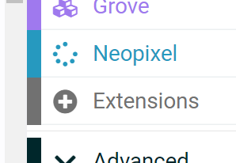
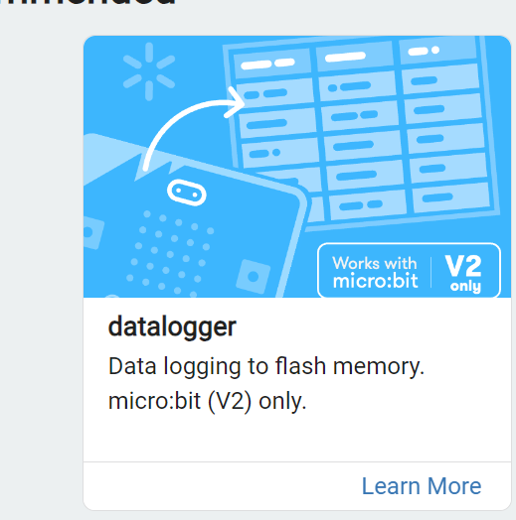
We need a new Extension
First, go to “Extension”. Here, the first extension on that list is “datalogger”. Click on that to add this extension.

Slide 3
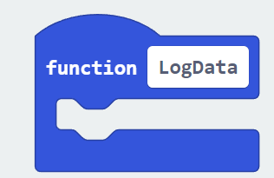
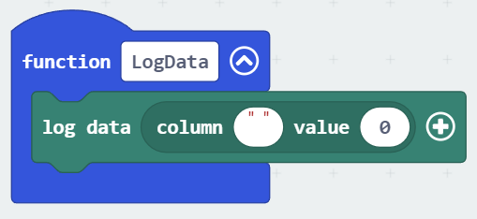
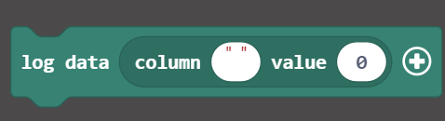
Now, we need to create a Function!
Create a function named “LogData”. Inside the LogData Function, place this block from “Data Logger”:

Slide 4
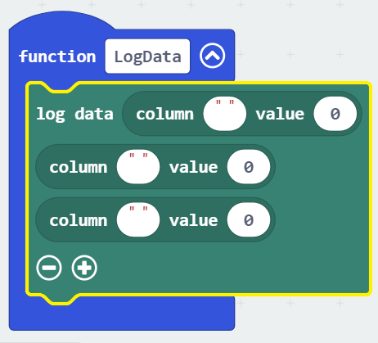
Codes for Logging Data
Click “+” sign to add two more of the same code block. We need to log data for “Temperature”, “Humidity”, and “Light”

Slide 5
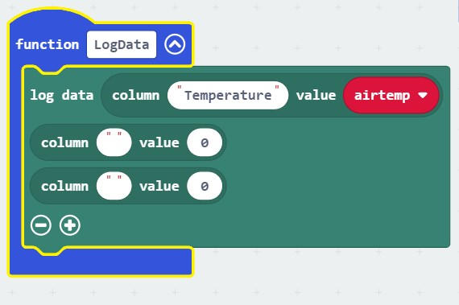
Codes for Logging Data
Now, let’s write the column name in the first (“ ”) box, and add the corresponding variable as the value (from the Variables block). First one is temperature.

Slide 6
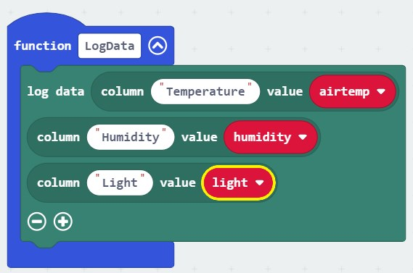
Codes for Logging Data
Now, we can write “Humidity” for the second column, and “Light Level” for the third column, and then add corresponding variables from the “Variables” block.

Slide 7
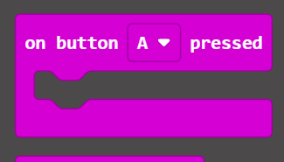
Starting Data Logging
Now, we want to start Data Logging with the press of button A. Find “On button press A” code from “Input”.

Slide 8
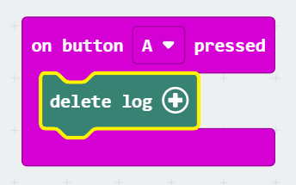
Start a new data logging session
The Micro:bit may have previously logged data. To make sure, we first add a code to delete previous log at the very beginning.
Add “delete log” code from the datalogger.

Slide 9
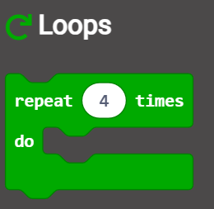
Start a new data logging session
Now, we want to decide, how long we would log the data. We may decide to log data for 120 times (for 120 seconds or 2 minutes). To do that, we would need the “Repeat” block from the Loops.

Slide 10
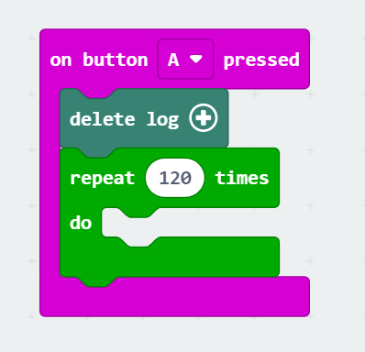
Start a new data logging session
Now add this repeat block under “delete log” block. Replace 4 with 120, as we will log data for 120 seconds or 2 minutes

Slide 11
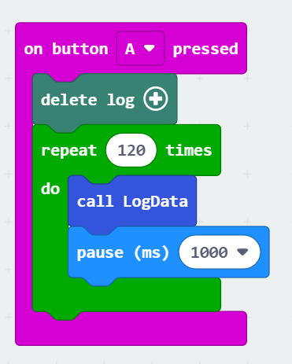
Start a new data logging session
Now, call the “LogData” function inside the “repeat” block. And after each incident of logging data, let’s add a pause of 1 second.

Slide 12
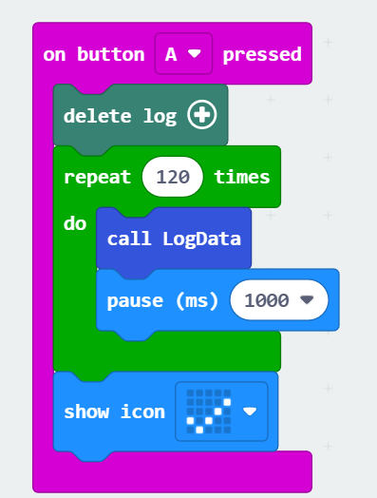
Add the last bit of codes
To let us know, whether data logging is finished, let’s add “show icon” code. So, we can know when data logging is over.

Slide 13
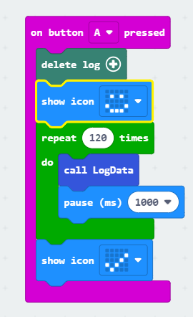
Add the last bit of codes
You can also add an optional code to show that “Data Logging” is going on. So, here, the smiley face will be on, when data logging is going on, and after it is finished, it will show the check mark.

Slide 14
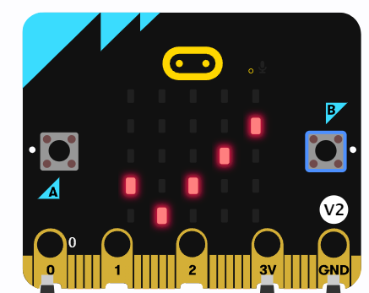
Now, start Data Logging
Download this code.
Then press A button to start data logging.
After you can see the icon on the Micro:bit, you are now ready to explore the datasheet.

Slide 15
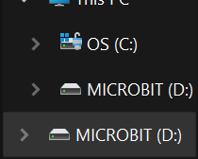
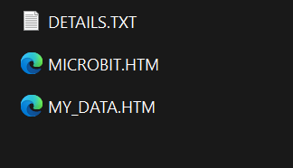
Explore the logged data
In your computer, you can find the Micro:bit drive.
Inside the Micro:bit folder, there will be a file named “MY_DATA.HTM”. This is where the logged data is stored.

Slide 16
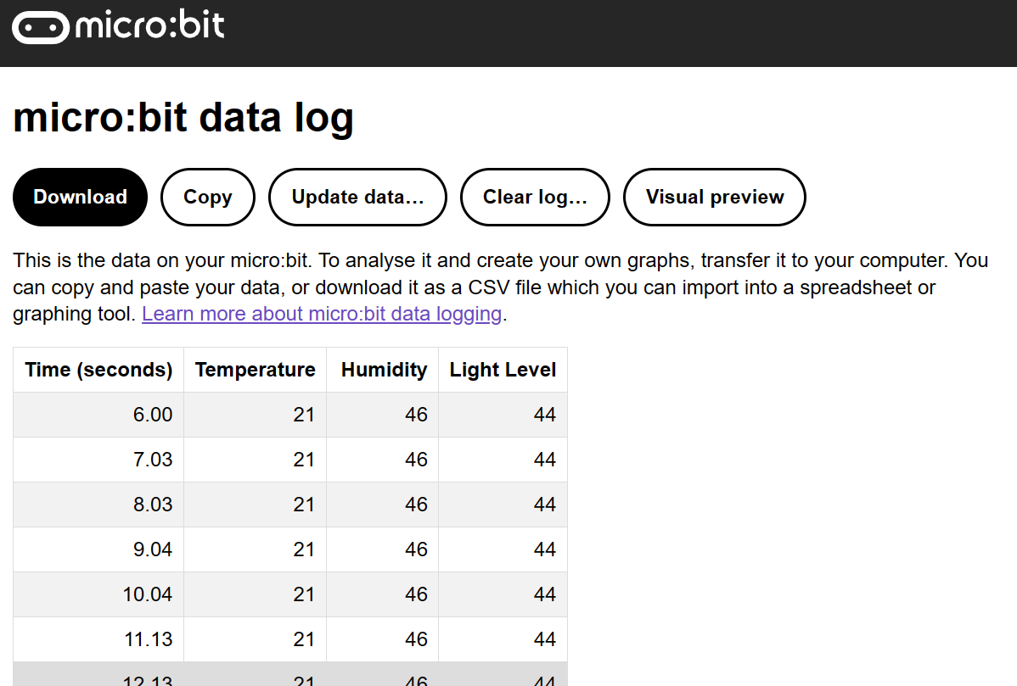
Explore the logged data
After opening the MY_DATA.HTM file, we would see this:

Slide 17
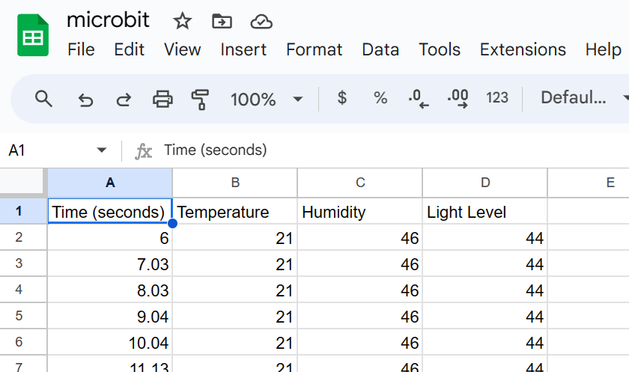
Download the logged data
If you click “Download”, you would see the option to download the data file as .csv file. Then, you can open the .csv file on Google Sheets.

Slide 18

Using CODAP site for Data Visualization
There is a site which we can use to see our data.
Link: https://codap.concord.org/app/static/dg/en/cert/index.html
(You can also search for “CODAP” on Google and then select “For Educators” and then click the first “CODAP” word of that page to get there)

Slide 19
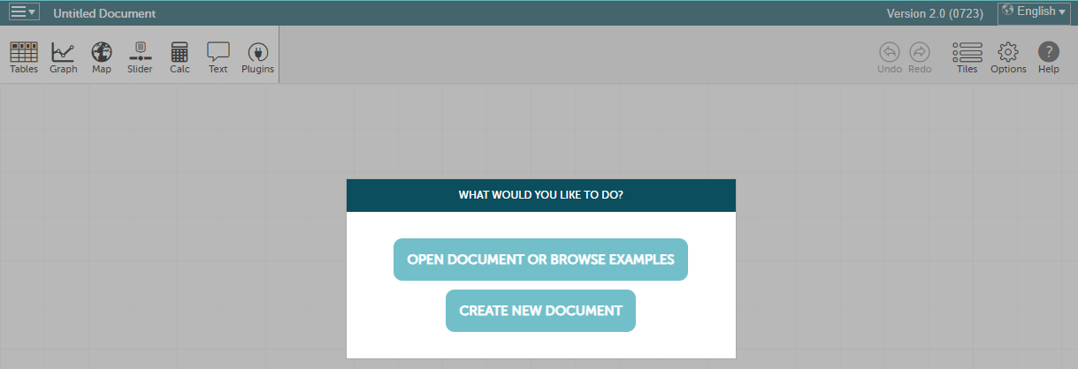
Using CODAP site for Data Visualization
Initially, the page will look like this:

Slide 20
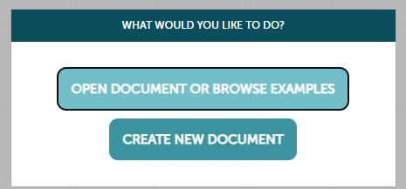
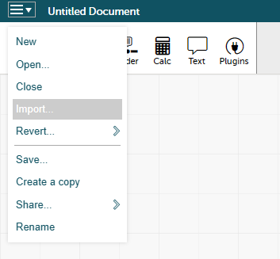
Using CODAP site for Data Visualization
Now, select “Create New Document”
Now, find the option for “Import” from the top-left corner.

Slide 21
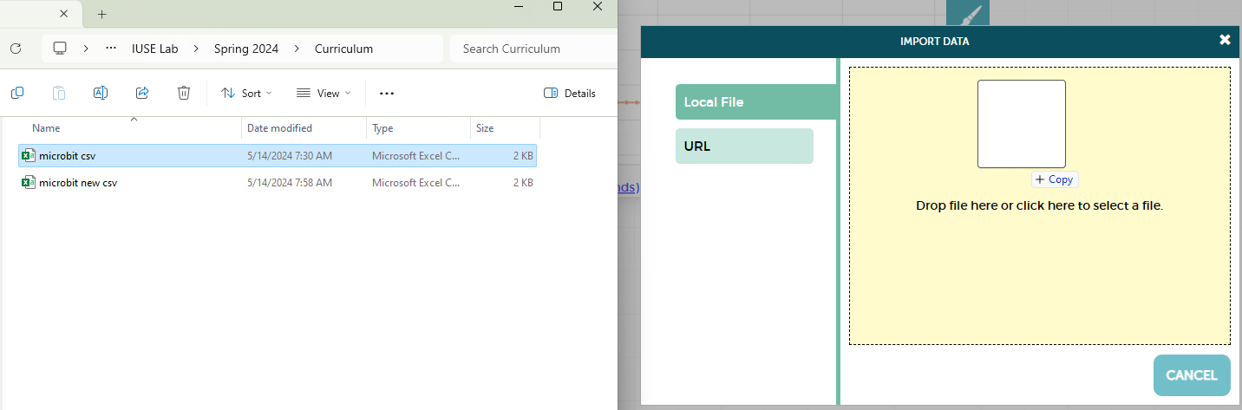
Using CODAP site for Data Visualization
Then, you can drag and drop the file into the white box, or you can click the white box to select the .csv file that you downloaded earlier.

Slide 22
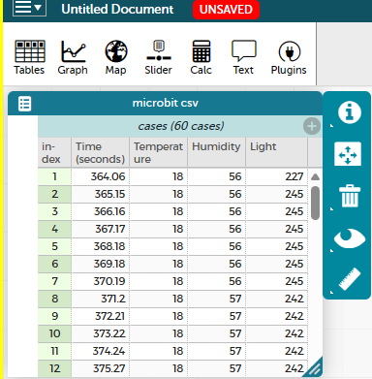
Using CODAP site for Data Visualization
Then, you would see the data like this:

Slide 23

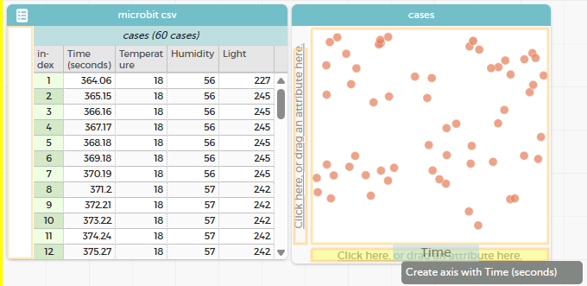
Using CODAP site for Data Visualization
Now, for example, you want to see Time vs Temperature graph.
Click “Graph” on the top of the table, which will pop up a new box.
Now, drag “time” from the table to the x-axis of the graph.

Slide 24
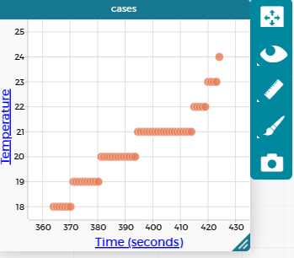
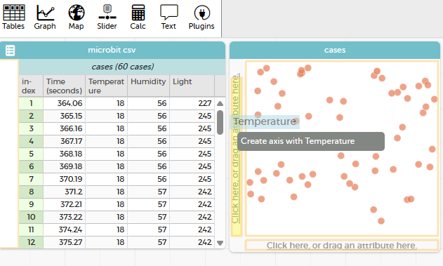
Using CODAP site for Data Visualization
And now, if you drag “temperature” from the table to the y-axis of the graph, you will see a graph.

Slide 25
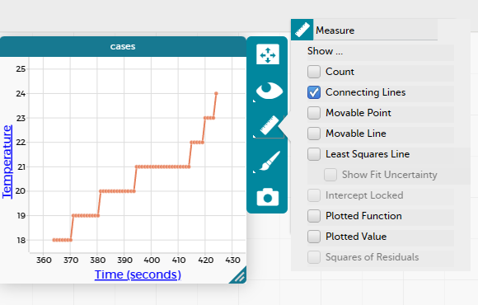
Using CODAP site for Data Visualization
You can improve the view of the graph, by creating a connecting line. To do that, click the “ruler” sign, and select “Connecting Lines”

Slide 26
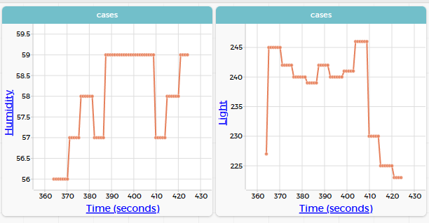
Using CODAP site for Data Visualization
You can create separate graphs for Humidity and Light.

Slide 27
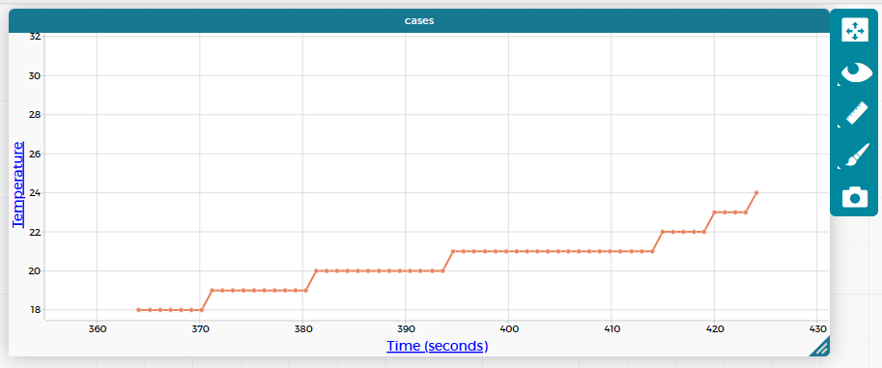
Using CODAP site for Data Visualization
You can also drag x or y axis to change the view of the graph:

Slide 28
Task:
Collect data that will include a “spike” in the temperature, humidity, and light levels (for example, push the “A” button, wait a few seconds, and then use your breath to create a spike in the temperature and humidity…)
Create a doc in the Google Classroom assignment.
Create 3 graphs– one for temperature/ time, one for humidity/ time, and one for light levels/ time. Screen shot each and put in the doc. Turn in the assignment with the attached doc.

