Slide 1
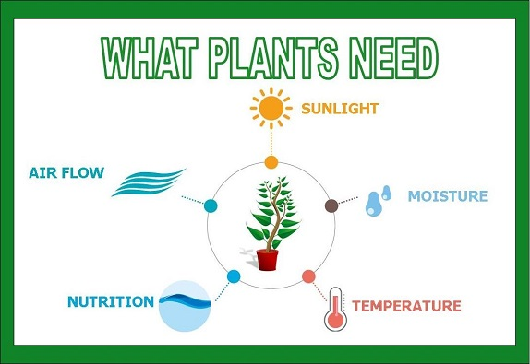
How to control lights?
How much light do plants need?
We can make a timer
or
We can use the light sensor

Slide 2
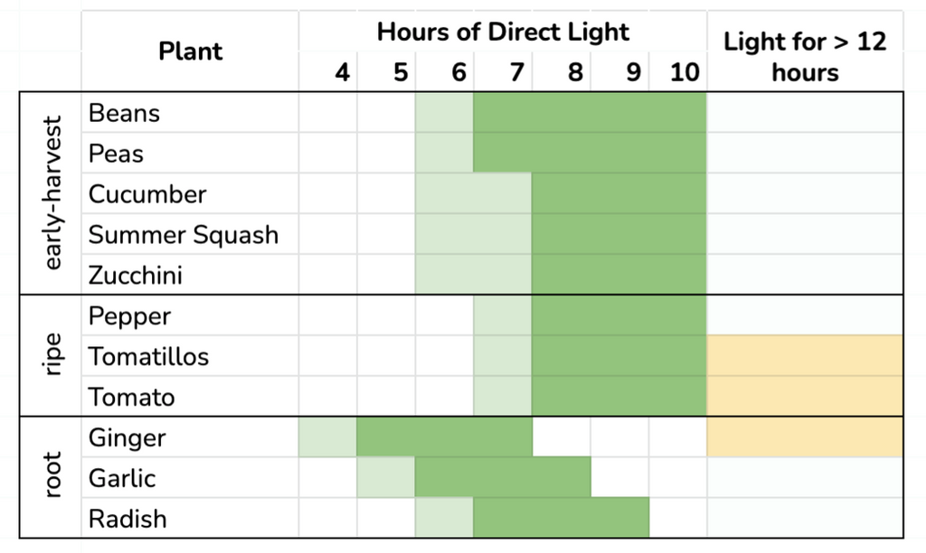
Let’s control our lights
Without light a plant will not grow because photosynthesis is unable to happen.
How much light is enough? Depends on your plant:
  Basil is happiest with about 10 to 14 hours of light but can handle 18 to 20 hours per day
Plants are happiest with 4000+ lux

Slide 3
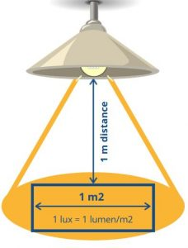
What is a lux?
Lux is a measure of intensity of the light
More lux means the light is either very close to your plant or the light is very bright

Slide 4
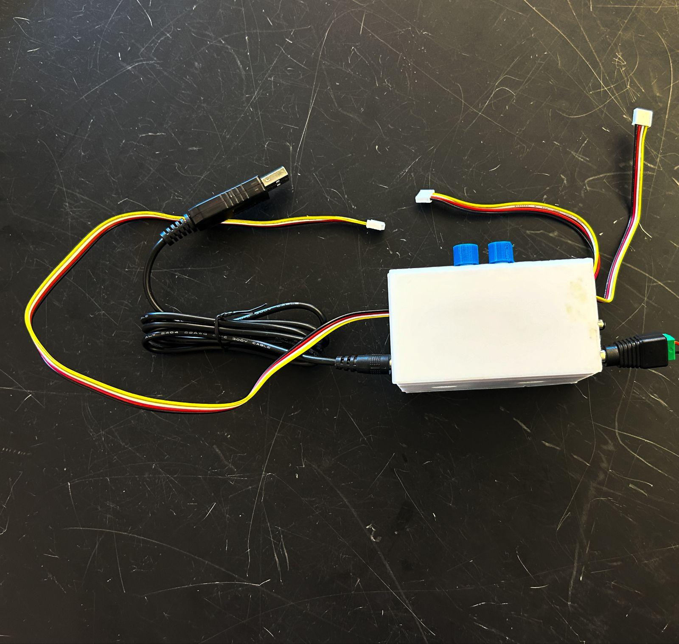
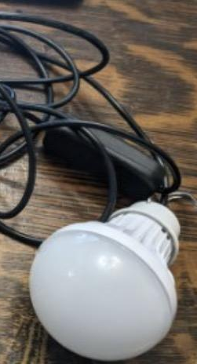
Step 1: What we need
Get our new materials
  Relay (relay = switch) with wires attached
    Male and female ends
  A lightbulb with USB connector
  4 pin wire
  Light Sensor
Will need everything else from before (Microbit, shield, 5 volt power cable, etc…)

Slide 5
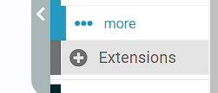
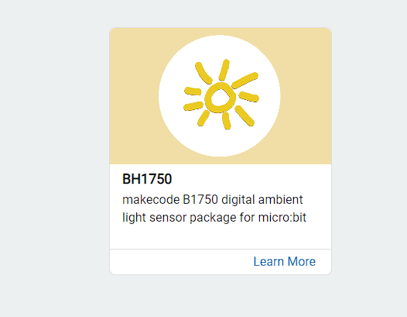
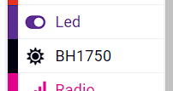
Step 1: Use the Light Sensor to Get Light Data
First, we should attach our Light sensor to the I2C Hub (there should be one port remaining on the hub)
Then, we need to find an extension to use our Light Sensor. Go to “extensions” and type “BH1750”
Add the BH1750 extension to your makecode window

Slide 6
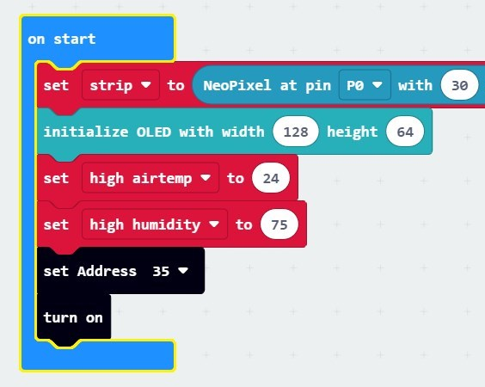


Step 2: Use the Light Sensor to Get Light Data
Remember, whenever we needed to initialize OLED screen, we had to add something on the “On Start” block. We need to do this again for the Light sensor.
From BH1750 block, find
and put this inside “On Start”
Then, add block under the
set Address 35 block

Slide 7
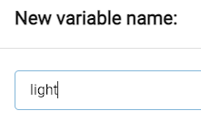
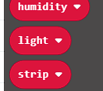

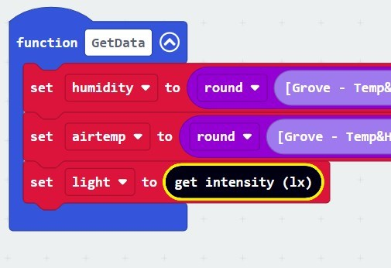

Step 3: Use the Light Sensor to Get Light Data
Now, create a new variable named “Light” from Variables
Bring the block inside the GetData Function
Now, from BH1750 block, bring the
to replace the 0

Slide 8
Your Challenge
Make your lightbulb turn ON when the classroom lights are turned off
Make your lightbulb turn OFF when the classroom lights are turned on
YES! You may turn the classroom lights on and off (respectfully)
Find the lux level in YOUR greenhouse (it may vary a bit if your greenhouse is say closer to the window than another group’s)

Slide 9

So this sounds familiar…..
What do you think we need to do?
Hmmm…..

Slide 10
Solutions

Slide 11
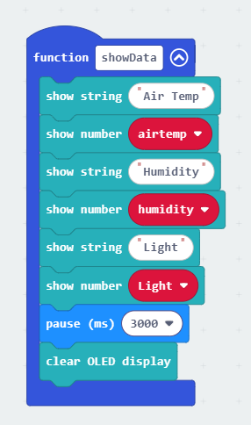
Step 4: How to Show the Light Data
Now, you can show Light Data on your OLED Screen. You can “duplicate” the show string and show number block for airtemp/humidity
Your final code will look like this:

Slide 12
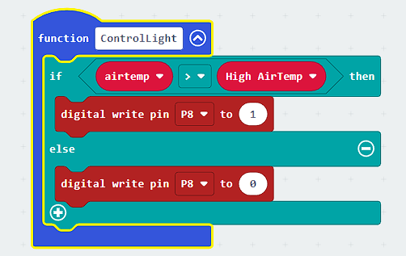
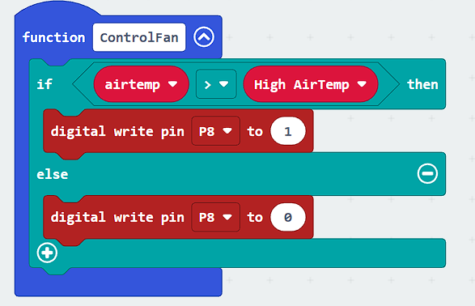
Step 5: Using Light Data to Control Light
We are going to need a conditional (LOGIC) statement again, right?
Let’s copy and paste an existing similar function
  Say ControlFan?
Click on ControlFan and hit Control+C (Copy) and then Control+V (Paste)
Change the name of the new function from ControlFan2 -> ControlLight

Slide 13
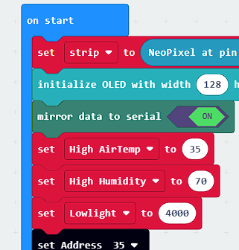

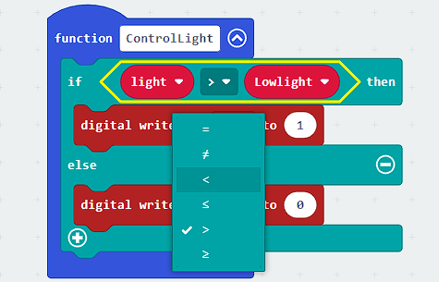
Step 6: Compare LowLight with light sensor data
You can create a global variable
and give a lux value of 400.
(you will get the Lowlight value from the lux value in YOUR greenhouse with the classroom lights turned ON)
In the ControlLights function change “airtemp” to “Light” and change the highairtemp to “Lowlight”
Here, if light reading from sensor is LESS THAN our LowLight value, then we want to set the relay to 1 (ON) [Which means, Lightbulb will turn on.]

Slide 14
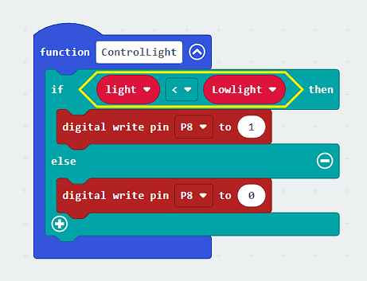
Step 5: Turn on and off the relay
Make sure you change the pin to P2 (or whatever PIN you have the relay plugged into) and the 1 and 0 (on and off) settings are correct)
Here the relay gets a signal of 1 (ON) if the light reading is lower than “Lowlight”.
The relay gets a signal of 0 (OFF) if the light reading is above our LowLight value.

Slide 15
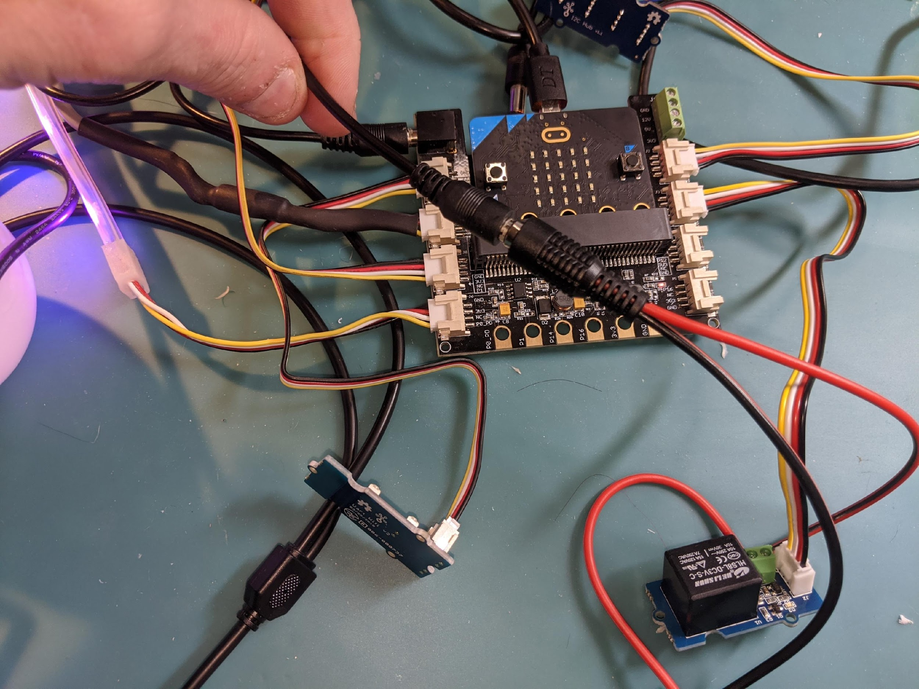
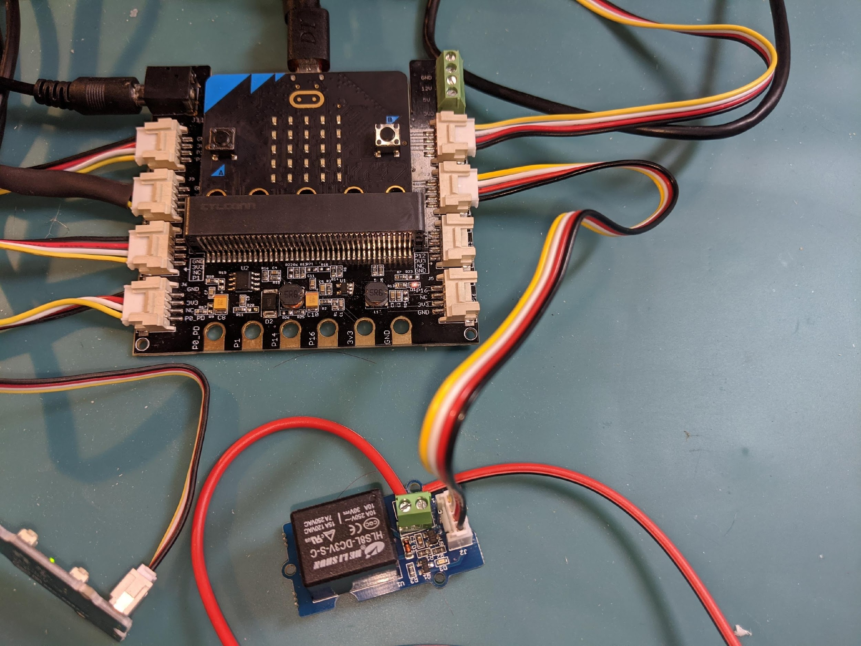
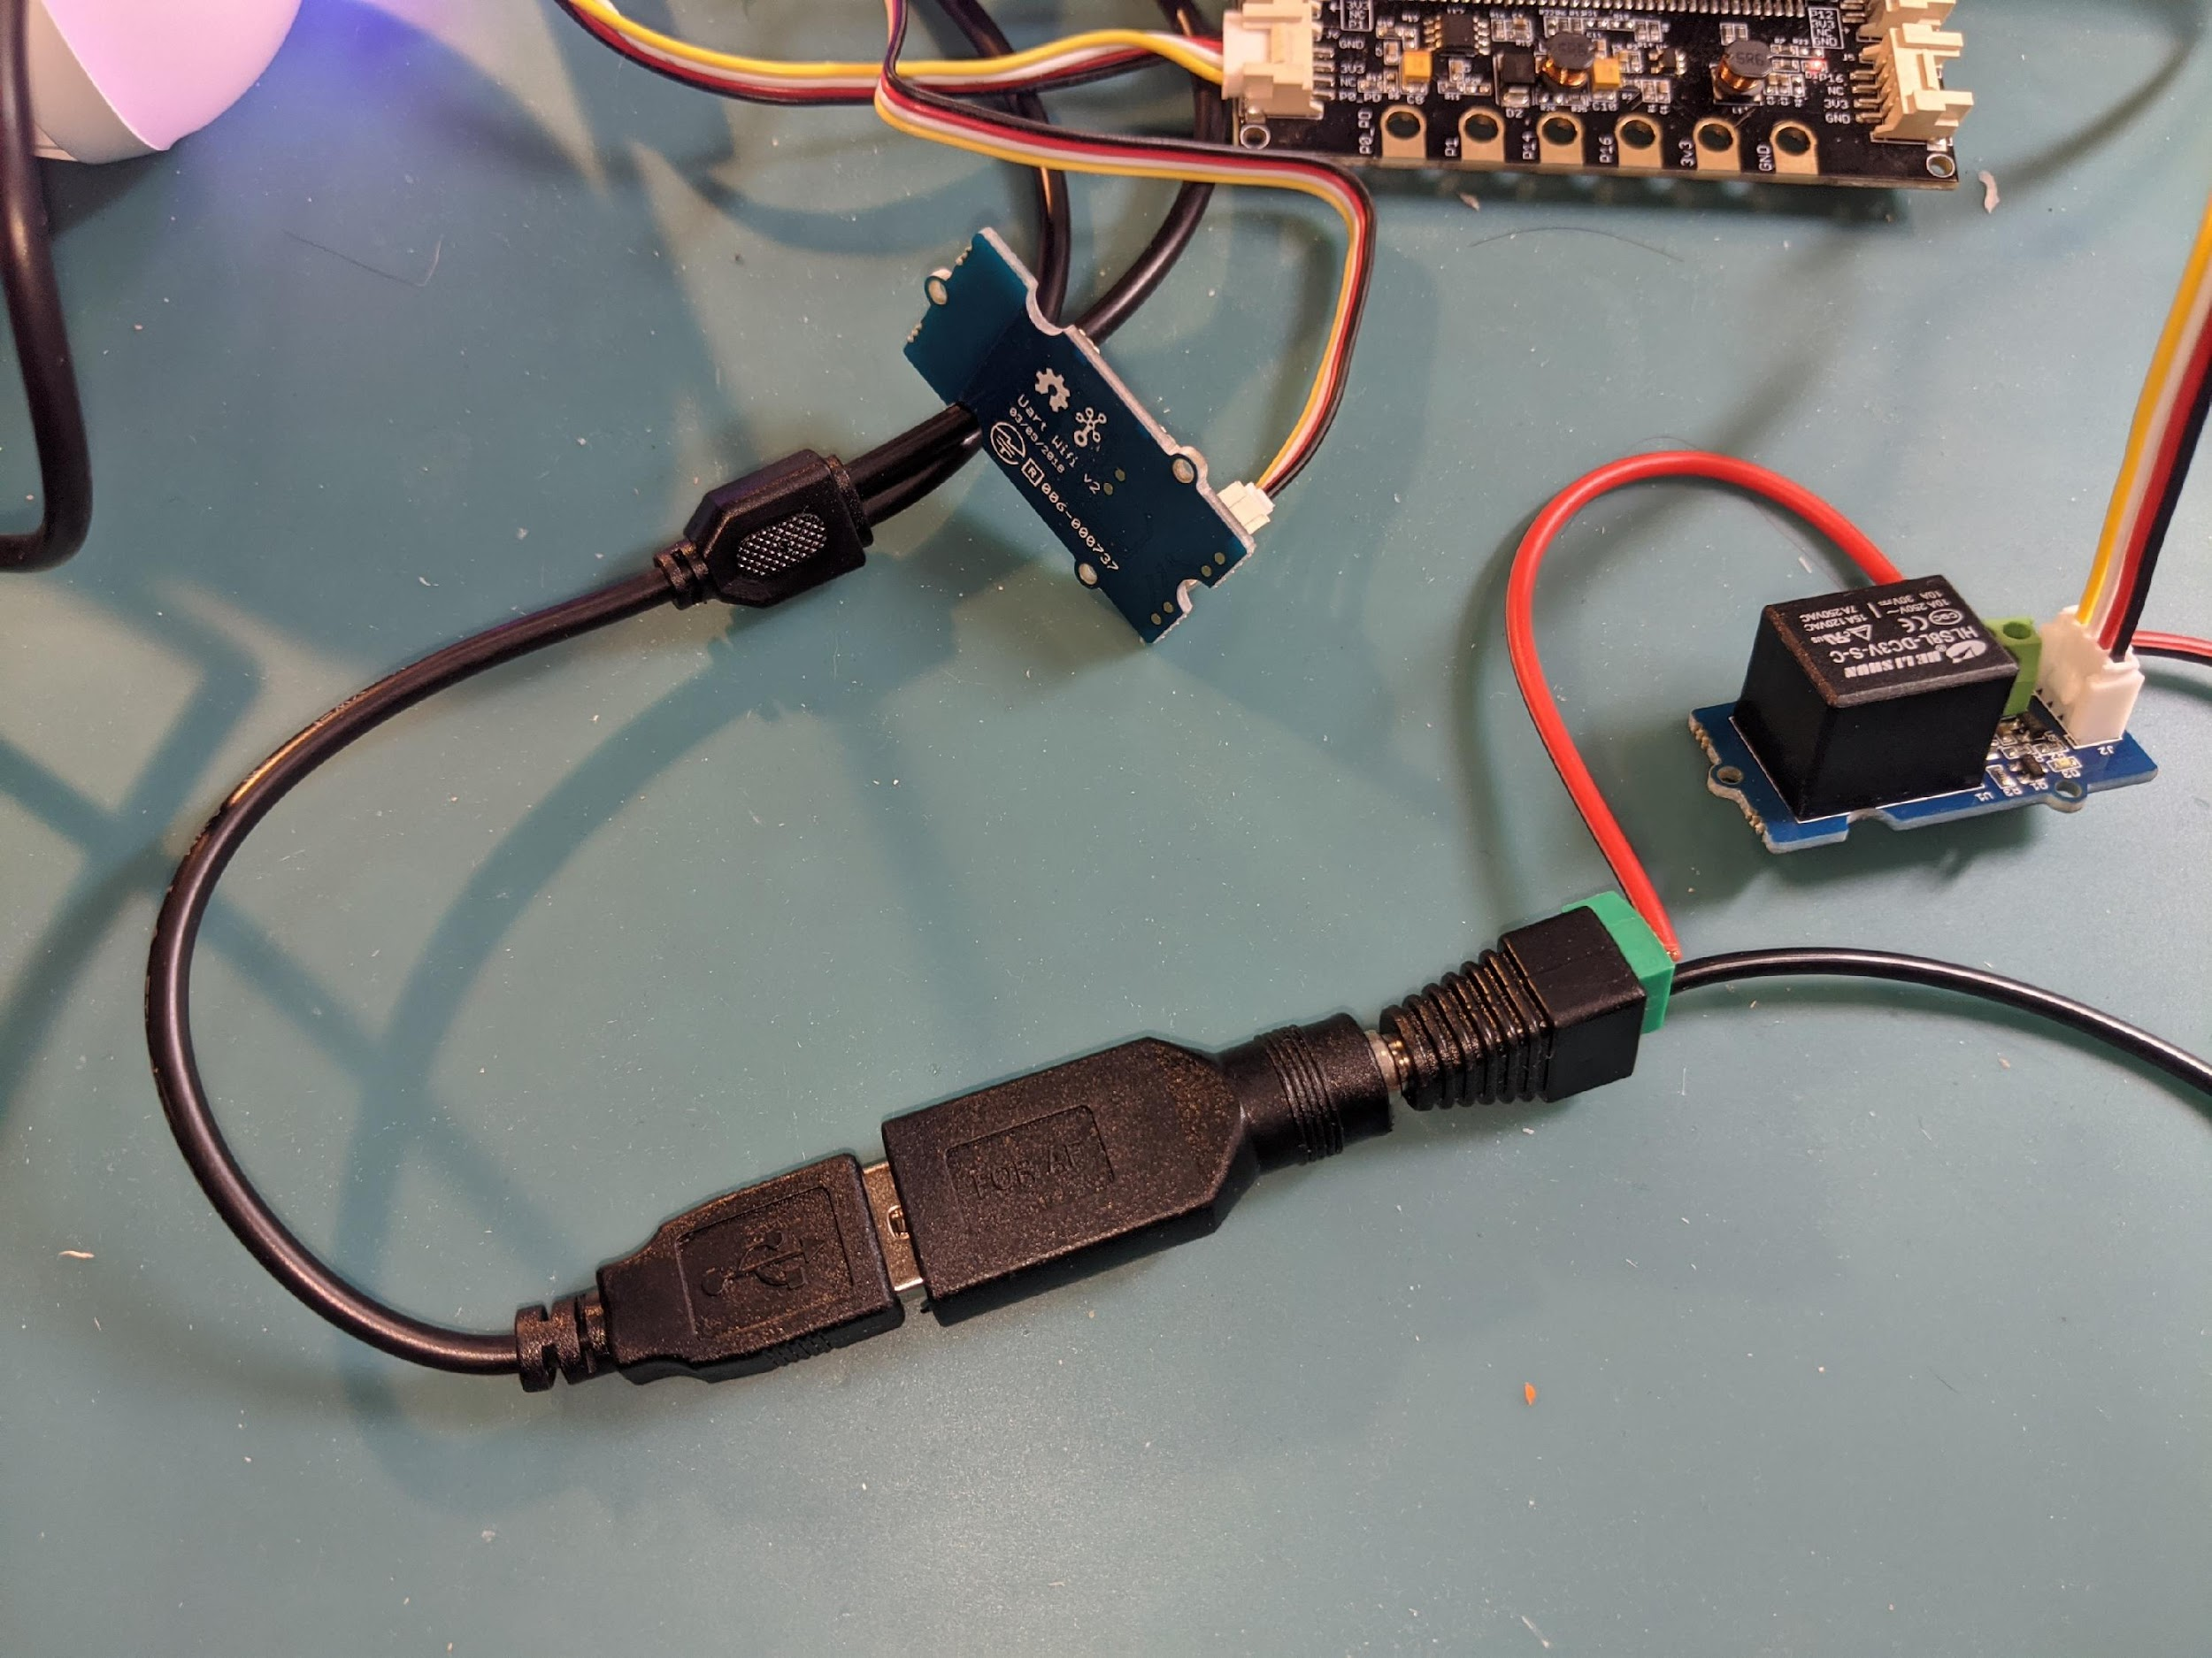
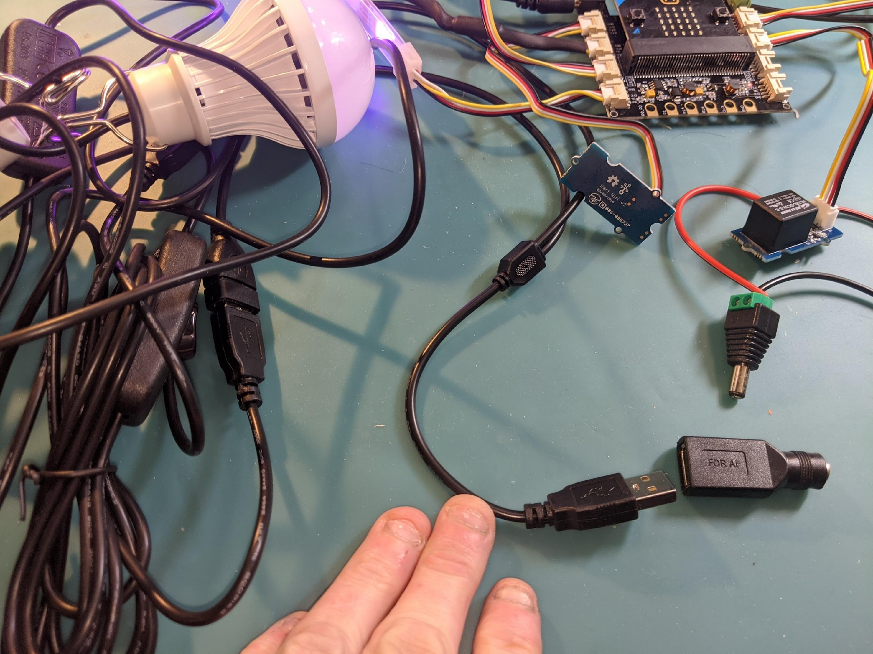
Step 6: Plug to shield and test
Plug the relay to the 5V power cable
Relay gets plugged into P2/P8/P12/P16 (or whatever PIN you told your program!!)
This is the P8 port
Connect the light bulb USB to a USB to female connector
And connect the female connector to the relay
Light bulb connecting wire

Slide 16
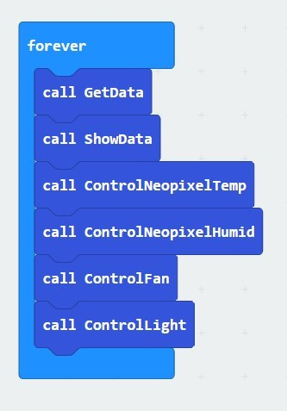
Step 7: Call ControlLight and download and test
Download the program to your micro:bit and test and see if your code works!

Slide 17
Troubleshooting
Test your lights and relay
  Shine a bright light on the light sensor and then cover it up, do the lights go on and off? NO?
    Make sure relay is in the right Port (P2, or the port that you have chosen)
    Make sure your code is correct
    Double check that the wires are plugged in correctly.
Does the relay have a red light on? Yes?
  Do you hear a click when the relay is supposed to be on? NO?
    Replace the relay. If that doesn’t work, replace the cable.
IF you have done all of these, then ask your instructors for help!

Slide 18
Challenge
Can you set your light on for 12 hours to be ON, and then to be OFF for next 12 hours, and repeat this cycle?
(Hint: you do not need to calculate everything, you can use the blocks from “Math”!)

