Slide 1
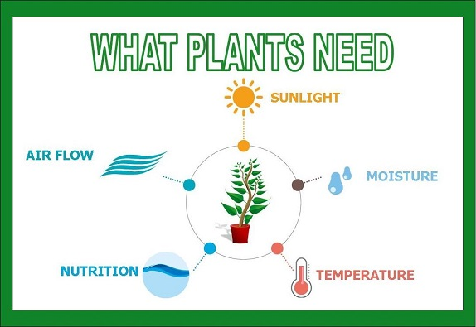
Lesson 4: Relays and Fans!!
Let’s look at air flow (wind) and check how it impacts the health of our plants!
Air Flow is important!

Slide 2

Why do plants need fresh air?
What do you think?

Slide 3
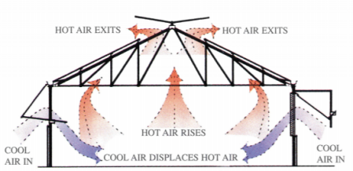
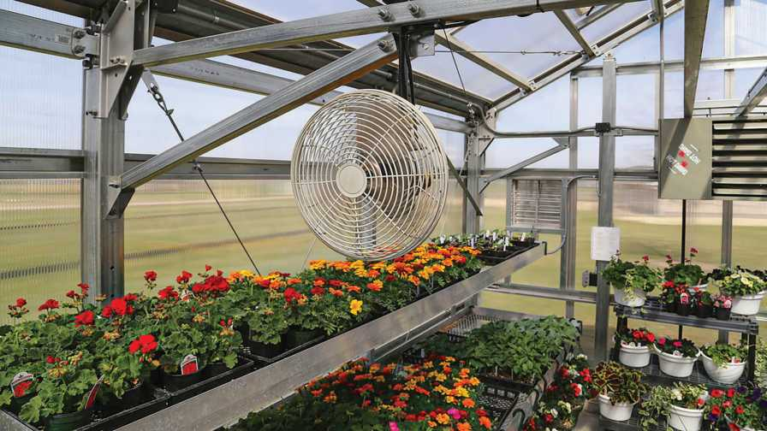
Let’s control air flow in our greenhouse
Why does air flow matter??
Why do greenhouses have fans?
Greenhouses get hot!!!!!

Slide 4
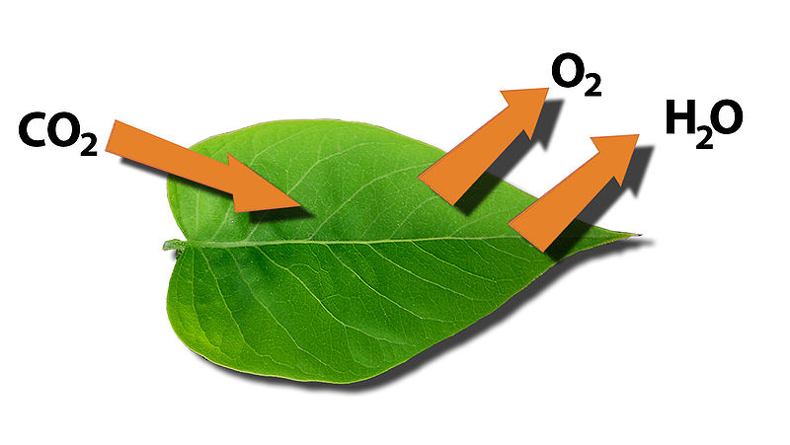
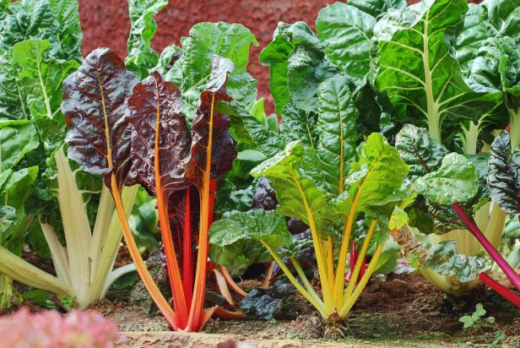
Air flow and happy plants!
Good air flow helps keep humidity equal throughout the greenhouse
Wind/air flow helps keep CO₂ supply fresh for the leaves
  Good for photosynthesis!!
  Helps with transpiration – takes water vapor away
    Cools the plant
Strengthens the stem of the plant
  Makes the plant stronger and better able to survive

Slide 5
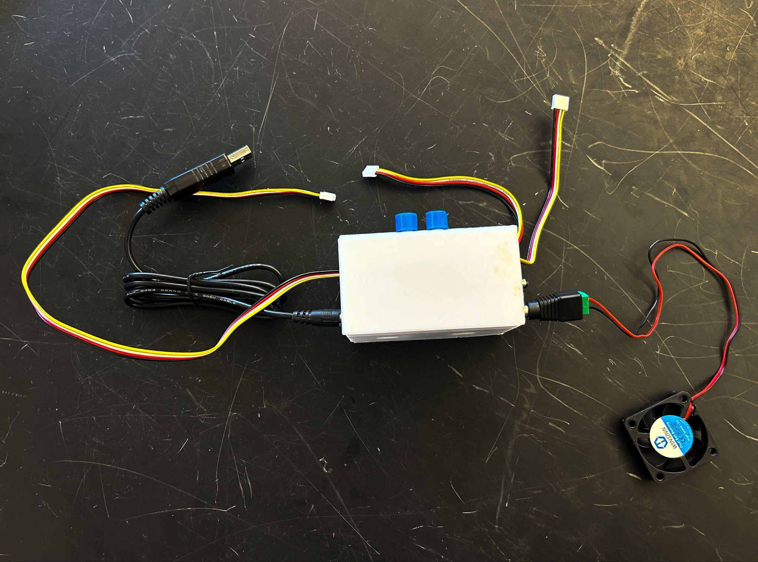
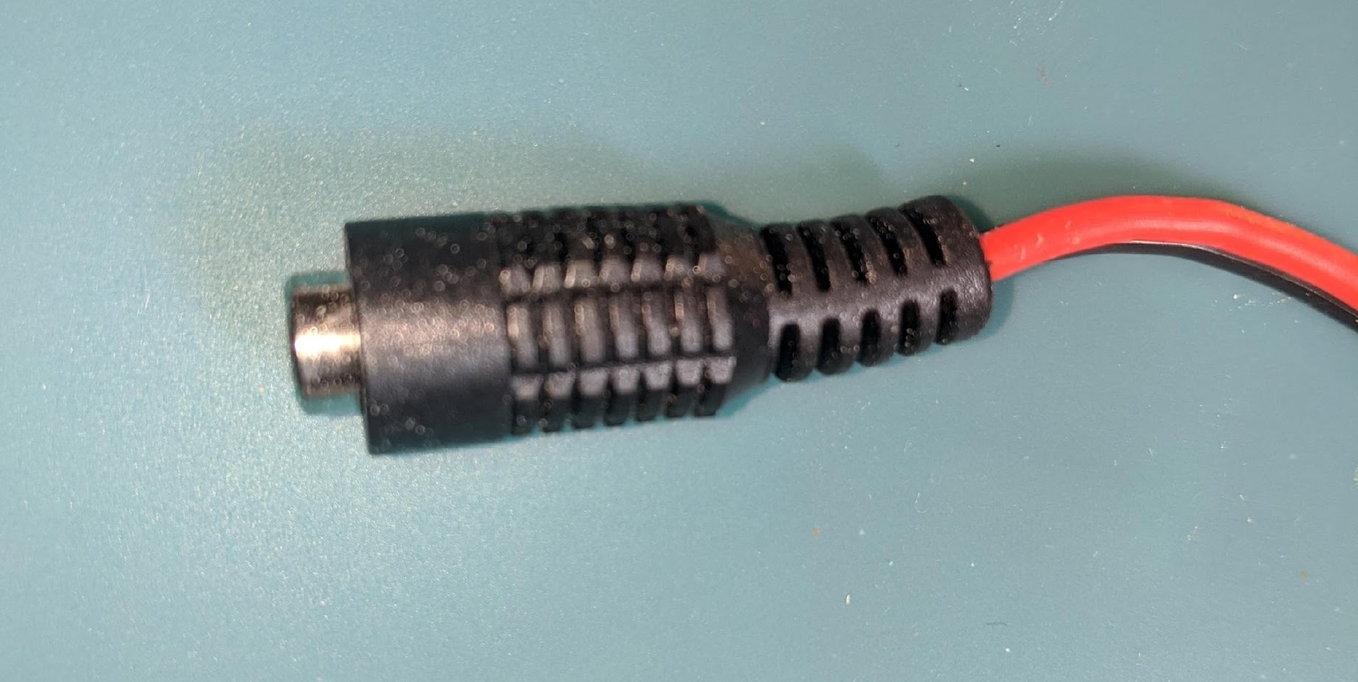
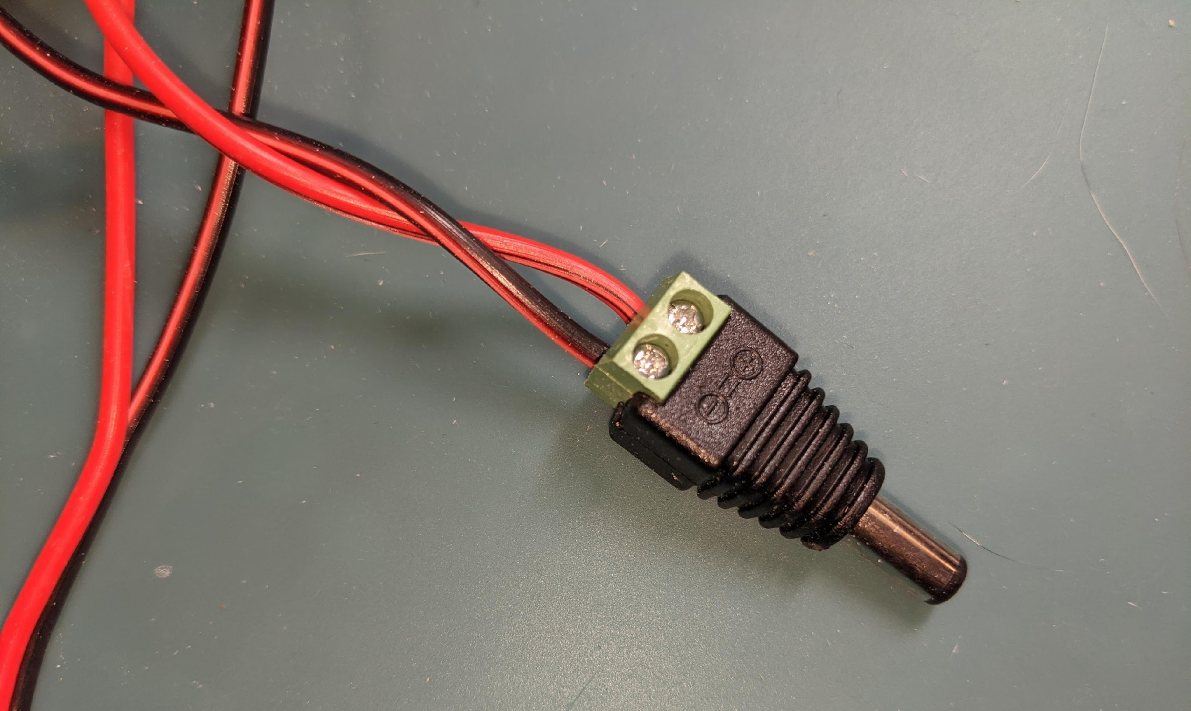
Step 1: Get materials
Get our new materials
  Relay (relay = switch) with wires attached
    Male and female ends
    Four Pin Wire
  USB Fan with adapter
  A 5 Volt USB to power for your shield
You will need everything else from before
To increase the speed of your fan you will need a 5 Volt to 12 Volt USB power cable.
Female Plug
Male Plug

Slide 6
Go to makecode.microbit.org
Open your Greenhouse file. We are going to add new code to it!

Slide 7
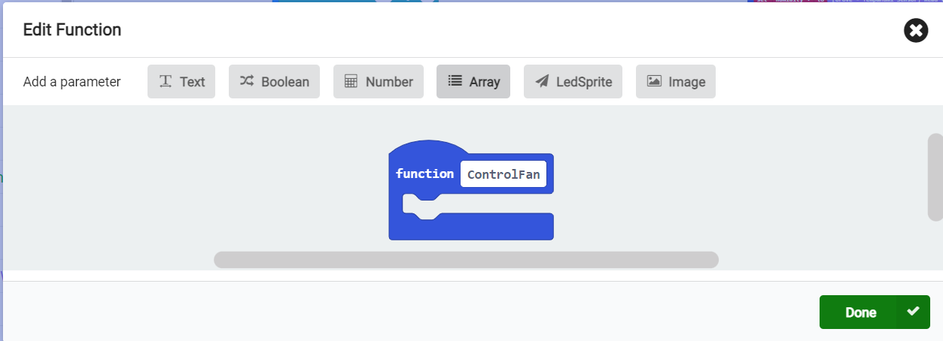
Step 2: Make a function to control your relay
Go to Functions and Make a function.
Name it ControlFan.
Click “Done”.

Slide 8
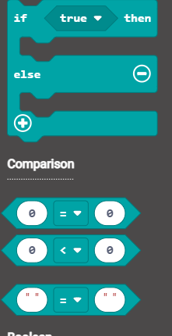
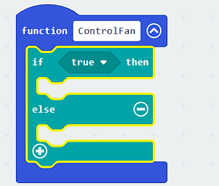
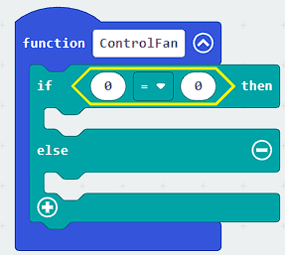
Step 3: Turn the relay on/off + LOGIC
We probably want the fan to come on when the greenhouse is too hot or too humid…
From LOGIC
Need a IF-<true>-THEN-ELSE block
Drag the “if-true-then” block to your Control Fan function
Replace TRUE with a comparison block

Slide 9
Using our variables from the last lesson:
high airtemp
high humidity
Are these global or local variables?
Global!

Slide 10
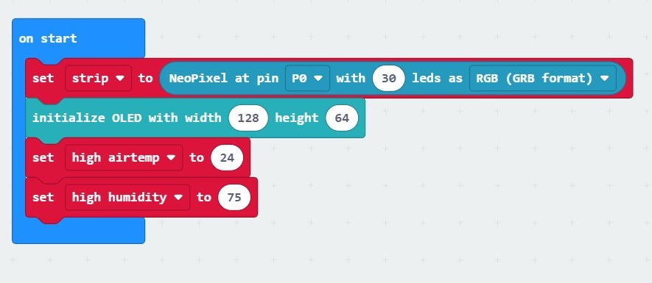
Step 4: Need to compare our data with something!
How hot do we want our greenhouse to be? How humid do we want it to be?
We really DO NOT want our greenhouse to be more than 24 degrees Celsius (76 degrees Fahrenheit).
So, now we can check whether our “high airtemp” variable on the “On Start” block has been set to 24 (or 76, if you chose Fahrenheit)

Slide 11
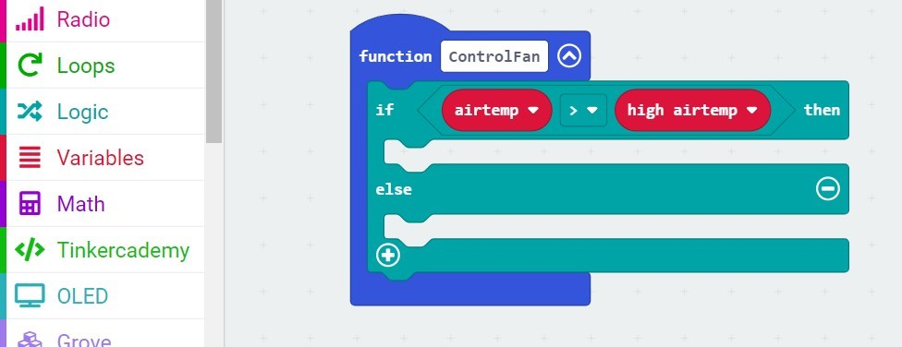
Step 5: Test a condition
We want the fan to come when the air temperature is over our set “high airtemp”.
So replace the 0s with
  airtemp (sensor data)
  high airtemp (your set global variable)
Change the comparison to:
“If airtemp > high airtemp, then…”

Slide 12

Step 6: Use our Data and a Relay to turn on/off the Fan
The Relay is a DIGITAL relay…
  It only understands the numbers 0 and 1
  0 = off
  1 = on
  This is binary language in computer science
This is why computers are so FAST!!! They only know ZEROs and ONEs

Slide 13
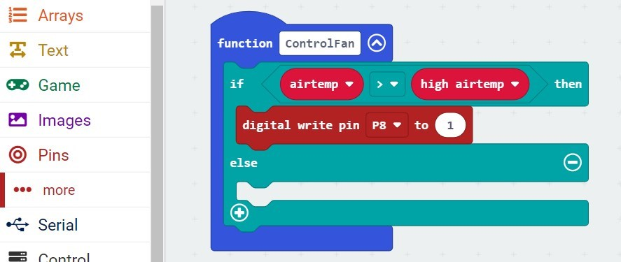
Step 6 (cont.): Turn the relay on and off
If the air temperature is high, you want the relay to be “ON” in order to switch on the fan
  so drag a “digital write pin” block from Pin (under Advanced) to the “If-else” block
  The Pin will be P8, where the relay will be plugged in)
  And set the value to 1 (1 = ON)

Slide 14
So in English, rather than code-speak, what have we said so far?
If the Air Temperature in the greenhouse is too high (above our high airtemp), the relay will turn on.

Slide 15

So what goes in the space under the “else” in our logic block?

Slide 16
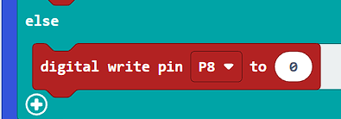
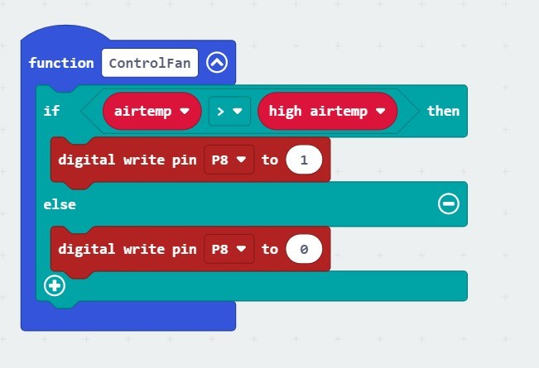
Step 6 (cont.): Turn the relay on and off
Repeat for the “else”, but keep the value to 0 = OFF
(remember to select the correct pin, in this case, P8)
Your final code will look like this:

Slide 17
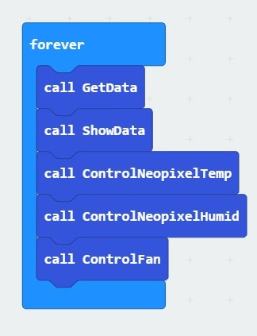
Step 7: Call your function
Remember to put the call ControlFan in your forever loop!!
  Before you download to your micro:bit!!

Slide 18
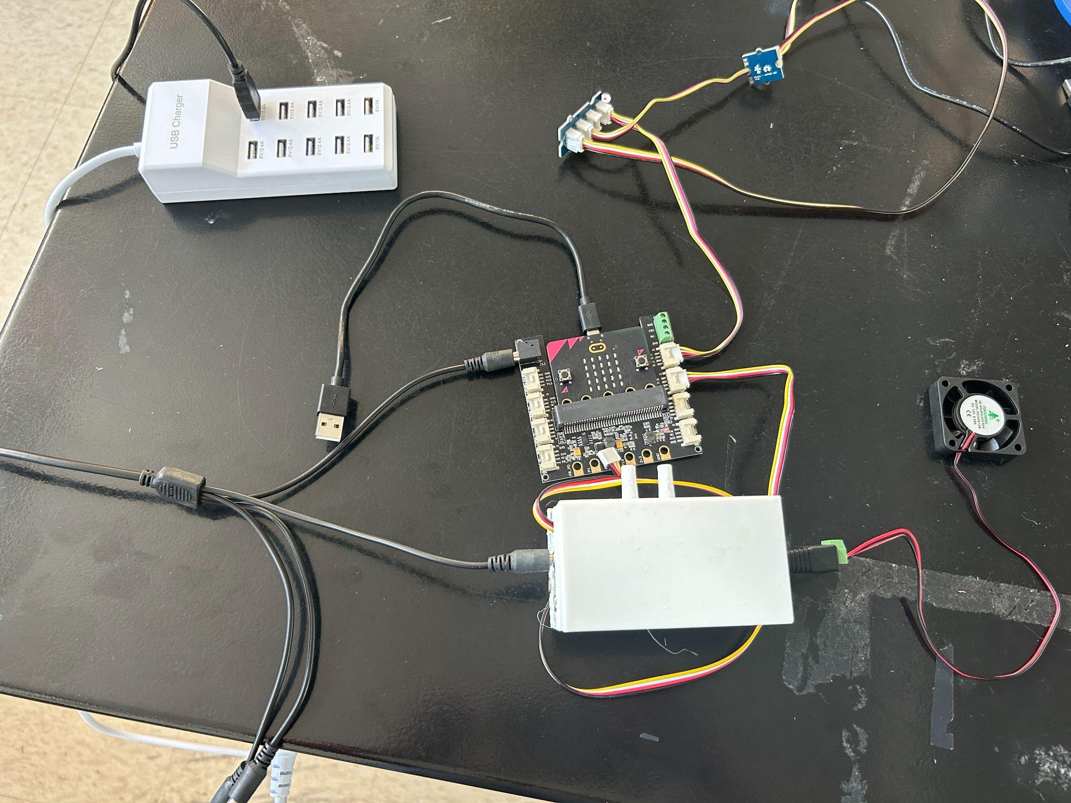

Wiring the Circuit
4 pin wire from #1 goes into Pin P8 (or whatever Pin you define in your code for the fan)
Fan #1:
Power for fan–put one splitter end into #1B
Fan plugs into #1A

Slide 19
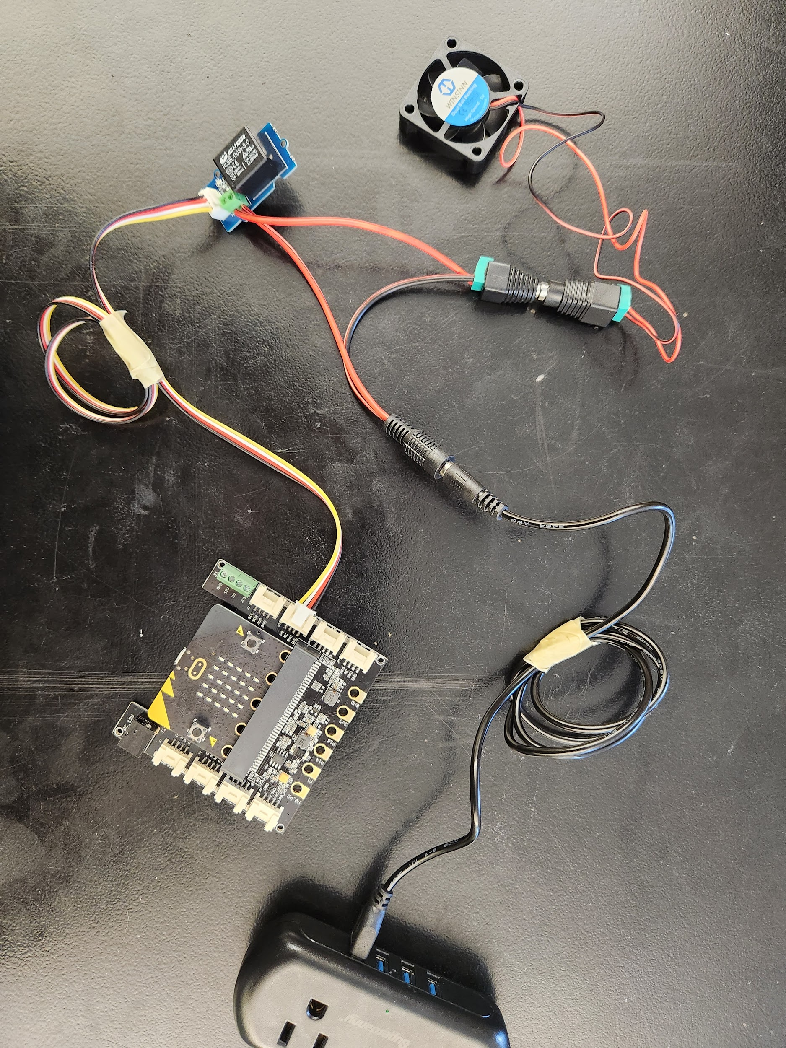
How to wire your circuit. (If you are not sure ASK!)
male cable to USB to power
fan
P8
relay
(on/off)
Plug the relay into correct PIN (P2/P8/P12/P16)
P2

Slide 20
Extras… Additions… Challenges
Is there anything else that you would like to modify about your greenhouse?
Could the code be modified to turn on and off the fan depending on the humidity AND the temperature levels?

