Slide 1
Lesson 1: Part 1
Introduction to Micro:bit

Slide 2
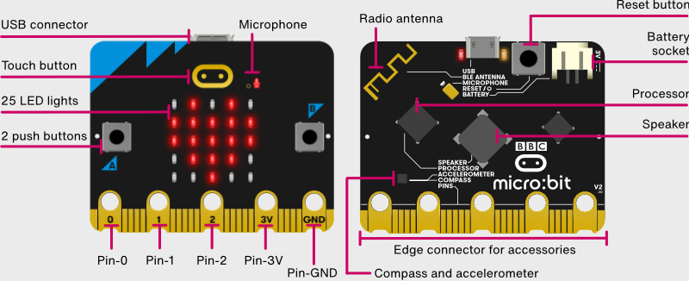
About the micro:bit
Microbits can talk to each other
The “brain”
Can play music
Where we will connect our sensors

Slide 3
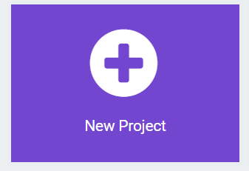
Lets Program…..
Go to:
https://makecode.microbit.org/
Click on New Project

Slide 4
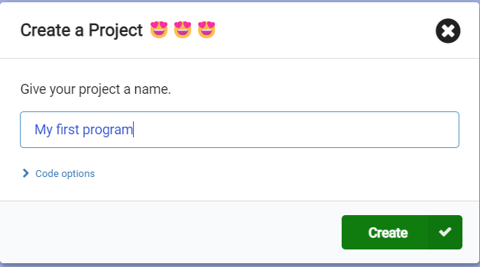
Give your project a name!
You can give any name
Try to give a name that describes the program!
Easier to remember!
Click create!

Slide 5
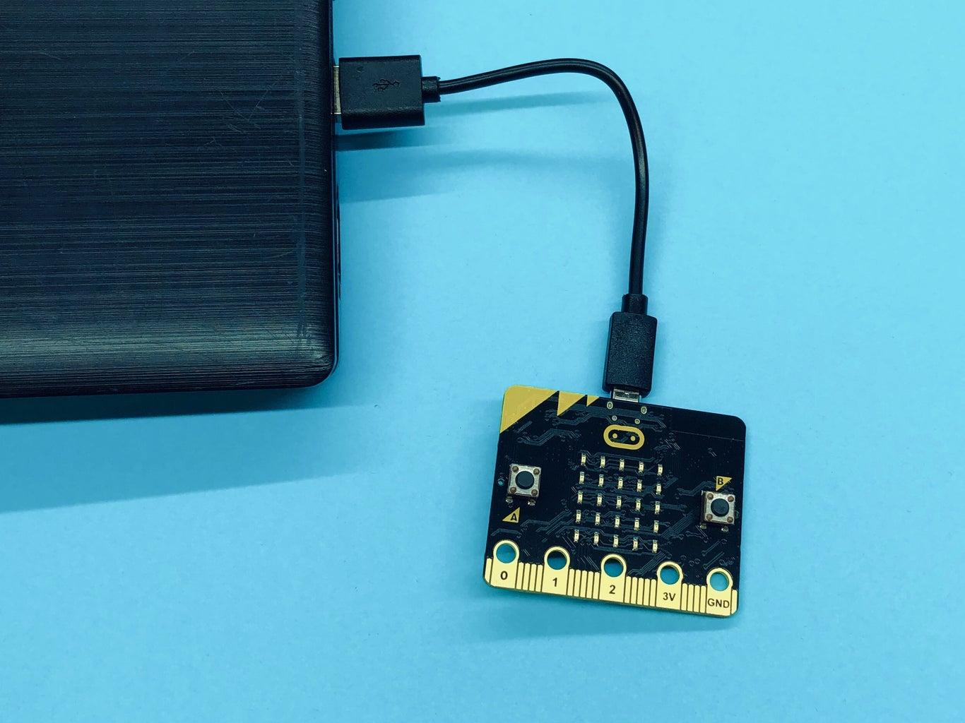
Connect micro:bit to your computer
The micro:bit may have a program on it… so …
Your micro:bit may make a lot of noise or images may start to flash.
Ignore it for now.

Slide 6
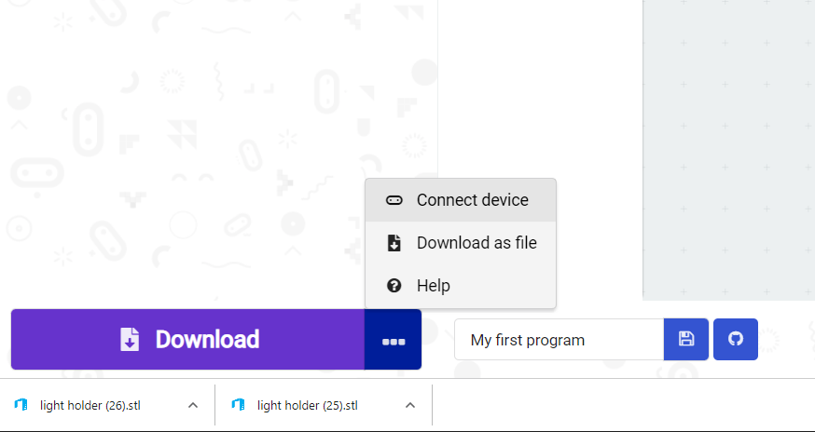
Introduce YOUR micro:bit to YOUR computer
In Makecode:
Click on the three dots next to the “Download” button in the bottom left of the screen
Choose “Connect device”

Slide 7
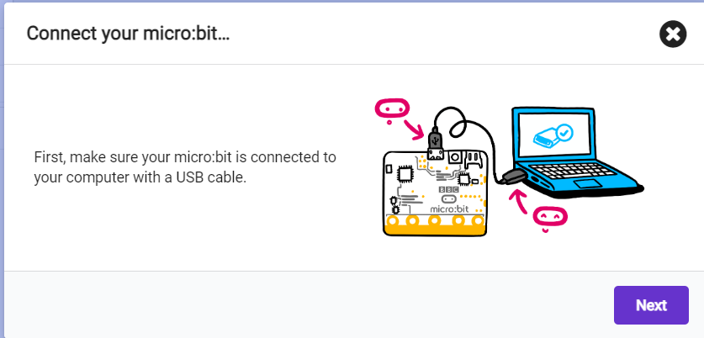
Click NEXT when window pops up

Slide 8
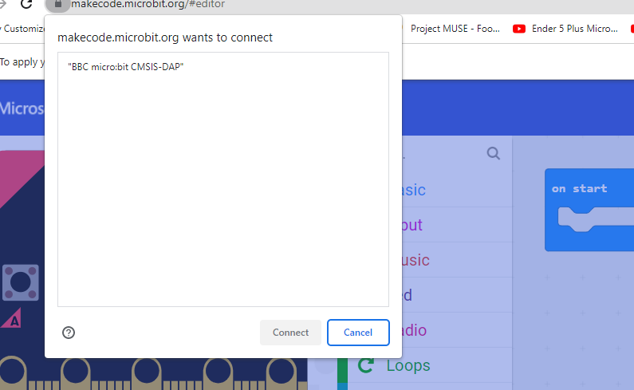
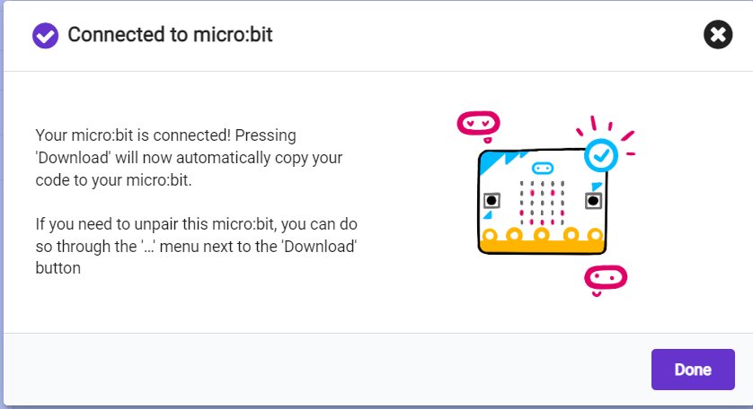
Select your micro:bit
Click on BBC micro:bit
Should be the only option
Click “Connect” after selecting the Micro:bit
Click DONE when connected!

Slide 9
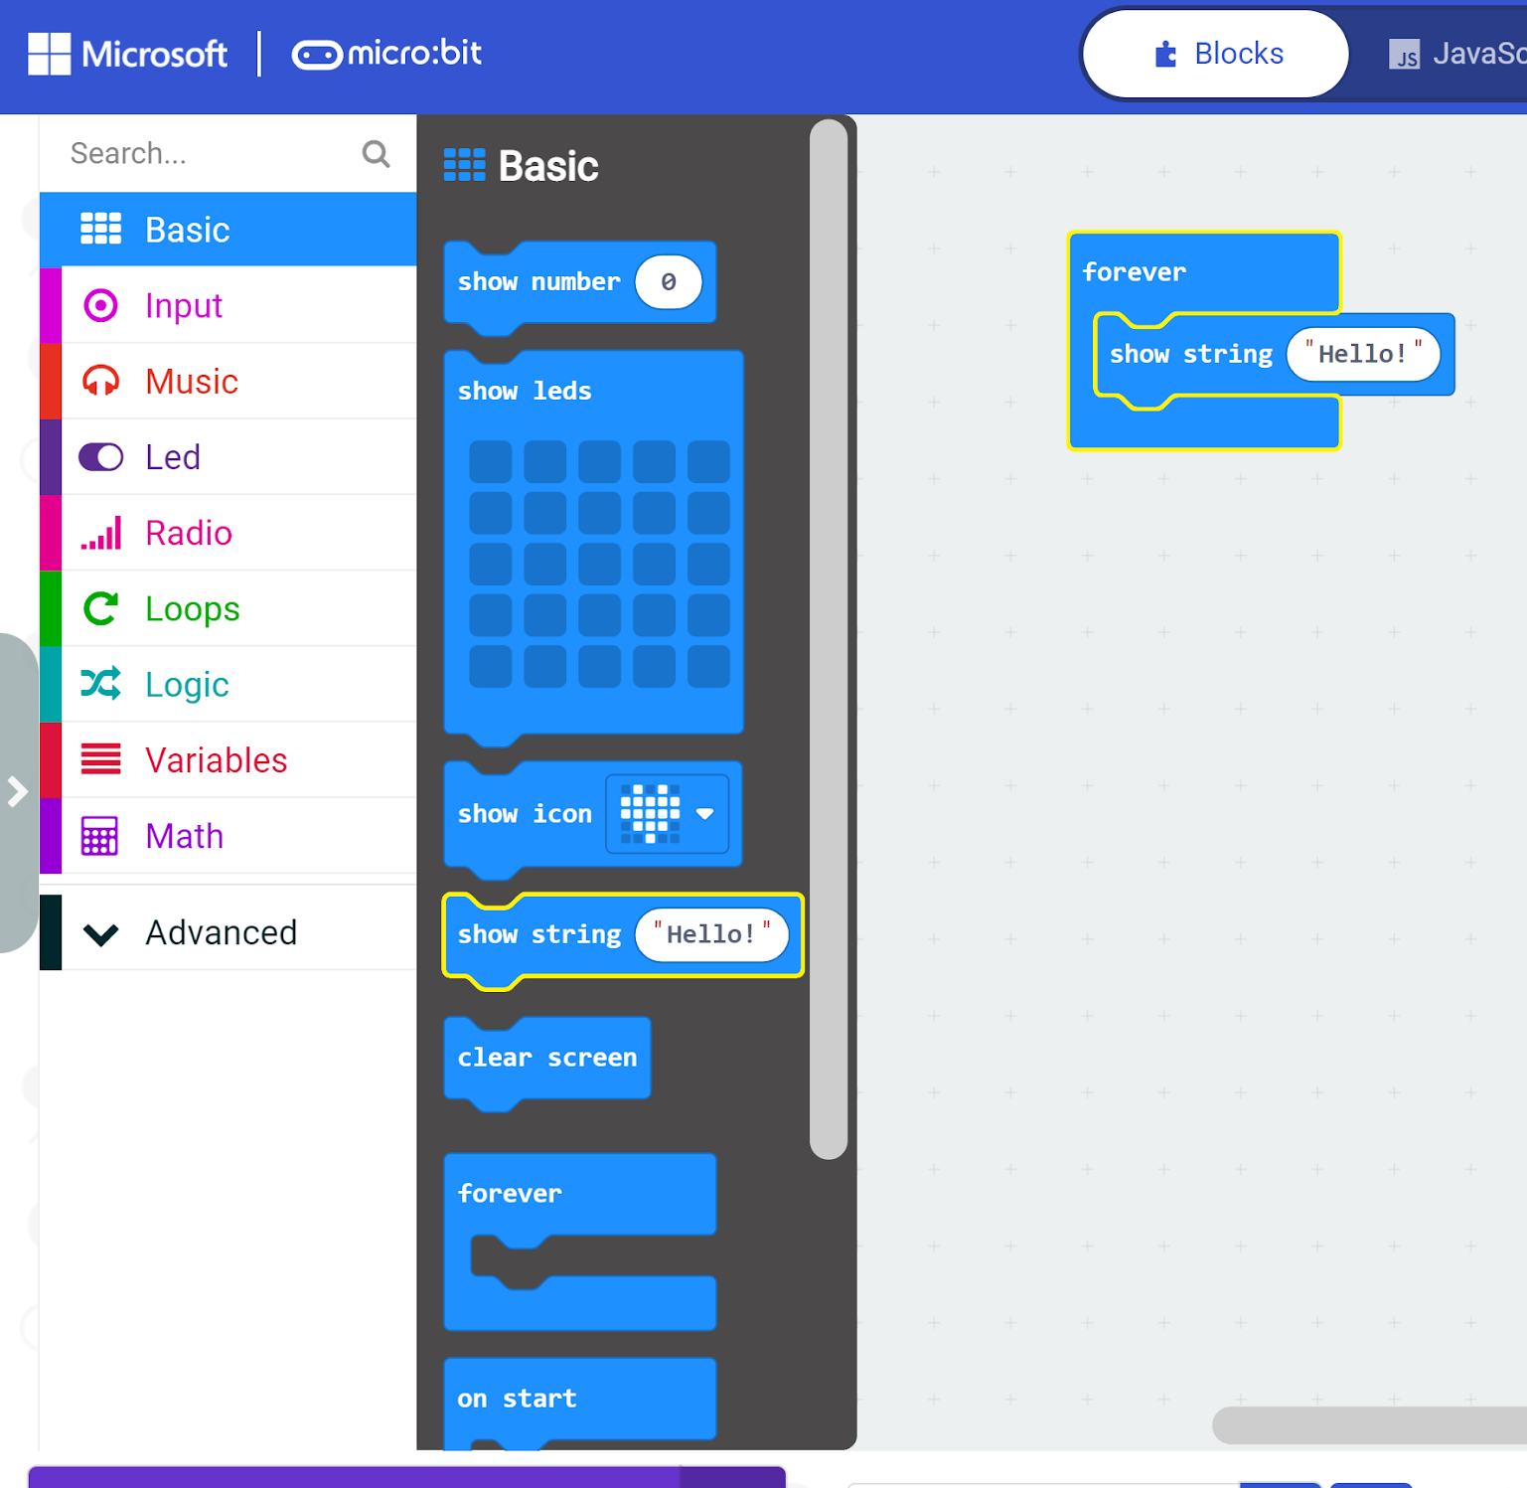
Lets get your name on the micro:bit
In MakeCode:
Click on “Basic” from the left panel
Drag show string block to “forever” loop
  Whatever is in the forever loop runs FOREVER! (It means “Repeat forever”)
  “String” is a set of characters representing Text and Number digits, like: Hello World, deer23tiger, etc.
Change the “Hello” to your name:
(Such as: “Peter”)

Slide 10

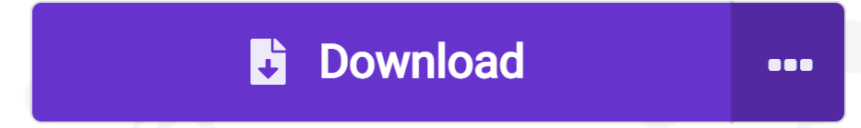
Always remember to make sure your micro:bit is plugged into the computer and click DOWNLOAD!
This sign means:
Micro:bit is connected
This sign means:
Micro:bit is not connected. If you click “Download” now, it will save the file in your computer.

Slide 11
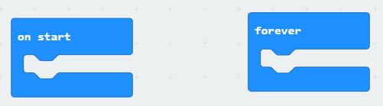
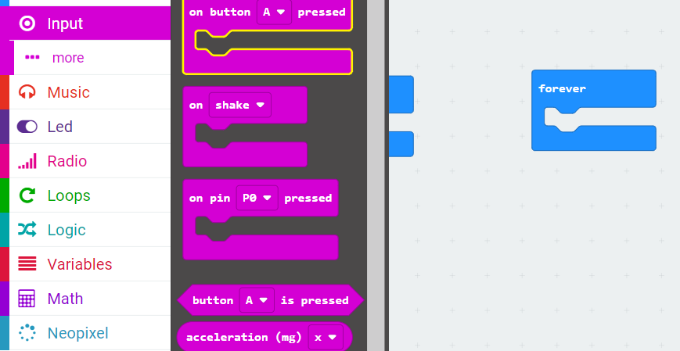
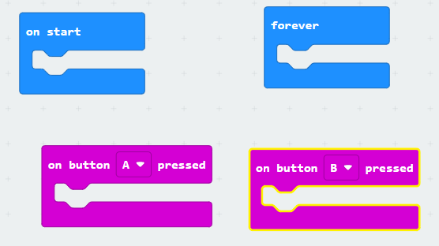
Now let’s play a little…..
Delete everything out of your forever loop
From the Input Block drag
  “on Button A pressed”, – DRAG TWO OF THESE! (Second one will be dim)
  On one of them, use the dropdown menu and change A to B (then both blocks will turn pink)

Slide 12
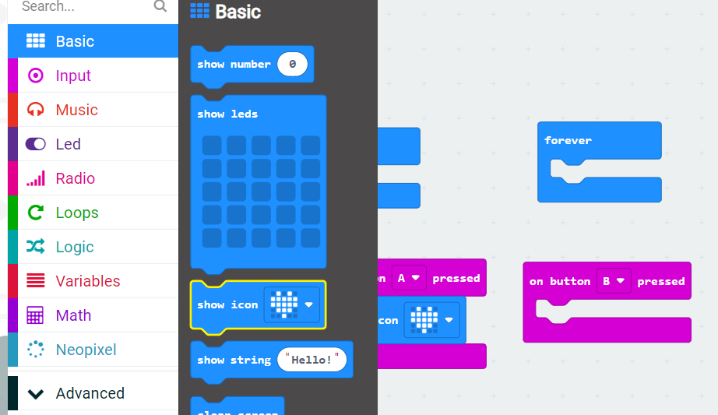
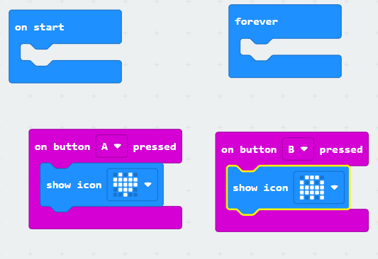
If This Happens then DO that!
This is your first introduction to a basic computer science idea of IF-THEN (If something happens, then do something)
What happens when we press button A?
  Let’s do something
  From Basic block drag show icon to A
  Pick an Icon… heart…
Do the same for B

Slide 13
Always remember to make sure your micro:bit is plugged into the computer and click DOWNLOAD!

Slide 14
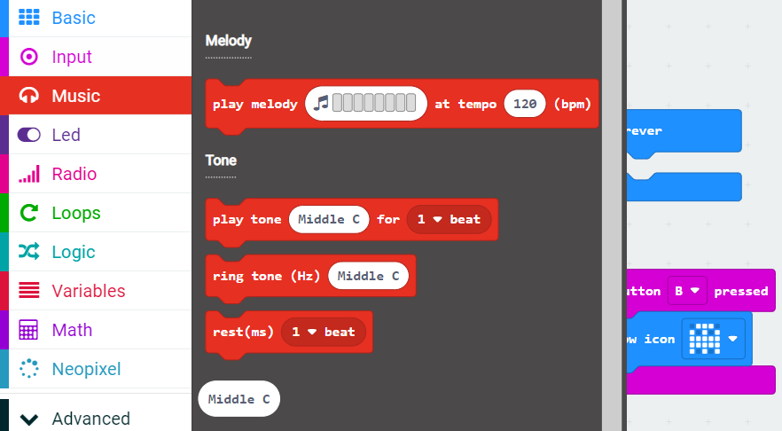
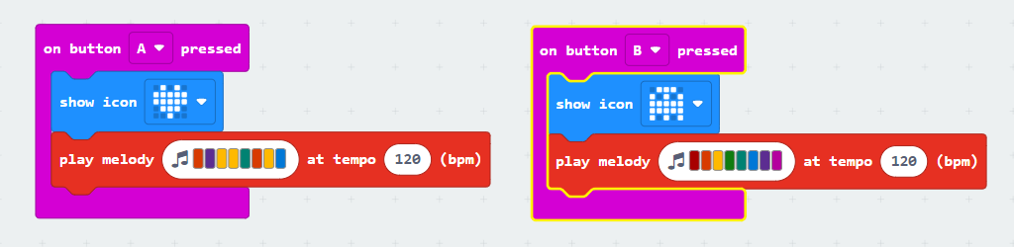
Play… how about music?
From the music block drag play melody to A and make a song
Do the same for Button B.
Notes:
This creates a lot of noise in the classroom. Can be avoided.

Slide 15
Challenges
Can you get your name to scroll across the micro:bit if you press button A? But if you press B have it scroll your favorite food or color?
Can you have your micro:bit display a smiley face when you press button A but display a sad face when you press button B?
Can you flash 3 icons one after another when you press A and B buttons at the same time?
Can you have your micro:bit do something fun or cool if you shake the micro:bit?

Slide 16
Lesson 1: Part 2
Use the micro:bit to use the Neopixel LED Strip

Slide 17
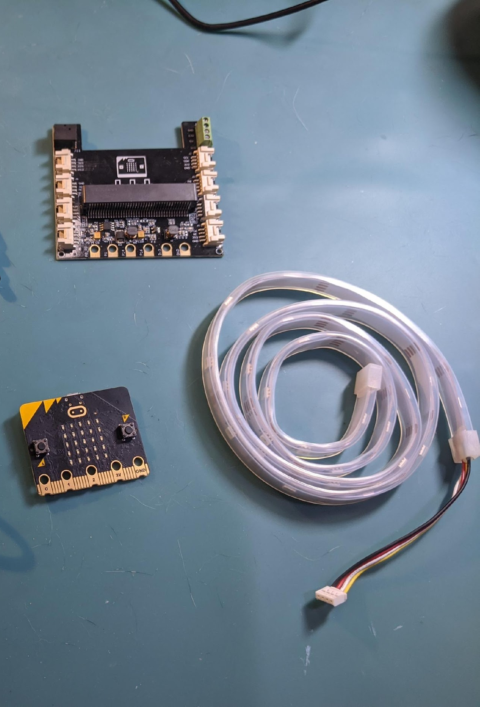
What do you need?
What we will need
Micro:bit
Shield
LED light strip
USB cable (connect micro:bit to your computer)
2
3
1

Slide 18
Let’s Program…..
Go to:
https://makecode.microbit.org/
Click on New Project

Slide 19
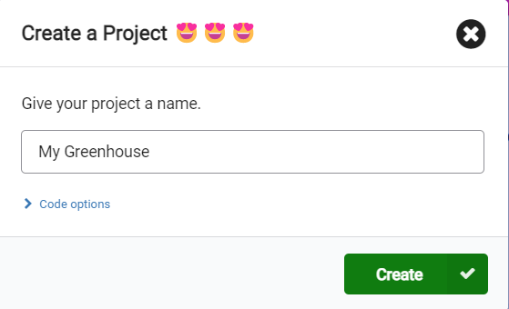
Give your project a name!
Lets give this one
My Greenhouse as we will re-use this file over and over again

Slide 20
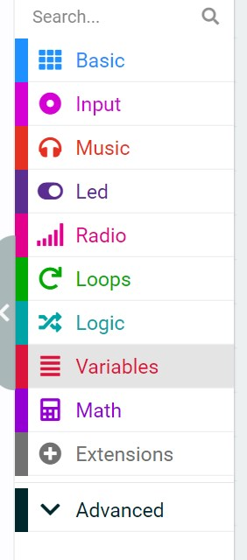
Installing the Neopixel extension
An EXTENSION allows us to use new tools and sensors that aren’t automatically recognized by micro:bit. Think of an extension as adding a library of blocks that allow you control a new sensor
Click on Extensions

Slide 21
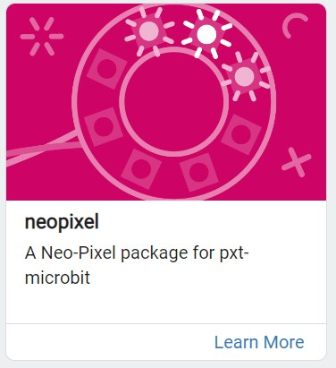
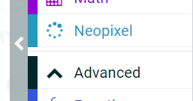
Pick neopixel
Click on neopixel and click OK
Neopixel is a fancy word for LED light strip!
You will now have a new set of blocks!

Slide 22
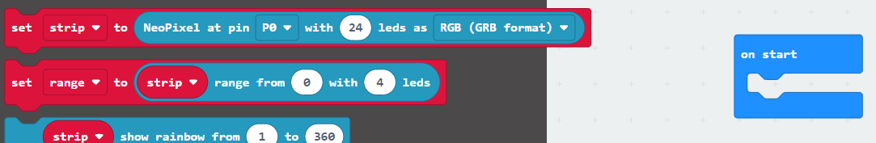
Step 1: Tell micro:bit it will have a LED strip
Drag the top block in neopixel to the on start block
This tells micro:bit that it will have an LED strip attached.
  If you don’t do this you will get an error!!

Slide 23
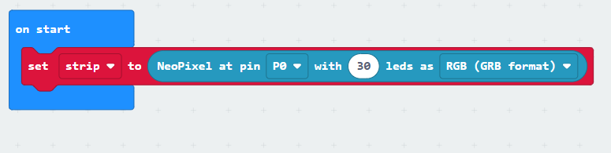
Two things to note here…
Note the pin is P0
Count the number of LED bulbs on your LED strip. If the number is NOT 24 (the default number), you need to change the number

Slide 24
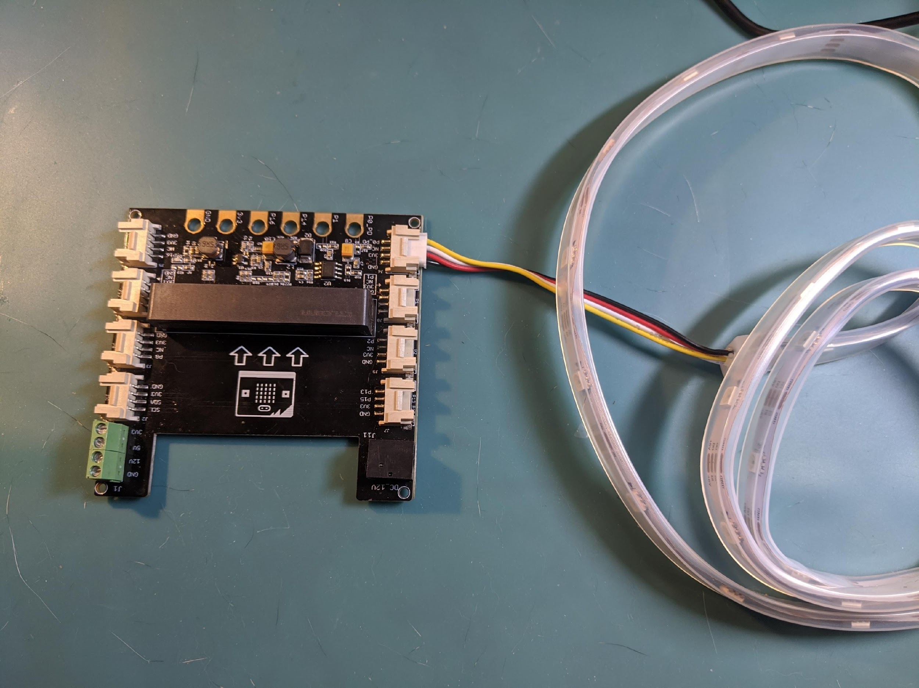
Step 2: Plug your LED strip into your shield
Be sure it is in P0
In MakeCode we said the LED strip would be on P0

Slide 25
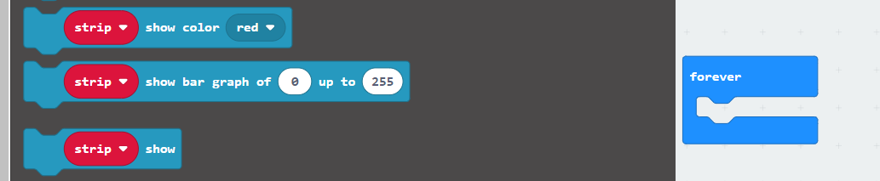
Step 3: Change the colors of the LED strip
Let’s turn the LED strip to your favorite color
From the Neopixel Block drag the “strip show color” block to the forever block

Slide 26
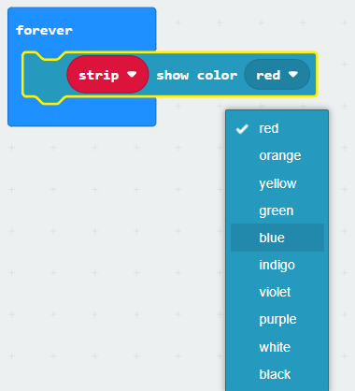
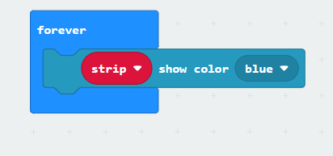
Change the color of the LED strip
Change the color from red to your favorite color (avoid black for now!)

Slide 27
Step 4: Plug your micro:bit into your computer
Download the code
Once program is downloaded unplug your micro:bit

Slide 28
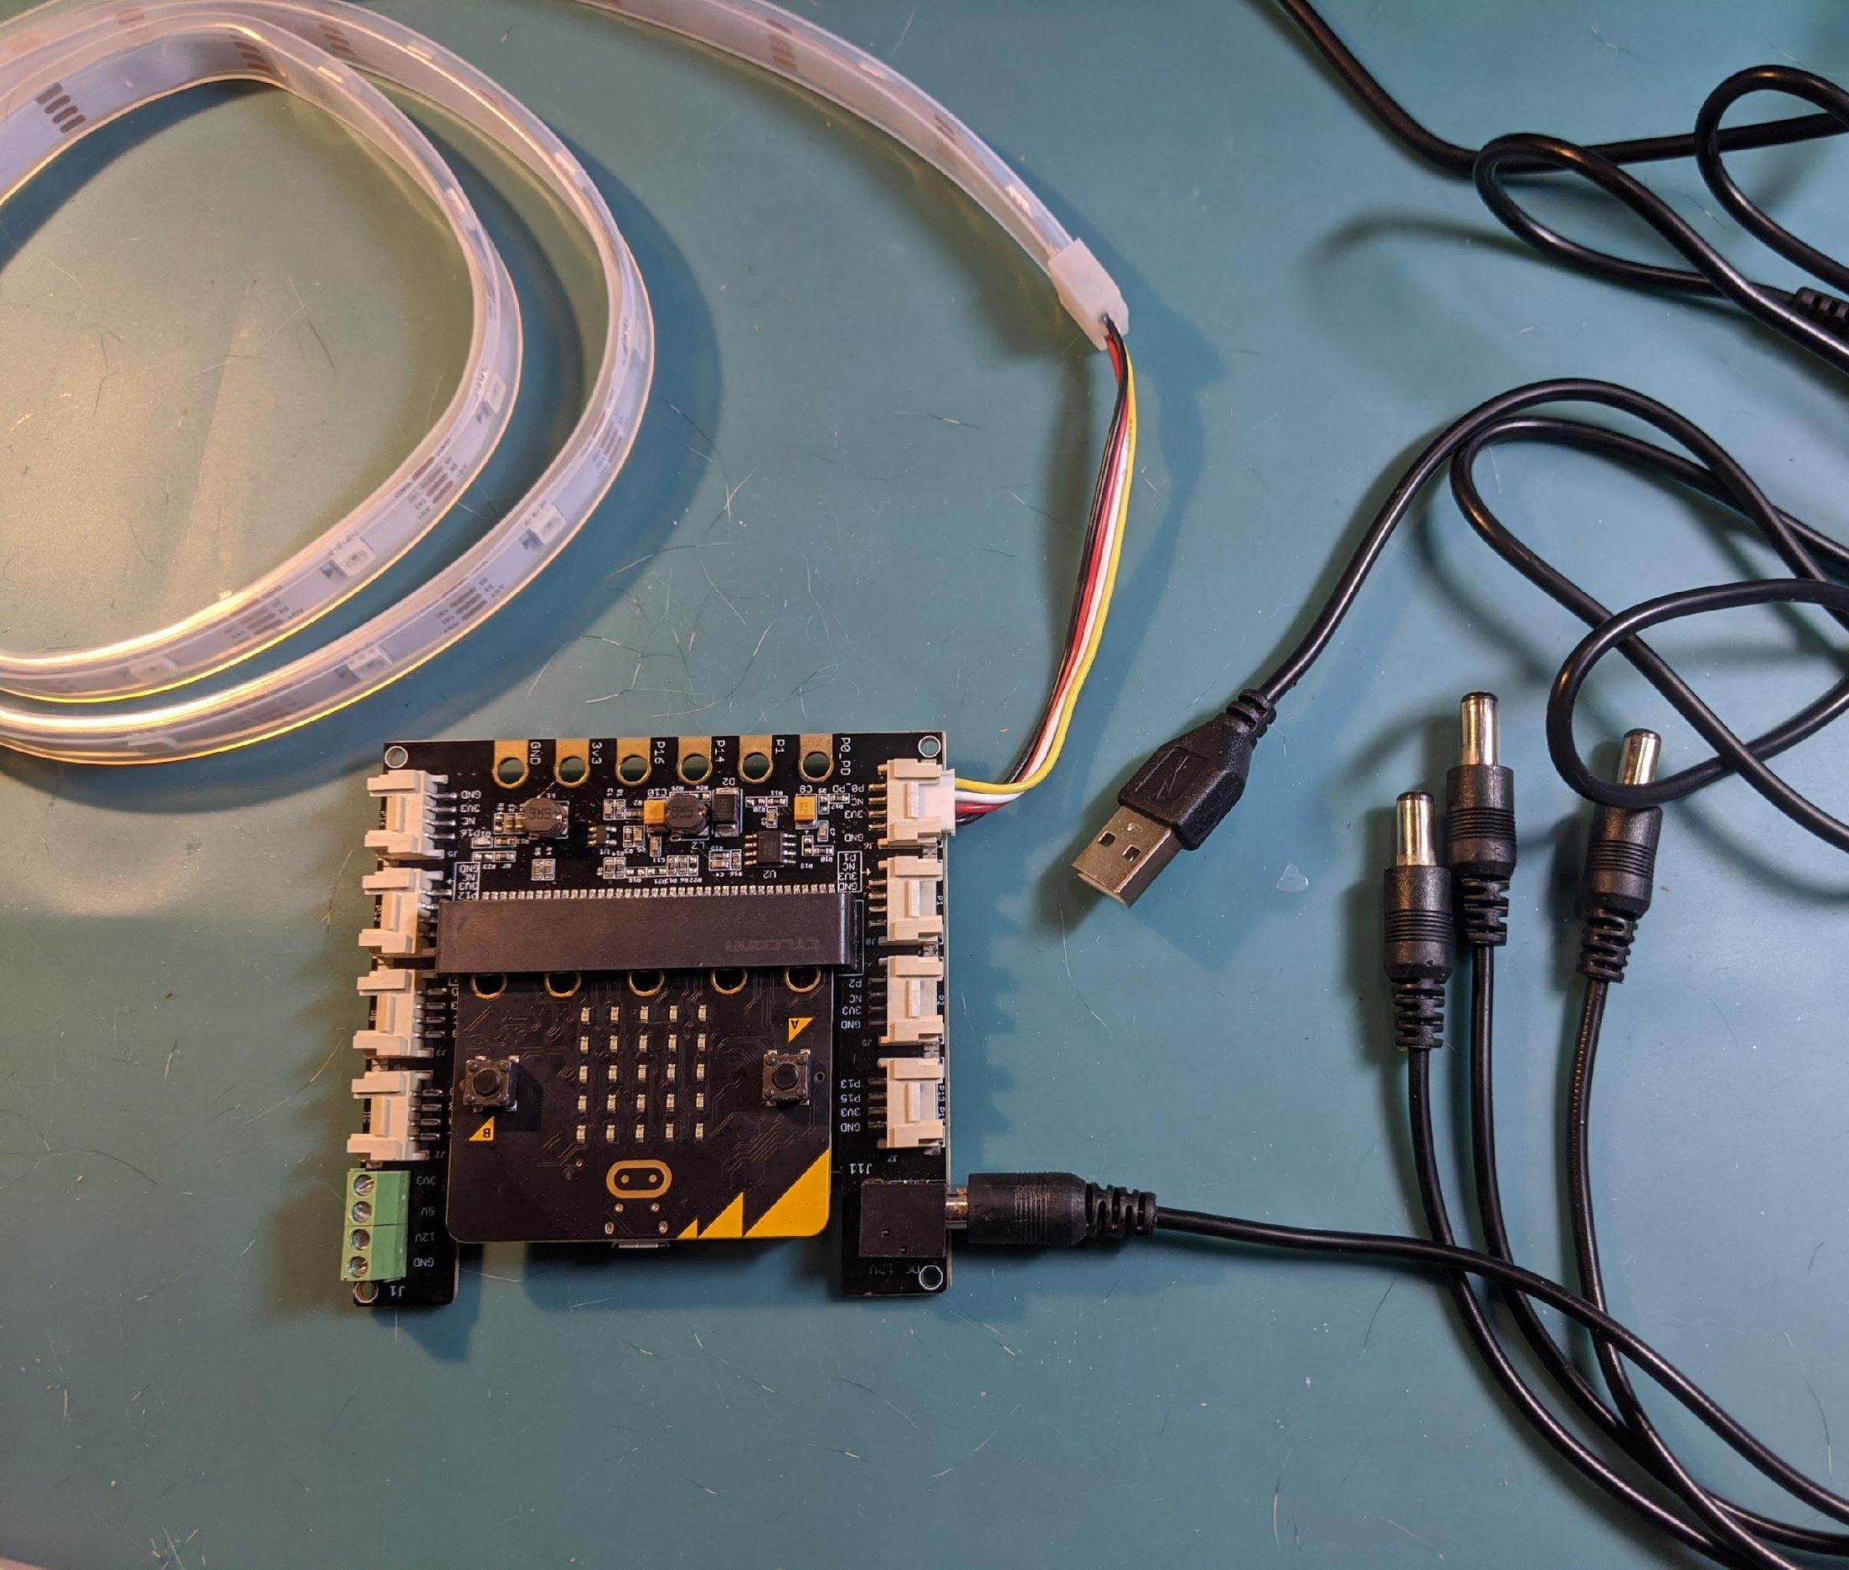

Step 5: Connect to Power and Shield
Plug into shield: Be sure the LED lights are facing up!
Shield should have 5V cord plugged in here – do not use micro:bit as power source
You LED strip should turn your favorite color!

Slide 29
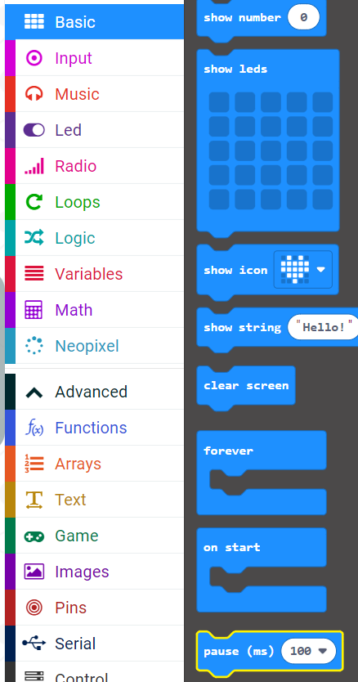
How about making the LED strip blink?
You will need a Pause block from the Basic menu
Why? - the micro:bit runs the program so fast that it will blink too fast for your eye to see!

Slide 30

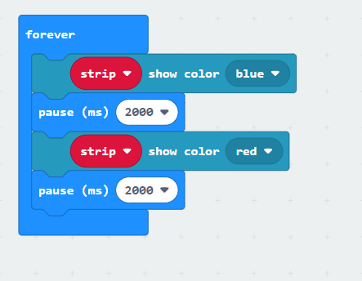

Let’s have your LED strip blink two colors
Drag from the
  Another strip show color
  From the block
    Put two Pause statements at 2000ms (2 seconds)
  You need the second pause, otherwise you may not see the red color.

Slide 31
Note: To avoid glitchiness
Take your micro:bit out of your shield
Connect your micro:bit to your computer
Download the code to micro:bit (while not inside the shield!).
Place the micro:bit back into the shield!

Slide 32


Challenges
Can you make your LED strip look like a rainbow? (HINT look in the neopixel block for the rainbow)
Can you make your LED strip blink slowly between 5 different colors?
  Hint: think Pauses!
What if you wanted to light up one LED bulb at time?
  Hint: you will need these two blocks
      (click on the … more to find this block)

Slide 33
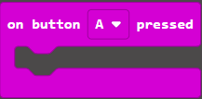
Challenges
Can you use the buttons to change the color of the LED strip?
  HINT: You need to use “on button ….” From the INPUT block
  5. Can you have your micro:bit show an icon that aligns with a color on the LED
  strip? For example, an angry face icon and red LED lights?
  6. What other fun things did you try?

Slide 34
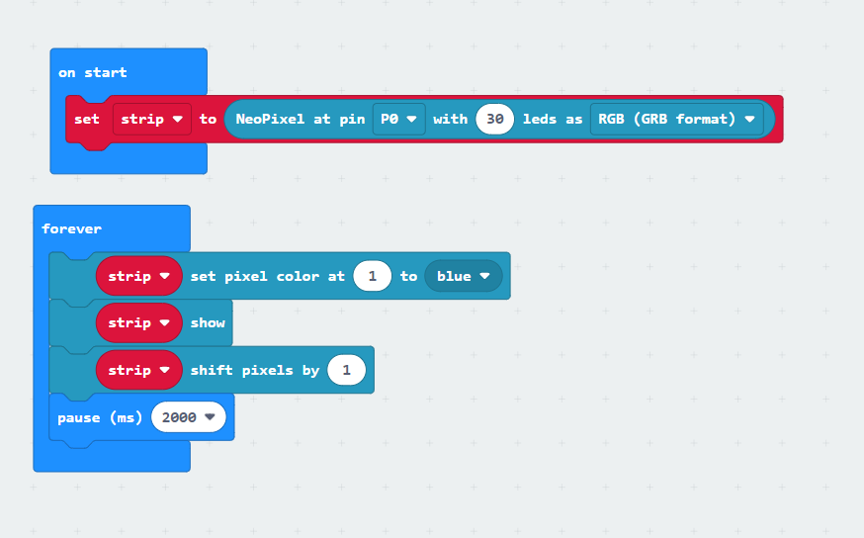
Solution to Challenge 3

Slide 35
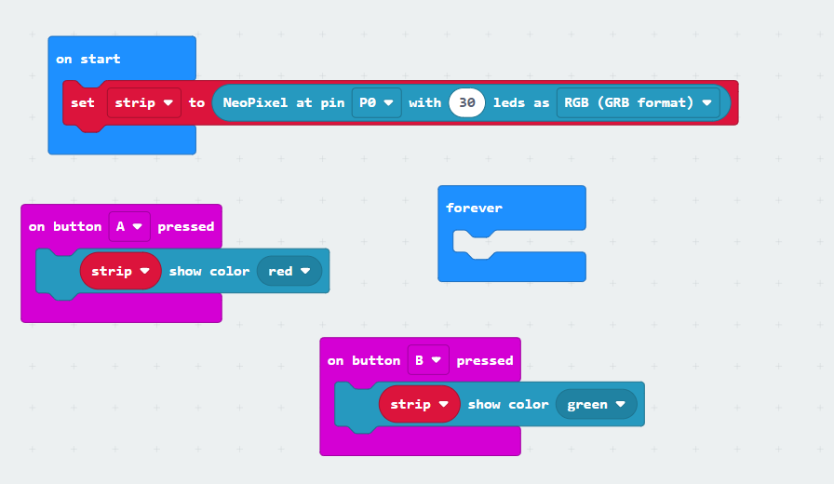
Solution to Challenge 4: Use buttons to control LED strip–NOTE–Forever loop needs to be empty!

