Slide 1
Lesson 0b Getting Started with the sensors

Slide 2
How can we monitor the temperature and humidity?
What would we need?
Sensors to sense the air temperature and humidity
OLED display to display the data (we need to see it live!! a display of the temperature and humidity data, much better than the LED display on micro:bit!)
micro:bit + shield (to plug-in the sensors)
code
What does a sensor do?
A sensor detects and measures the air temperature, and convert it into electrical signals for the micro:bit to process.
Notes:
The sensor converts the data to electrical signals

Slide 3
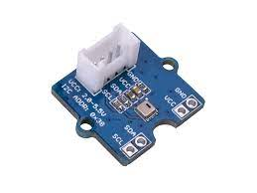
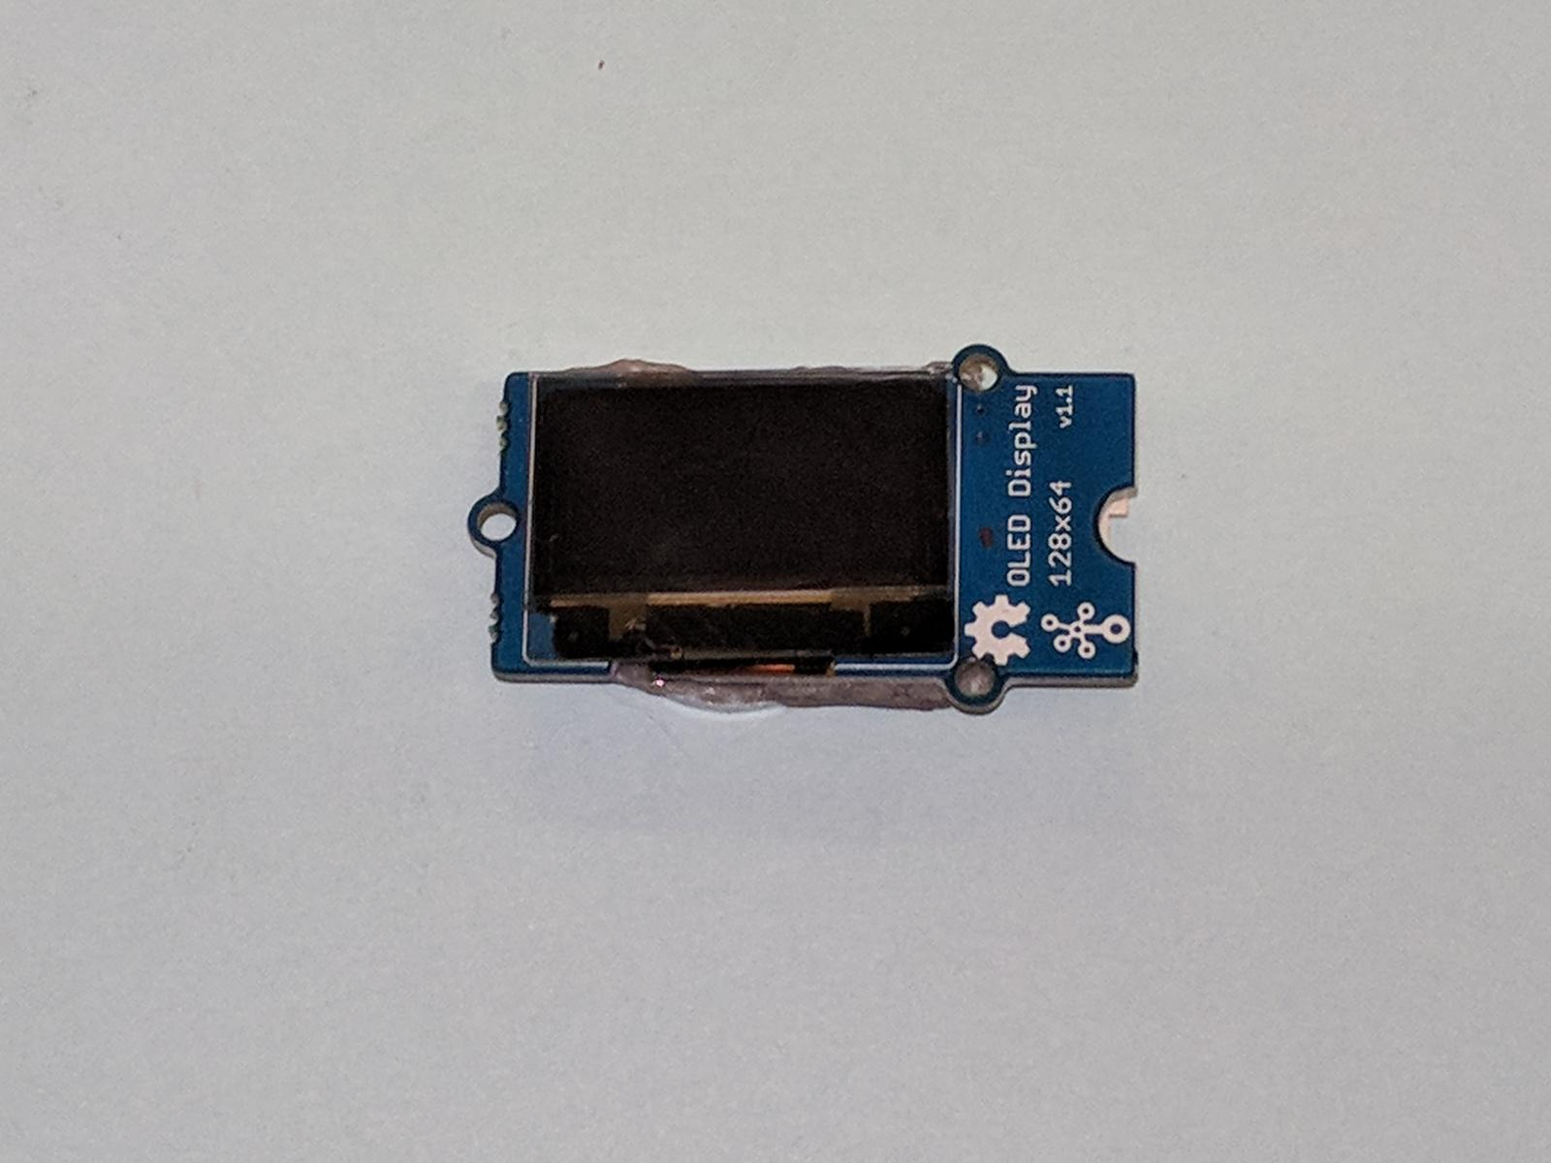
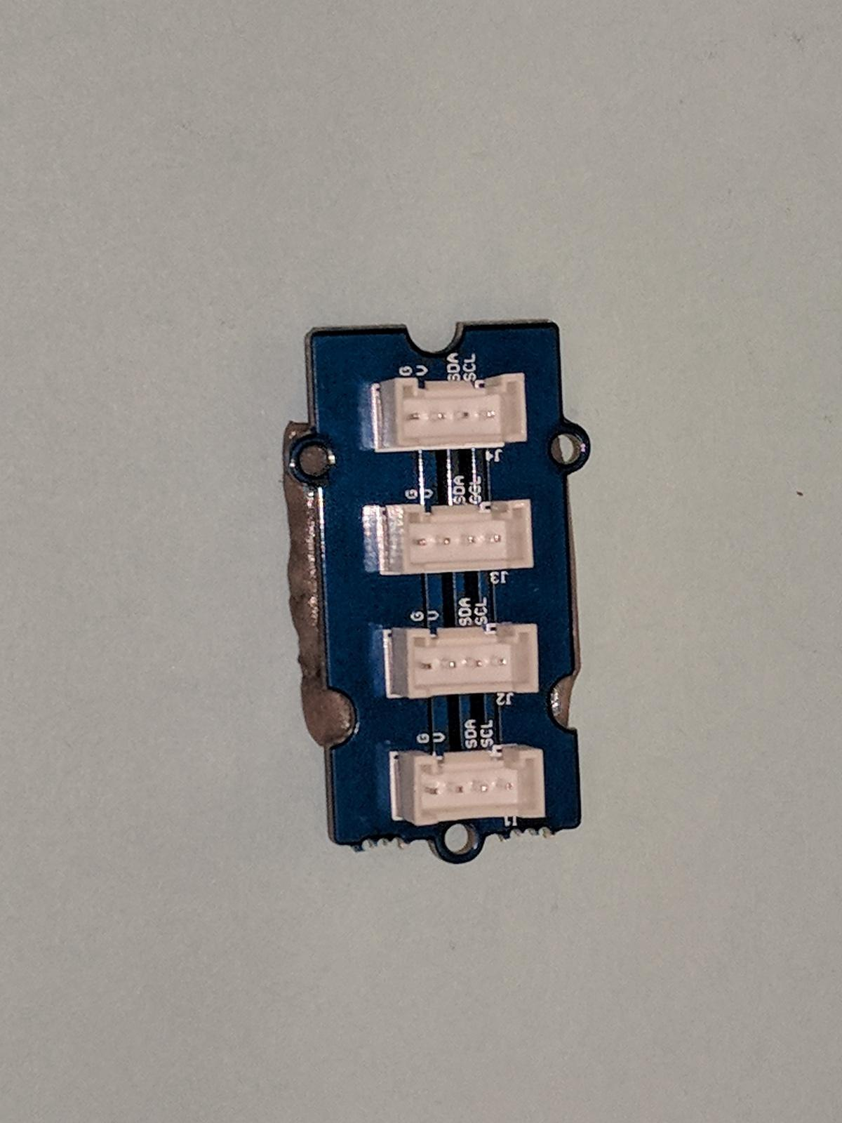
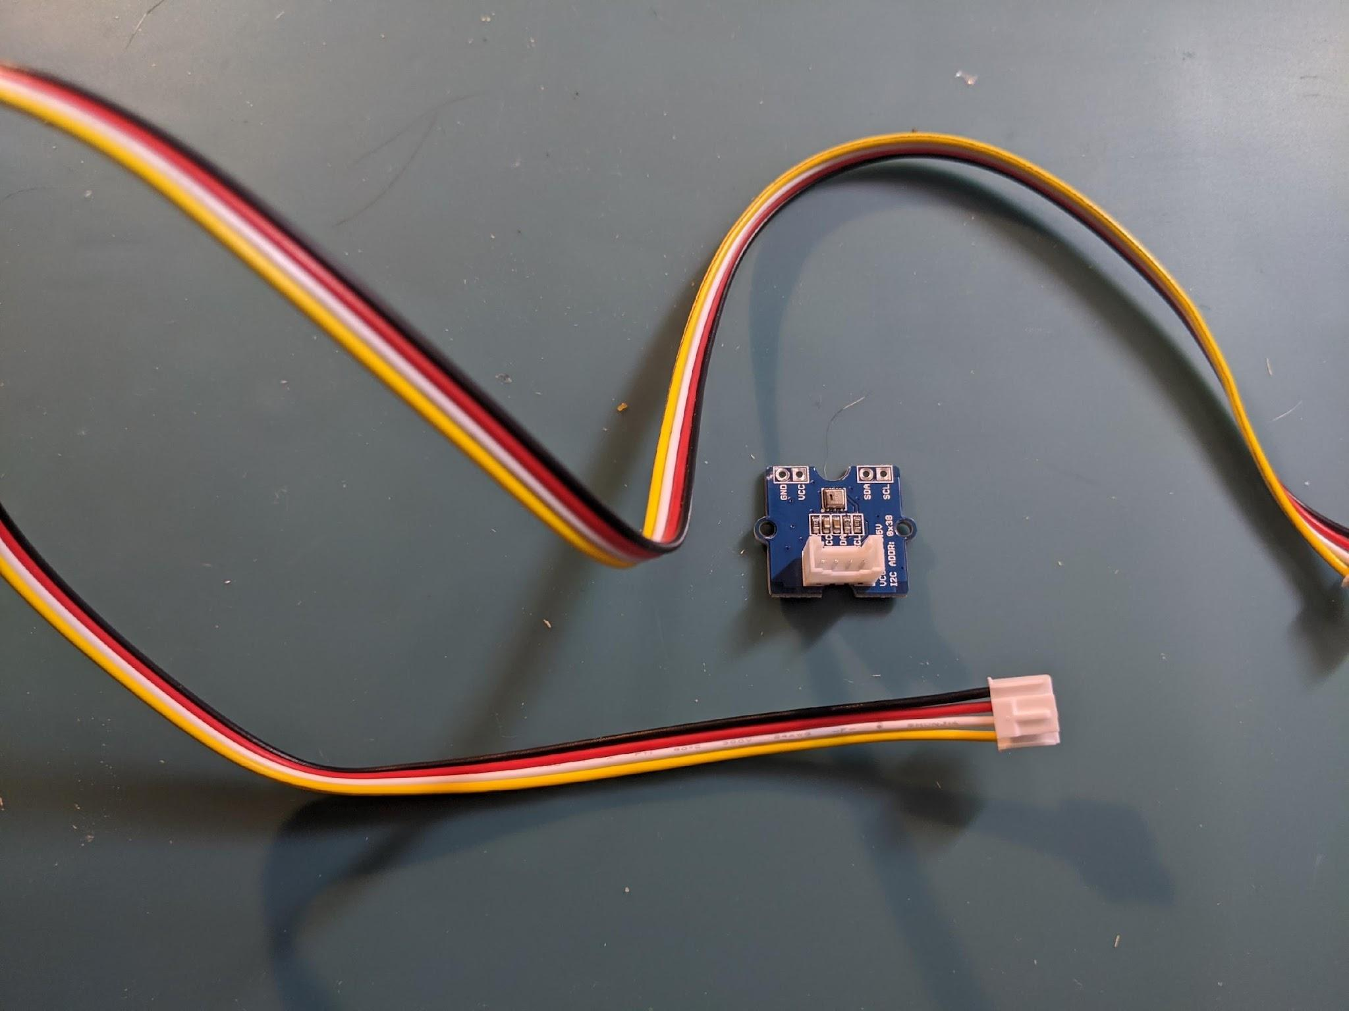
What we need:
Microbit & Shield and USB cable - just like before
AND
An AHT20 (Air Humidity/Temperature Sensor) and 2 four pin wires
An OLED screen
A I2C Hub
AHT Sensor
OLED Screen
I2C Hub
Four Pin Wires

Slide 4
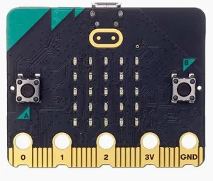
How can we monitor the temperature and humidity?
sends the command to show the data on the OLED display
sends the data to micro:bit
AHT Sensor detects and measures the air temperature and humidity
OLED display that displays the temperature and humidity data
micro:bit uses code to save the data and determine how to display the data
Notes:
The sensor converts the data to electrical signals

Slide 5
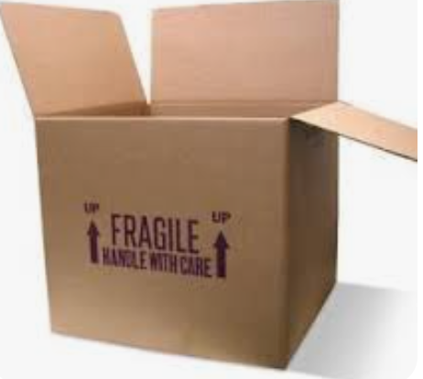
What the code would look like?
Step 1: we need to create a variable in MakeCode to store the data
What is a variable in coding?
Think a variable as a labeled box where you can store information like numbers, words, or other things.
This information can change, or "vary," which is why it's called a variable.
Think of it as a container that can hold different things at different times.

Slide 6
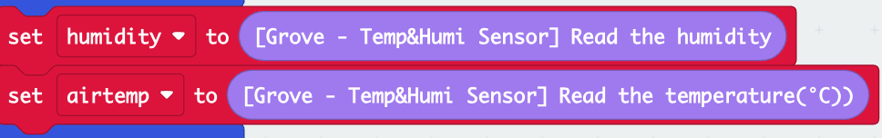
Step 1: Create variables
We will be measuring ___________ and ________________________ with this sensor.
We will be setting up variables called humidity and airtemp to store the humidity and air temperature data collected from the sensor
humidity
air temperature

Slide 7
Step 2: Create functions for micro:bit to get the data
A function is a block of code that will get used over and over again.
A function is a PART of our larger code. It has an important job to do!
Think about a soccer team. A function is like one of the positions. But it takes ALL of the positions working together to make the team. We will have many functions working together to make our greenhouse smart!

Slide 8
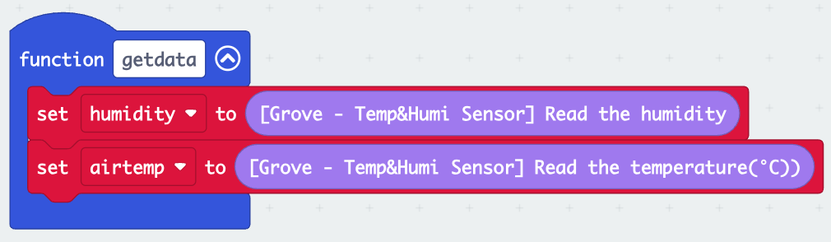
A function looks like this
What does this function do?
It tells micro:bit that humidity and airtemp data are stored in variables called “humidity” and “airtemp.”
When the function is used, it tells the sensor to store the data in the two variables.

Slide 9
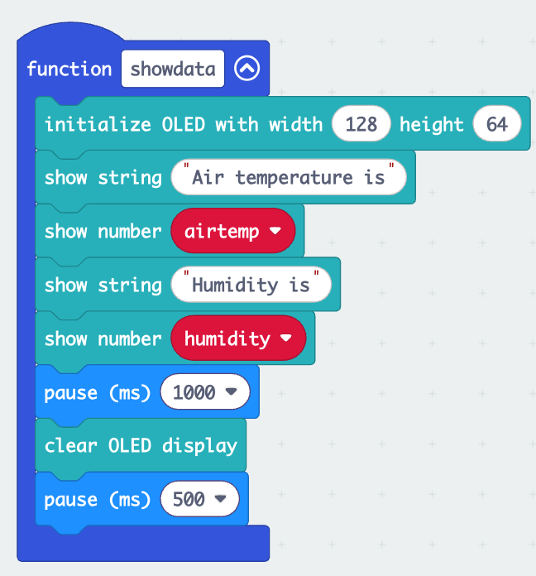
Step 3: Create another function to see the readings/data
First we need to tell micro:bit to initialize the OLED display (recognizing this display).
Then display the data on the OLED display
Why do we need to add the “pause”?

Slide 10
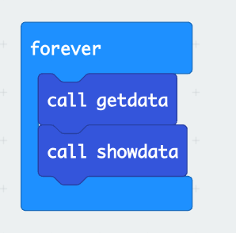
Step 4: Call the functions
Remember to call the functions in the “forever” loop so that micro:bit will carry out these functions!!
Pay attention to the sequence- Your micro:bit must first get the data and then display!

Slide 11
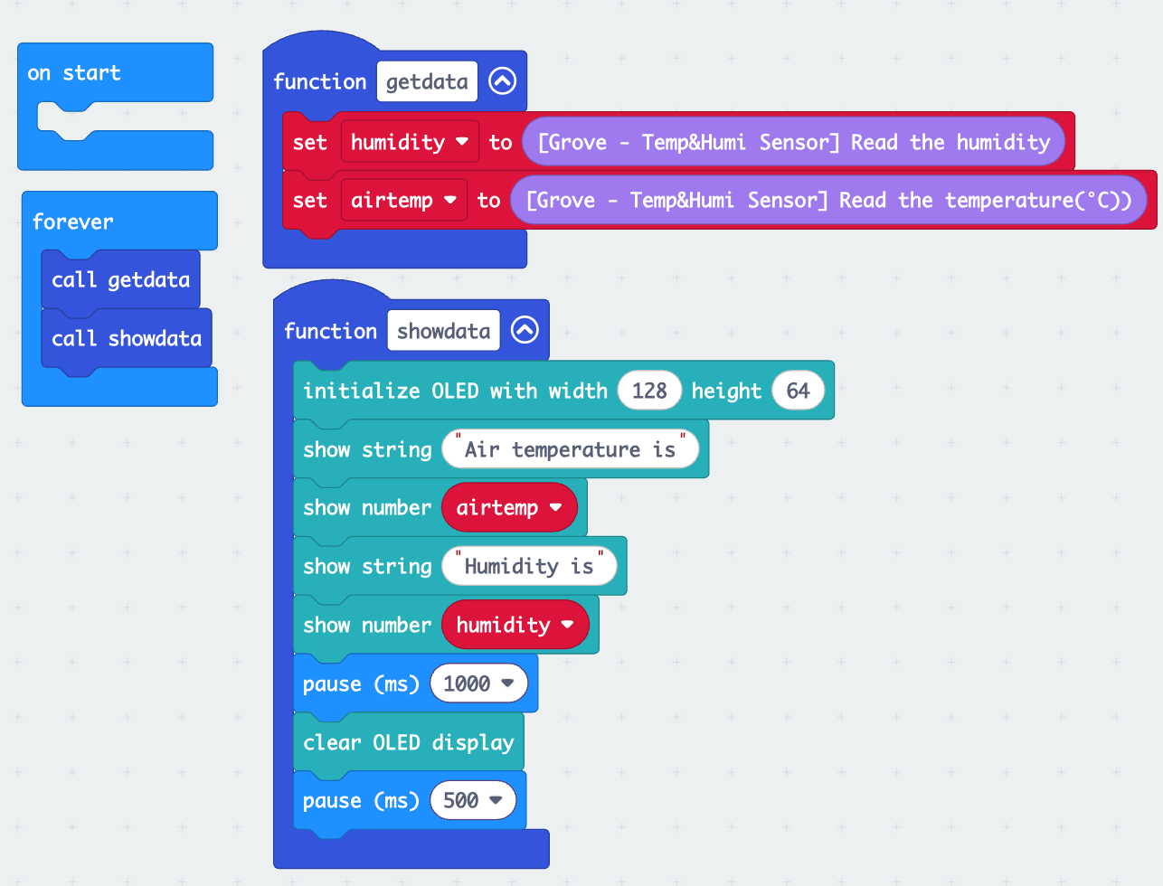
What the final code looks like if we want to monitor the temperature and humidity?

Slide 12
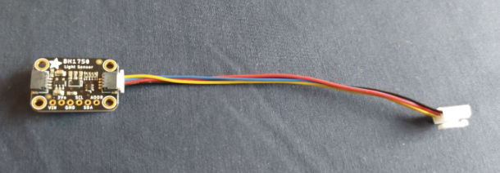
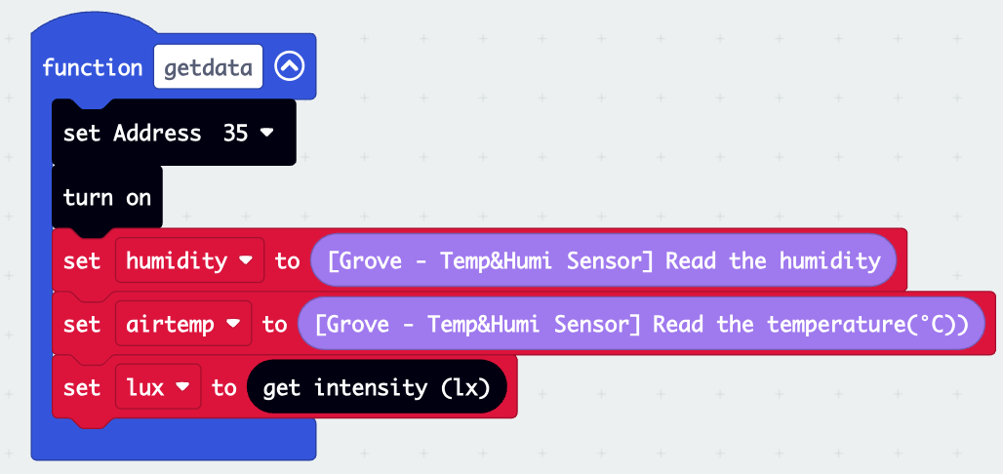
What if we also want to monitor the light?
We need a light sensor.
Light sensor needs to be turned on first.
Define a variable called “lux” to store light data.
Add the variable to the “getdata” function

Slide 13
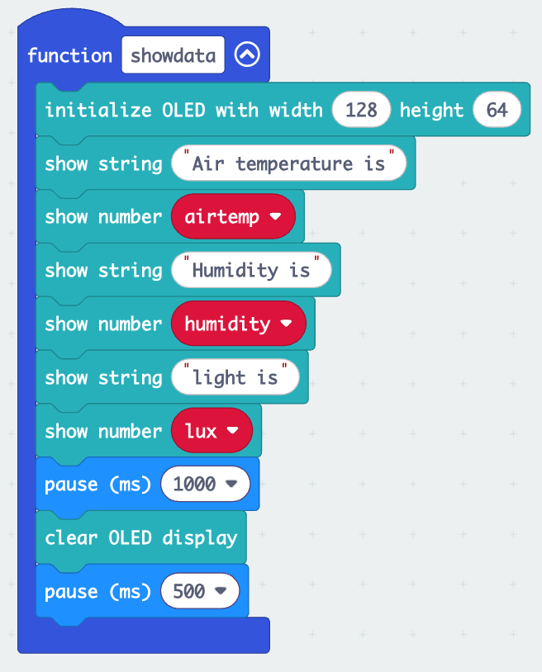
Display light data on the OLED display

Slide 14
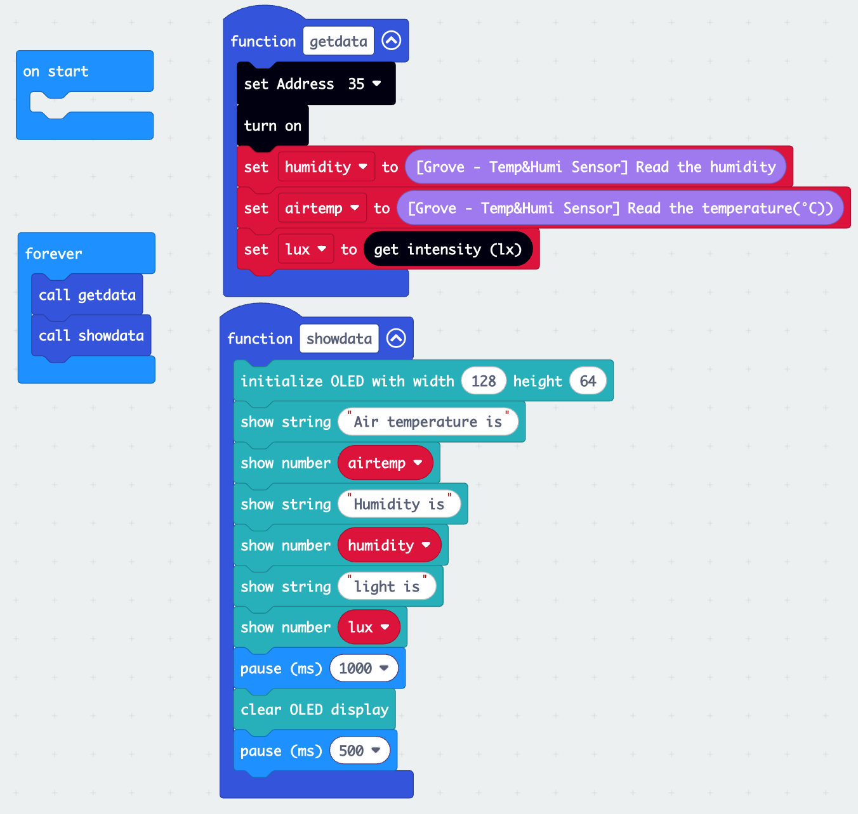
final code

