Slide 1
Lesson 0a Getting Started with the micro:bit

Slide 2
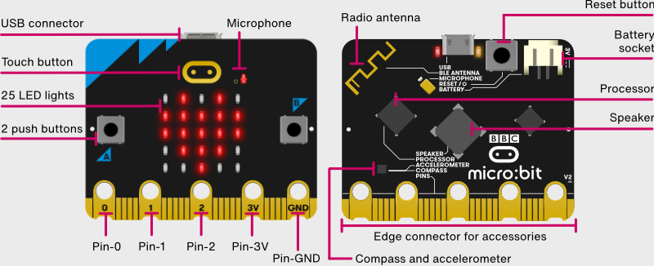
About the micro:bit
micro:bits can talk to each other
The “brain”
Can play music
Where we will connect our sensors

Slide 3
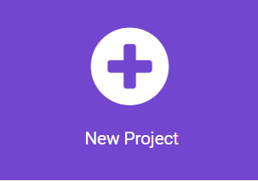
Program using Blocks (puzzle pieces)
Go to: https://makecode.microbit.org/
Click on New Project

Slide 4
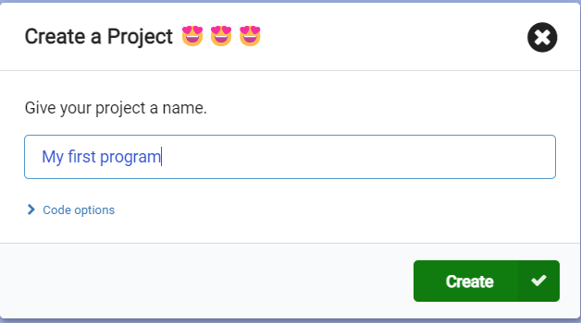
Give your project a name!
You can give any name
Try to give a name that describes the program
Easier to remember!
Click create

Slide 5
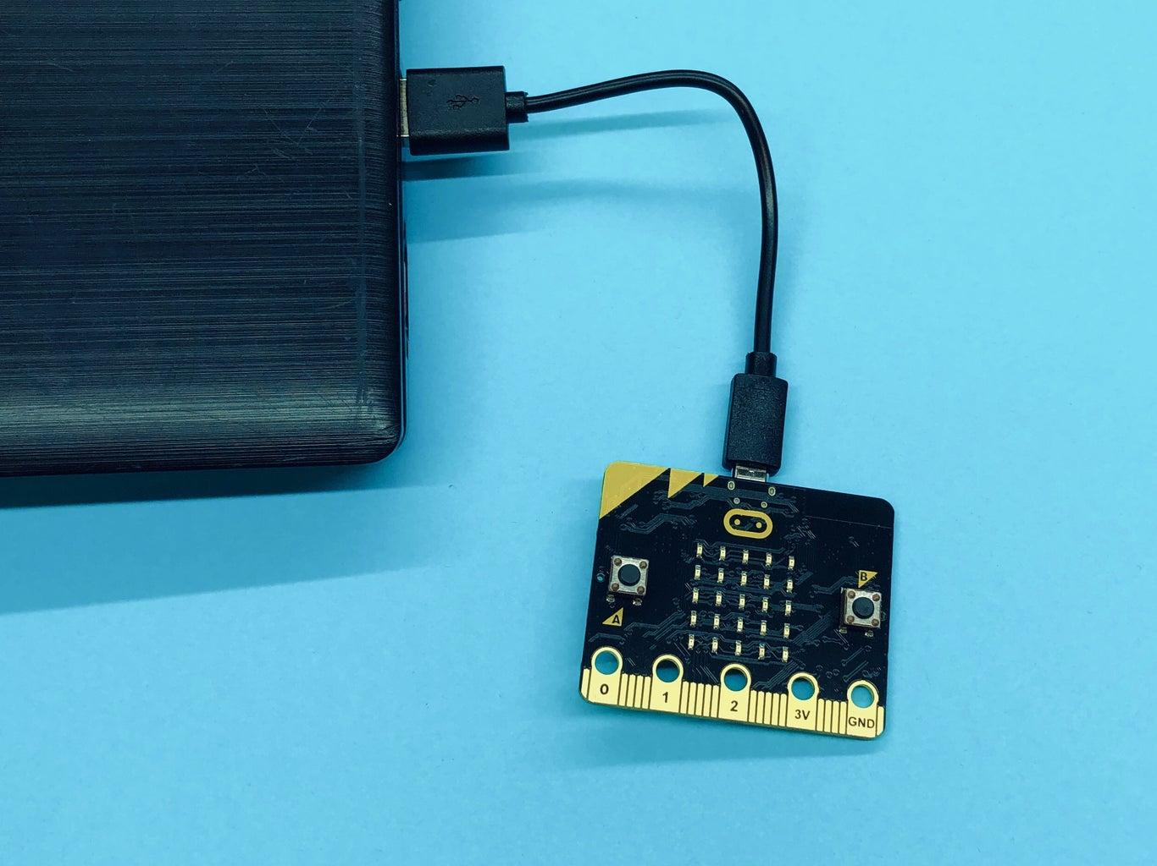
Connect micro:bit to your computer
The micro:bit has a program on it… so …
Your micro:bit is going to make a lot of noise!
Images are going to flash
You can press A and B and things will happen

Slide 6
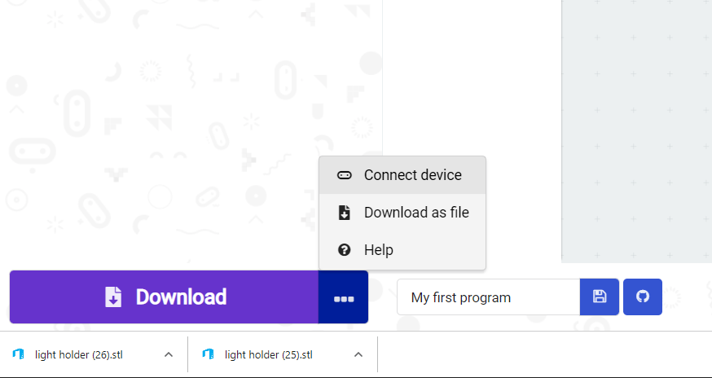
Introduce YOUR micro:bit to YOUR computer
In Makecode
Click on the three dots next to the “Download” button in the bottom left of the screen
Choose “Connect device”

Slide 7
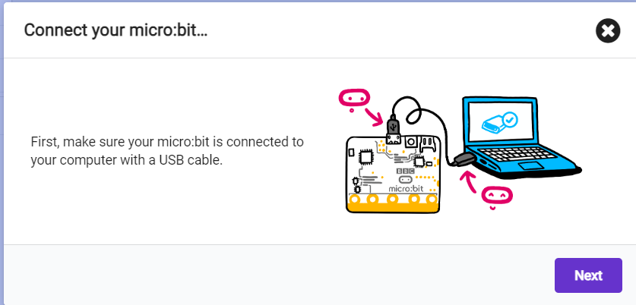
Click NEXT when window pops up

Slide 8
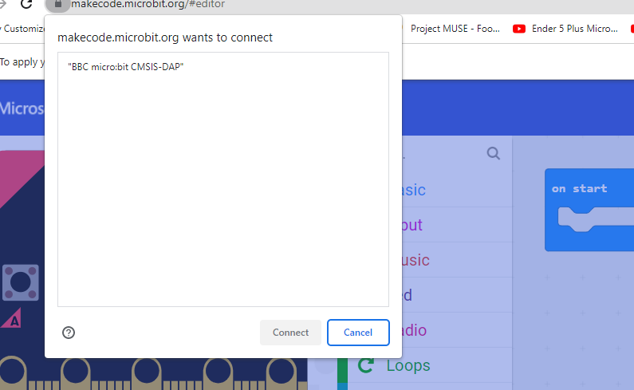
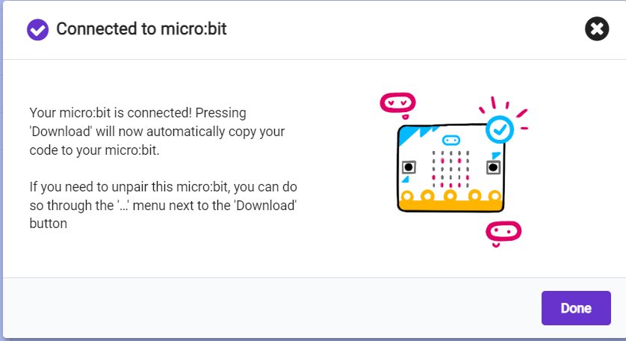
Select your micro:bit
Click on BBC micro:bit
Should be the only option
Click “Connect” after selecting the Micro:bit
Click DONE when connected!

Slide 9
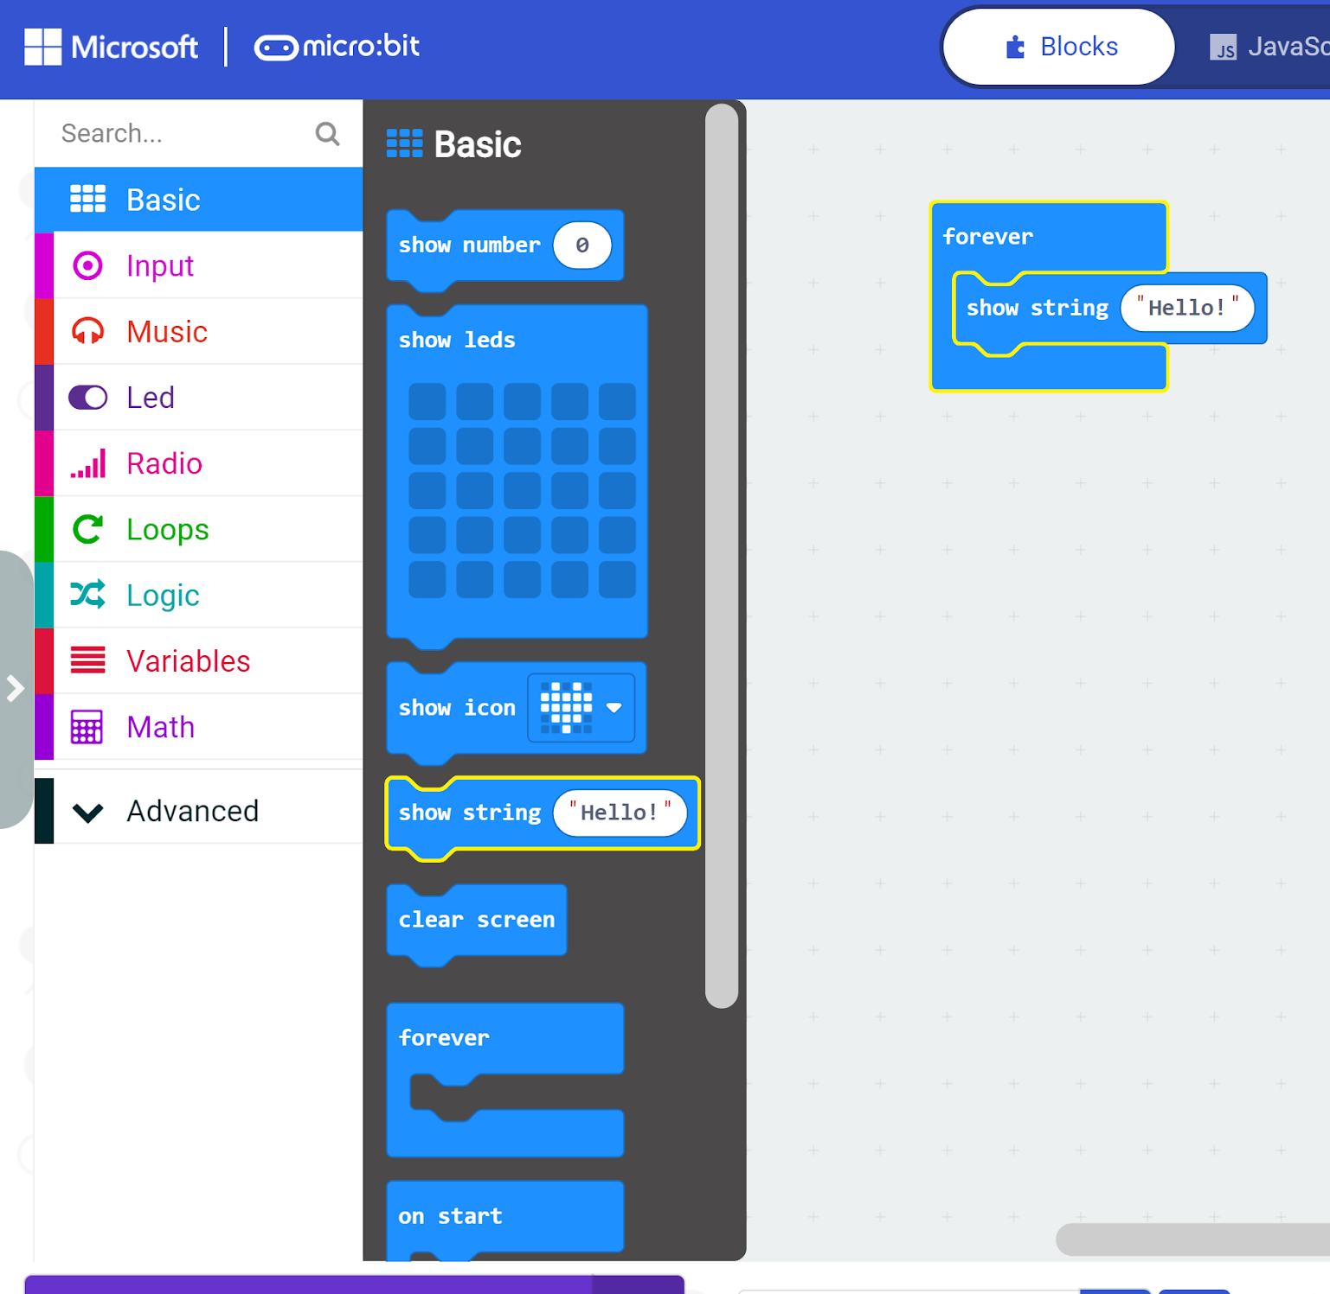
Lets get your name on the micro:bit
In MakeCode:
Click on “Basic” from the left panel
Drag show string block to “forever” loop
Whatever is in the forever loop runs FOREVER! (It means “Repeat forever”)
“String” is a set of characters representing Text and Number digits, like: Hello World, a3ddfe3, deer23tiger, etc. (It can not understand the value of the numbers, it considers numbers just as letters)
Change the “Hello” to your name: (Such as: “Peter”)

Slide 10

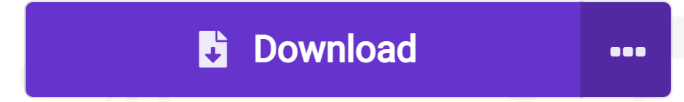
Always remember to make sure your micro:bit is plugged into the computer and click DOWNLOAD!
This sign means: Micro:bit is connected
This sign means: Micro:bit is not connected. If you click “Download” now, it will save the file in your computer.

Slide 11
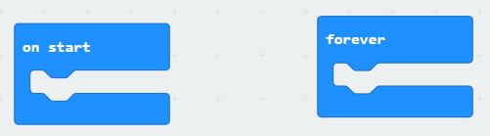
Now let’s play a little…..
On start: This is where you put code that you want the micro:bit to run at the very beginning of the code
Forever: this is the code that you want the micro:bit to run again and again (Meaning: “Repeat Forever”)
Computer code in “On Start” and “Forever” is run in sequence (from top to bottom)

Slide 12
Let’s Play: Show your name on the micro:bit
In MakeCode:
Click on “Basic” from the left panel
Drag show string “Hello” block to “forever” loop
Whatever is in the forever loop runs FOREVER! (It means “Repeat forever”)
“String” is a set of characters representing TEXT (NOT NUMBERS)
Change the “Hello” to your name

Slide 13
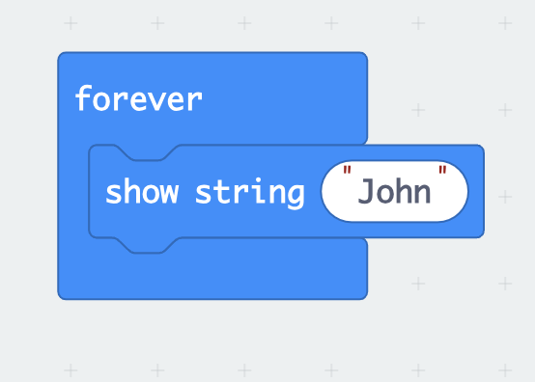
So your Forever block looks like this!

Slide 14
Always remember to make sure your micro:bit is plugged into the computer and click DOWNLOAD!

Slide 15
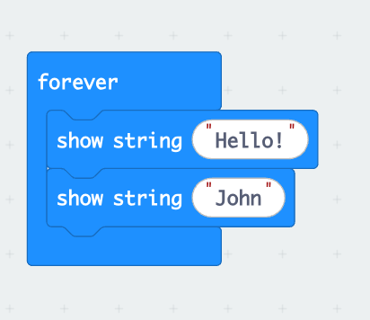
Let’s Play More:
Drag these two puzzle pieces to your forever block. Change the second string “John” to your name.
Download the code, what did you see on your micro:bit LED screen?

Slide 16
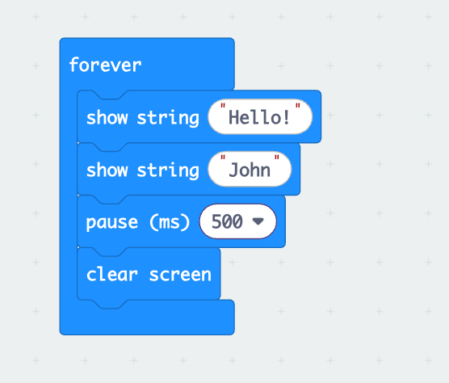
Let’s Play More:
Drag these four puzzle pieces to your forever block.
Download the code, what did you see on your micro:bit LED screen?
What did you notice the different performance of the micro:bit between this code and your code?

Slide 17
What did you notice the different performance of the micro:bit between the code on the left and the code on the right?
Notes:
Understand the importance of adding “pause” in coding

Slide 18
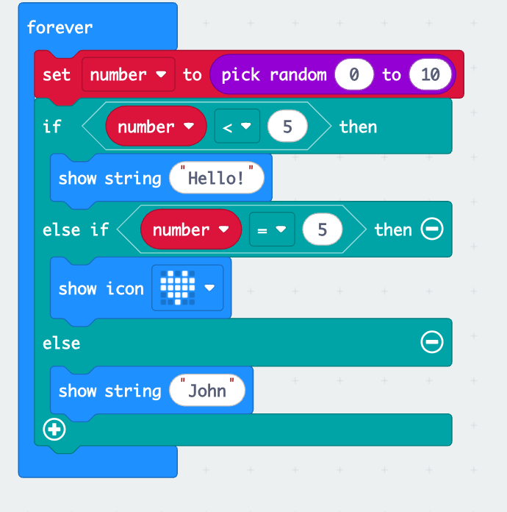
Let’s explore more code
What do you think this code would do?
Ask students to click an URL to this page and download the code to check their understanding.
Notes:
Use a random number to control what will be shown on micro:bit

Slide 19
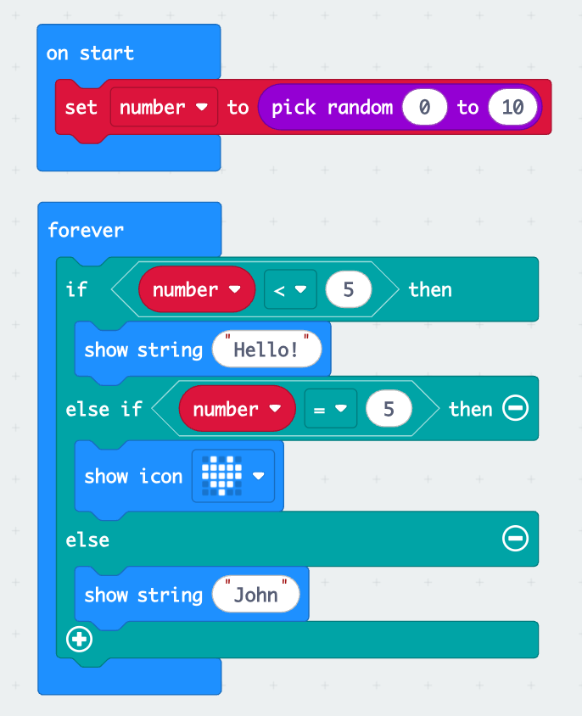
What would this code do?
What do you think this code would do?
Ask students to click an URL to this page and download the code to check their understanding.

Slide 20
What did you notice the difference between two codes?

