Slide 1
Design of Formative Experiences Portfolio
Ethan Smith
Spring 2025

Slide 2
Brainstorming and Ideation
My project began with a simple idea: how could I create a task that shows Interconnection in people’s lives? My powerful idea preceded my prototyping, and I had been considering for a while how one might be able to guide others through the complex interconnections in their lives.

Slide 3
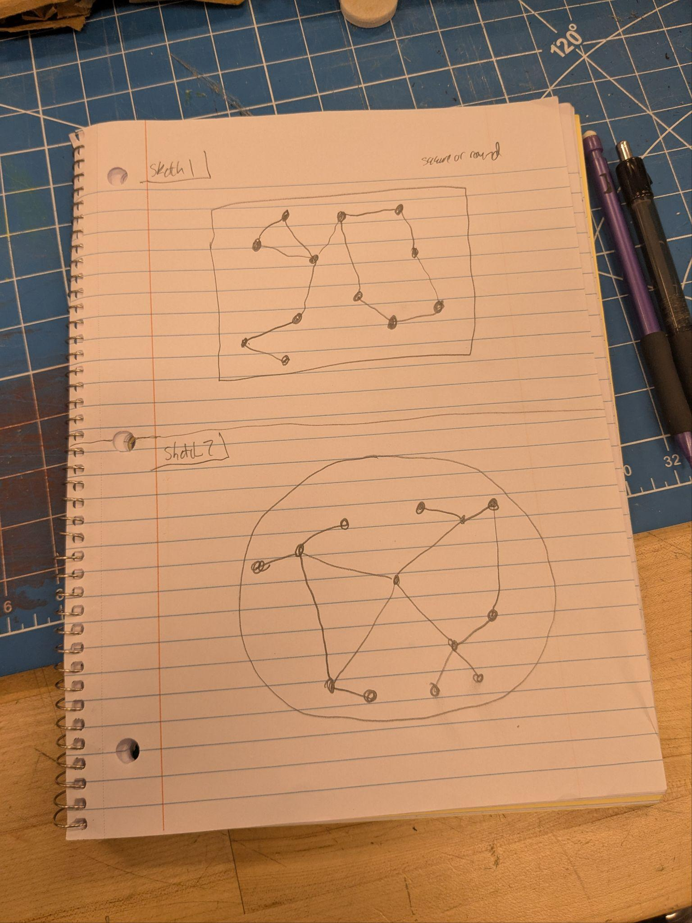
Ideation
So in attempting to identify how I might represent this, I quickly latched onto the idea of a web. Webs are abundant in presentations of ecological phenomena across the sciences and social sciences, and I began seeing where I could take this idea. My ideas began on paper before quickly transitioning to digital and physical formats.

Slide 4
Forms of Tinkering
I began exploring various mediums for exploring interconnection, especially as a web. I was drawn to both digital and physical prototypes.

Slide 5
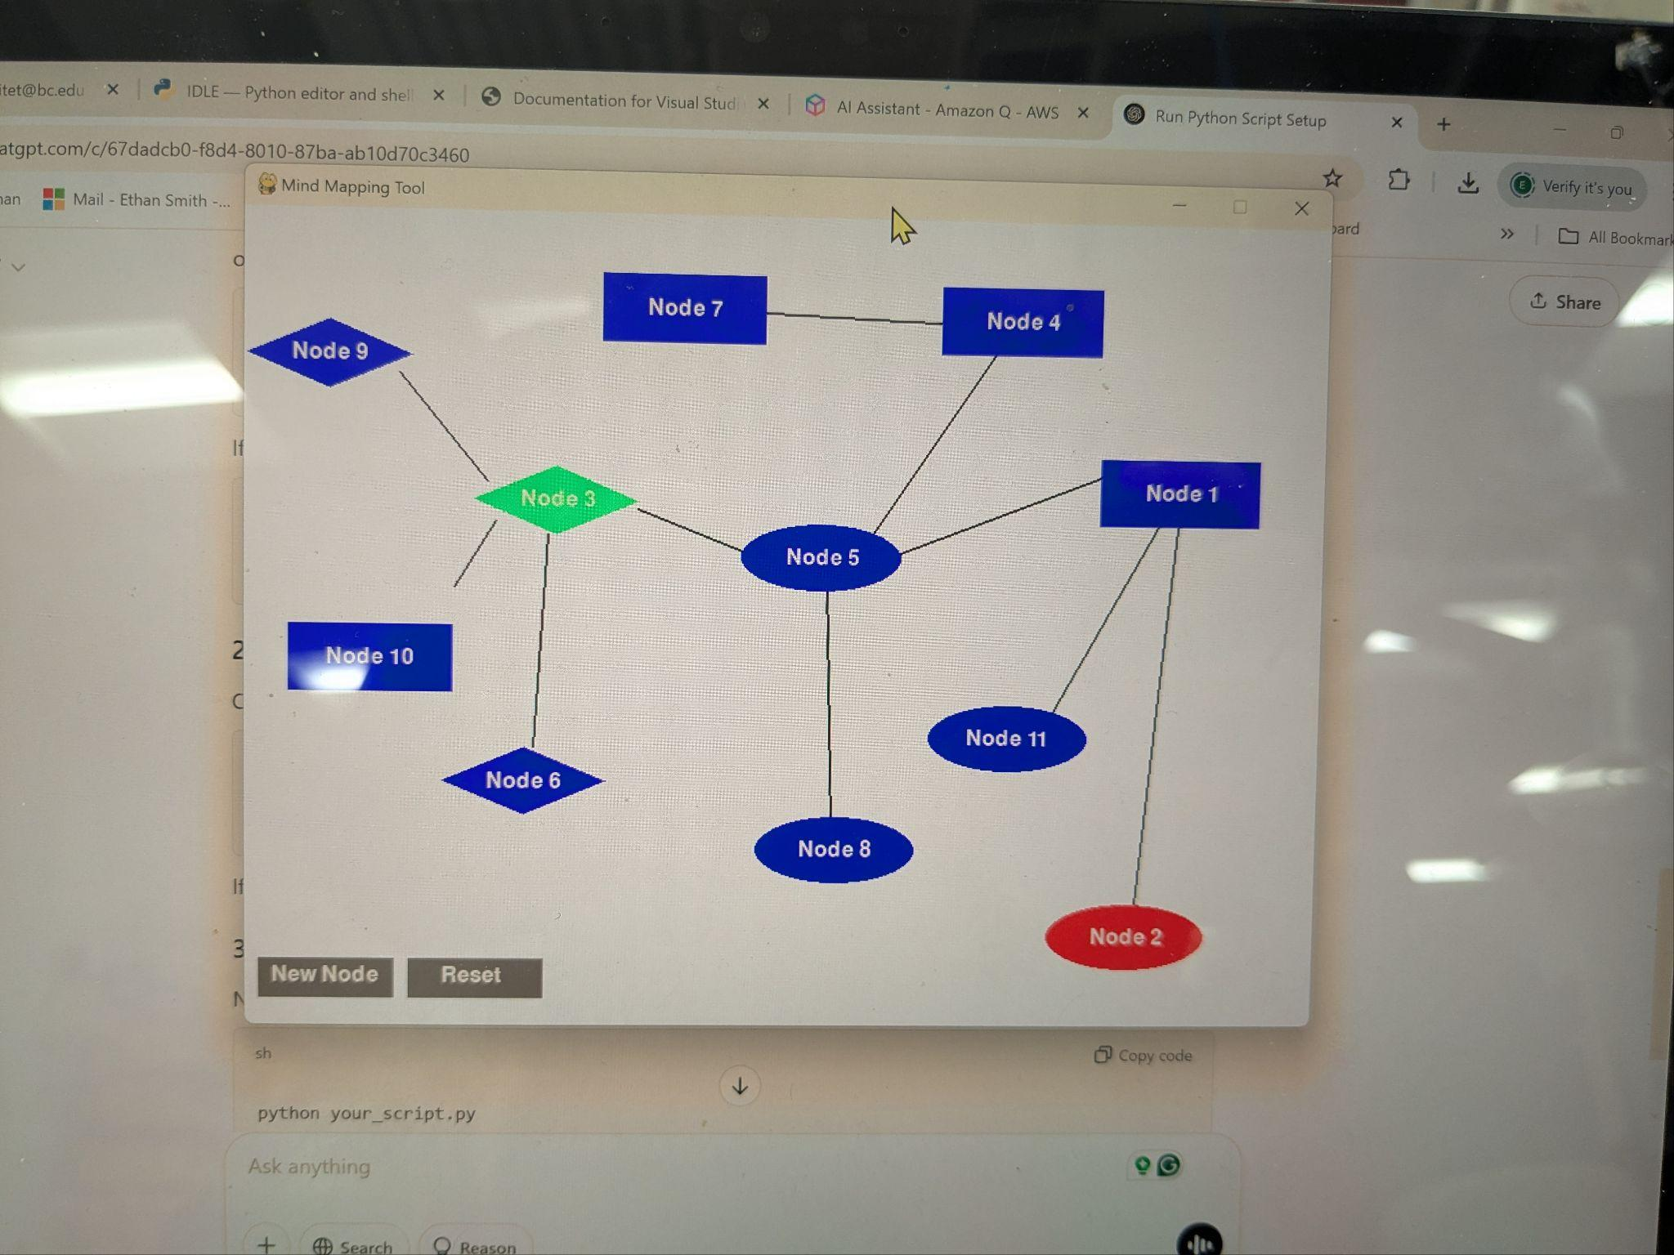
Digital Tinkering
Before I even began tinkering in the makerspace, I had already mapped out a very rudimentary design digitally. Programmed in Python with the help of Cursor AI and Amazon Q, this early prototype expedited my learning of Python in a short timeframe. And though most of the generation still relied on the AI, I was able to figure out some basics in Python along the way, and I ended up using Cursor AI similar to a drag and drop website builder. It was helpful enough that I was able to fully envision what became the end product, though I went through about 15 different prototypes in all before I fixed most of the bugs. Likewise, it allowed me to consider how I might also make a physical prototype.

Slide 6
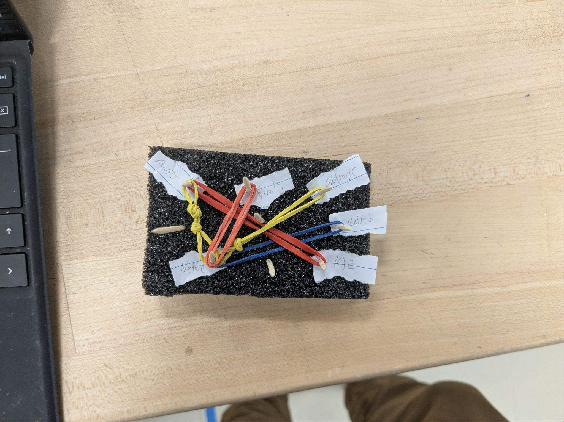
Physical Tinkering
In our first visits to the makerspace I began to just experiment with materials ready at hand. On the first day, I decided to make a miniature. In this process I just wanted to make something simple and physical that represented the basic idea. This design made manifest a simple web, but it had a long way to go before becoming interactive. This small mock up allowed me to experiment with materials and brainstorm how different materials led to different modes of manipulation on behalf of the user. This mini-mock-up was creative but not very useful.

Slide 7
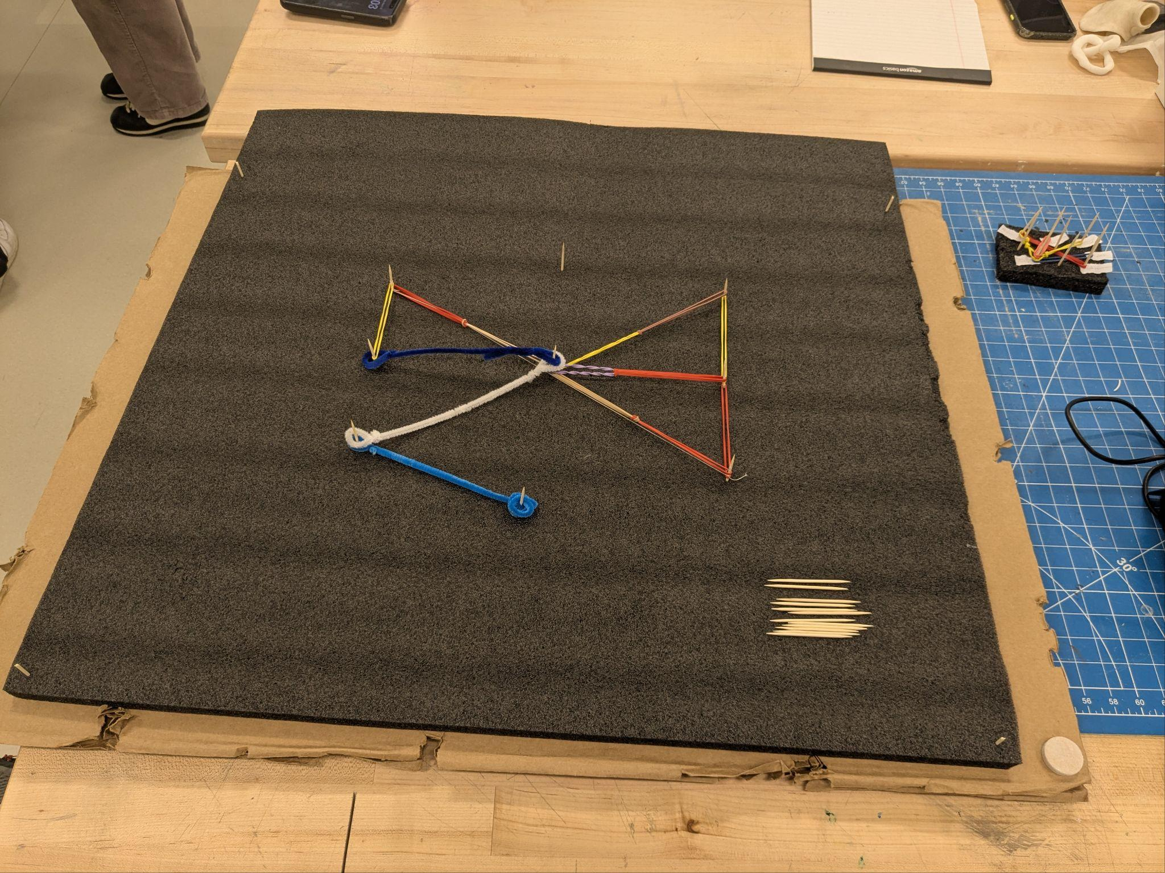
Physical Tinkering Pt. 2
I continued experimenting with materials on hand, and I found them quite limiting. However, for the sake of the project, I was able to create a larger version that let me showcase my idea physically. However, these limitations revealed several challenges, and I continued working toward understanding how a user might be able to work with the tool more interactively. In the early stages, I noted how my idea was able to shine through, I could explain it well, and I could get at least some materials to represent it; however, it became clear that in order for this to transform into a more user-friendly game, that I would need to consider outside inspiration and identify a method and materials for making the web come alive.

Slide 8
What goes in a web?
In the process of thinking of webs, I considered from the very beginning about how what I wanted to include should relate to how people view their lives and their education. Thus, I was drawn to the prompts and what became the nodes early on in the process. I chose questions that felt like that were open-ended and led users to create a map easily. However, I included choices of nodes that were open to various levels of challenges as well as a variety of ways to be constructed, allowing for endless varieties. Some of the nodes included things like Friends and Family, but others were more difficult or abstract and included Success, Money, Strangers, and Identity.

Slide 9
The Process + Learning
Utilizing various physical and digital methods, I was able to finally identify pathways for success. It is worth noting some of these struggles on the way to the final products.

Slide 10
The Process
Throughout the iterative process of this project, I drew inspiration from several areas. As mentioned, the digital format became clear from the beginning, and this success influenced the physical prototype; however, this was not enough, and I had several challenges identifying materials that worked well. In particular, the design challenge became not just begin able to represent a web but utilizing materials that could be shaped into a web that allowed the user to manipulate them easily. In particular, what became the “connector nodes” were the most challenging piece. However, after identifying that the initial materials were inadequate, I continued with the digital design process until I reached near success. This allowed me to really try to understand how I might make a physical version that attempted to mimic the digital version as much as possible. In the process, I experimented with various manipulable materials. Brainstorming with some friends, we identified how magnetic materials allowed for this, and we came upon the idea of fridge magnets like the ones used to make magnetic poetry. A friend of mine has “written” an entire book using these actually, and I was instantly hooked by the idea. The connecting nodes in the end remained challenging but I managed to figure out a solution. This inspiration allowed me to experiment with various materials, and in the end I chose to keep the solution relatively low tech with laminated sheets and adhesive magnets. These could be adapted to any white board or similar magnetic surface large enough.

Slide 11
Final Prototypes
After several iterations, I was able to capture my idea in two forms: digitally and physically. This allowed me to present nearly the same information using differentiated mediums.

Slide 12
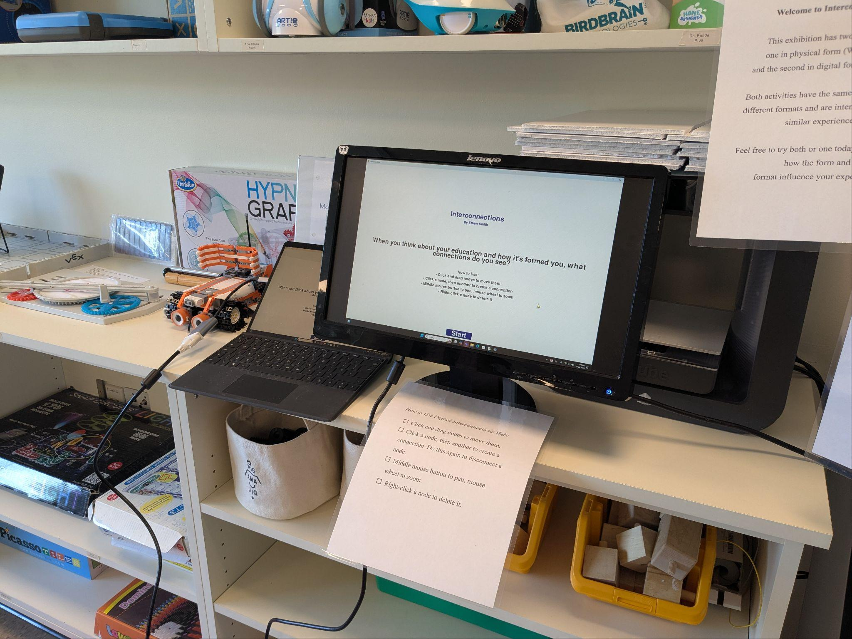
Digital Prototype
The final digital version utilized my laptop and an external monitor. An ideal prototype would have utilized a touch screen, but these materials worked out well. You can see the close up to the left, which shows the final version being tested before a run through. Users were given a mouse and were presented with the monitor opening screen (next slide) as well as a set of directions on the screen and attached as paper.

Slide 13
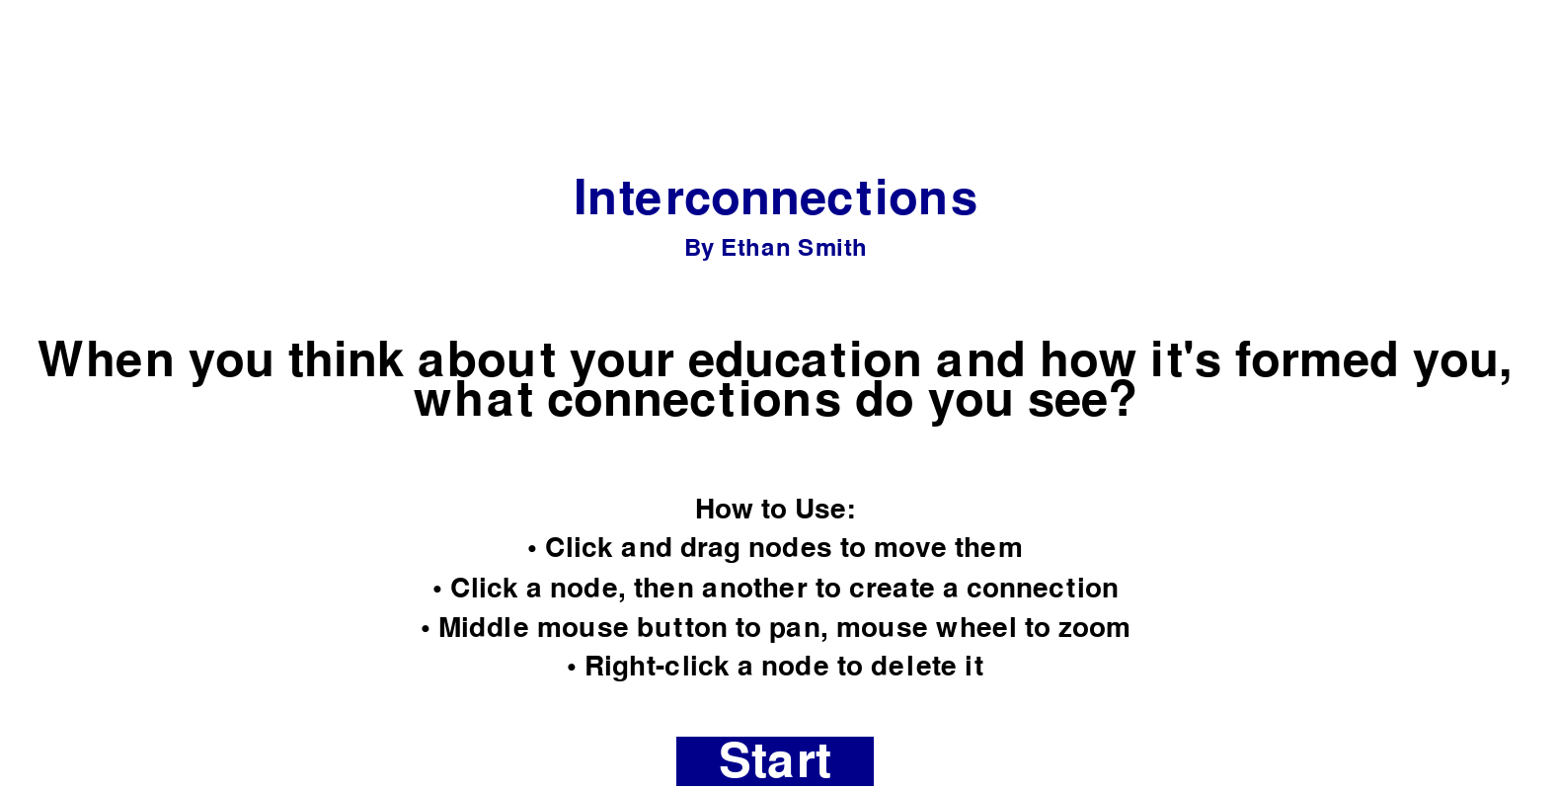
Opening Screen
This was the opening page for the game/application, which prompted users with the main prompt, a title, and a short description of how to use the tool, one that was also posted physically on the monitor.

Slide 14
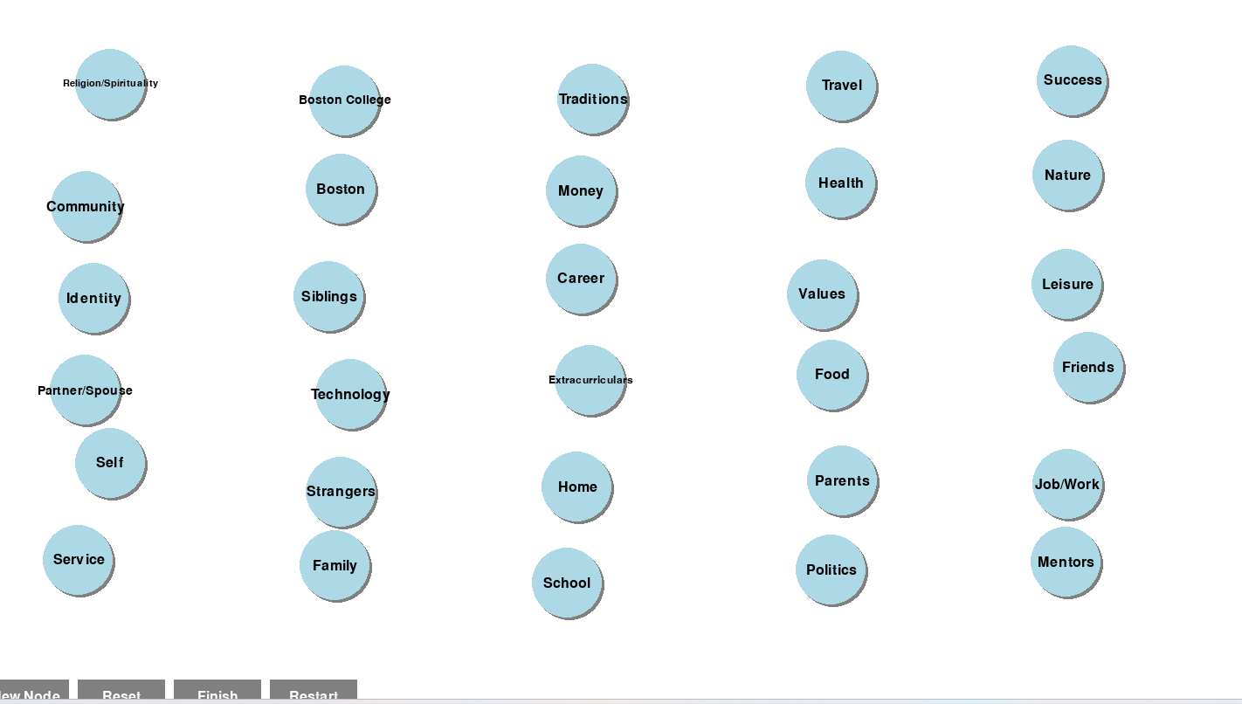
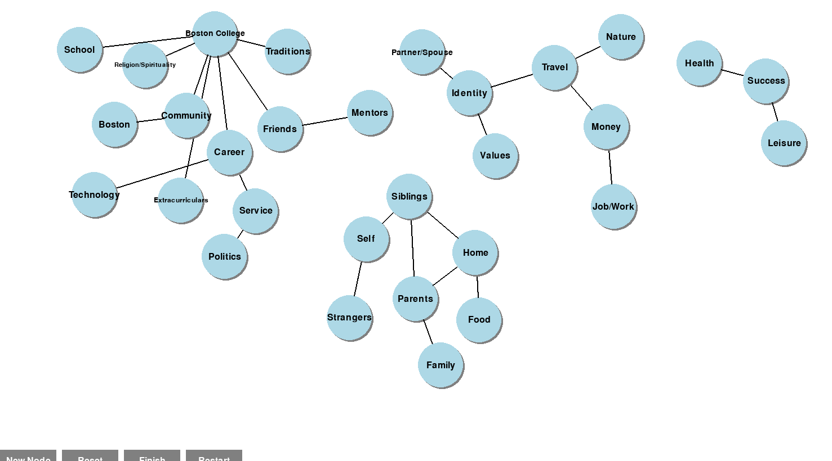
In the Game
Guided by the main question, users began constructing their own webs, which are represented to the left. The top image is the default starting point for the game, which utilizes all of the nodes, randomly organized each time. On the opening screen, users were able to restart the game if needed, reset the nodes, finish the game, or create new nodes. The basic instructions guide users through constructing a web, an example of which is the bottom image. User interact with the nodes by clicking, dragging, and connecting various nodes, with the ability to delete, add, or maneuver them in various ways. I added all of these features to be a relatively intuitive way of representing a web. I gained inspiration from mind mapping tools such as Miro, and considered how a user might just utilize their fingers to manipulate the nodes. In the end, a mouse was sufficient.

Slide 15
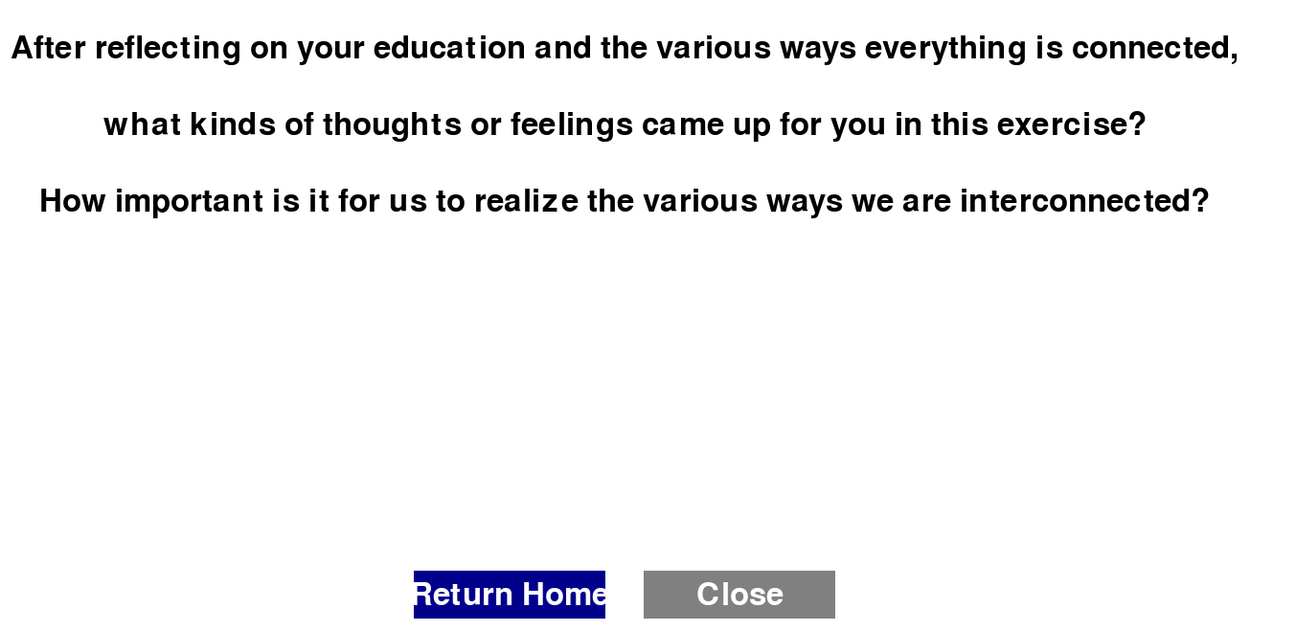
Closing Screen
After finishing their webs, users were prompted with a set of reflection questions to ponder as they leave the game. The return home button allowed the user to restart for the next user, which eliminated the need to start the game up from scratch and made it very user friendly and easy to replicate, a key advantage of the digital over the physical prototype.

Slide 16
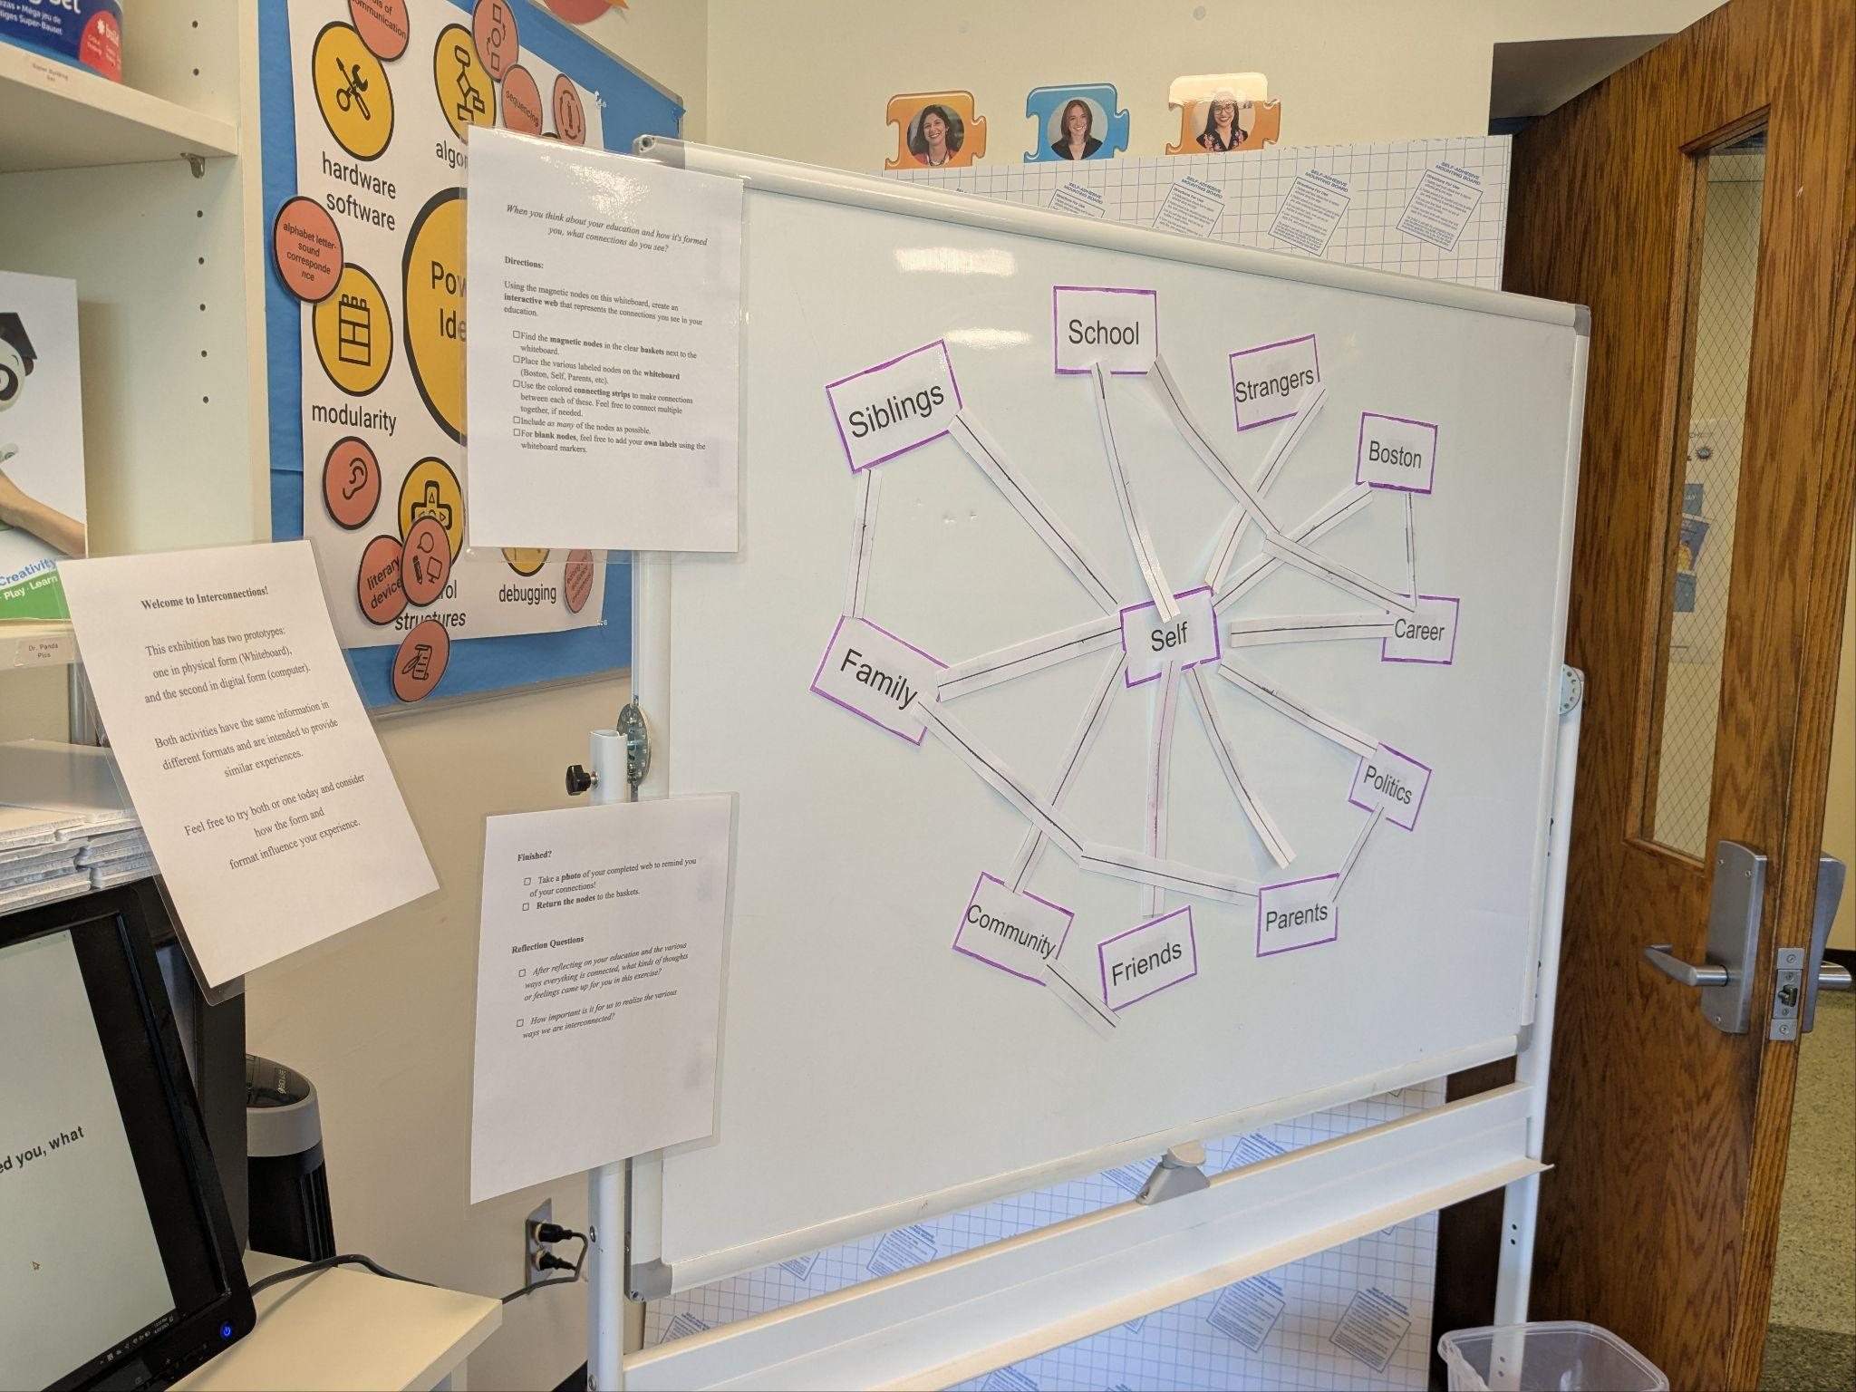
Physical Prototype
All of the same components found in the digital version were present in the physical version, though they were presented in a different form. The example to the left shows the nodes and connectors for a simple map created by a participant. The prompts and instructions were located on the left side of the board. As can be seen, the manipulable nodes were magnetic laminated sheets of paper each with labels representing some aspect of a person’s life, as previously mentioned. Users made maps like this one to draw connections between the various nodes and represent how they thought those concepts were connected in their own lives in relation to their education.

Slide 17
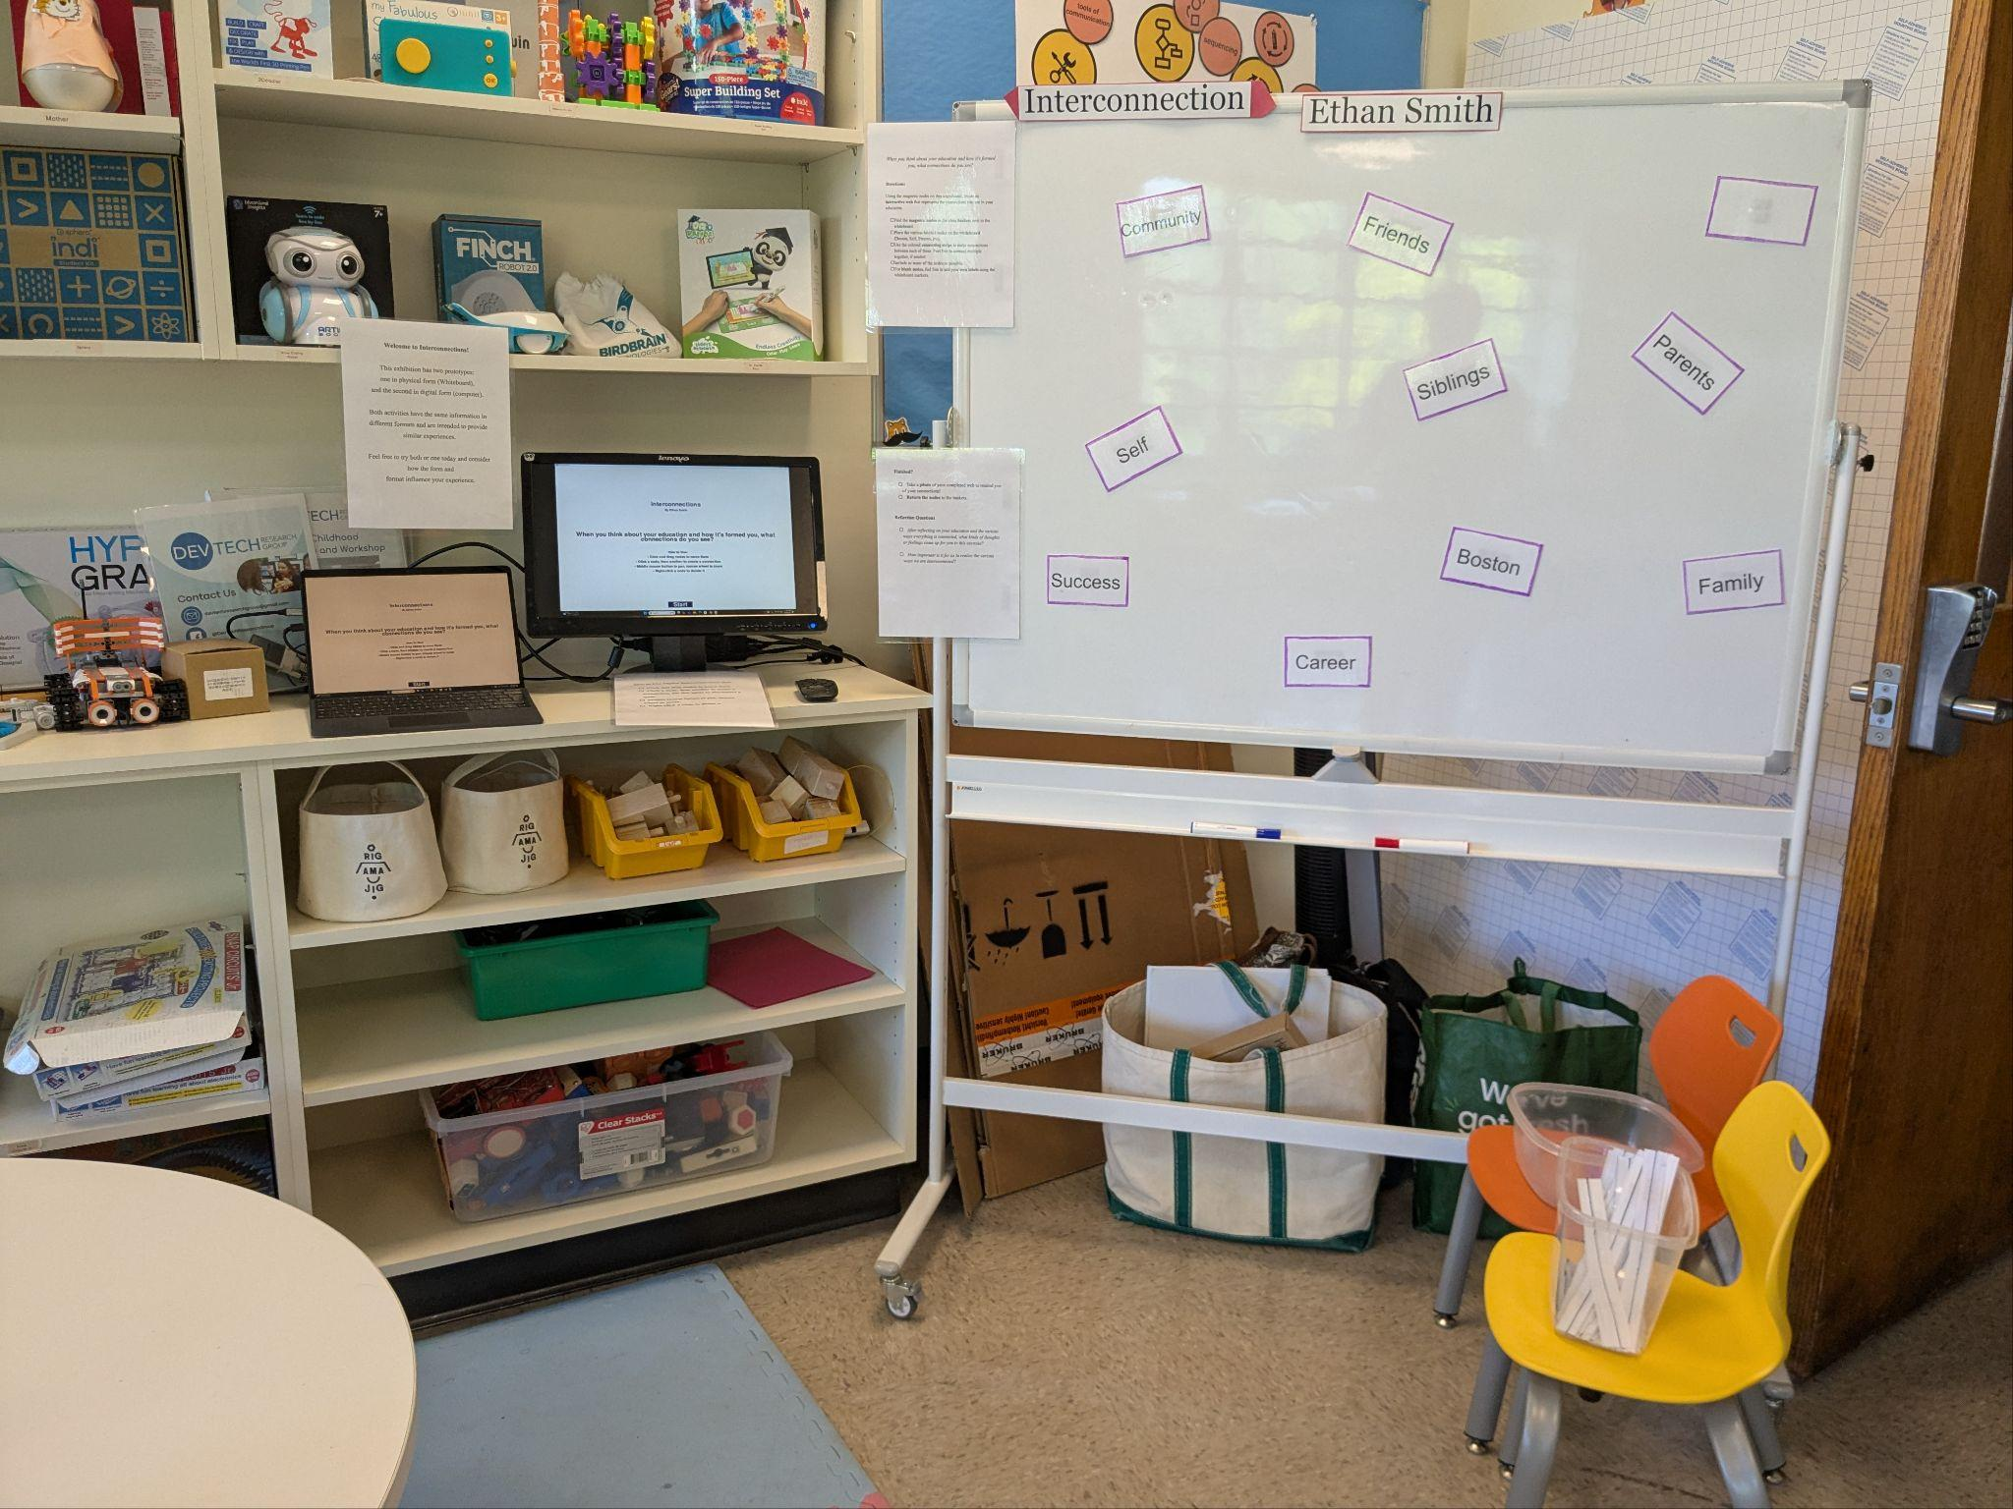
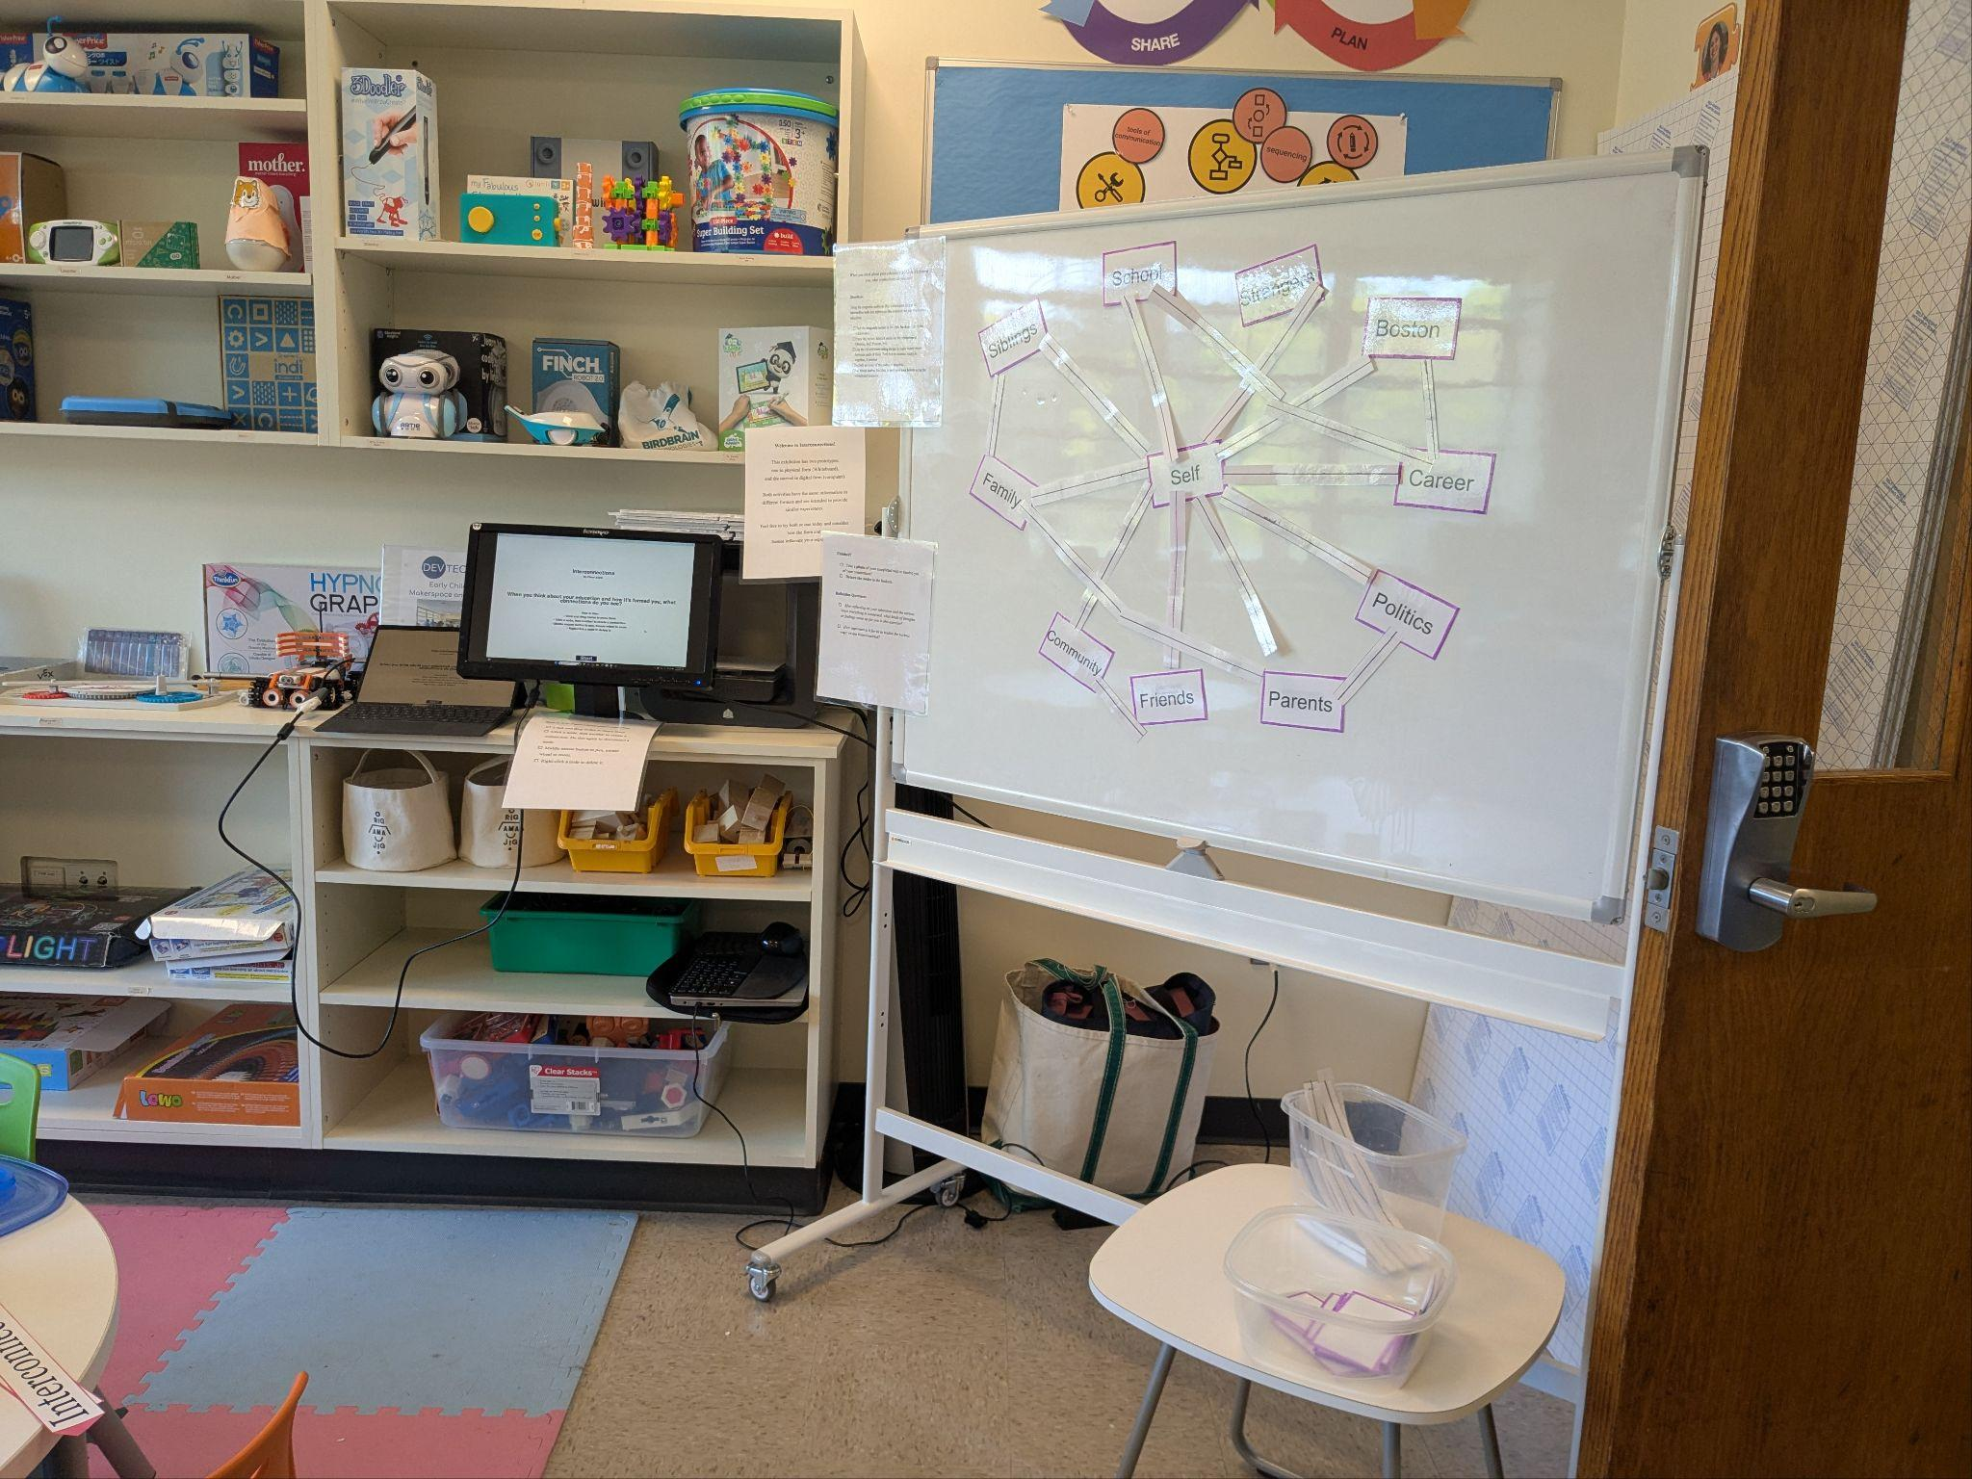
In the Museum

Slide 18
Further Reflection

Slide 19
Final Reflections
In the process of creating these prototypes, I was able to modify, adapt, or adjust my products as I went along. Given the time and materials and other constraints, I believe I produced two models that represented my powerful idea well, and were approachable, useable, and worthwhile. If given more time or materials, there are a number of features that I would, of course, improve upon, including adding a touch screen interface and improving the graphics for the digital version. Likewise, the physical version could use large aesthetic overhaul. Additionally, it would have been interesting to try to integrate my exhibit with others more intentionally as well. Nonetheless, the process allowed me to ideate, experiment, and produce a useable product that highlighted an important aspect of formation that is often overlooked. Likewise, though fewer users interacted with my exhibit than some others, the experience seemed to be worthwhile, with many commenting that the exhibit made them think more deeply, which is the main goal.

