Slide 1
Controlling the Neopixel LED Light Strip with Temperature/Humidity Data
GO BACK TO YOUR GREENHOUSE PROJECT CODE!

Slide 2
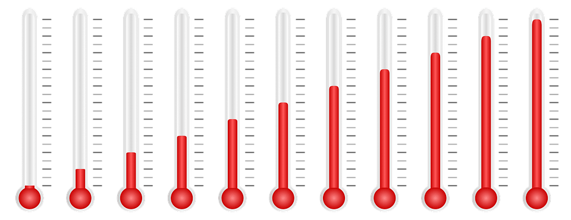

Lesson 3: Using the data!
What if we want to change our LED strip to a different color if the temperature got too high?
  Or the Humidity was too high or too low?

Slide 3

We are going to be using an LED Light strip…
What extension do we need to get?

Slide 4
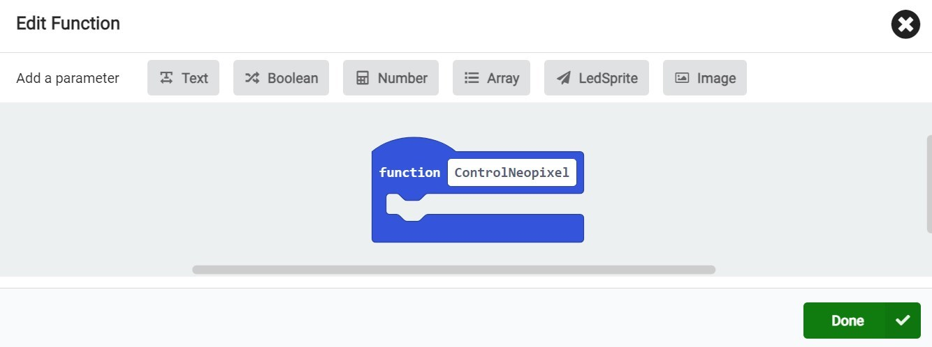
Step 1: Create a new function!
From the left panel, find Functions
Click “Make a function…” and name it ControlNeopixel

Slide 5
Global Variables vs. Local Variables
Before going to the next steps, we need to understand two concepts:
1. Global Variables
2. Local Variables
Global variables: the value of these variables always remain the same, the value that YOU define/ choose
Local variables: the value of these variables keeps on changing, for example, the values will depend on the sensors.

Slide 6
Global Variables vs. Local Variables (cont.)
We will create some global variables, which can be used multiple times in our code. These variables will contain fixed values.
Our first global variable will be “high airtemp” and our second variable will be “high humidity”.

Slide 7

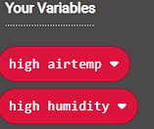
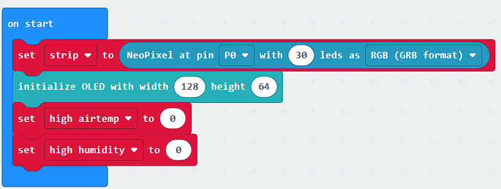
Step 2: Creating Some Global Variables
First, we will go to
Then we will create two new variables, “high airtemp” and “high humidity”
NOTE: DO NOT CREATE A VARIABLE CALLED “STRIP!” Where do you find all blocks for the LED Light Strip?
Then inside the “on start” block, we will put “set high airtemp to 0” and “set high humidity to 0” blocks.

Slide 8
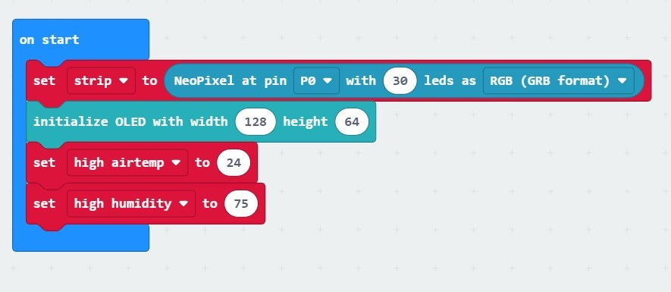
Step 3: Setting the values of Global Variables
Now, you can choose high airtemp and high humidity values.
This should be based on your plants. If unsure, you can choose 24°C/ 76°F for high airtemp, and 75 for high humidity
These are the highest values that we have determined that will keep our plants healthy–any higher and our plants may not thrive!

Slide 9
Step 4: Use new Global Variables in your “ControlNeopixel” Function
We want to change the Neopixel light, based on the temperature (or humidity)
The logic is:
When “airtemp” is greater than “high airtemp (24°C/ 76°F), turn the Neopixel light Red
Otherwise (ELSE), (when airtemp is lower than “high airtemp”) turn the Neopixel light Green

Slide 10
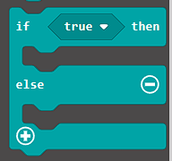


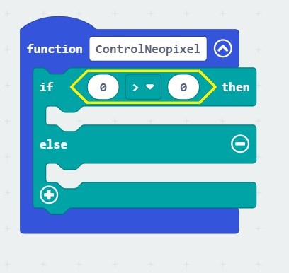
Step 4 (cont.): Finishing the “ControlNeopixel” Function
From , find this “If…else..” block and put it inside the “ControlNeopixel” function
Again, from , find the comparison block.
Move this block and place onto the “True” of the “if…else…” block

Slide 11

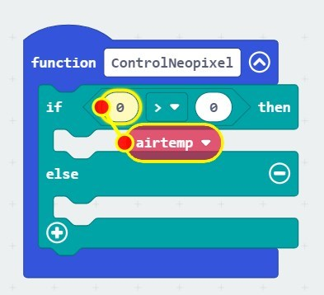
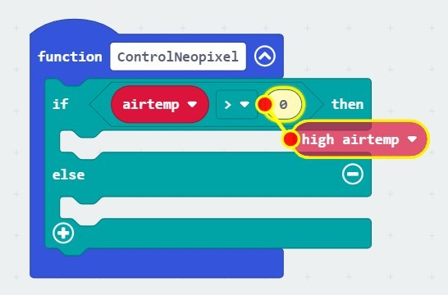
Step 4 (cont.): Finishing the “ControlNeopixel” Function
From , find “airtemp” and “high airtemp” variables and put it inside the comparison block

Slide 12
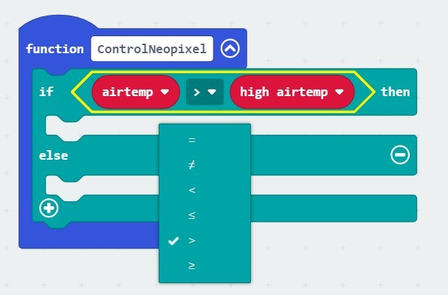
Step 4 (cont.): Finishing the “ControlNeopixel” Function
Remember, the logic is, if airtemp is “greater” than high airtemp, neopixel strip will show “Red”.
Change the comparison sign to “>”

Slide 13
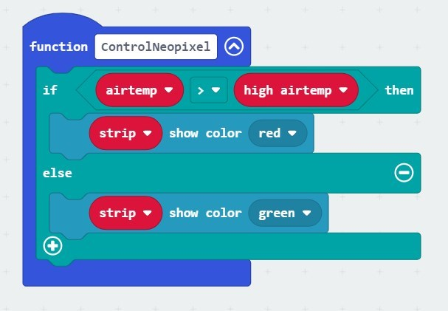

Step 4 (cont.): Finishing the “ControlNeopixel” function
Then from , put “strip show color red” under if statement:
Remember, our logic is, otherwise (when airtemp is not “greater” than high airtemp), neopixel strip will show “Green”.
Then from , put “strip show color red” under else.
Change “red” to “green”

Slide 14
Step 5–Before you download, what MUST happen with your Function “ControlNeopixel”?

Slide 15
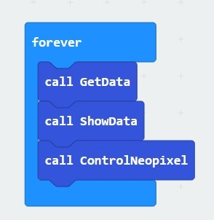

Step 5: Make sure all functions are called!
Double check to make sure that all of your functions are in your forever loop!
Now download and test your program!!!

Slide 16
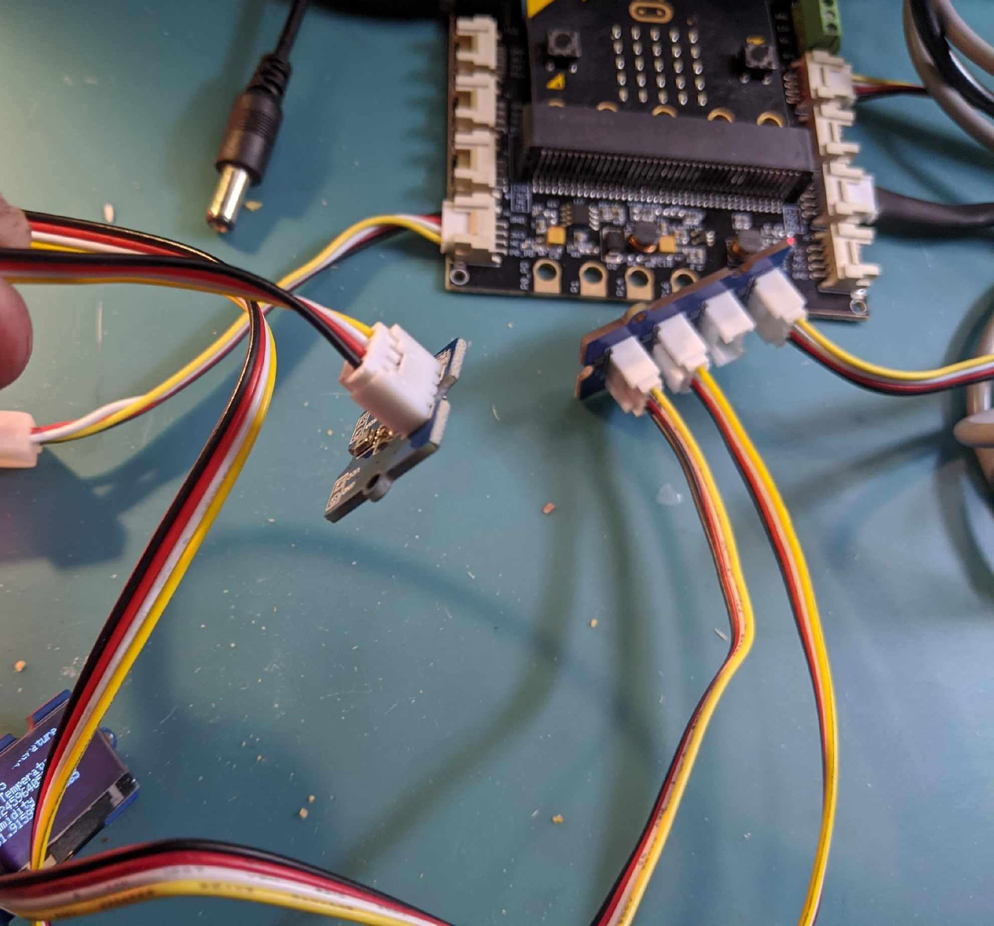

Step 6: Wire up your circuit
LED strip on P0
I2C Hub goes on I2C Port (by the Green block)
Power into Power (see next slide!)

Slide 17
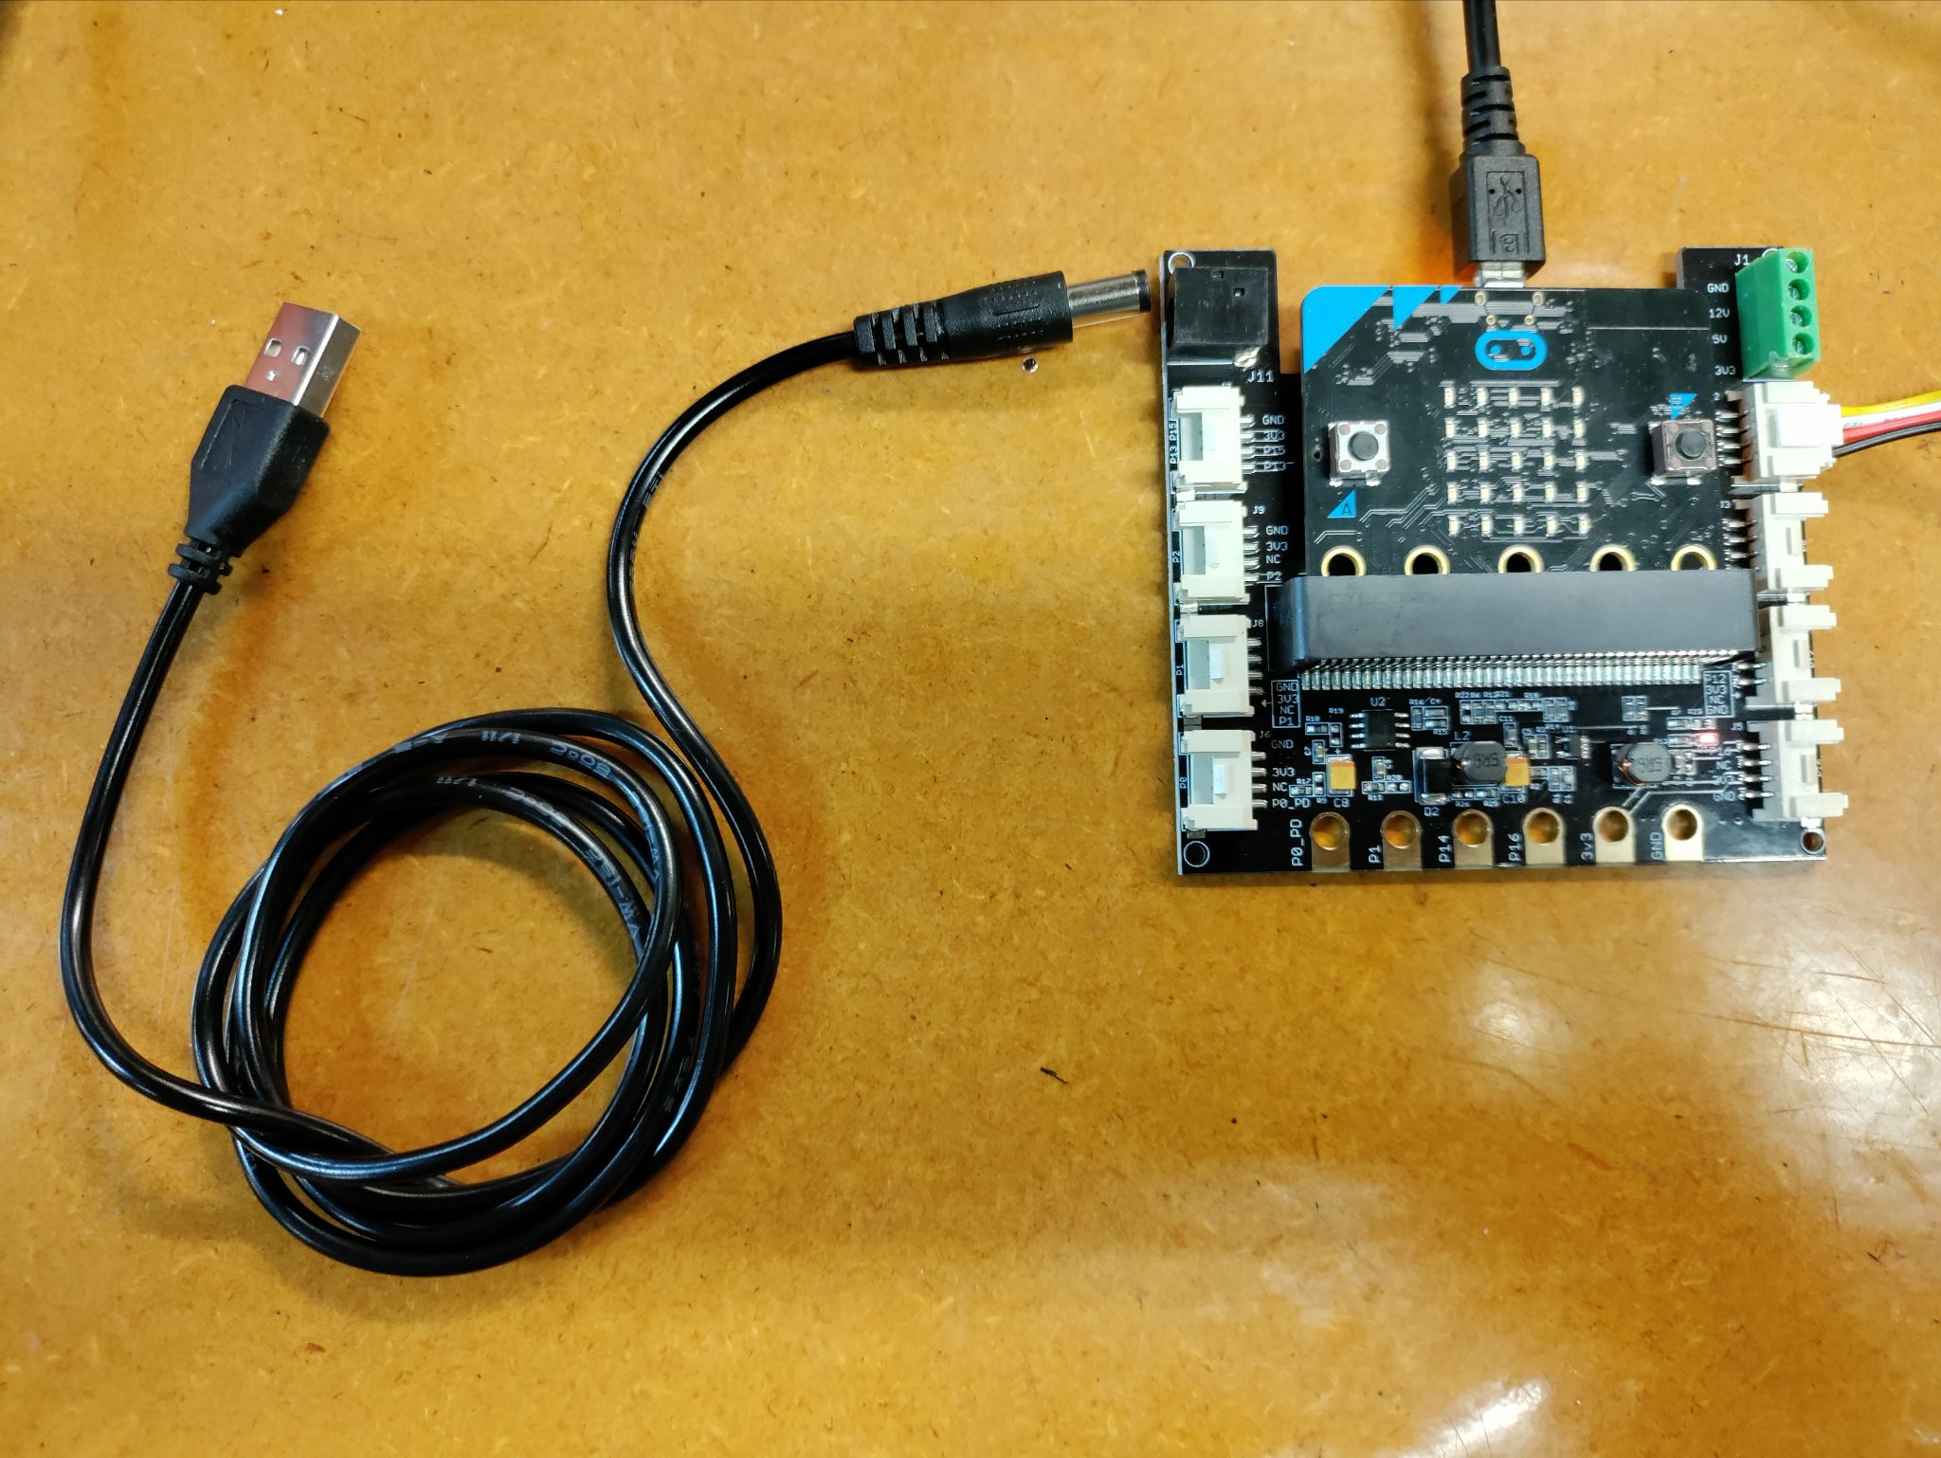
Remember, we are no longer powering our shield attachments via the micro:bit! The micro:bit cord is ONLY for downloading code!
THIS photo shows how you should be powering now…the 5V cord should be plugged into an outlet and NOT your Chromebook!

Slide 18

Challenges!!
What if you wanted to know about temperature AND humidity? Can you modify your program to let you know if your temperature AND your humidity are too high? HINT: Look in the LOGIC block under Boolean.
What if you wanted a little bit of warning about temperature? What if you wanted your LED strip to be green if the air temperature is below 70 °F (21 °C), yellow if it is between 70-80 °F (21-27 °C), and red if the air temperature is over 80 °F (27 °C)?
[Advacned] Can you make half of your light strip warns for temperature (red/ green) and the other half warns for humidity (two different colors)? [Hint: You need to use “Range” of Neopixel]

Slide 19
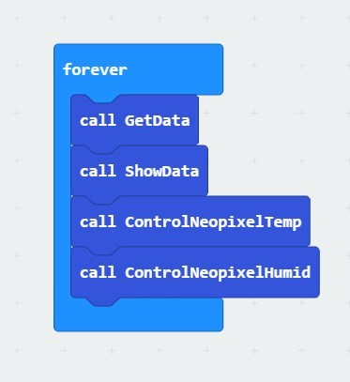
Challenge #1 Solution (cont.)

Slide 20
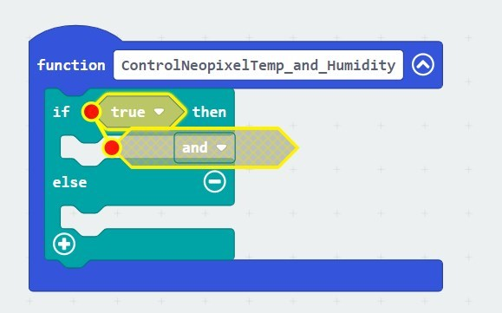
Challenge #2 Solution
Replace the “True” with the “and” block from the Logic Extension

Slide 21
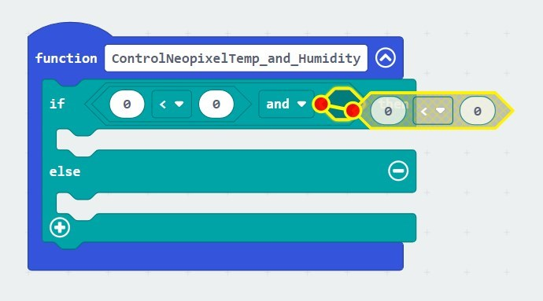
Challenge #1 Solution (cont.)

Slide 22
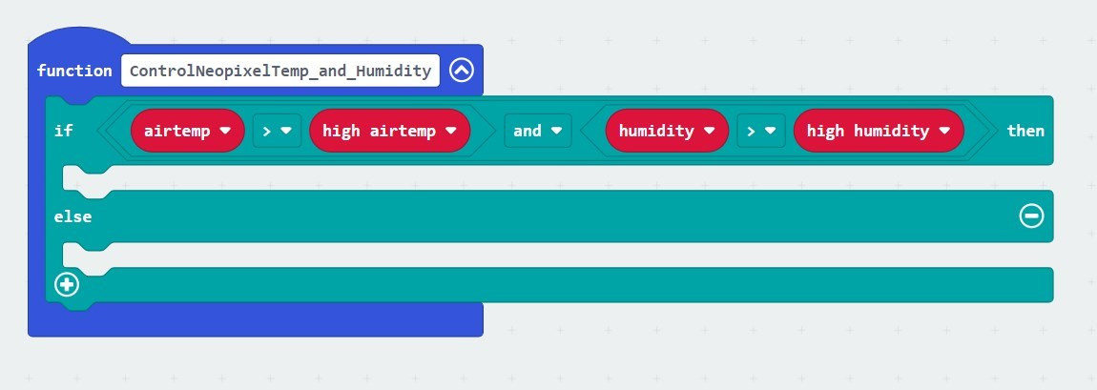
Challenge #1 Solution (cont.)

Slide 23
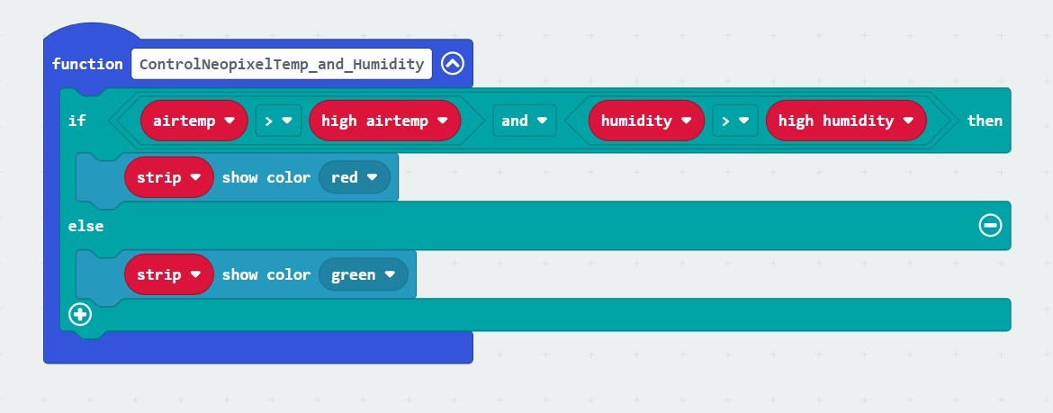
Challenge #1 Solution (cont.)

Slide 24
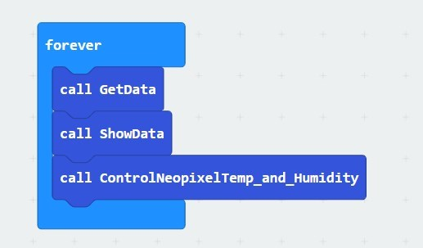
Challenge #1 Solution (cont.)

Slide 25
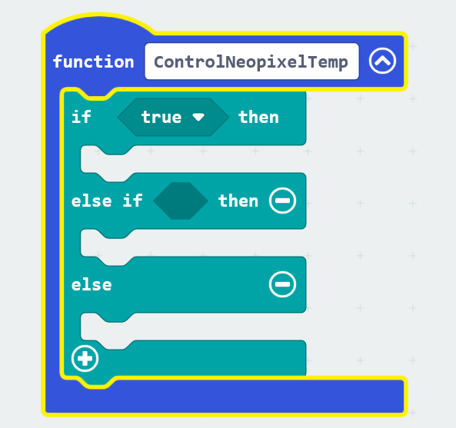
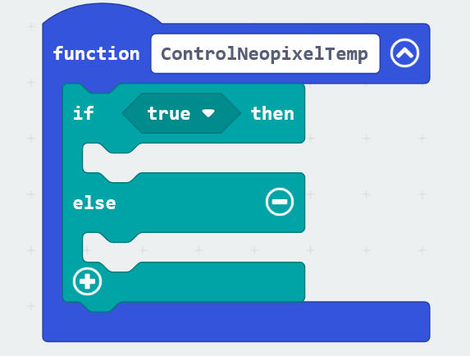
Challenge #2 Solution

Slide 26
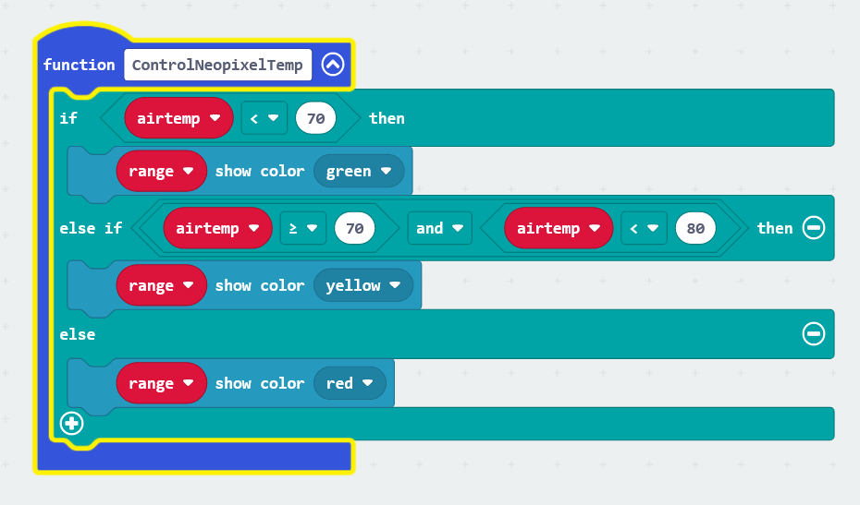
Challenge #2 Solution (cont.)

Slide 27
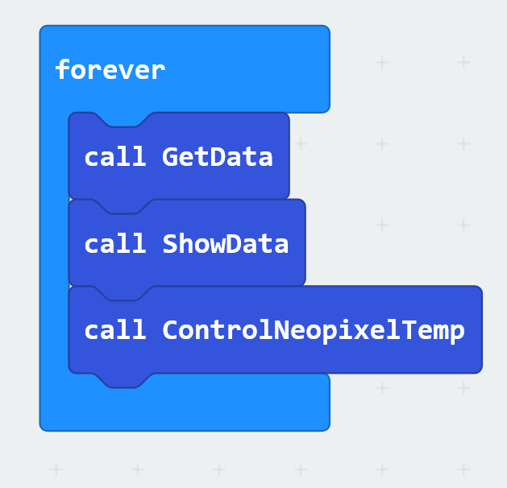
Challenge #2 Solution (cont.)

Slide 28
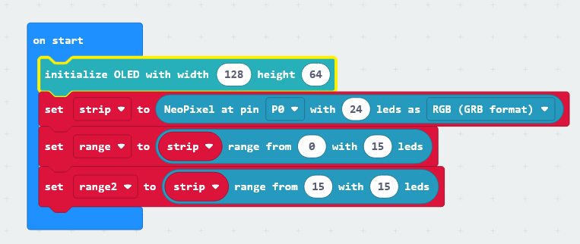
Challenge #3 Solution

Slide 29
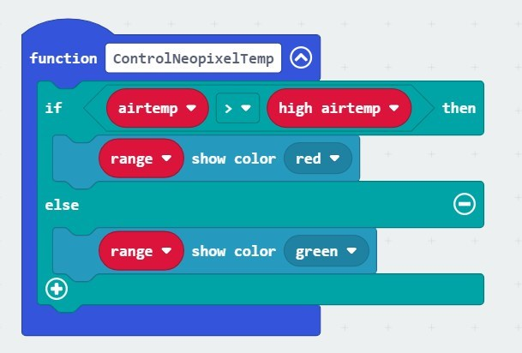
Challenge #3 Solution (cont.)

Slide 30
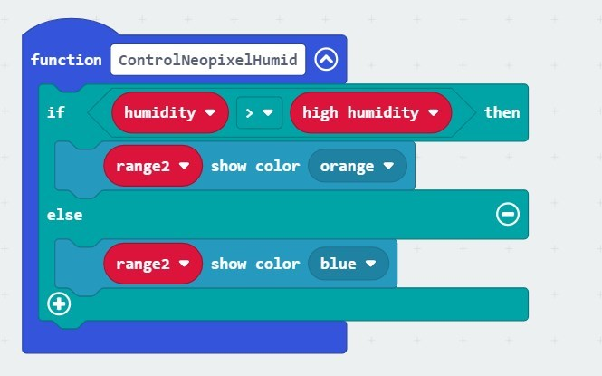
Challenge #3 Solution (cont.)

