Slide 1
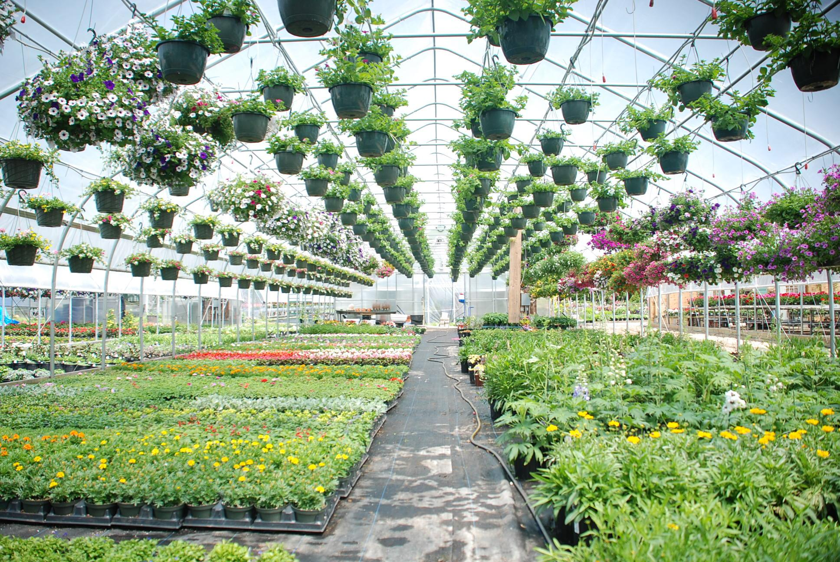
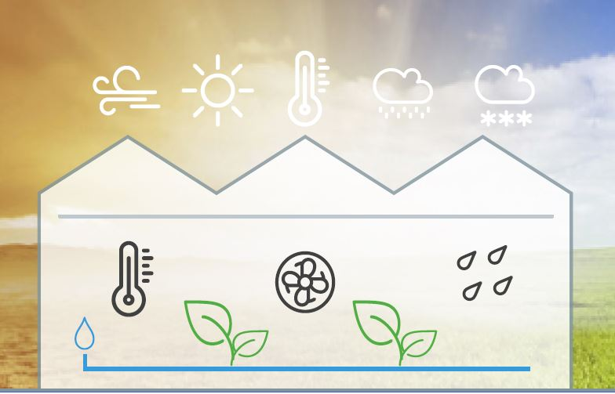
Lesson 2:
Using Temp/Humidity Sensor and OLED Screen

Slide 2
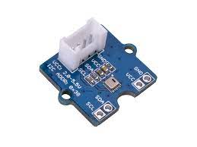
Part 1:
AHT20 (Air Humidity and Temperature) Sensor

Slide 3
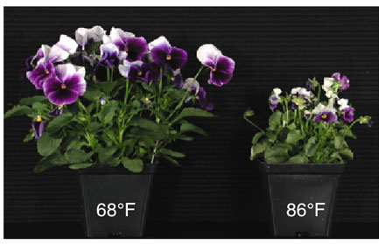
If you were this plant?
What temperature would you grow best at?

Slide 4
What are some factors that impact the health of a plant?
Think-pair-share as many factors as you can!

Slide 5
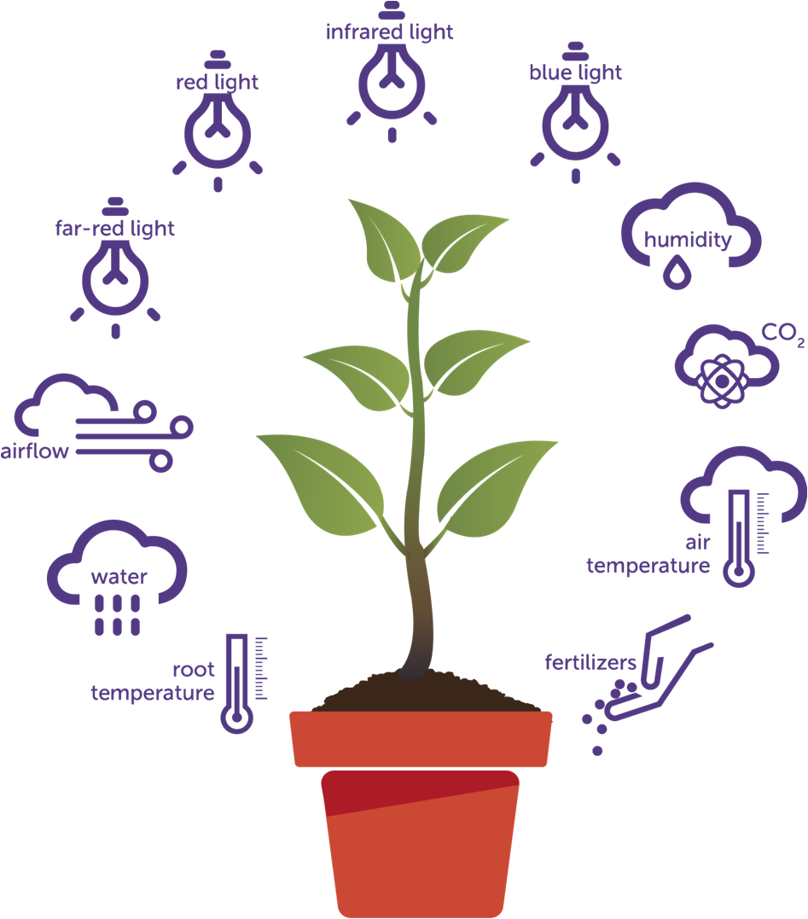
The Environment and Plants
There are many environmental conditions that impact the health of a plant
We are going to focus on:
Air Temperature
Humidity
Light
Air Flow (fresh air)

Slide 6
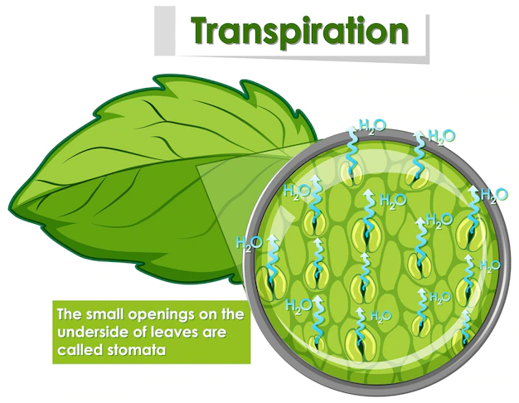
Why is temperature important to plants?
Plants SWEAT!!
Transpiration!
Transpiration- release of water through stomata (openings in the leaves)
Plants release water vapor to help cool themselves
  Just like us!!!!

Slide 7
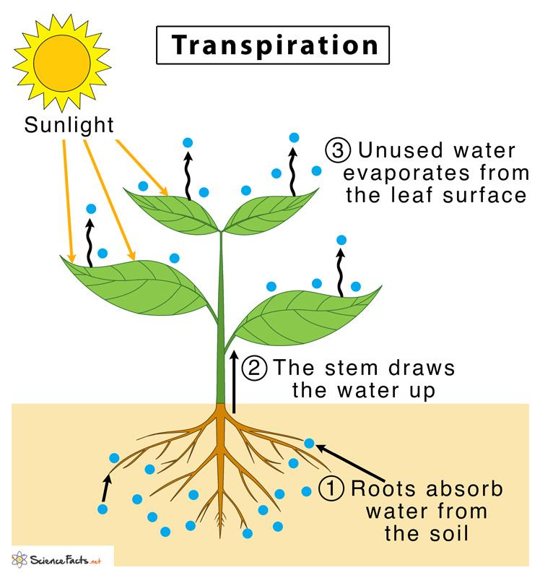
Higher temperatures mean a higher rate of transpiration.

Slide 8
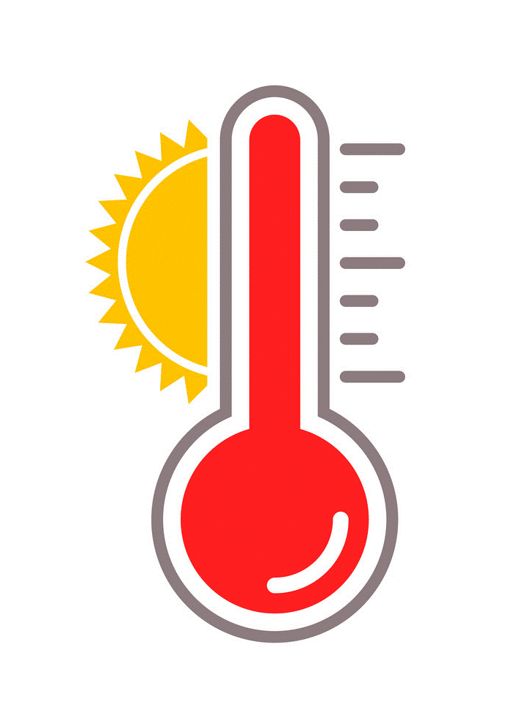
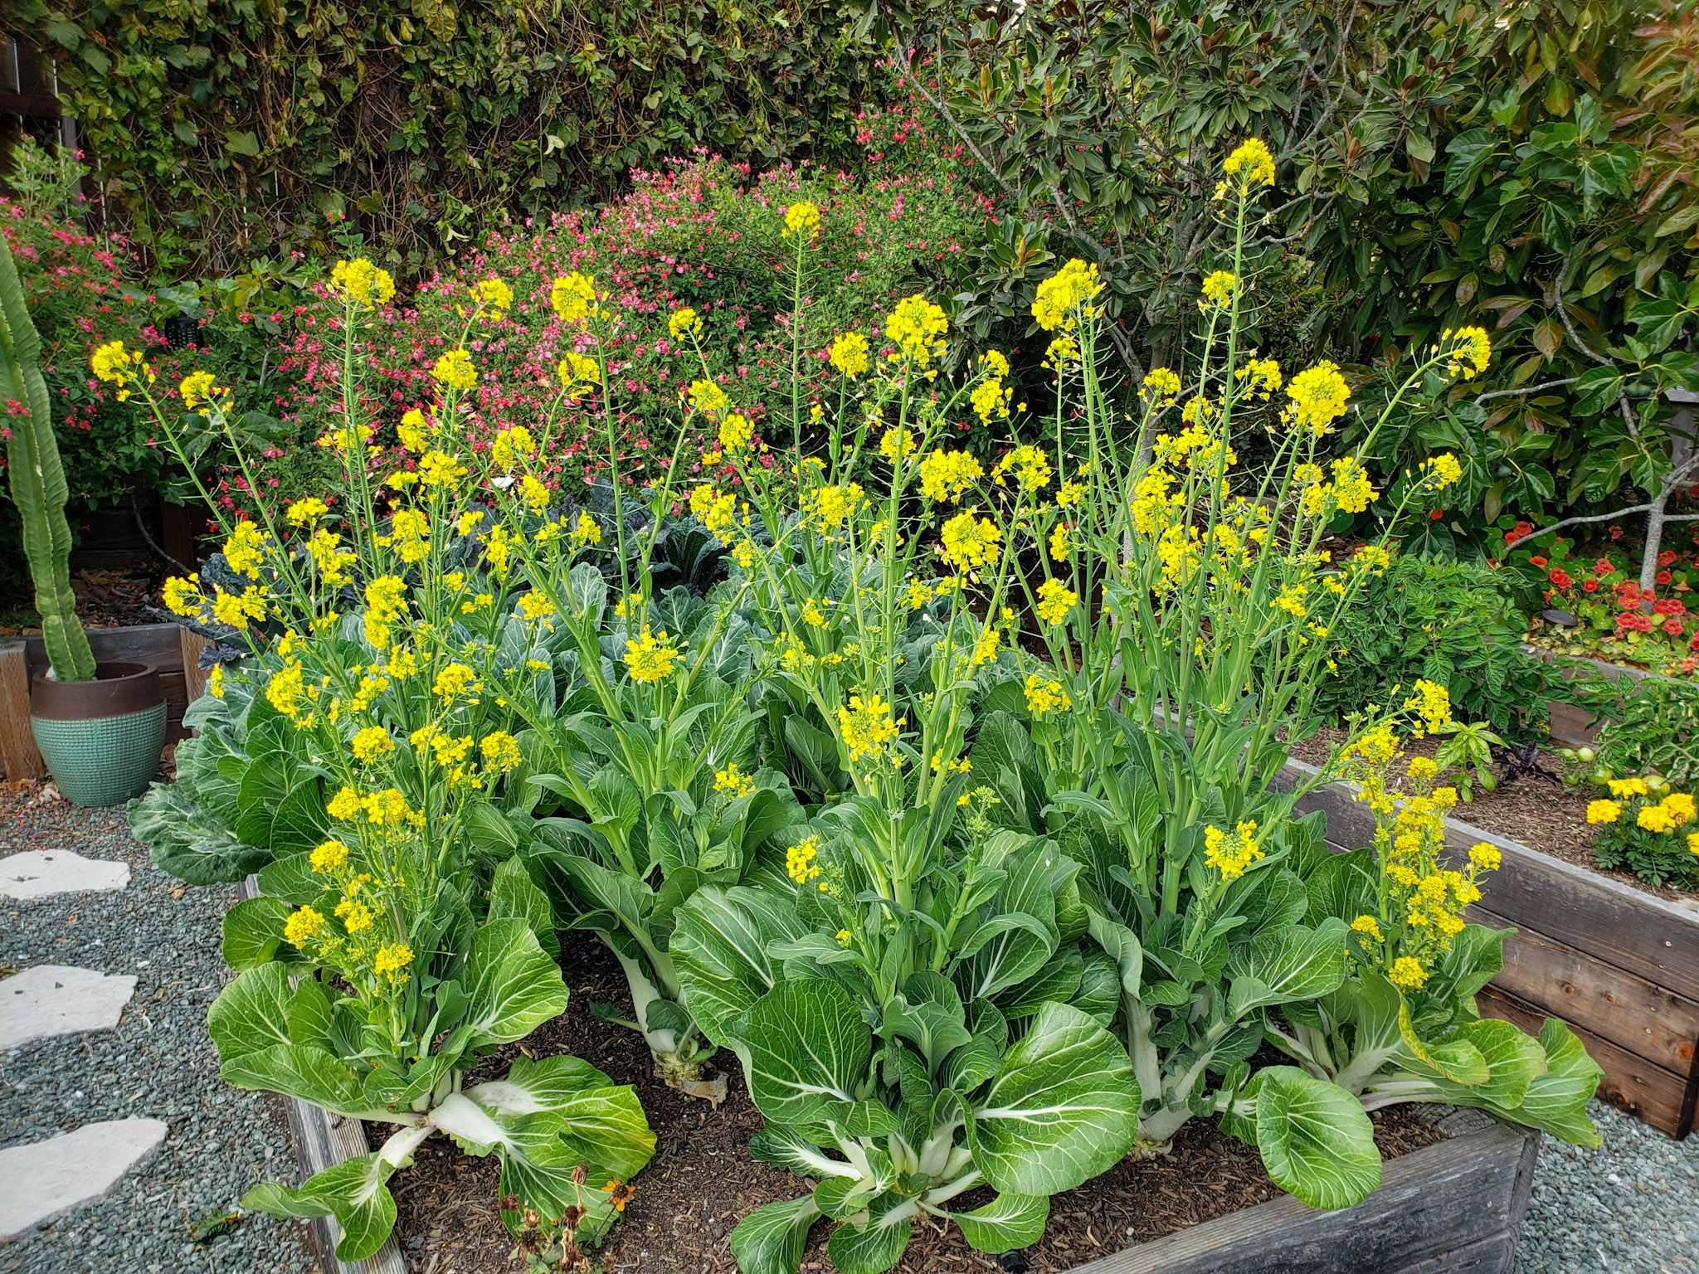
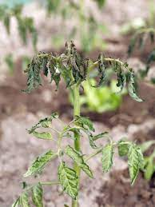
Also, if it is too HOT…
Plants feel stress and start the process of seed production too early (bolting)
They may also wilt
Most plants like 65-80 ℉ (18-27 ℃)

Slide 9
Be sure to research the optimal temperature for your plants!

Slide 10
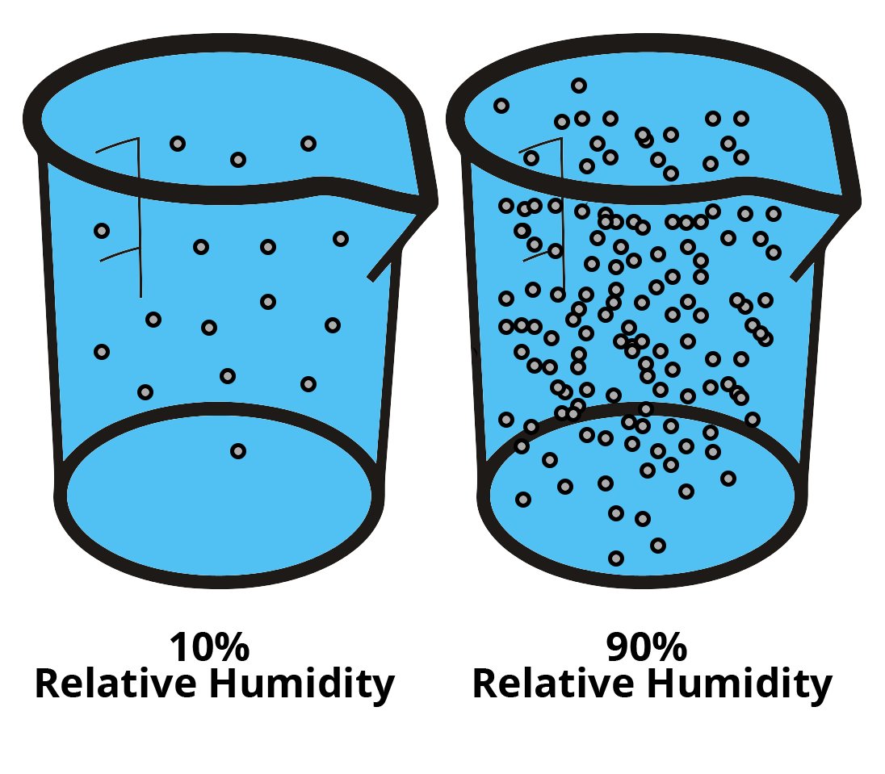
What is humidity and why is it important to plants?
Think of relative humidity as how much water vapor the air can hold
Humidity is influenced by temperature and therefore by amount of transpiration!

Slide 11
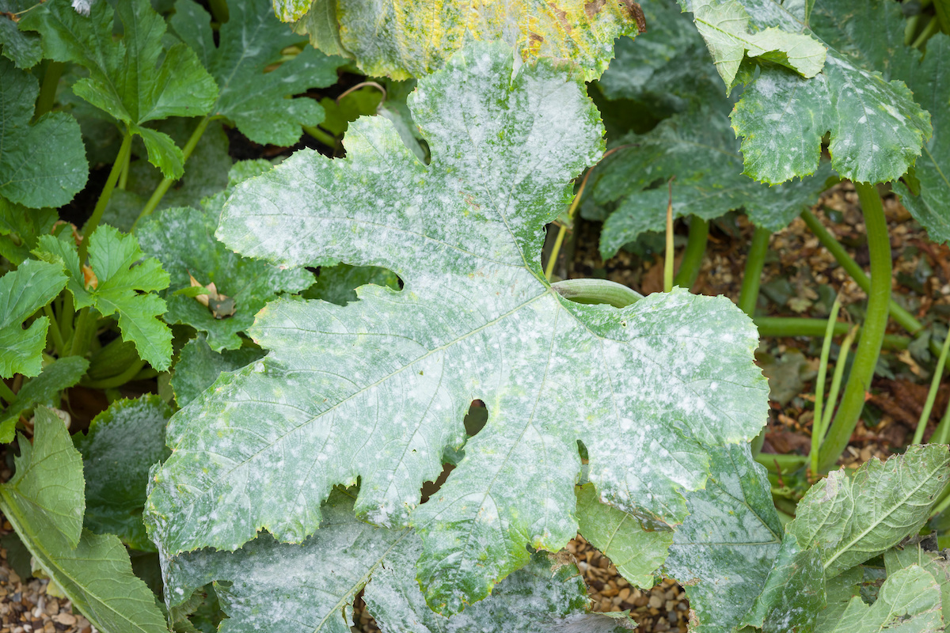
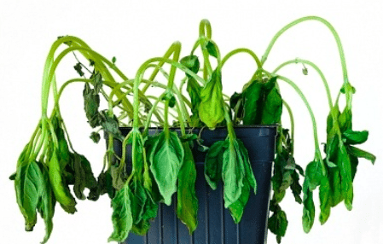
High humidity can result in mold and mildew on plants.
Low humidity can cause plants to dry out and need more water.

Slide 12
Be sure to research the optimal humidity for your plants
It will likely be higher than what humans prefer–maybe 60-80% humidity…

Slide 13
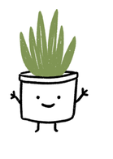
So what are good conditions for happy plants?
Most plants - not that different than humans
Happy from 65-80 °F (18-27 °C) during the day and 60-70 °F (16-21 °C) at night
Plants tend to like it more humid than us humans
A good relative humidity number is 60%

Slide 14
How can we monitor the conditions for our plants?

Slide 15
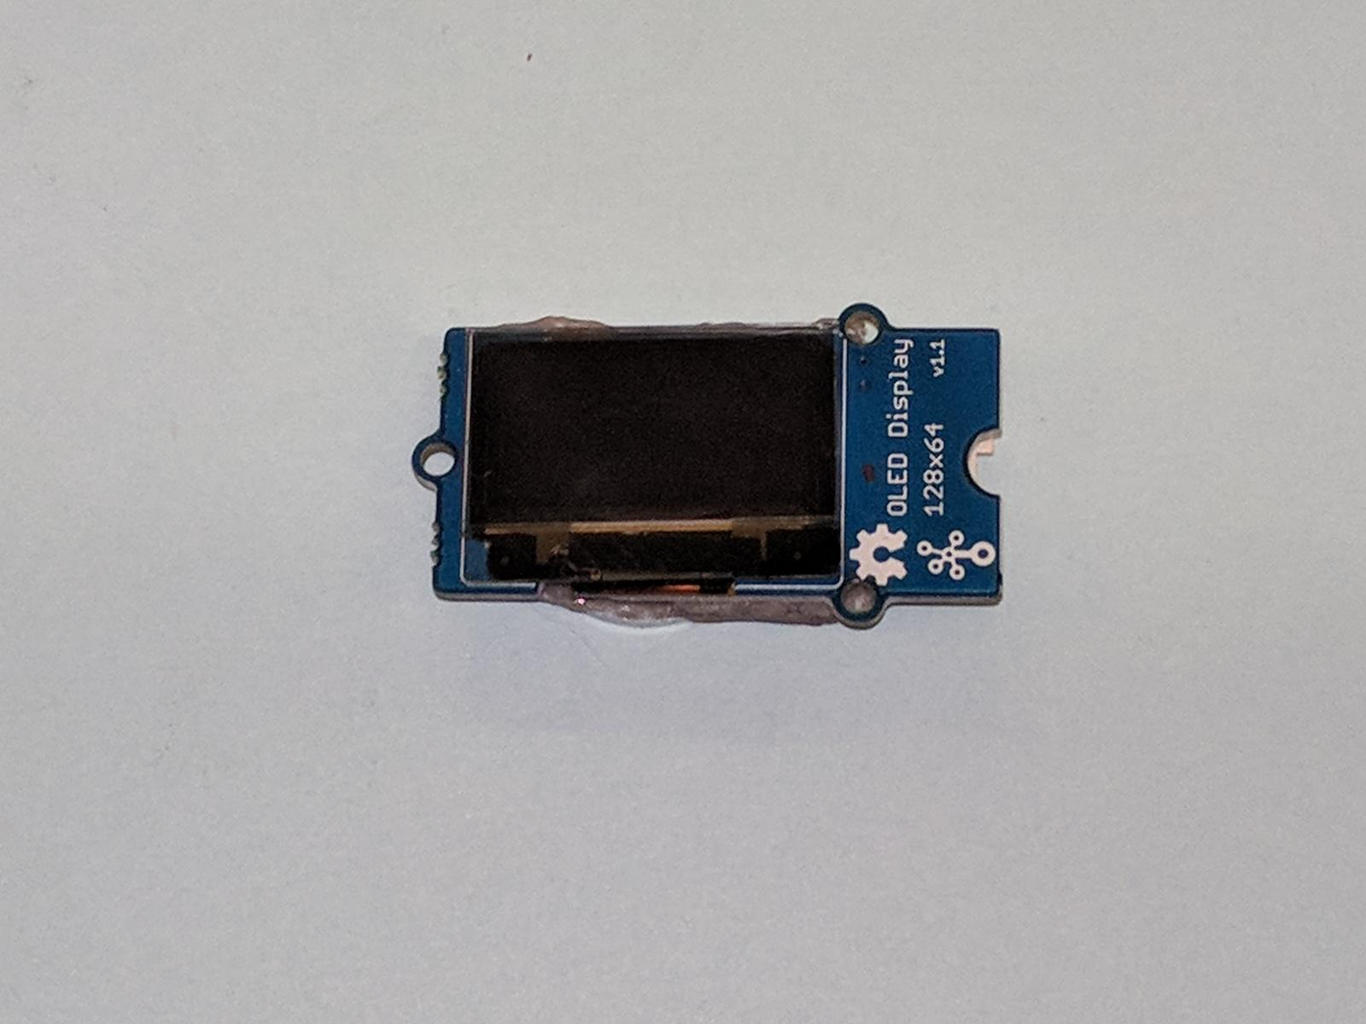
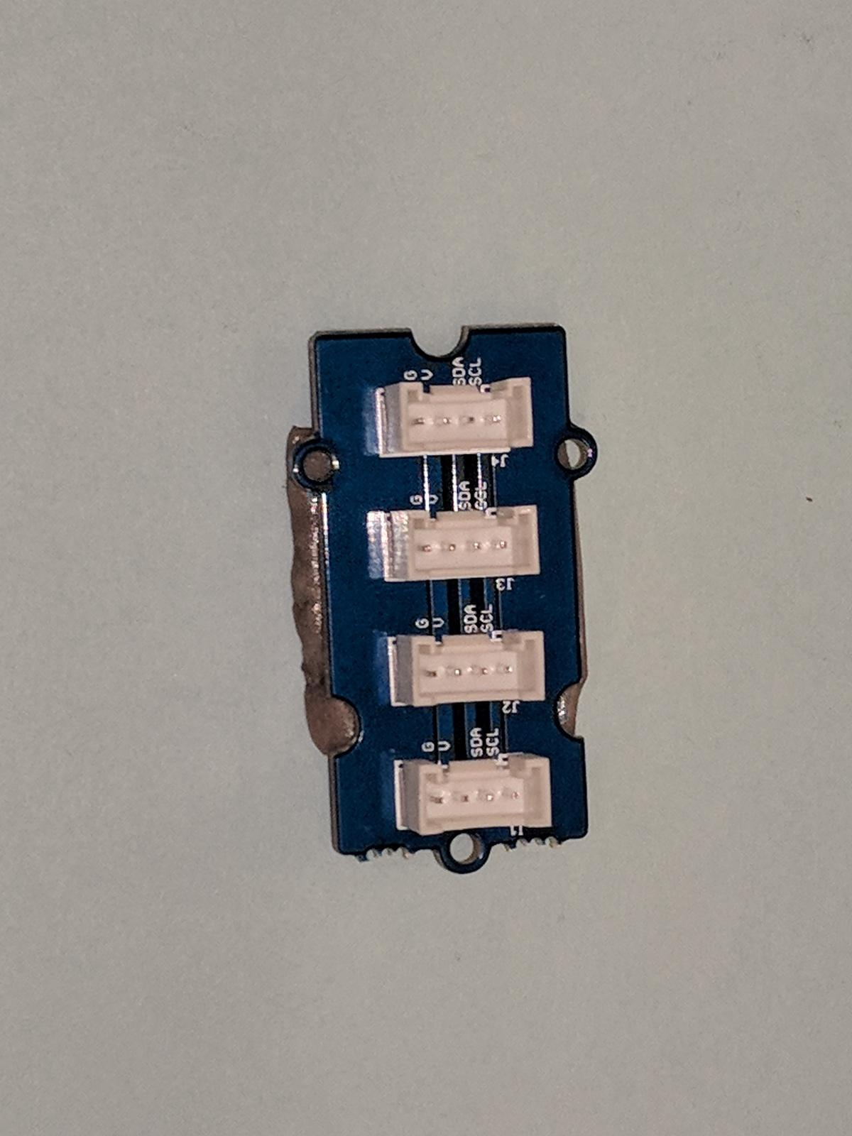
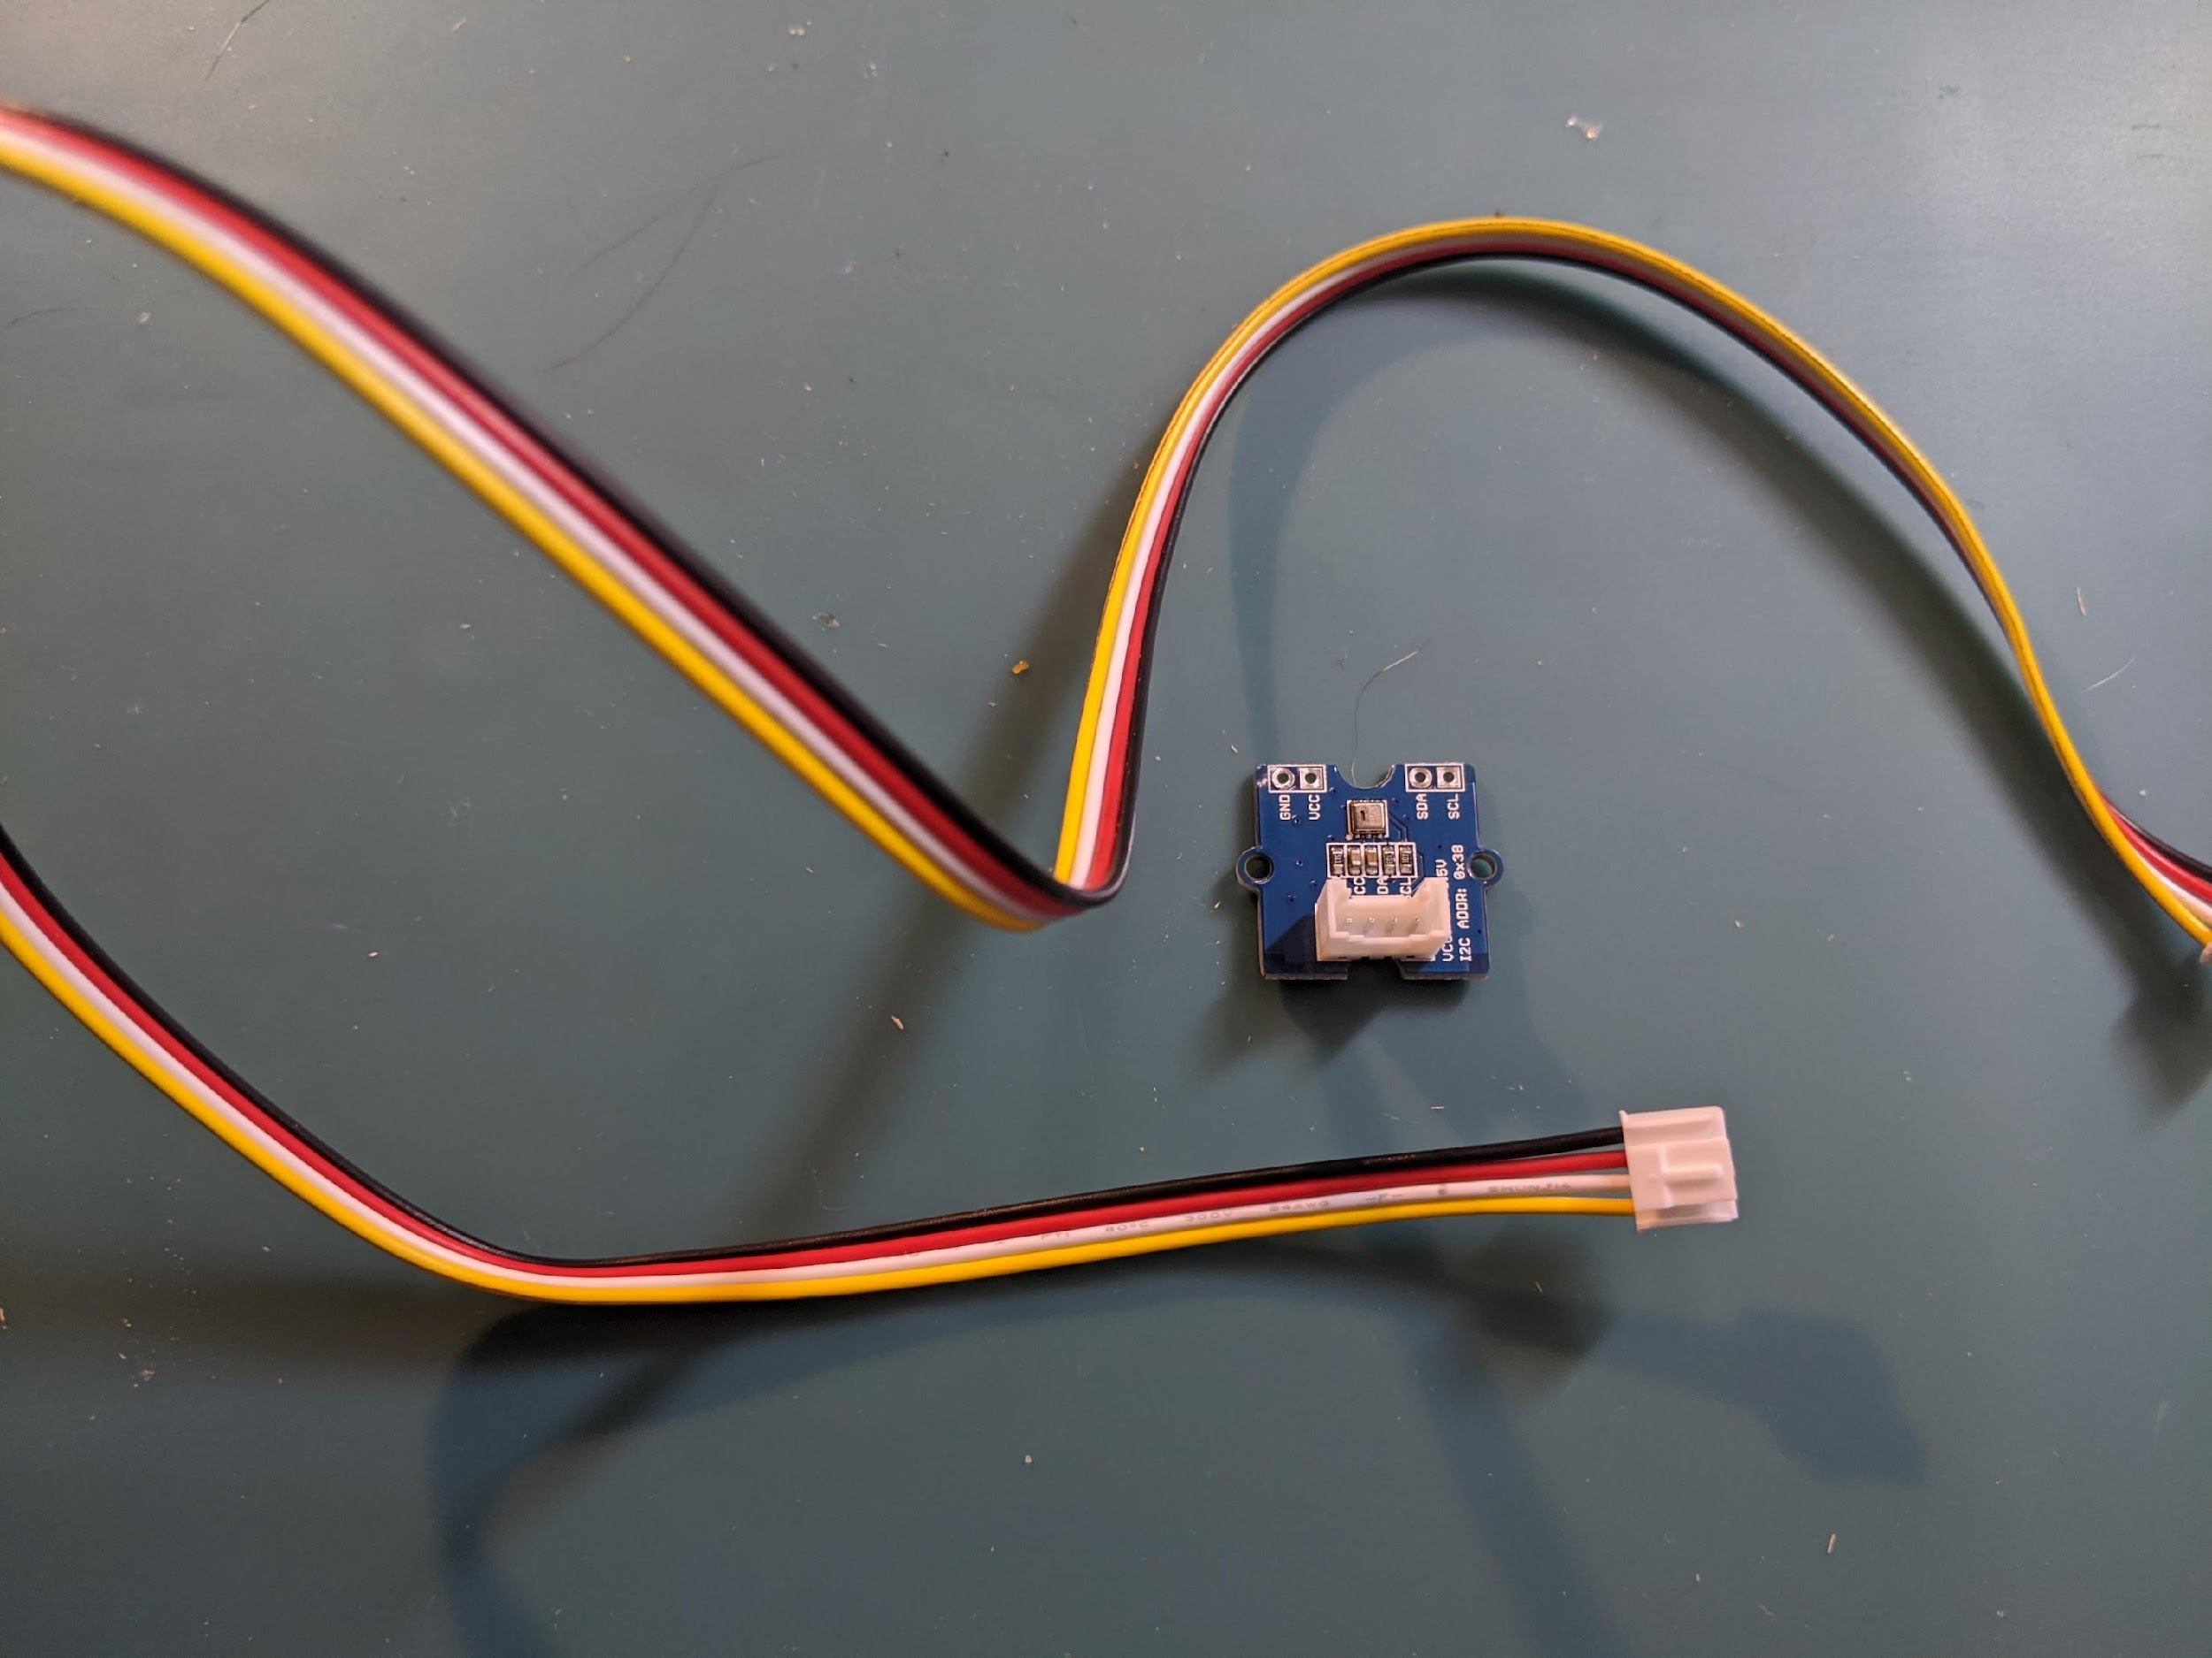
What we need:
Microbit & Shield and USB cable - just like before
AND
An AHT (Air Humidity/Temperature Sensor) and 2 four pin wires
An OLED screen
A I2C Hub
AHT Sensor
OLED Screen
I2C Hub
Four Pin Wires

Slide 16
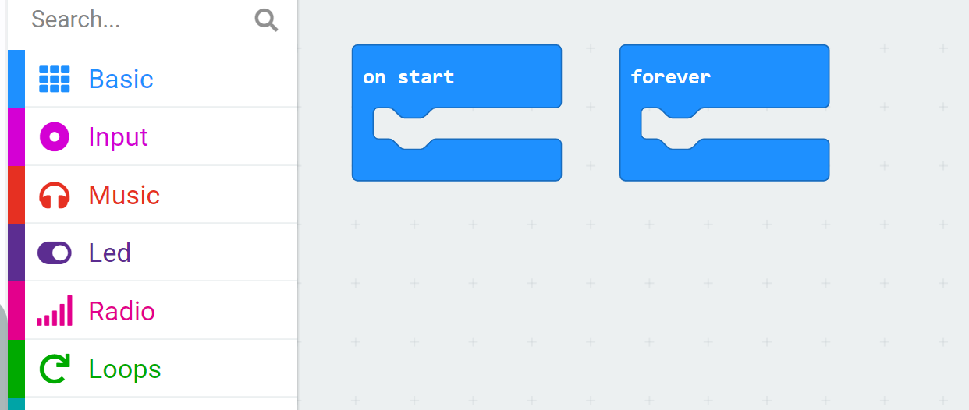
Step 1: Go to Makecode.microbit.org
Open your Project “My Greenhouse”
Delete any coding blocks from “On Start” and “Forever”

Slide 17
Remember from Lesson 1
An EXTENSION allows us to use new tools and sensors that aren’t automatically recognized by micro:bit. Think of an extension as adding a library of blocks that allow you control a new sensor

Slide 18

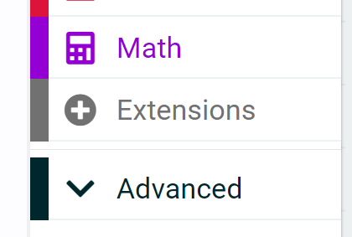
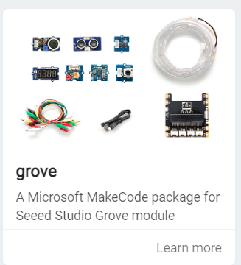

Step 2: We need a new extension!
Click on Extensions
Search for “grove”
Click on the grove extension

Slide 19
Step 3: Create variables
Refresher: What is a variable?
Something that CHANGES or varies
Variable is a box where we can store data.
For example, in “Airtemp” variable, we can store the data of the air temperature we collect from a sensor.

Slide 20
Two types of variables:
Independent Variable:
What the EXPERIMENTER or the DESIGNER changes
Would be graphed on the x-axis
Example: Do we put one fan or two fans in our greenhouse?
Dependent Variable:
What is MEASURED (affected by the independent variable)
Would be graphed on the y-axis
Example: Measure the TEMPERATURE with one fan and with two fans

Slide 21
Step 3: Create variables
These are what we are going to MEASURE with the sensor
We will be measuring ___________ and ____________________.
Let’s create these variables!
humidity
air temperature

Slide 22
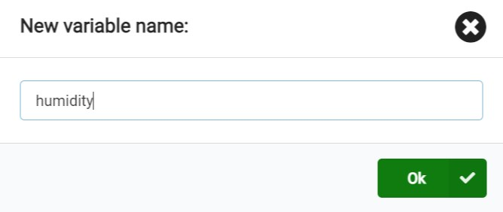
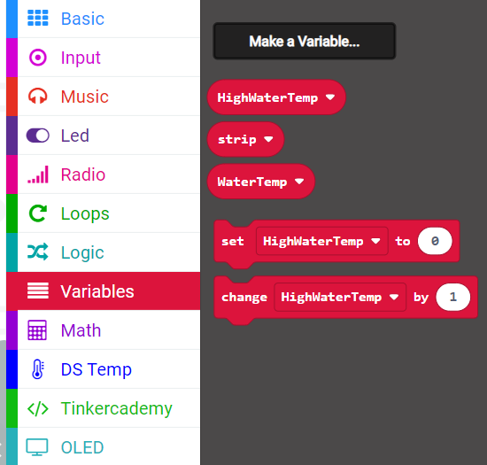
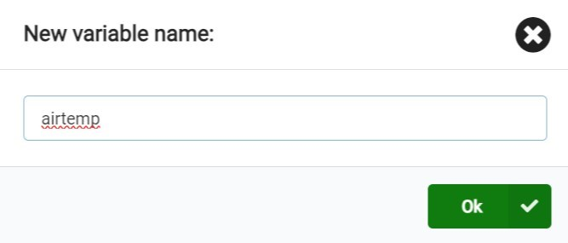
Step 3: Create Variables
Go to the Variables block
Make TWO Variables:
humidity
airtemp

Slide 23
Step 4: How to get the readings or data???
We are going to make a function. A function is a set of code-blocks that will be used over and over again.
A function is a PART of our larger code. It has an important job to do!
Think about a soccer team. A function is like one of the positions, for example, “Striker”. The role of striker is different than a midfielder.
It takes ALL of the positions working together to make the team. Similarly, we will have many functions working together to make our greenhouse smart!

Slide 24
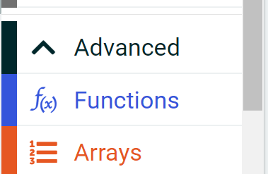
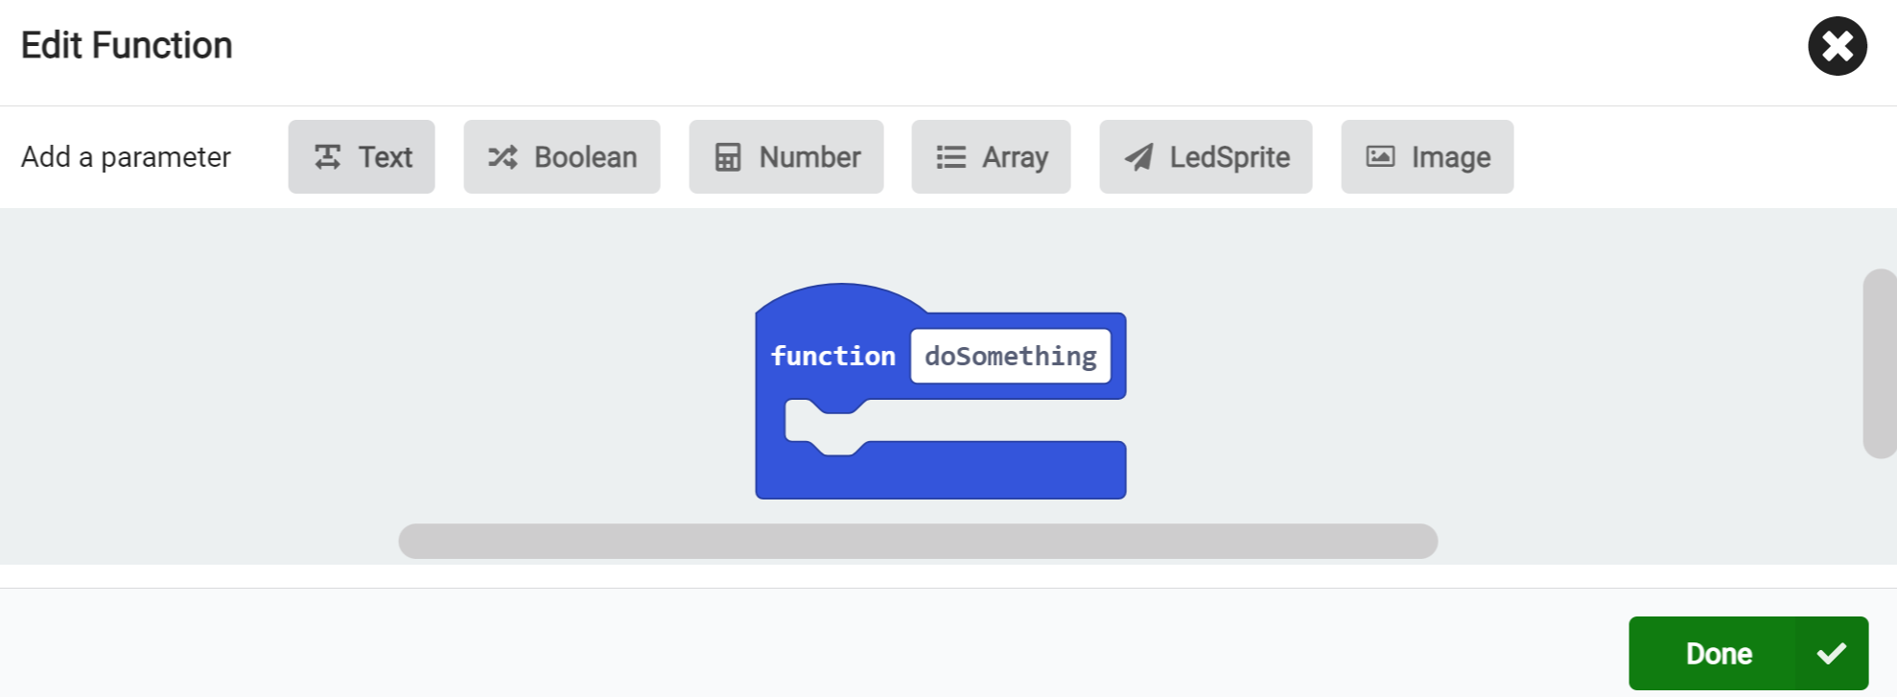
Functions can be found under Advanced.
“Make a Function” then change the name of the Function to GetData

Slide 25
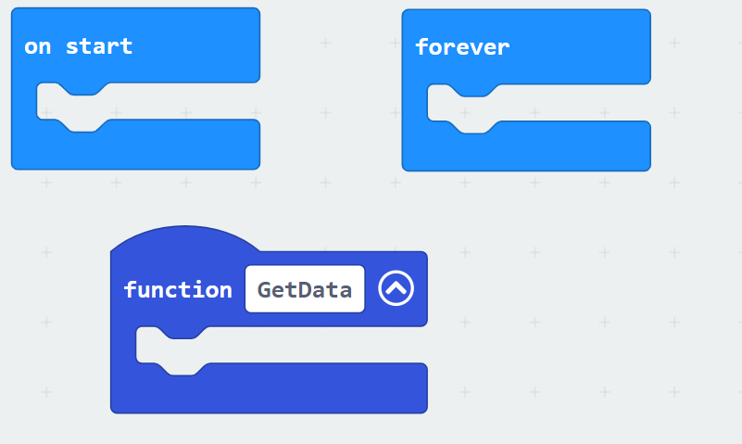
Your program should look like this now:

Slide 26
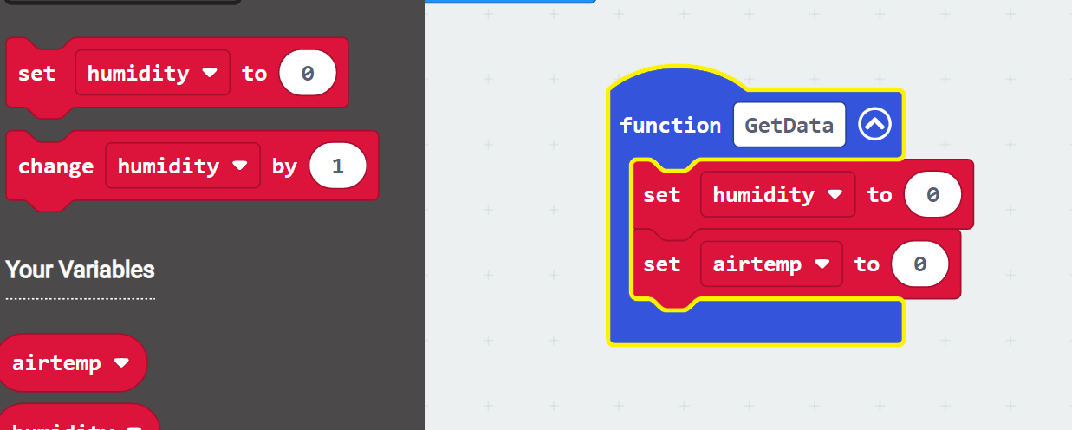
Step 5: Drag the new variables into the get data function
From the Variables block drag the “set humidity (or airtemp) to 0” block to the “GetData” function TWO times
Use the dropdown to make sure one says humidity and one says airtemp

Slide 27
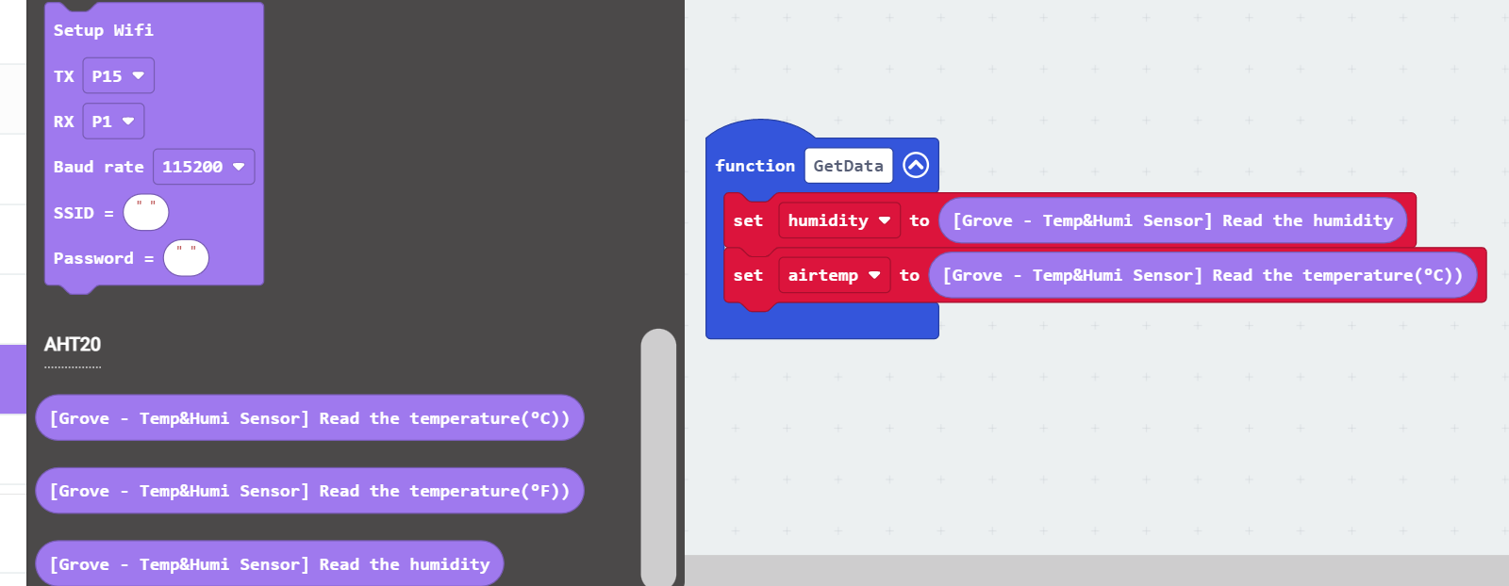
Step 6: The GROVE extension has the coding blocks needed to read the humidity and temperature
From the Grove Block drag the “Read the humidity” and “Read the temperature” blocks to replace the 0 in the “set air temp” and “set humidity” blocks

Slide 28
NOTE! You choose whether you will get the data in ℃ or in ℉
But you need to be consistent throughout your code!

Slide 29

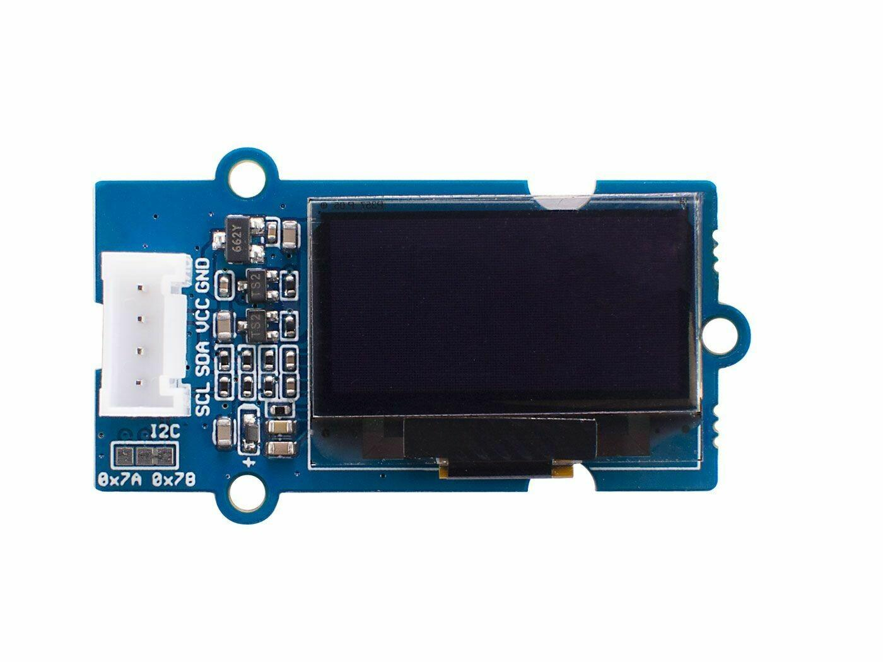
Lesson 2, Part 2: How can I SEE the Data?
We will use a screen!

Slide 30

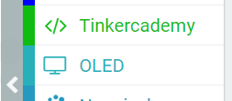
Step 1: Installing an extension to use the screen
Click on extensions and type the word tinker search box
Click on the tinkeracademy-tinker-kit extension
Now you have a new OLED block
OLED = Organic Light Emitting Diode –
Carbon Film that when electricity hits the film,
it lights up

Slide 31
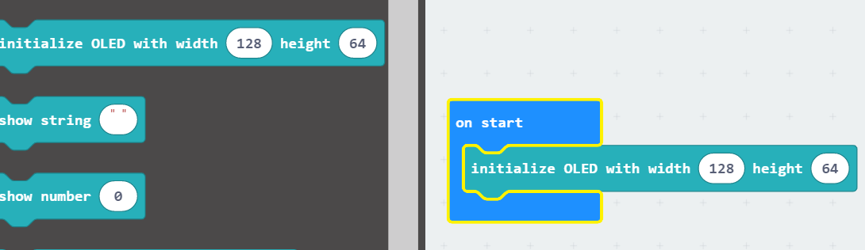
Step 2: Tell Micro:bit that a screen will be attached
Drag the initialize block to the on start block.
You do not need to change anything here.

Slide 32


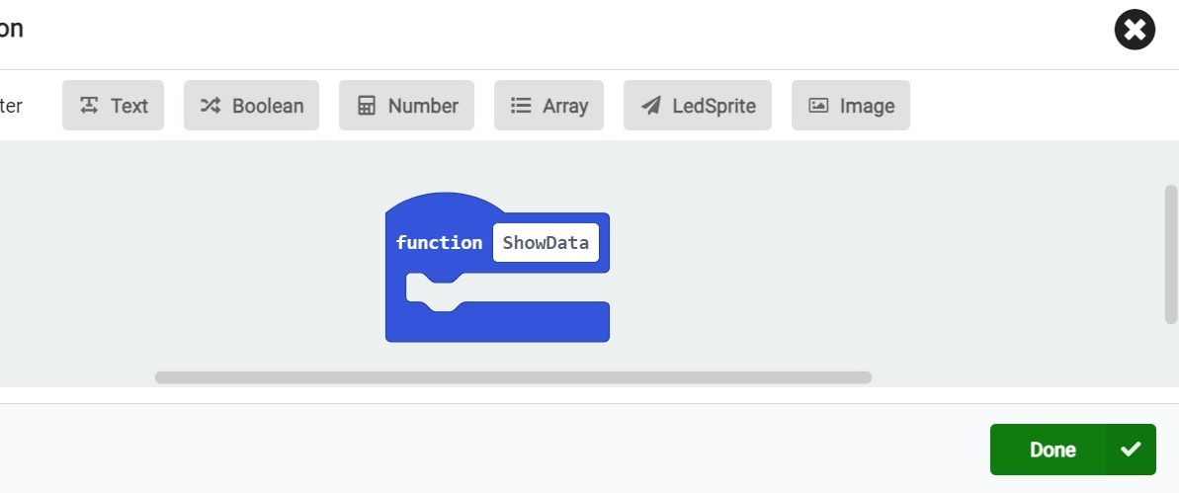
Step 3: Make another function: ShowData
We want to SHOW our data so make a ShowData Function
Click on
Name the function
"ShowData” and
click Done

Slide 33
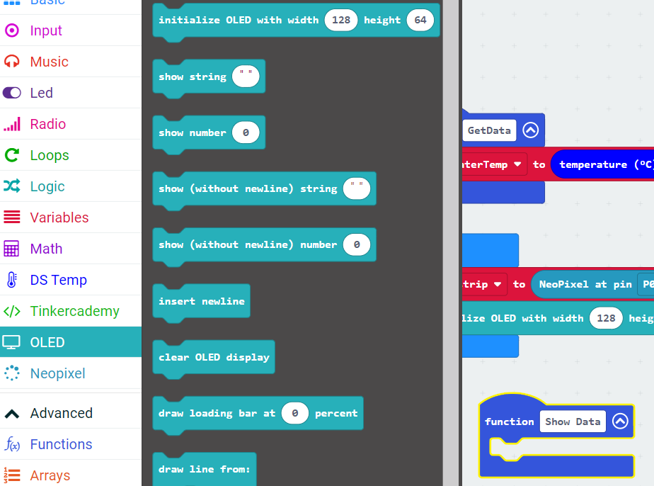
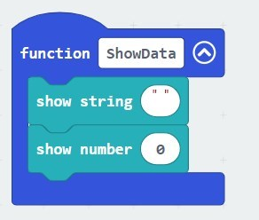
Step 4: Show the data on the screen
Drag Show String and Show Number from the OLED block to function Show Data
(Be careful, do NOT use the blue “show string” or “show number” from Basic!)

Slide 34
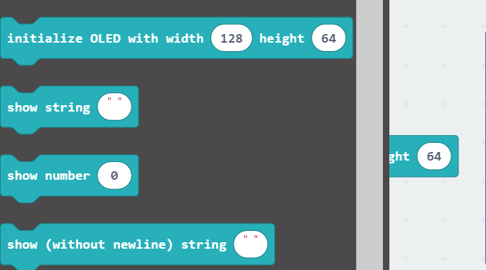
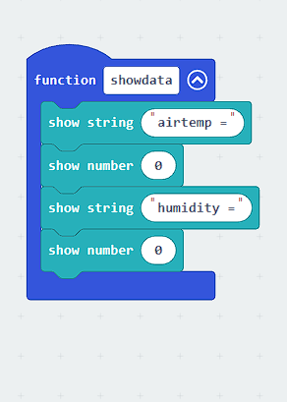
Step 4 continued: Copy blocks of Show String and Show Data and add the text as in the photo.

Slide 35
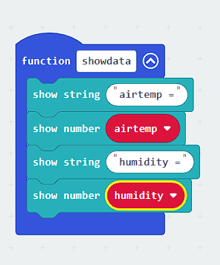
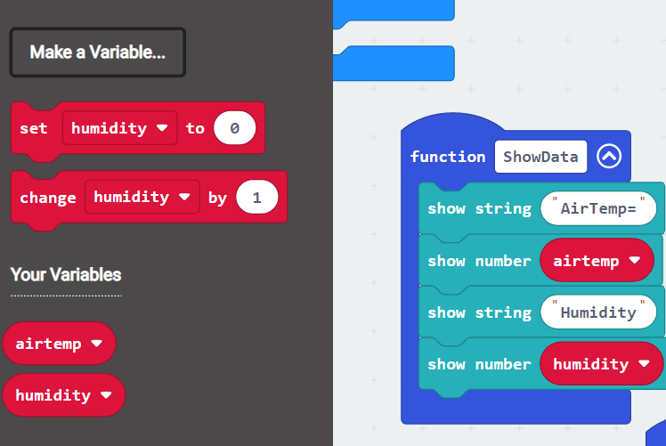
Step 4 cont: Show data on screen
From Variables drag “airtemp” to replace the 0 in “show number” under the corresponding “show string”
From Variables drag “humidity” to replace the 0 in “show number” under the corresponding “show string”

Slide 36
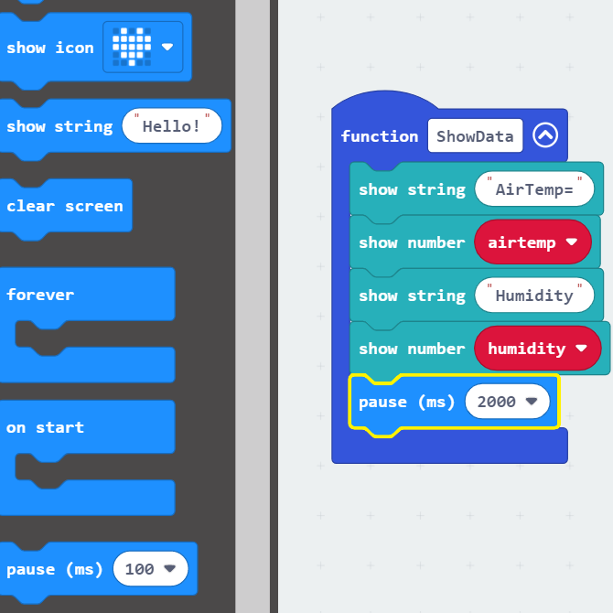

Step 4 continued: Slow down
The micro:bit will go so fast what we won’t be able to read the data so we need to slow it down.
From the
  Drag Pause and change to 2 seconds (2000ms)
(If you download the code now, the screen will fill up with letters and numbers, so we need to do another step to clear screen after showing the data for a few seconds)

Slide 37
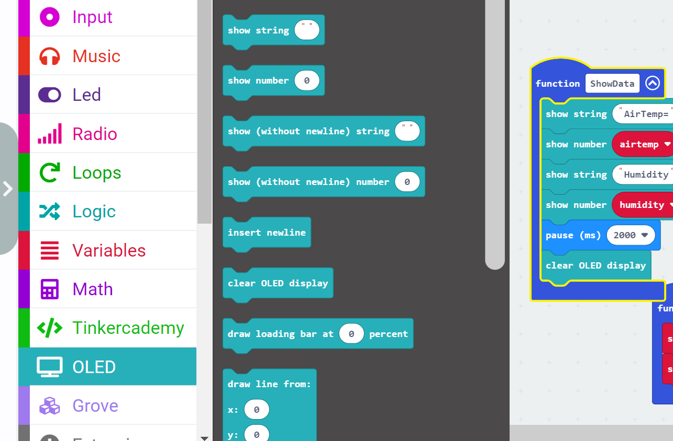
Step 4: Continued: Clearing your screen
From the OLED block drag the “clear OLED display” block to the bottom of your ShowData Function
This will erase your screen so it won’t fill up!

Slide 38
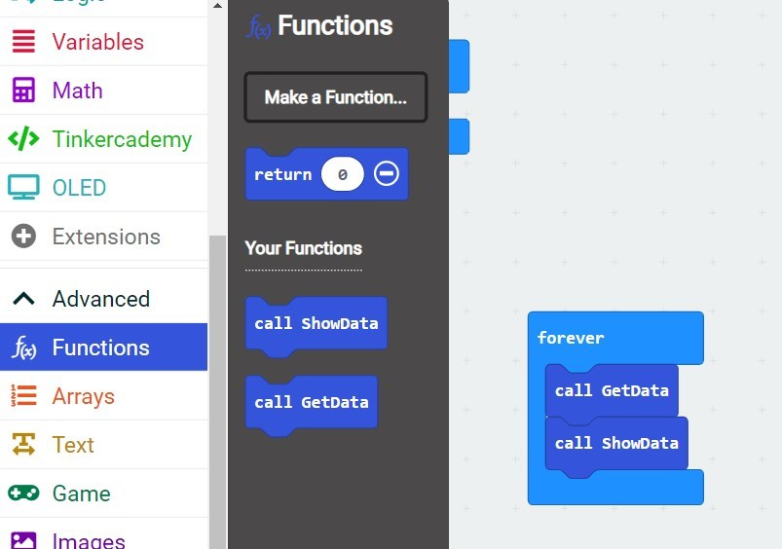
Step 5: Call your Functions!
Once you create any Function, you need to tell your program to RUN that Function
In programming, this is often called “Calling” the Function
From Functions drag
call GetData and
call ShowData into the
forever loop

Slide 39

Almost there! What is the next step?
Step 6: Download the program to your micro:bit

Slide 40
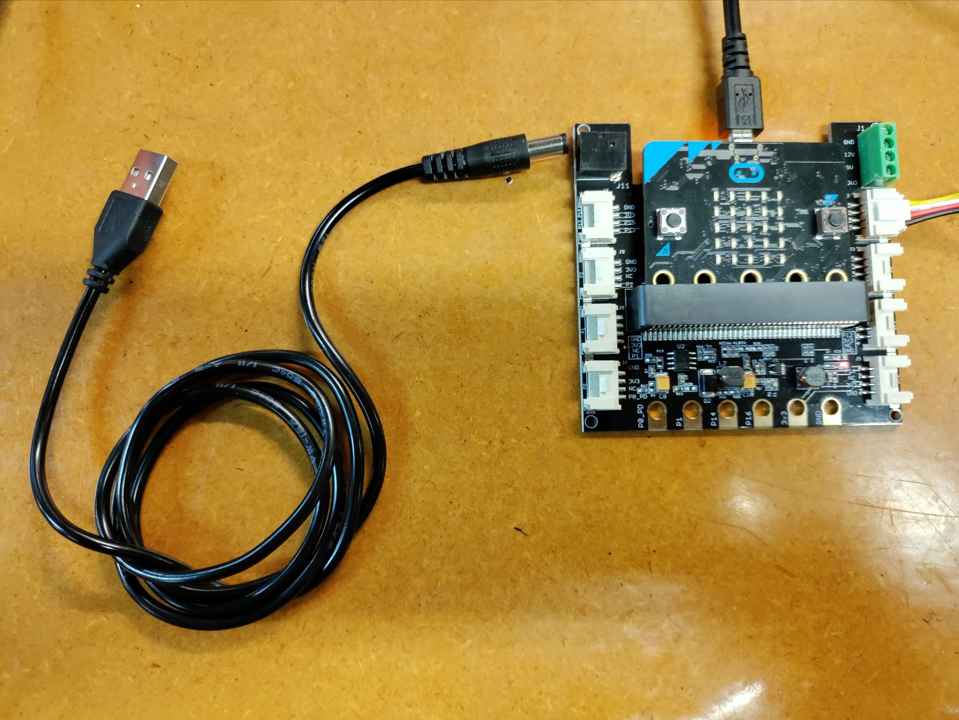
Step 7: Complete your circuit
POWER! We are no longer powering our shield attachments via the micro:bit! The micro:bit cord is ONLY for downloading code!
THIS photo shows how you should be powering now…the 5V cord should be plugged into an outlet and NOT your Chromebook!

Slide 41
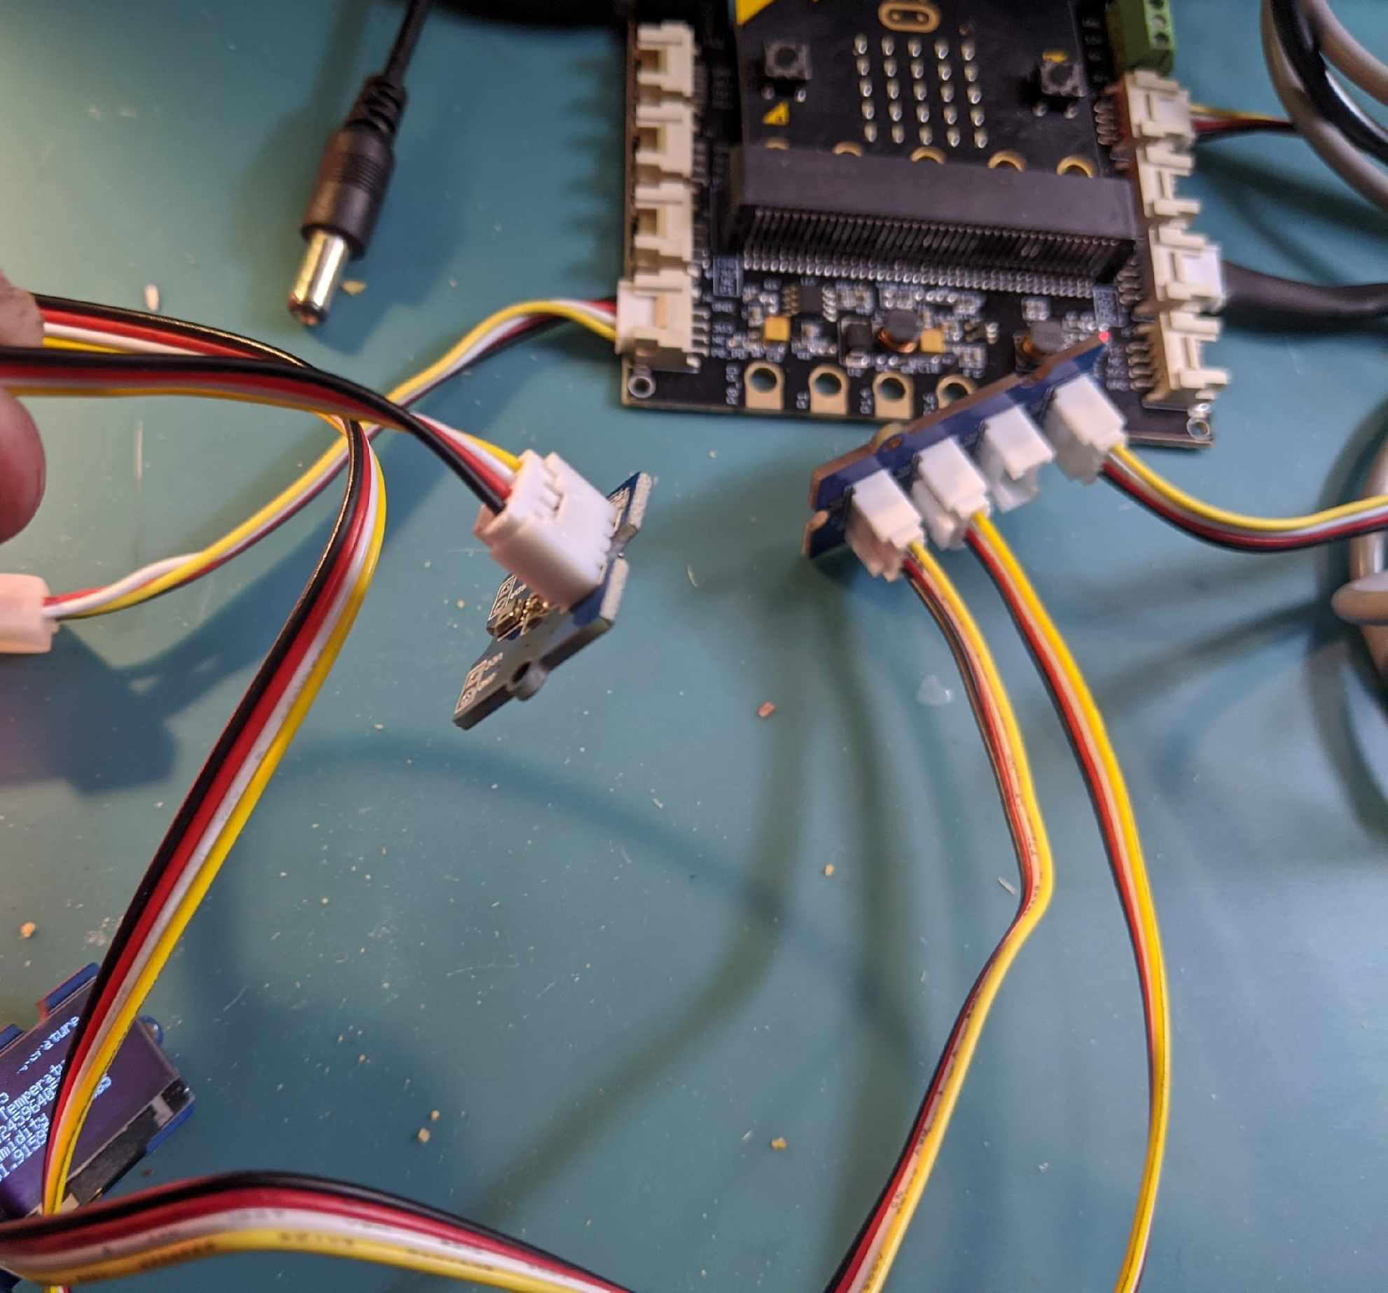



Step 7: Complete your circuit (cont.)
Plug the AHT20 (Air Temp/Humidity) Sensor into the I2C hub
Plug the OLED screen into the I2C hub
Plug the I2C hub into the pin just under the green box on the shield
Plug your micro:bit into the shield
You should now see data on your OLED screen!

Slide 42
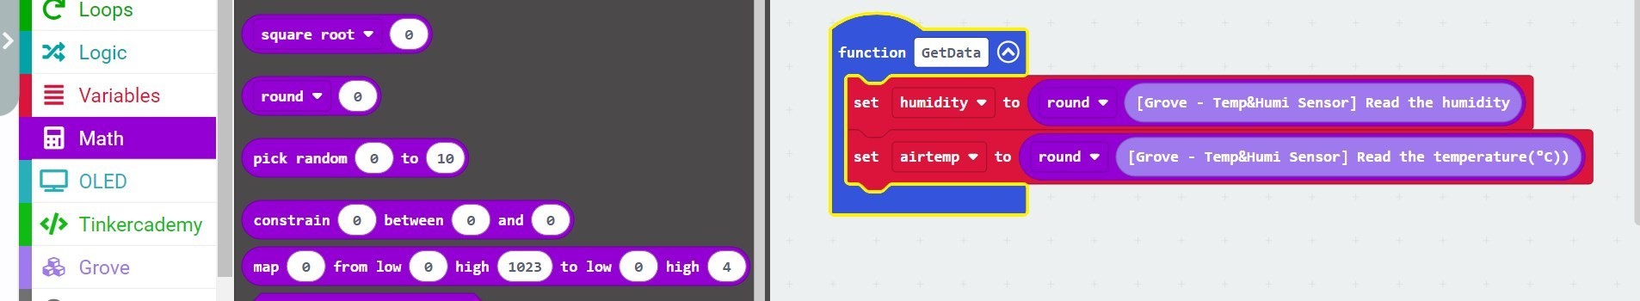
Rounding the temperature and humidity numbers!
You may see a lot of decimal numbers, like 28.34235352…, we can fix it.
* Go to the Math Extension and find the “round” block
* Place the “round” block in the GetData Function as shown.

