Slide 1
A Dream for the Academy
Denver 2002

Slide 2
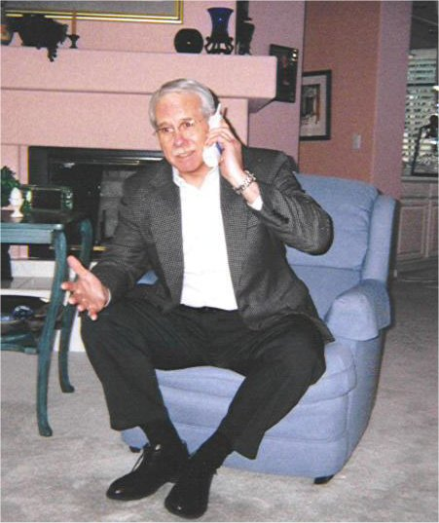
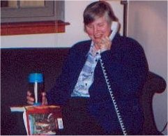
A Dream
for the
Academy
Denver 2002

Slide 3
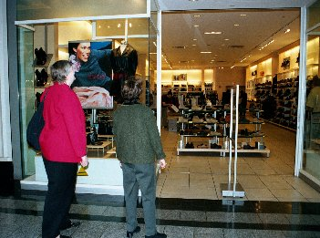
A Dream
for the
Academy
Denver 2002

Slide 4
A Dream
for the
Academy
Denver 2002

Slide 5
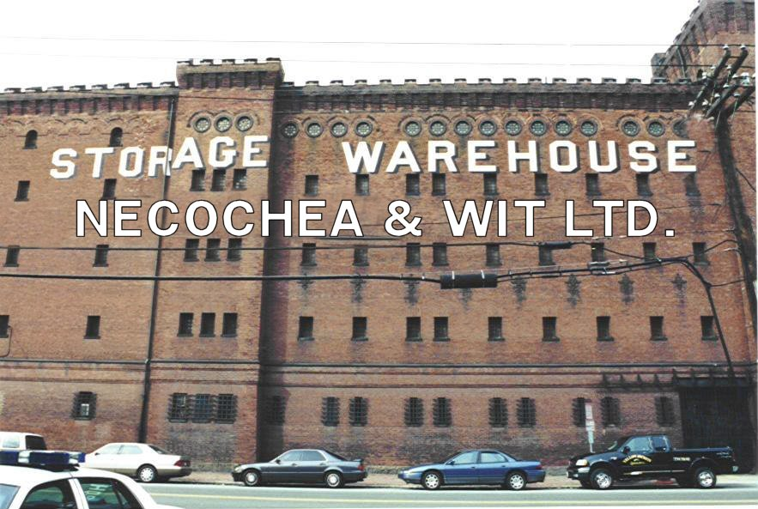
A Dream
for the
Academy
Denver 2002

Slide 6
A Dream
for the
Academy
Denver 2002

Slide 7
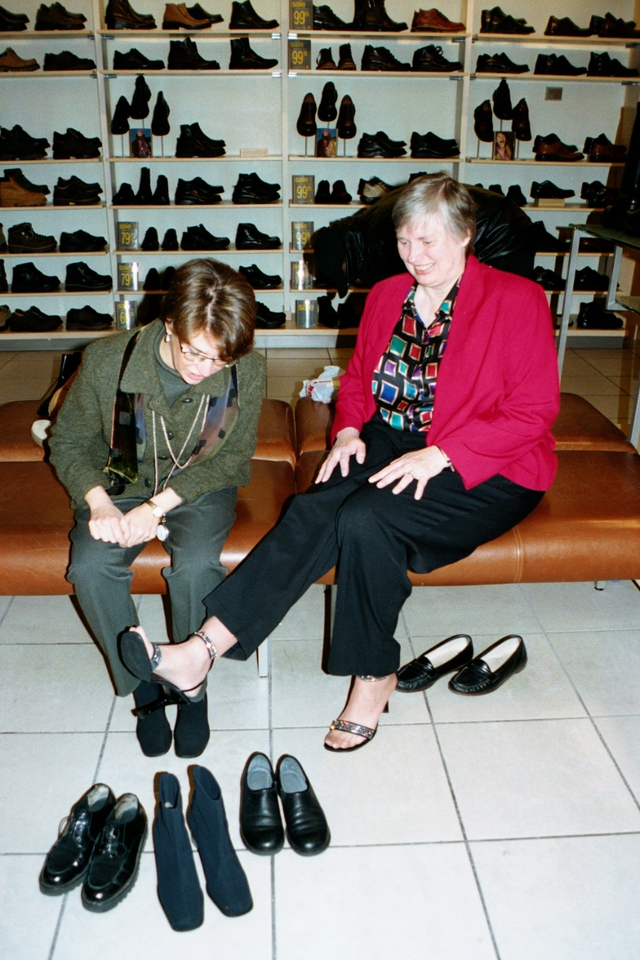
A Dream
for the
Academy
Denver 2002

Slide 8
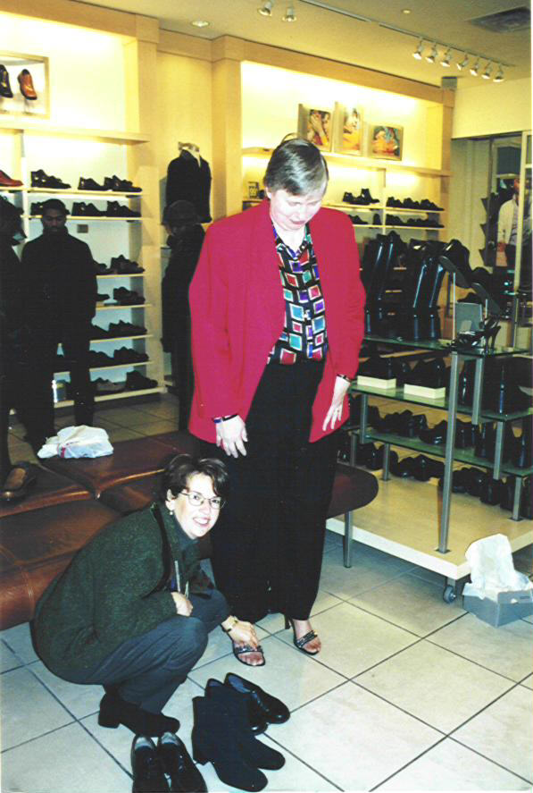
A Dream
for the
Academy
Denver 2002

Slide 9
A Dream
for the
Academy
Denver 2002

Slide 10
A Dream
for the
Academy
Denver 2002

Slide 11
Cable Fraud Arrests; Founder, Sons Accused of Looting Adelphia
Tyco Workers Say Faith in Company is in Shambles
A Dream
for the
Academy
Denver 2002
A Worldcom Whopper; Company Reports It Overstated Earnings by $3.8B
Enron and the Culture of Greed
Andersen Shredded: Jury Finds Audit Firm Guilty of Obstruction

Slide 12
A Dream
for the
Academy
Denver 2002

Slide 13
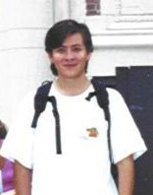
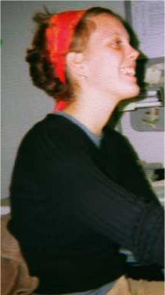
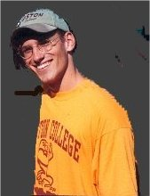
A Dream
for the
Academy
Denver 2002
Raul Necochea
Mirjam Wit
Frank Klemovitch

Slide 14
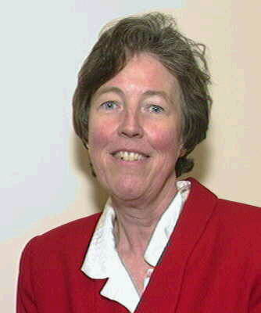
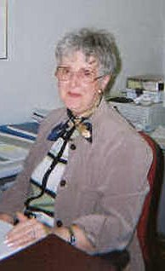
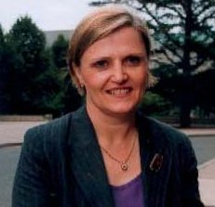
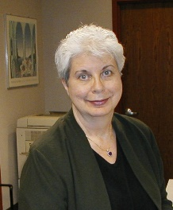
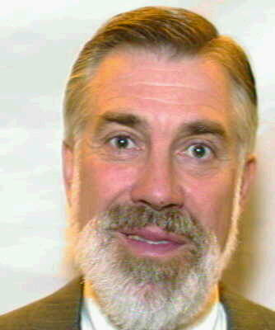
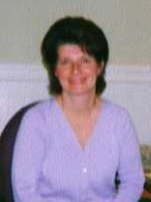
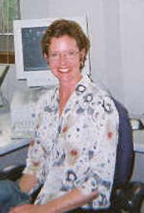
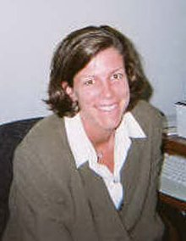
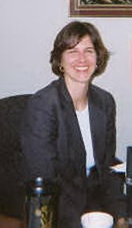
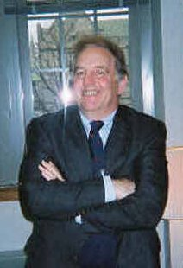
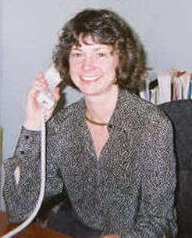
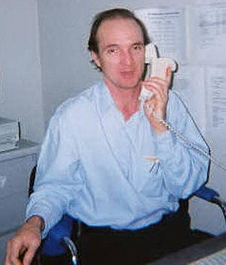
Helen Peters
Barbara
Vichnichi
Nancy
Powers
Jean Passavant
A Dream
for the
Academy
Denver 2002
Jack Neuhauser
Nancy Samya
Theresa Carey
Amy Lacombe
Shelly Skeens
Peter Rollins
Lori Egan
Charlie Sullivan

Slide 15
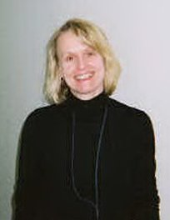
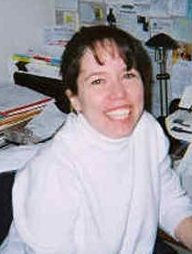
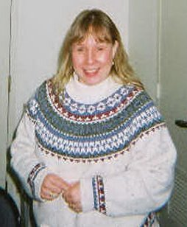
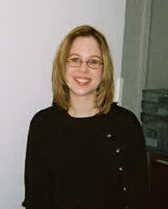
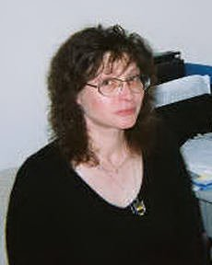
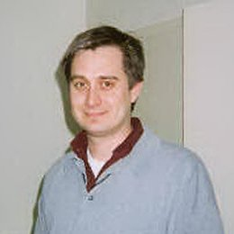
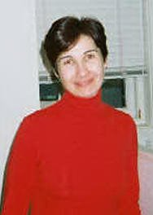
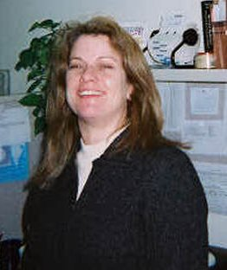
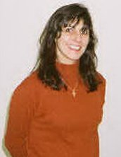
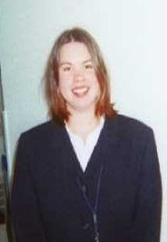
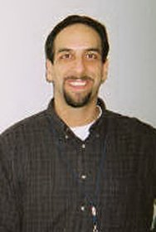
Nancy
Urbanowicz
Terese Loncar
Heather Crowe
Annmarie Koory
A Dream
for the
Academy
Denver 2002
Elena Bunin
R.J. Valeo
Alina Matay
Susan Zaid
Linda Panzer
Taryn Fiore
Matt Suppa

Slide 16
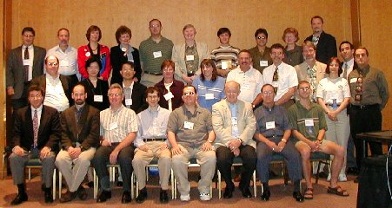
A Dream
for the
Academy
Denver 2002

Slide 17
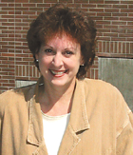
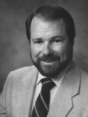
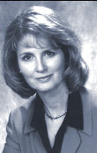
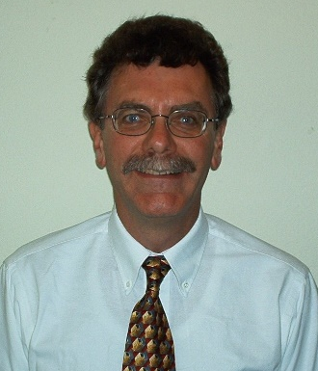
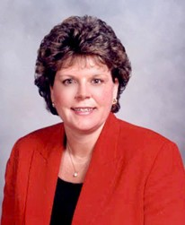
Committee Chairs
A Dream
for the
Academy
Denver 2002
Raymond Saner AOM Council
Nancy Leonard Placement
Eleanor O'Higgins International Theme
David Jamieson Practice Theme
Regina Greenwood Co-Historian
Stephen J. Havlovic Conference
Gordon Rands Environment
Geralyn Franklin Exhibitors

Slide 18
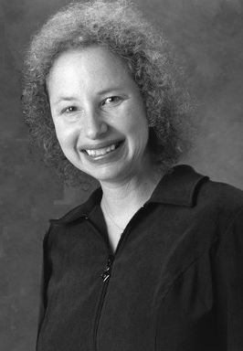
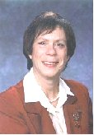
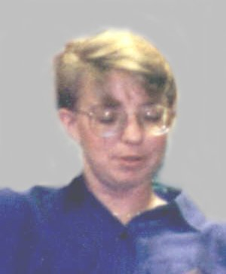
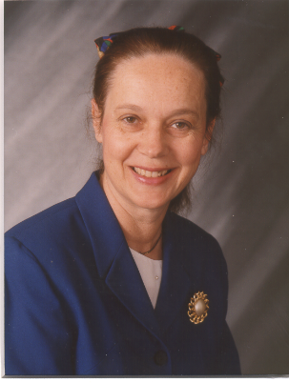
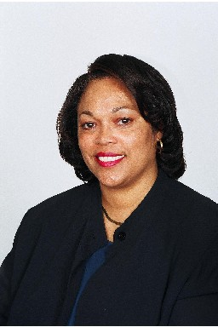
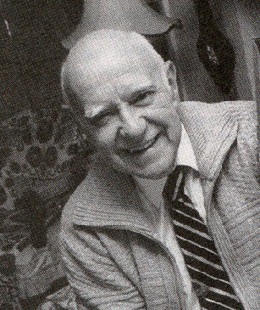
Committee Chairs
A Dream
for the
Academy
Denver 2002
Lisa Gundry Mentoring
Joan Weiner Teaching
Karen Whelan-Berry Sponsorships
Jane Whitney Gibson Membership
Joycelyn Finley-Hervey Mentoring
Charles Wrege Co-Historian

Slide 19
A Dream
for the
Academy
Denver 2002

Slide 20
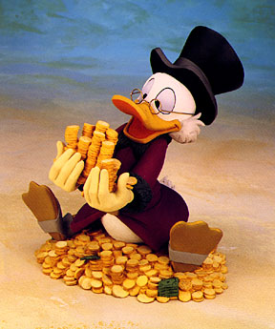
A Dream
for the
Academy
Denver 2002

Slide 21
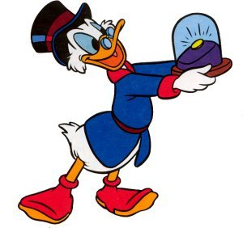
A Dream
for the
Academy
Denver 2002

Slide 22
A Dream
for the
Academy
Denver 2002

Slide 23
A - Z
A Dream
for the
Academy
Denver 2002

Slide 24
A Dream
for the
Academy
Denver 2002

Slide 25
A Dream
for the
Academy
Denver 2002

Slide 26
A Dream
for the
Academy
Denver 2002

Slide 27
Enron Scandal May Force Change of Ethics Rules
Bush Urges Tougher Penalties for Corporate Corruption
On Corporate Corruption:
Time to Jail CEOs
A Dream
for the
Academy
Denver 2002
Shareholders Rebel Against Huge Rewards for Failure
What Must Be Done?: The Experts Weigh in on How to Prevent Future Enrons

Slide 28
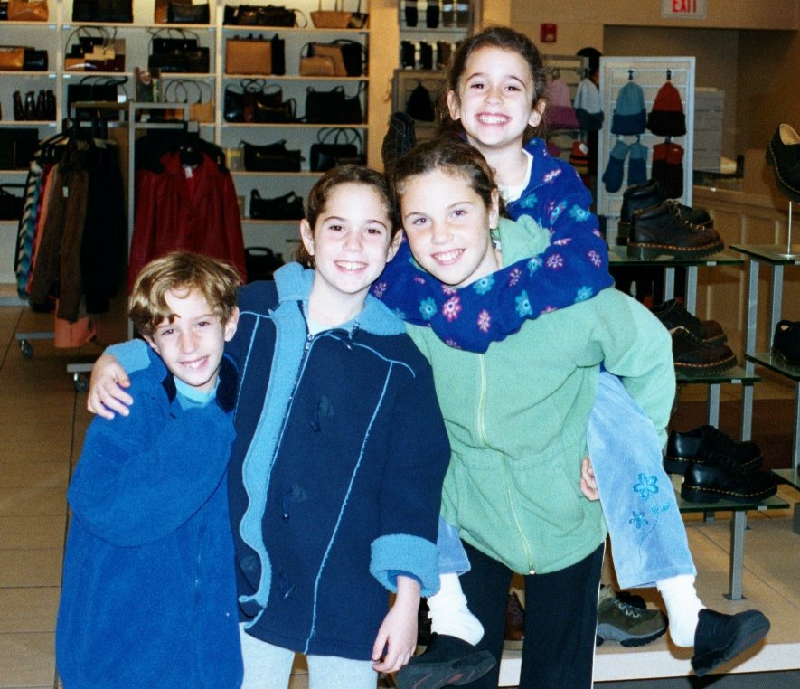
A Dream
for the
Academy
Denver 2002

Slide 29
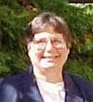
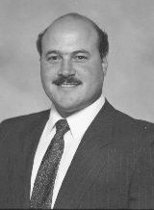
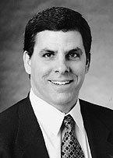
A Dream
for the
Academy
Denver 2002

Slide 30
“I’ve been your
electric pen-pal for
over nine years now, and I have to admit that leaving this is nearly like
abandoning your
child in a basket on the steps of the orphanage”
A Dream
for the
Academy
Denver 2002
Dwight Lemke

Slide 31
A Dream
for the
Academy
Denver 2002
“One unexpected
discovery about
being an editor is
that manuscripts
become almost
like your child”
Tom Lee
with his son Joe

Slide 32
In Memory … September 11, 2001
A Dream
for the
Academy
Denver 2002
Lynn Goodchild
Shawn Nassaney
Bryant College Alumni

Slide 33
A Dream
for the
Academy
Denver 2002

Slide 34
A Dream
for the
Academy
Denver 2002

Slide 35
A Dream
for the
Academy
Denver 2002

Slide 36
A Dream
for the
Academy
Denver 2002
Pure Research Applied Research
Professor Manager
VS.
Theory Practice
Scholar Practitioner

Slide 37
A Dream
for the
Academy
Denver 2002

Slide 38
A Dream
for the
Academy
Denver 2002

Slide 39
A Dream
for the
Academy
Denver 2002

Slide 40
A Dream
for the
Academy
Denver 2002

Slide 41
A Dream
for the
Academy
Denver 2002

Slide 42
A Dream
for the
Academy
Denver 2002

Slide 43
A Dream
for the
Academy
Denver 2002

Slide 44
A Dream
for the
Academy
Denver 2002

Slide 45
A Dream
for the
Academy
Denver 2002

Slide 46
A Dream
for the
Academy
Denver 2002

Slide 47
A Dream
for the
Academy
Denver 2002

Slide 48
A Dream
for the
Academy
Denver 2002

Slide 49
A Dream
for the
Academy
Denver 2002

Slide 50
A Dream
for the
Academy
Denver 2002

Slide 51
A Dream
for the
Academy
Denver 2002
Thanks to: John Meyer, Deborah Ancona,
Linda Ducharme, Jane Dutton, Ron Dufresne,
Tere Ferrer, Peter Frost, Brad Googins, Ben Haimowitz, Mike Hitt, Joanne Martin, Jean Passavant, Susan Regan, Peter Rivard, Bert Spector and Mirjam Wit

Slide 52
A Dream for the Academy
Denver 2002

