Slide 1
Numerical Calculations of the Transmission Function in a Plane-Parallel Atmosphere
June 6 , 2018
Atmospheric Transmission Models – Modeling in Remote Sensing 2018 Meeting
Dr. John Roadcap, AFRL/RVBY, Kirtland AFB, New Mexico
Prof. Surendra Singh, University of Tulsa, Tulsa Oklahoma
Distribution A – Cleared for Public Release

Slide 2
Overview
Measurements of Diffuse Transmission
Diffuse Reflection and Transmission
Principles of Invariance
Functional Expansions
Numerical Methods
Single Scattering Properties
Results
Conclusions
Distribution A – Cleared for Public Release

Slide 3
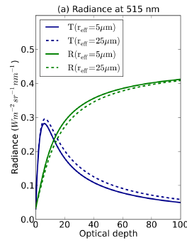
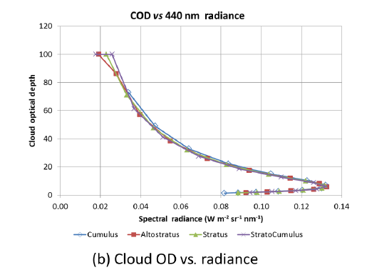
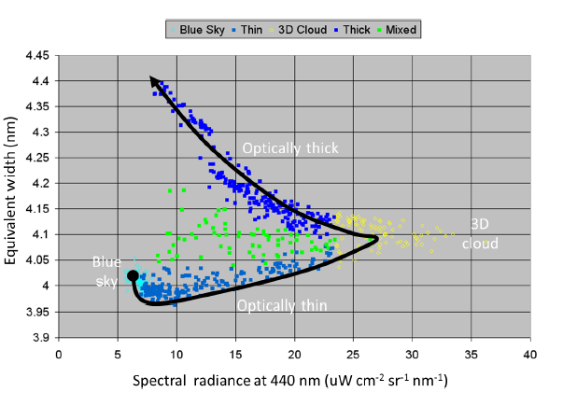

Diffuse Transmission
Zenith-view sunlit cloud radiances
in models and measurements
McBride et al, 2011: Atmos. Chem. Phys., 11, 7235-7252
Niple et al, 2016: Atmos. Meas. Tech., 9, 4167-4179
Distribution A – Cleared for Public Release
Distribution A – Cleared for Public Release

Slide 4
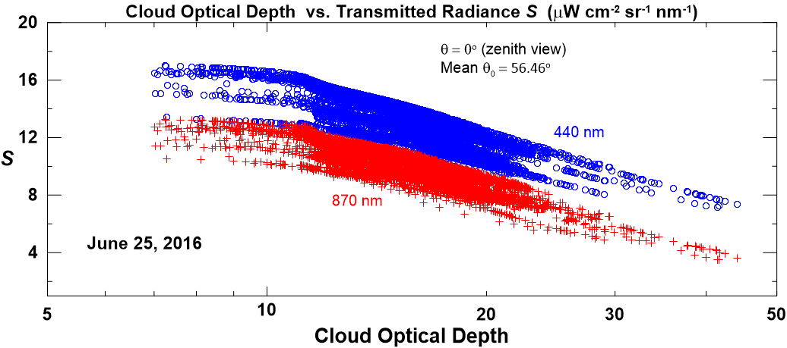
Diffuse Transmission
Zenith-view measured sunlit cloud
radiances vs. cloud optical depth
Scalar intensity
Data provided by Aerodyne, Inc.
Distribution A – Cleared for Public Release

Slide 5
Diffuse Reflection and Transmission
Fundamental functions of radiative transfer
plane-parallel scattering atmosphere
τ_{λ} = optical depth
Scalar quantities
π F
Reflection
< 2
Transmission
cross-
calibration error
Reference: Chandrasekhar, S., 1960: Radiative Transfer. Dover, New York. Chapter I, Section 13, p. 21.
Distribution A – Cleared for Public Release
Distribution A – Cleared for Public Release
Notes:
5

Slide 6
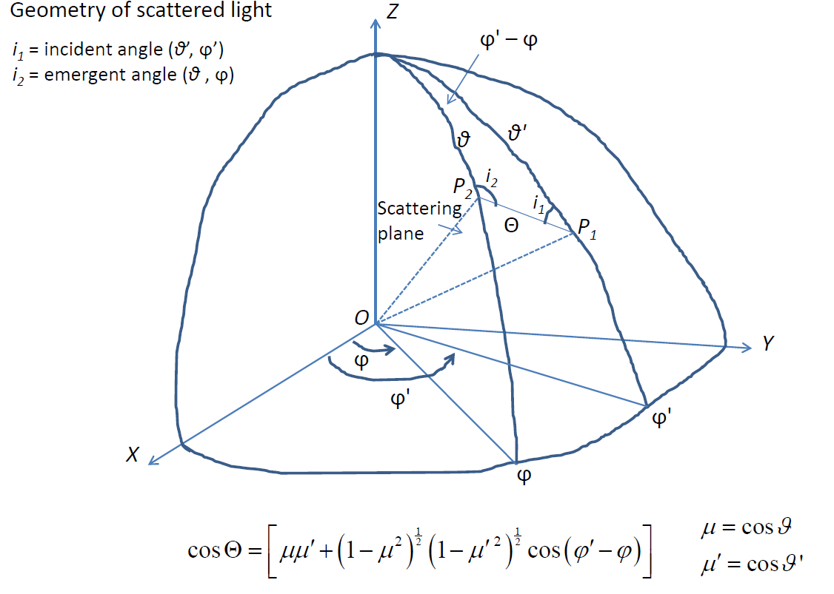
Plane-Parallel Scattering Geometry
Θ = angle of
scattered light
Chandrasekhar, S., 1960: Radiative Transfer. Dover, New York. Chapter I, Section 17, p. 39.
Distribution A – Cleared for Public Release

Slide 7
Principles of Invariance
Introduced by V. Ambartsumyan¹:
-- plane-parallel semi-infinite atmosphere
-- diffuse reflection function only
-- semi-infinite layer optical properties (ω₀, p(Θ)) are
invariant to the addition of a finite layer with same properties
-- summation over functional expansions in terms of
associated Legendre polynomials (P_{l}^{m})
Extended and codified by S. Chandrasekhar²:
-- plane-parallel atmosphere of finite optical depth
-- both diffuse scattering and transmission functions
-- phase function expansions using addition theorem
for the Legendre polynomials
-- numerical expressions for the non-linear integral equations
including expanded scattering and transmission functions
Function expansions are non-linear, separable, and non-homogeneous
¹Ambartsumyan, V., 1958: Theoretical Astrophysics. Pergamon, New York. Chapter 33.
²Chandrasekhar, S., 1960: Radiative Transfer. Dover, New York. Chapters II, IV, VI, VII.
Distribution A – Cleared for Public Release

Slide 8
Principles of Invariance (cont’d)
Solution procedures for a finite optical depth
Express phase function in Legendre polynomials with finite number of
terms l = 0 - N
Expand phase function using addition theorem for spherical
harmonics in terms of plane-parallel geometry (μ, μ’, φ’ – φ)
where
Rewrite the integral equations for scattering and transmission using
expanded phase function so they separate for the m Fourier components
Simultaneously solve the differential equations for S^{(m)} and T^{(m)}
Sum modal solutions:
to retrieve azimuthal dependence
Chandrasekhar, S., 1960: Radiative Transfer. Dover, New York. Chapters VI, VII.
Distribution A – Cleared for Public Release

Slide 9
Principles of Invariance (cont’d)
Integrodifferential equations for S^{(m)} and T^{(m)}
Scattering function (diffuse):
Transmission function (diffuse):
where
and
Chandrasekhar, S., 1960: Radiative Transfer. Dover, New York. Chapter VII, Section 53.
Distribution A – Cleared for Public Release

Slide 10
Numerical Methods
Solve as initial-value problem
1. Determine the operational numbers:
N = finite polynomial expansion for Legendre coefficients
K = order of Gaussian quadrature for definite integrals (K ≥ 0.35 N)
m = Fourier series expansion number (0 ≤ m ≤ N)
Δτ = finite difference increment (single scattering ~ Δτ = 10⁻⁵)
2. Numerically integrate scattering and transmission equations
simultaneously for each independent mode m using Adams’
extrapolation and interpolation formula¹ (predictor-corrector)
3. Apply symmetry factor for diffuse transmission and reflection:
4. Sum mode solutions over m = 0 – N, including azimuth dependence (φ₀ – φ)
¹Abramowitz, M., and. I. Stegun, 1972: Handbook of Mathematical Functions. Dover, New York, Chapter 25.
Distribution A – Cleared for Public Release

Slide 11
Numerical Integrations
1. Operational numbers:
N = 2 (Rayleigh) N = 30 (stratus) (Legendre series expansion #)
K = 31 (order of Gaussian quadrature)
m = 0 - 2 (Rayleigh) m = 0 - 30 (stratus) (Fourier series expansion)
Δτ = 10⁻⁵ (finite difference increment)
2. ω_{l} stratus expansion coefficients use Heyney-Greenstein approximation
-- diverges for l > 3 but allows lower order quadratures (K = 31)
-- H-G approximation used in Air Force radiative transfer models
Numerical integrations of S^{(m)} and T^{(m)} from τ₁ = 0 – 128, for 31 x 31
(μ, μ₀ ) arrays at each step
-- Δτ ≤ 10⁻⁵ suppresses numerical instability
Expansion coefficients and associated Legendre polynomials are
computed once for all τ₁ integration steps (for large speed-up)
5. S^{(m)} and T^{(m)} are symmetrical in (μ, μ₀) for all values of τ₁
Distribution A – Cleared for Public Release

Slide 12
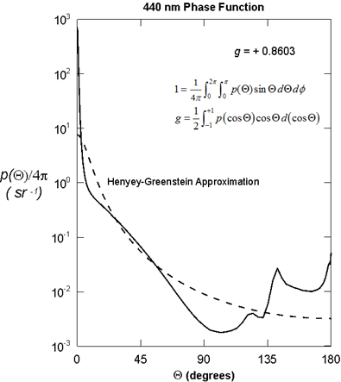
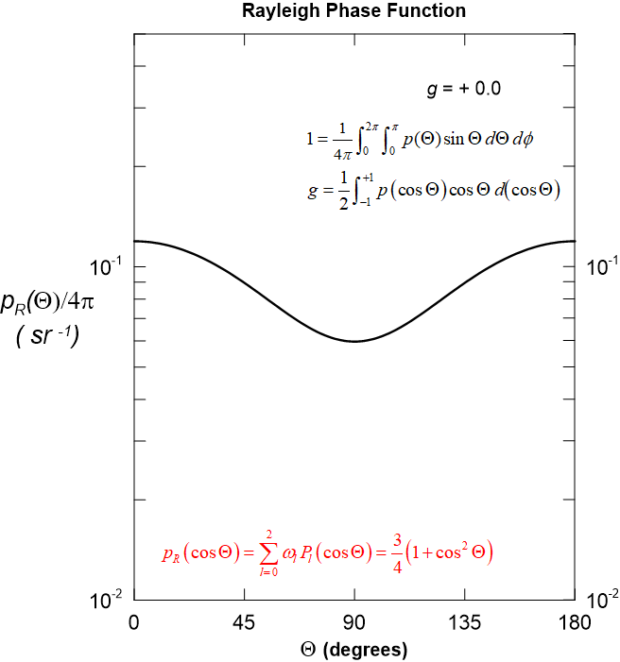
Single Scattering Properties
Phase functions for stratus and air molecules
1
1
¹ Liou, K.N., 1980: An Introduction to Atmospheric Radiation. Academic Press, New York. Chapter 6
Distribution A – Cleared for Public Release

Slide 13
Single Scattering Properties
Phase function expansion coefficients
Legendre expansion coefficients¹:
Rayleigh expansion coefficients:
ω₀ = 1 ; ω₁ = 0 ; ω₂ = 0.5
Henyey-Greenstein approximation:
ω_{l} = ω₀ (λ) · (2l +1) · g**l
ω₀ (λ) = single scattering albedo
¹ Liou, K.N., 1980: An Introduction to Atmospheric Radiation. Academic Press, New York.
Appendix G
Distribution A – Cleared for Public Release

Slide 14
Transmission Functions
Rayleigh phase function ; m = 0 *
τ = 1.0
τ = 1.5
μ₀
μ₀
μ
μ
0 < μ ≤ 1 ; 0 < μ₀ ≤ 1
*azimuth independent component
Distribution A – Cleared for Public Release

Slide 15
Transmission Functions
Stratus (H-G) phase function ; m = 0
τ = 1.0
τ = 1.5
μ₀
μ₀
μ
μ
0 < μ ≤ 1 ; 0 < μ₀ ≤ 1
Distribution A – Cleared for Public Release

Slide 16
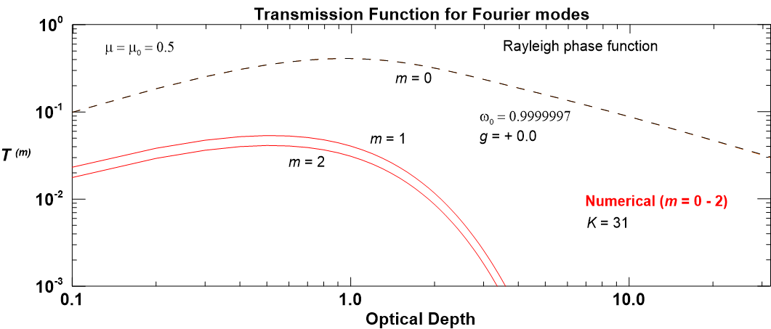
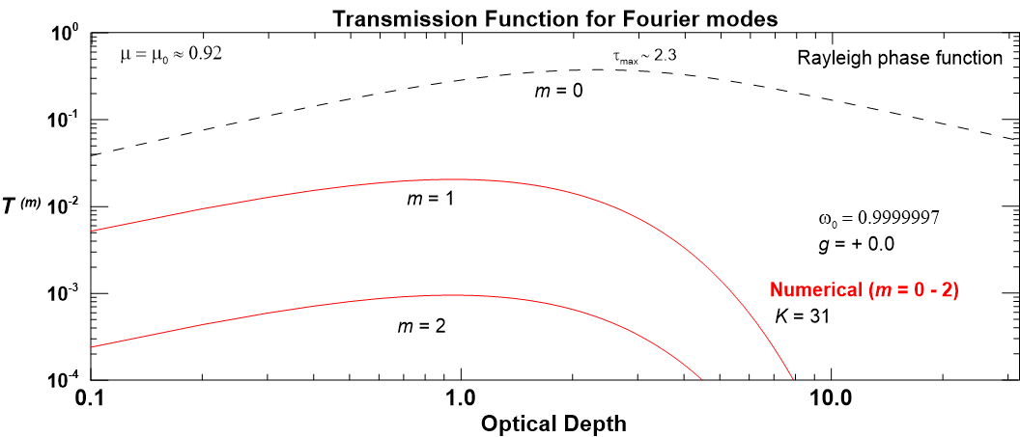
Transmission Functions
Rayleigh phase function
m = 0 – 2
ω₀ = 1.0
μ = μ₀ = 0.5
m = 0 – 2
μ = μ₀ = 0.92
ω₀ = 1.0
Distribution A – Cleared for Public Release

Slide 17
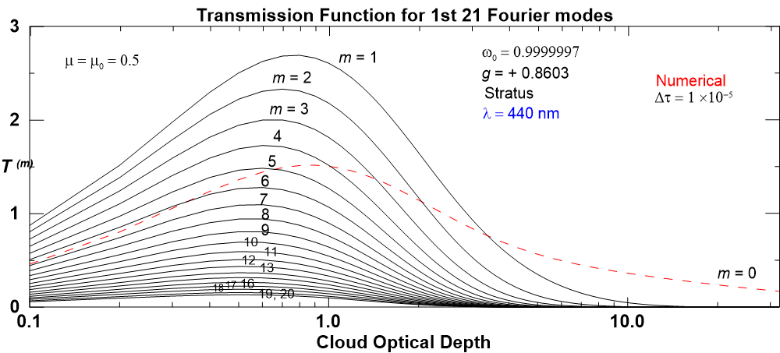
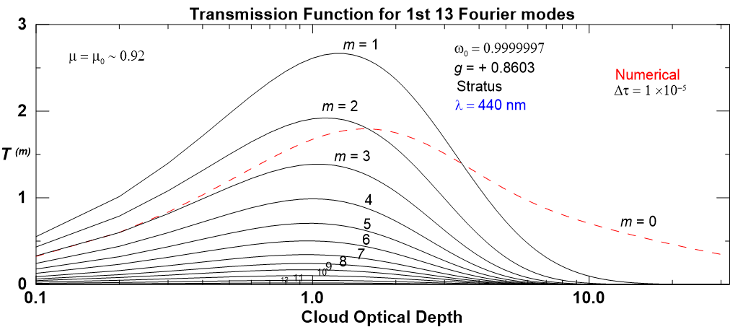
Transmission Functions
Stratus phase function at λ = 440 nm
m = 0 – 20
μ = μ₀ = 0.5
m = 0 – 12
μ = μ₀ = 0.92
Distribution A – Cleared for Public Release

Slide 18
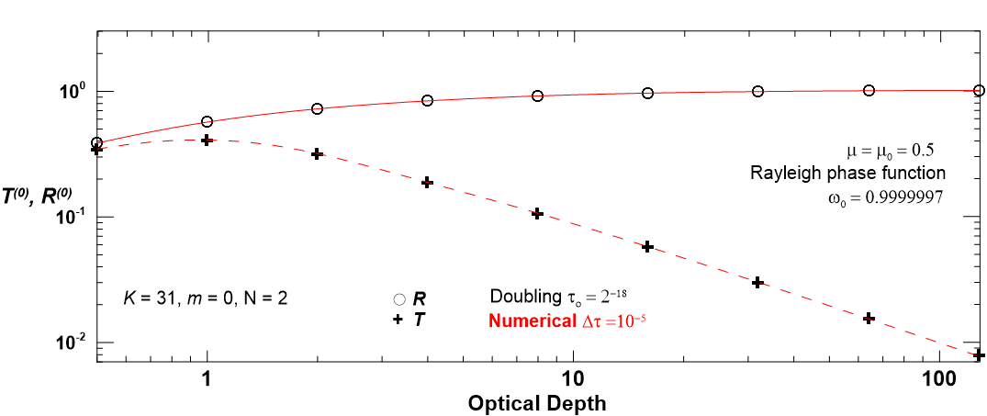
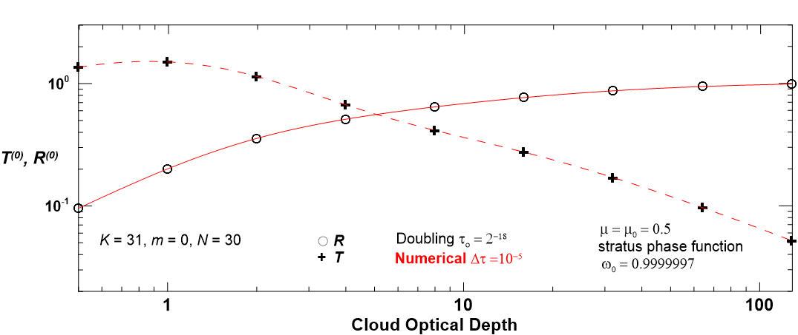
Functional Comparisons
Doubling¹ vs. numerical methods
ω₀ = 1.0
m = 0
μ = μ₀ = 0.5
R = S/(4μμ₀)
Distribution A – Cleared for Public Release
¹Hansen, J. E., 1971: J. Atmos. Sci., 28, 120-125.

Slide 19
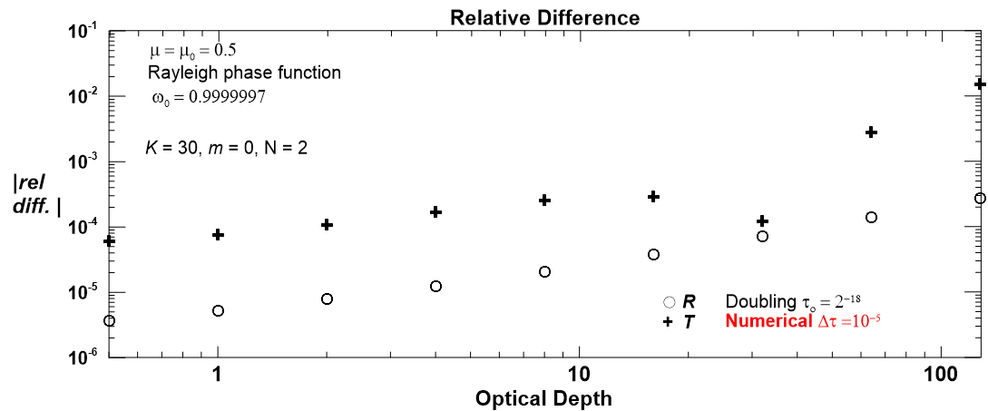
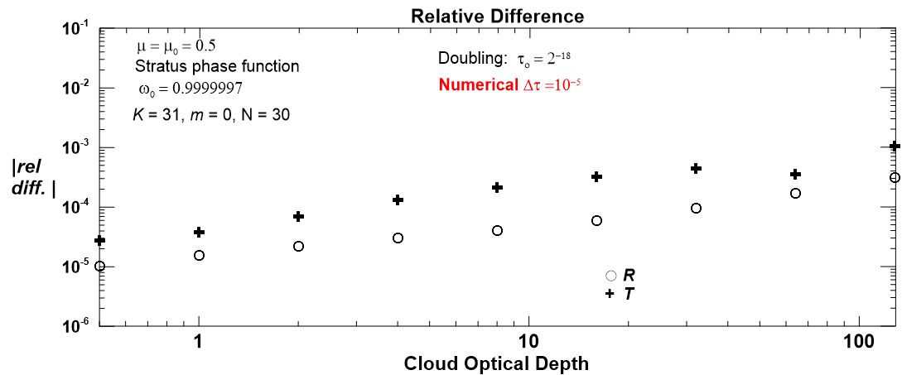
Functional Comparisons
Differences between doubling and numerical methods
ω₀ = 1.0
m = 0
μ = μ₀ = 0.5
R = S/(4μμ₀)
Distribution A – Cleared for Public Release

Slide 20
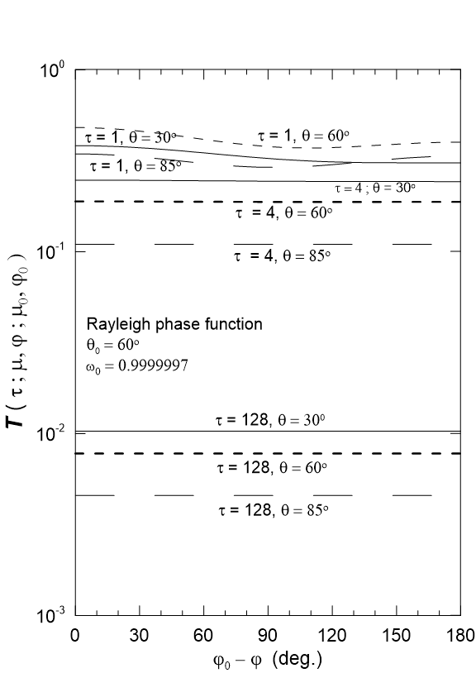
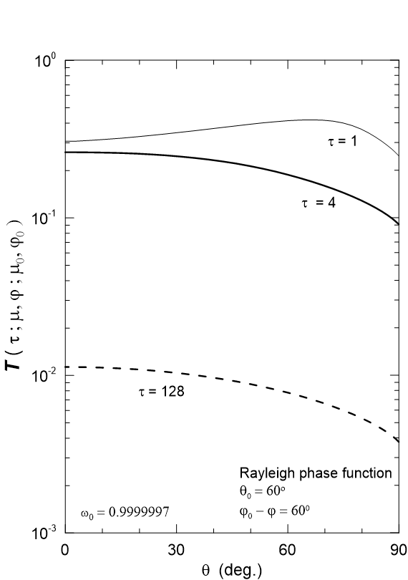
Azimuth Angle Dependence
Sum over modes using Rayleigh phase function
ω₀ = 1.0
Distribution A – Cleared for Public Release

Slide 21
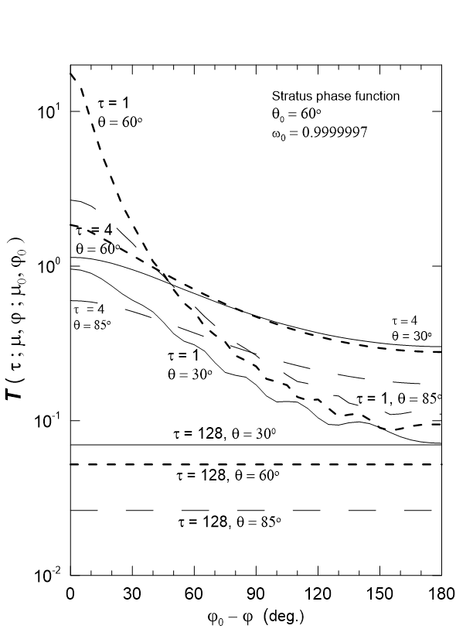
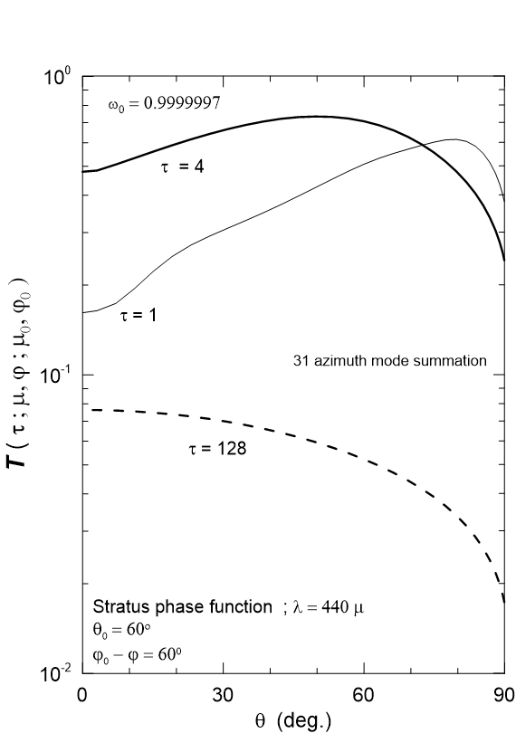
Azimuth Angle Dependence
Sum over 31 modes using stratus phase function
Distribution A – Cleared for Public Release

Slide 22
Fourier Component Behavior
Transmission vs. reflection
τ = 1.5
μ=μ₀=0.5
for Rayleigh phase function
for stratus phase function
“N” denotes a negative value
Distribution A – Cleared for Public Release

Slide 23
Conclusions
Numerical calculations provide physical insight into higher order transmission function behavior associated with multiple scattering in a plane-parallel layer possessing homogeneous optical properties
Numerical methods are well-suited for multi-core parallel computer processing due to the Fourier component independence
Azimuth and zenith angle dependence, as well as transmission amplitude, is greatly amplified by the stratus phase function when compared to the Rayleigh phase function
Transmission functions exhibit uniform behavior between components and do not switch sign at higher order modes
Transmission function may be better suited for retrieving cloud properties in homogeneous layers at visible wavelengths, when compared to the reflection function
Distribution A – Cleared for Public Release

Slide 24
Acknowledgment
Professor Singh’s work at AFRL was supported by the U.S. Air Force Summer Faculty Fellowship Program
Distribution A – Cleared for Public Release

