Slide 1


MODTRAN®6
Overview and Features
T. Perkins, A. Berk
Spectral Sciences, Inc., 4 Fourth Ave, Burlington, MA 01803
Jeannette van den Bosch
USAF Research Laboratory, Kirtland AFB, NM 87117
2018 Atmospheric Transmission Models – Modeling in Remote Sensing Meeting, Newton, MA
4 – 6 June 2018, Boston College
MODTRAN® is a registered trademark owned by the United States Government as represented by the Secretary of the Air Force.

Slide 2
Outline
Overview
  MODTRAN Features and Updates
  Line-By-Line Approach
MODTRAN Interfaces and Tools
  JSON Format
  GUI Application
  Aerosol Toolkit (ATK)
  Atmospheric Generator Toolkit (AGT)
  The MOD6 Application Programming Interface (API)
Future Directions
  Updating MODTRAN6 Molecular Databases

Slide 3
MODTRAN General Description
Atmospheric Radiative Transfer Algorithm for computing IR / Vis / UV Transmittances, Radiances, Fluxes, …
  Line-By-Line and Statistical Band Model and Correlated-k Algorithms
0.2, 2.0, 10.0 or 30.0 cm⁻¹ Spectral Resolution from band models
Stratified Molecular / Aerosol / Cloud Atmosphere
  Standard and Auxiliary Molecular Species
  Built-in and User-Specified Particulate Optical Properties
Solar and Thermal Scattering
  DISORT Discrete Ordinate N-Stream Model
  Diffuse Transmittances and Spherical Albedo
Spherical Refractive Geometry
Multiple Spectral Convolution and Filtering Options
Many Applications: Remote Sensing, Scene Simulation, Algorithm Development, Measurement / Data Analyses, Climate Forecasting, …

Slide 4
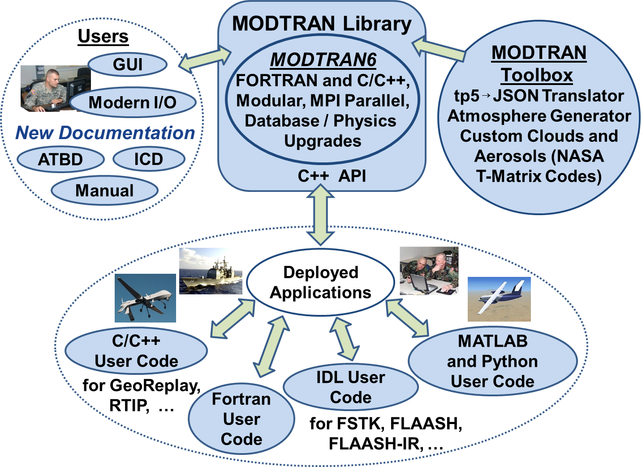
Overview of MODTRAN6
MODTRAN modernization
  Mixed Fortran and C/C++
  Modular partitioning
  Parallel options
  Improved I/O scheme
  Retains all Mod5 features
Software documentation
MODTRAN Toolbox
  Custom aerosols and clouds
    NASA Mie & T-Matrix code
  Atmosphere generator
Physics upgrades
  Line-by-line (LBL) RT option
  Improved DISORT integration
Graphical user interface (GUI)
Library interface (API)
T-Matrix and Mie Codes)

Slide 5
2018 Update
Version 6.0.1 Released in May
  Maintenance release
    Better error handling and logging
  GUI Improvements
    Changes to layout and plotting
  New Input and Output options
    JSON output format
  API and Documentation revisions
Forthcoming 2018 Release
  Band Model refinement, based on HITRAN 2016

Slide 6
JSON Interface
JavaScript Object Notation (JSON)
  Open-source standard for data interchange
  Similar to XML but more compact (less markup)
  Position-independent parameters
  Named key/value pairs produce a self-descriptive input format
Input configurations with minimal redundancy
  Unused or default values may be omitted completely
  “Repeat” input cases can inherit values from a previous case
    Ex: Varying a single parameter, “H2OSTR”, could define a new case with only one input parameter
Output format permits a purely JSON-driven interface
  Complete state of a calculation is available, including input settings, output data, and status information such as warnings and error messages.
Tape 5 is still supported, but the format is frozen

Slide 7
JSON Format
Top level structure is labeled “MODTRAN”, which contains an array of input cases.
MODTRAN will ignore anything outside of the “MODTRAN” structure, so users can add additional parameters for their own processing.
Example: For a tape5 to JSON conversion, the text of the original tape5 could be embedded as a string here.
{
"UserInfo" : "non-MODTRAN stuff here",
"MODTRAN" : [
{
# A comment line
"ModtranInput" : {
"name" : "05vs15nadirRAD_15",
"case" : 1,
"RTOptions" : {
"MODTRN" : "RT_MODTRAN",
"T_BEST" : false,
"IEMSCT" : "RT_SOLAR_AND_THERMAL",
"IMULT" : "RT_DISORT",
"NSTR" : 8,
“DISALB" : false
},
"Atmosphere" : {
"MODEL" : "ATM_MIDLAT_SUMMER",
...
... Etc.
}, # End input case 1, start another
{
"ModtranInput" : {
"name" : "05vs15nadirRAD_05",
"case" : 2,
... Etc.
MODTRAN extension of JSON format, a comment character.
Sub-structures correspond to Tape5 cards, with original input names carried over.
Inputs that will use the default values can be omitted. Defaults are defined in another JSON file, “keywords,json”.
JSON types:
  Key/value pairs {‘key’ : ‘value’}
  Strings, floats, integers, booleans
  Arrays: [ obj1, obj2,…]
  Any combination of the above
Additional cases for this input can follow here if desired.

Slide 8
Tape5 Input Converter
M 4 3 0 0 0 0 0 0 0 0 1 0 -1 .05
F 0F 0 380.000 1
1.00 1.00 1.05 1.00 1.00 1.00 1.00 1.00 1.00 1.00
A+ 1 1USS 0 0 0 0 0.000 0.000 0.000 0.000
1. .5
47 0 0 0
0.000e+00region 1 desert summer aerosol
0.201.016680.434950.8797 0.301.016680.434950.8797 0.341.019360.447350.8857
0.551.000000.219350.7980 0.691.037040.167430.7666 1.061.114910.037210.7143
1.541.208350.043480.7689 2.001.047120.042120.8557 2.250.905020.035770.8936
2.500.770220.050250.9116 2.700.667040.086210.9281 3.000.628860.114680.9247
3.390.812440.122180.8623 3.750.788880.100130.8493 4.500.677650.104040.8524
5.000.608420.104880.8551 5.500.511680.115510.8706 6.000.362390.150330.9038
6.200.337160.150810.9065 6.500.311720.152880.9079 7.200.670350.206630.7748
7.900.285240.129920.8881 8.200.301080.188320.8855 8.700.600290.258340.7717
9.000.829650.339030.6736 9.200.831530.346750.6684 10.000.808380.344870.6558
10.590.692100.275960.6814 11.000.669310.250000.6748 11.500.625310.232900.6805
12.500.526480.201000.7023 14.800.493950.190370.6708 15.000.487910.188070.6700
16.400.466220.177020.6539 17.200.461220.172020.6408 18.500.442030.181610.6366
21.300.485200.268970.5959 25.000.457050.223520.5460 30.000.401790.258470.5494
40.000.368010.239470.4688 50.000.000000.000000.0000 60.000.000000.000000.0000
80.000.000000.000000.0000100.000.000000.000000.0000150.000.000000.000000.0000
200.000.000000.000000.0000300.000.000000.000000.0000
4.90000 180.00000
2500 2600 25 5
0
{
"MODTRAN": [
{
"MODTRANINPUT": {
"NAME": "A+USS.tp5",
"CASE": 1,
"RTOPTIONS": {
"MODTRN": “RT_MODTRAN",
"LYMOLC": false,
"T_BEST": false,
"IEMSCT": “RT_TRANS”,
"IMULT": “RT_NO_MS”,
"DISALB": false
},
"ATMOSPHERE": {
"MODEL": 4,
"M1": 0,
"M2": 0,
"M3": 0,
"M4": 0,
"M5": 0,
"M6": 0,
"MDEF": 1,
"CO2MX": 3.80000E+02,
"H2OSTR": "",
"H2OUNIT": " ",
… },
tp5tojson

Slide 9
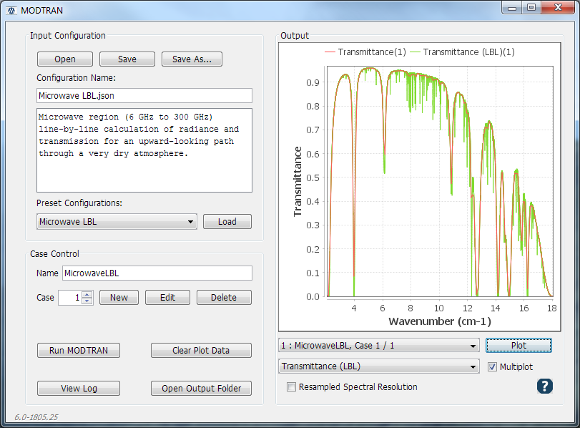
MODTRAN6 GUI
Main Panel
Open/Save Configuration
Load Examples
Create/Edit Input Cases
Execute and View Output

Slide 10
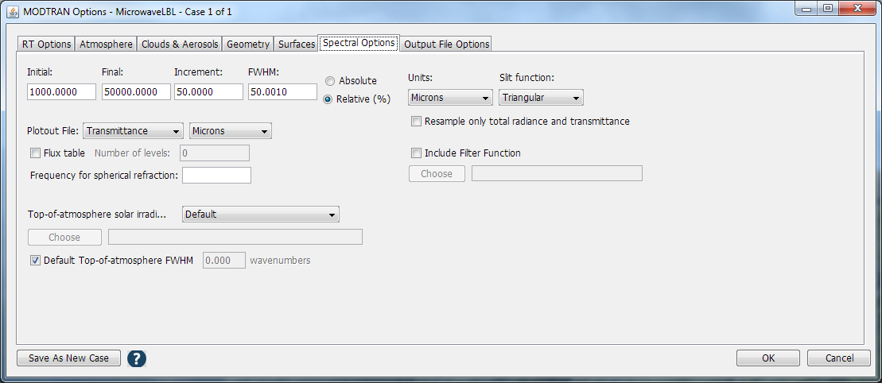
MODTRAN6 GUI
Case Editor
Parameter Groups
All input parameters are accessible
Replicate Configuration

Slide 11
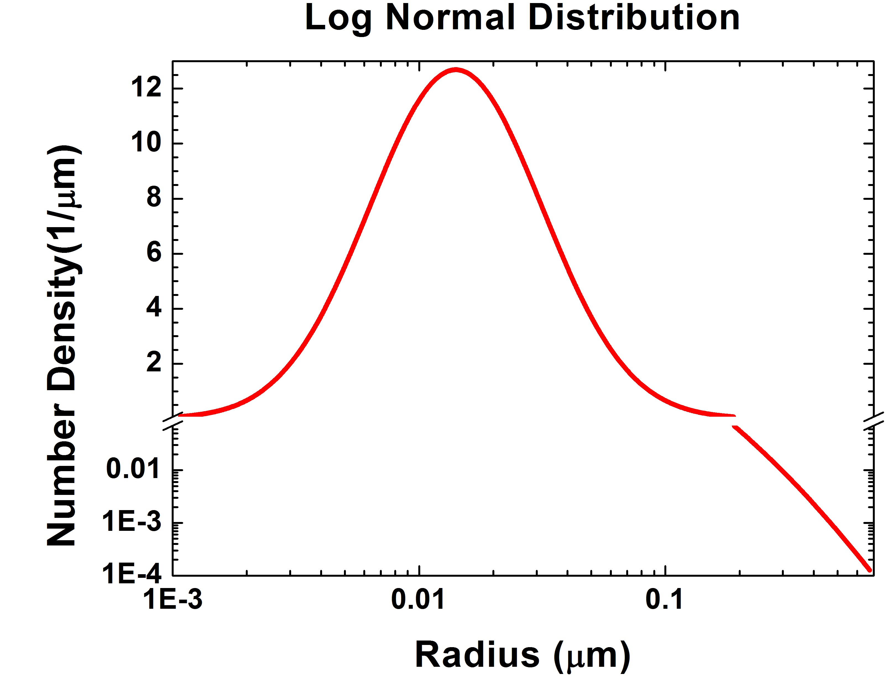
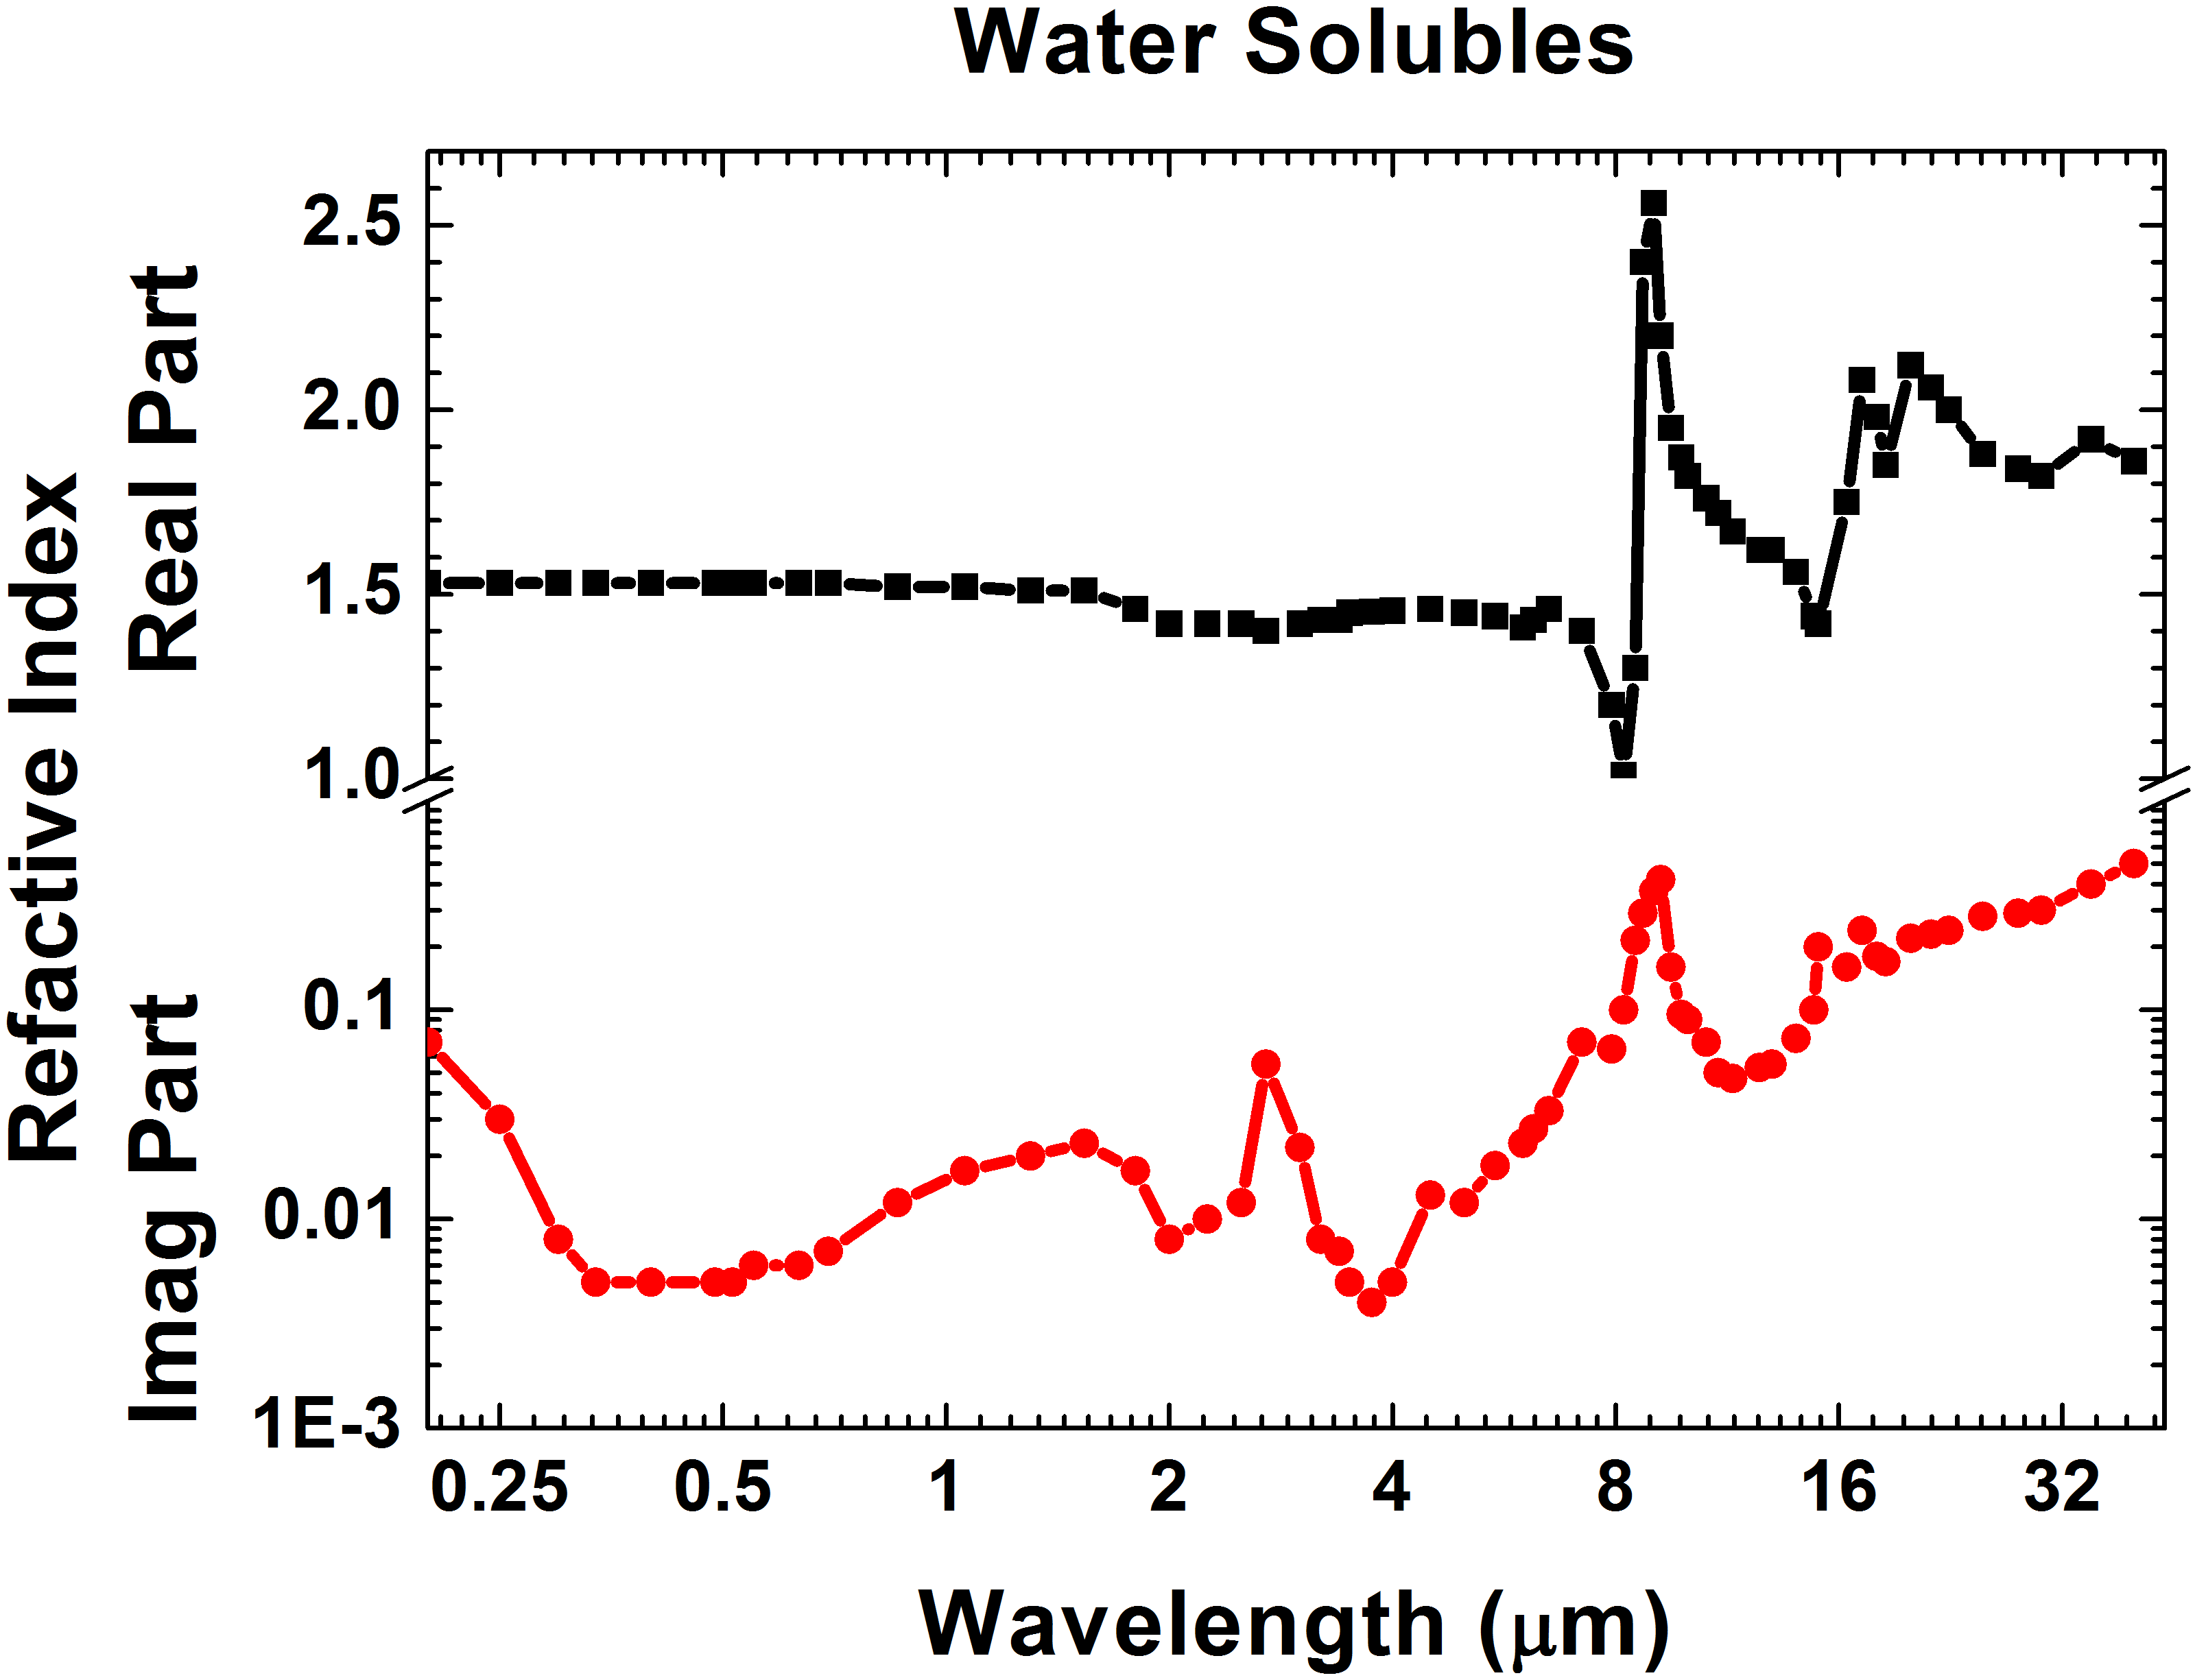
Aerosol Toolkit
Supplements the default aerosol models of MODTRAN
  Creates data files to describe “custom” aerosol types
  Generates formatted optical property data files (SAP)
  Interface via API or text input
Optical properties calculated directly
  Particle types, refractive indices, size distributions, density profiles
  Mishchenko’s Mie and/or T-Matrix code (NASA)
Size Distributions
Water Soluble Particles

Slide 12
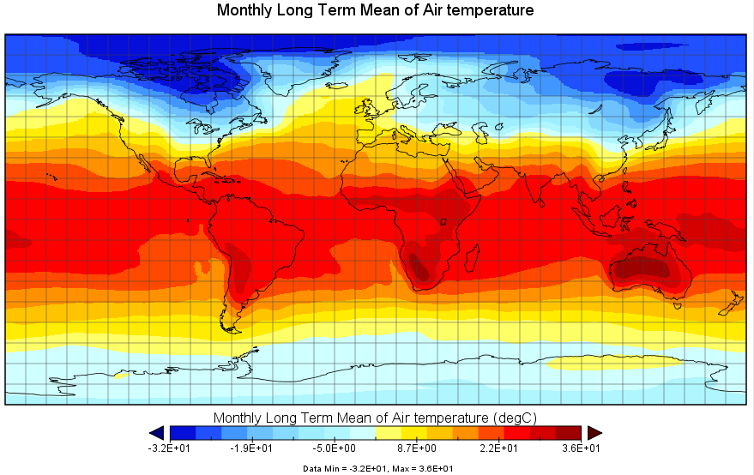
Atmosphere Toolkit
Objectives
Convert radiosonde measurements of pressure, temperature and relative humidity at 1000s of altitudes for input to MODTRAN (.json and .tp5).
Use weather station radiosonde data as input to MODTRAN. Typical measurements consist of up to ~200 altitudes of lower altitude measurements of pressure, temperature and relative humidity.
Prepare MODTRAN input from Latitude/Longitude NOAA long-term global averages (from 1981 to 2010) of T and RH at 17 pressure levels.
Overall Strategy
Use available measurements at lower altitudes, then fit standard model atmosphere data at higher altitudes.
Choose a standard models based on a least-square fit of temperature and pressure.
NCAR Reanalysis database

Slide 13
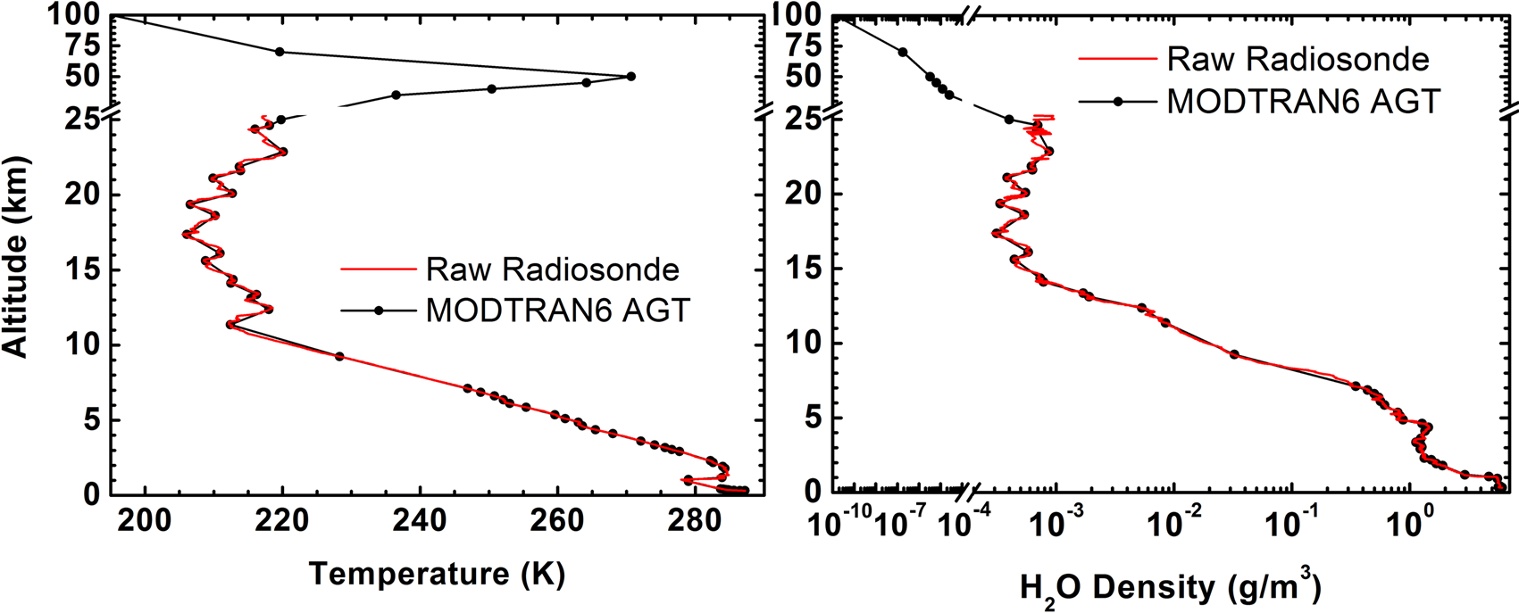
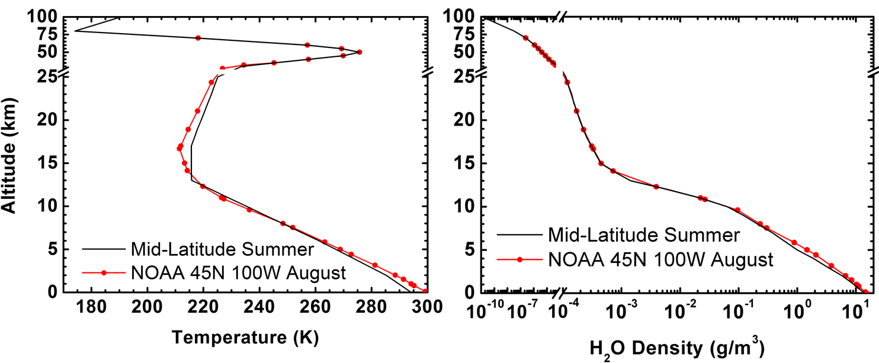
Atmosphere Toolkit
Radiosonde Processing
Global Model Fitting

Slide 14
API Overview
Top-level MODTRAN-API:
  Specify inputs
  Execute cases
  Retrieve output
Multiple interface methods offer flexibility
  Interact with or without file I/O
  Link directly with user applications
  Interface Control Document (ICD) with example code.
ModInput* inp = modCaseInput( case_index );
inp->Atmosphere.model = ATM_TROPICAL;
modExecute();
C
ModInput* inp = modtran->caseInput( case_index );
inp->Atmosphere.model = ATM_TROPICAL;
modtran->execute();
C++

Slide 15
API Design
ModLib: top-level object that encapsulates the functions of MODTRAN within a single interface
  Built as a shared/dynamic library (.dll, .so, .dylib)
  Internal code is not thread-safe (incompatible with multithreading)
API functions and structures have C/C++ bindings
  Most languages can link with standard ISO-C code
  Current development ported to Java, Python, and ENVI/IDL
  Matlab interface to follow
Supports new and legacy file formats for input and output
  Tape5 (translator), Tape6, Tape7, Tape8, Flux
  JSON text input and output
  CSV and tab-delimited text output (Excel)
  ENVI Spectral Libraries (binary output)

Slide 16
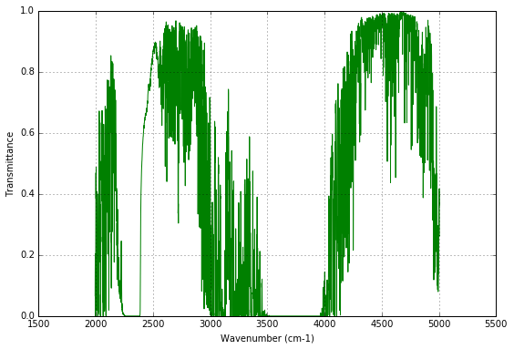
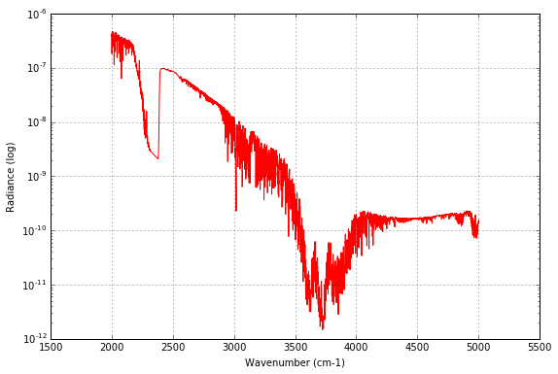
API Language Wrapping
Python
import pymodtran as pymod
import matplotlib.pyplot as plt
import numpy as np
# Initialize the MODTRAN library interface
modlib = pymod.ModLib()
# Create a basic downward-looking radiance calculation
modlib.caseCreate(1)
modin = modlib.caseInput(0) #case 0
modin.name = "test_radiance"
modin.options.iemsct = pymod.RT_SOLAR_AND_THERMAL
modin.spectral.v1 = 2000.0
modin.spectral.v2 = 5000.0
modin.spectral.dv = 1.0
modin.spectral.fwhm = 2.0
modin.geometry.h1alt = 15
modin.geometry.h2alt = 0.0
modin.geometry.obszen = 170.0
modin.fileopt.nofile = pymod.FC_NOFILES
#Run the configuration and plot the output
modlib.execute()
…
plt.figure(0,figsize=(9,6))
plt.plot(fr,tr, 'g')
plt.grid(True)
plt.ylabel('Transmittance')
plt.xlabel('Wavenumber (cm-1)')
plt.figure(1,figsize=(9,6))
plt.semilogy(fr,rd, 'r')
plt.grid(True)
plt.ylabel('Radiance (log)')
plt.xlabel('Wavenumber (cm-1)‘)
Scanned Output

Slide 17
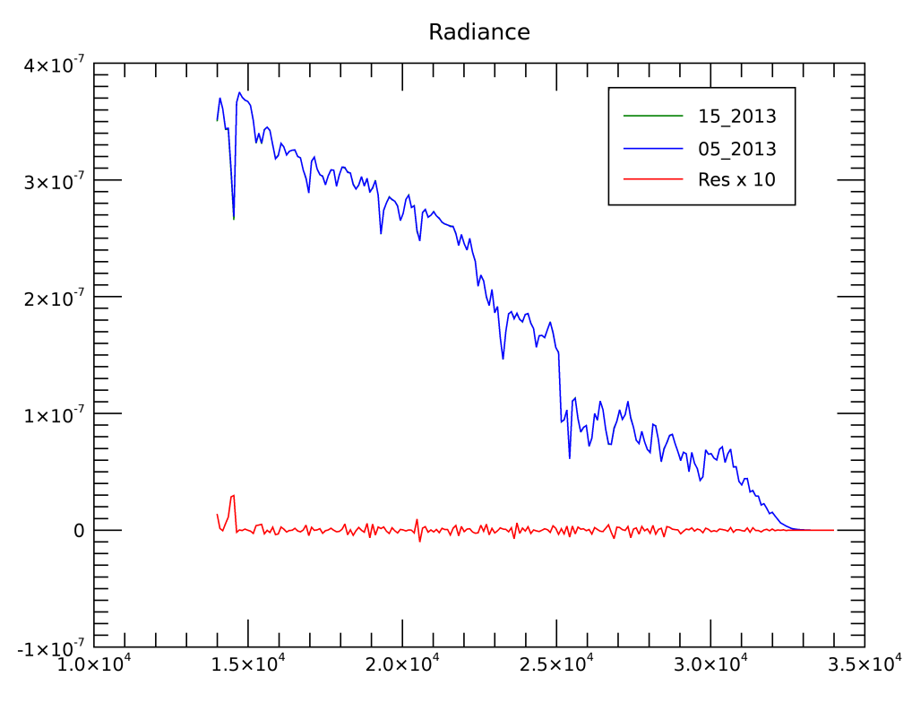
API Language Wrapping
pro idl_05vs15nadirRad
modtran = obj_new('modlib')
print, 'MODTRAN version ', modtran->version()
;configure the first case
inp = ModUtil.createInputDefault()
inp.NAME = '05vs15nadirRAD'
inp.DESCRIPTION = ‘Comparison of the 5 and 15 cm-1 band models'
inp.options.IEMSCT = 'RT_SOLAR_AND_THERMAL'
inp.options.IMULT = 'RT_ISAACS_2STREAM_AT_OBS'
inp.atmos.MODEL = 'ATM_US_STANDARD_1976'
inp.atmos.MDEF = 0L
inp.atmos.CO2MX = 380.0
inp.aerosols.IHAZE = 'AER_RURAL_DENSE'
inp.geometry.ITYPE = 2L
inp.geometry.IDAY = 1L
inp.geometry.H1ALT = 20.0D
inp.geometry.H2ALT = 0.0D
inp.geometry.OBSZEN = 180.0D
inp.geometry.IPARM = 2L
inp.geometry.PARM2 = 60.0D
inp.surface.SURFTYPE = 'REFL_CONSTANT'
inp.surface.SURREF = 0.40
inp.spectral.V1 = 13995.0D
inp.spectral.V2 = 34005.0D
inp.spectral.DV = 90.0D
inp.spectral.FWHM = 90.0D
inp.spectral.BMNAME = '15_2013'
print, 'Execute: ',modtran->execute()
ENVI/IDL
Scanned Output

Slide 18
Documentation
MODTRAN6 User Manual
  Setup and Tutorial
  I/O Descriptions
  Installation and Toolkit Instructions
Algorithm Theoretical Basis Document
  Detailed description of Radiative Transfer Methods
Interface Control Document
  Instructions for using the MODTRAN Application Programming Interface (API)
IEMSCT Name | # | Description
RT_TRANSMITTANCE | 0 | Spectral transmittance only mode.
RT_THERMAL_ONLY | 1 | Spectral thermal radiance (no Sun/Moon) mode.
RT_SOLAR_AND_THERMAL | 2 | Thermal plus solar radiance mode.
RT_SOLAR_IRRADIANCE | 3 | Directly transmitted spectral solar irradiance mode.
RT_LUNAR_AND_THERMAL | 4 | Thermal plus lunar radiance mode.
RT_LUNAR_IRRADIANCE | 5 | Directly transmitted spectral lunar irradiance mode.

Slide 19
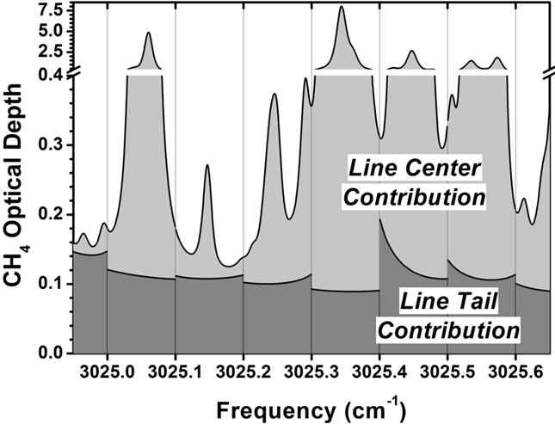
MODTRAN6 LBL
MODTRAN6 introduced a line-by-line algorithm to facilitate validation of the MODTRAN statistical band model and Correlated-k methods
MODTRAN, like most LBL algorithms, includes its own spin on LBL modeling
  All LBL models treat distant line contri-butions (Δν > 25 cm⁻¹) via continua
  MODTRAN solves the line-by-line model in contiguous 0.1 cm⁻¹ chunks
  Each molecular transition is explicitly modeled on-the-fly in two neighboring 0.1 cm⁻¹ bins, chosen to span the range of its line center positions
  Smoothly varying line tail (25 cm⁻¹ > Δν > ε cm⁻¹) contributions are summed and fit off-line to pressure (P) and temperature (T) dependent [2,2] Padé approximants in frequency (i.e. the ratio of quadratic polynomials)
  These pre-computed P and T fits are interpolated during processing
  The challenge: Insuring smooth transitions at each spectral bin edge

Slide 20
Updating Molecular Databases
Detailed validation of MODTRAN6 Line-By-Line and Statistical Band Model and Correlated-k algorithms was published last year
  A. Berk and F. Hawes, “Validation of MODTRAN®6 and its line-by-line algorithm” J Quant Spectrosc Radiat Transfer, 203 (2017) 542-556
A number of model upgrades were recommended
SSI recently initiated generation of new MODTRAN molecular data based on the HITRAN2016 line compilation
All recommended upgrades are being implemented coincident with the updating of the molecular databases

Slide 21
Update 1: Voigt Lineshape Function
Three distinct forms for the Voigt lineshape function are used in MODTRAN and its database generation modules
A new and simple rational expansion for the Voigt function f_{ν}(γ_{c}, γ_{d}) provides double precision accuracy, given spectral displacement ν and Lorentz and Doppler widths γ_{c} and γ_{d}
  AM Abrarov, BM Quine and RK Jagpal, Appl. Numer. Math., 129. 10.1016/j.apnum.2018.03.009, https://arxiv.org/pdf/1802.06077.pdf
  M, ς, C_{m}, α_{m} and φ_{m} are all constants
The AQJ form is being adopted universally within MODTRAN

Slide 22
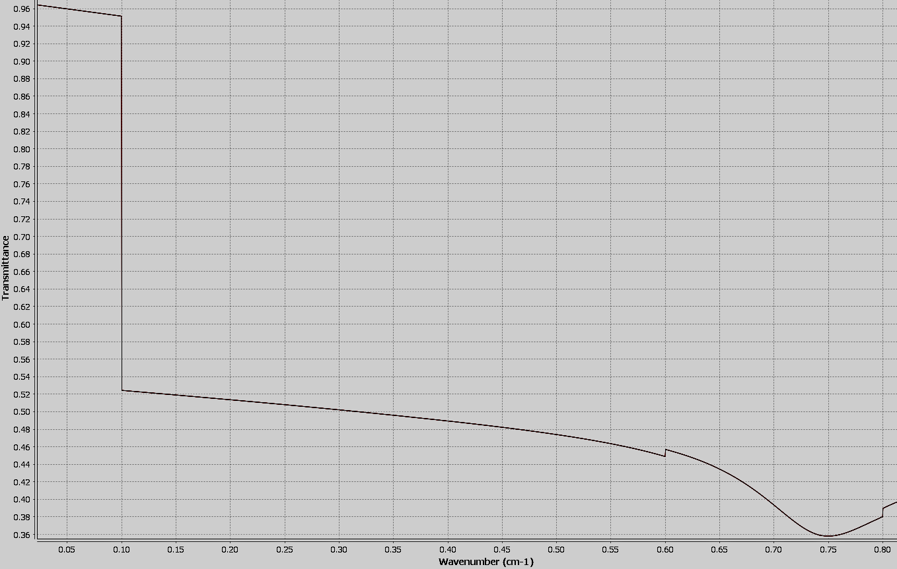
Update 2: VVH Lineshape
The MODTRAN6 LBL algorithm computes high resolution spectra independently in 0.1 cm⁻¹ bins
The development effort focused on removing bin edge dis-continuities, but problems remain in the microwave
MODTRAN adopted the Van-Vleck Huber (VVH) line shape function for modeling the MW region and for smooth transitioning into shorter wavelengths
Unfortunately, the pre-computed line tails were still generated with the Voigt lineshape function
Future line tail data are being computed using the VVH form

Slide 23
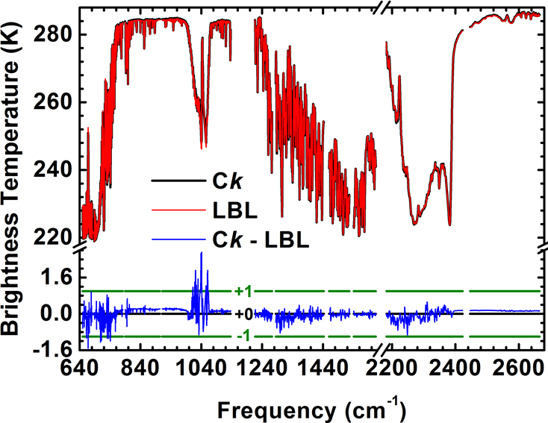
Update 3: Band Model Line Tails
Discrepancies between MODTRAN statistical methods and its LBL methods are larger than necessary
  See 15 μm CO₂ and 9.6 μm O₃ band residuals below
  MODTRAN band model line tail calculations offset the position of lines located “too close” to a bin edge
  This offsetting produces the largest MODTRAN errors
HITRAN 2016 band model line tails will be generated without line position offsetting
  Will line tail fits be adversely effected?
  If so, a correction scheme will be implemented
O₃
CO₂
AIRS Channels

Slide 24
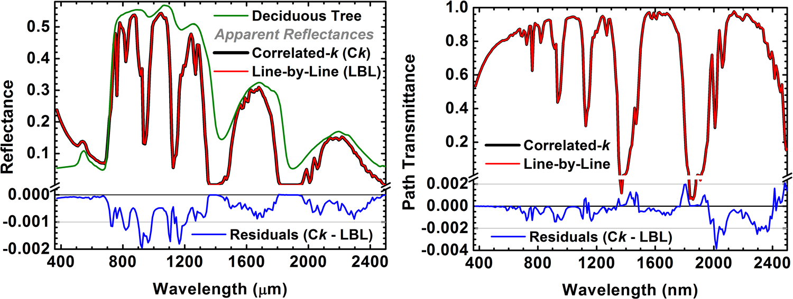
Update 4: Line Tail Pressure Grid
MODTRAN band model (BM) line tail data are generated at 1.0 and 0.1 atm Pressure (P² = 1.00 and 0.01 atm²)
LBL line tails required 4 pressure grid points (P² = 1.495, 1.000, 0.505 and 0.010 atm²) to model Lorentzian self-broadening and to capture the Doppler to Lorentzian regime transition
The small biasing of apparent reflectance (see blue curve) is caused by the
BM 2-point pressure interpolation
The new band model line tails will be generated at the 4 pressure grid points
  Temperature step size will be increased from 5 to 10 K
Self-broadening effects will also be added to the statistical models

Slide 25
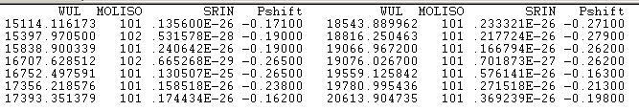
Update 5: Pressure/Density Line Shifts
HITRAN includes molecular transition pressure shifts
The AER algorithm, LBLRTM, models the shifts as density dependent – MODTRAN6 has adopted that approach
For 0 atm ≤ P ≤ 1 atm and 180 K ≤ T ≤ 330 K, all HITRAN 2012 line centers remained in 2 neighboring 0.1 cm⁻¹ spectral bins
Many line shifts are much larger in HITRAN 2016
Also, the temperature range is being increased: 160 to 360 K
The new MODTRAN databases will not allow transition frequencies to shift beyond the two neighboring spectral bins to which it is assigned

Slide 26
Future Directions
We are open to suggestions!
Integration of External Toolkits
  Incorporate the standalone aerosol and atmosphere utilities directly into the MODTRAN 6 library
  Pave the way for future 3rd-party toolkit additions
Expansion of API Output
  Current output limited to spectral data.
  Encode data normally found in logs, such as atmospheric profiles, refracted paths, aerosol properties, etc.
Matlab Interface Development
Polarization

