Slide 1
A data-driven approach for efficiently storing, evaluating, integrating and sampling spherical and hemispherical datasets
Adam Goodenough and Scott Brown
Modeling and Simulation Group
Digital Imaging and Remote Sensing Laboratory
Rochester Institute of Technology

Slide 2
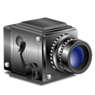
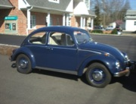
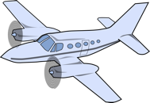
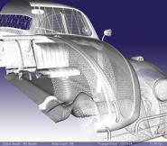
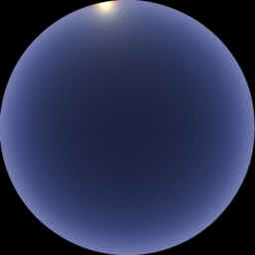
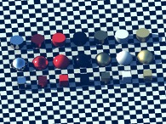
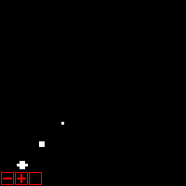
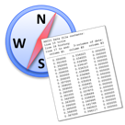
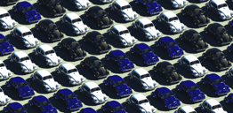
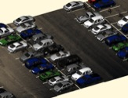
DIRSIG: The Basics
Instruments:
Imaging and
Non-Imaging Instruments
Modeling a
Real-world
Target
Platform Motion:
Dynamic location/orientation
Platform:
Attach multiple instruments
Collection Data:
Date and Time
Geometry:
3D geometry model by “natman” (Neil Taylor)
Obtained from BlendSwap
CC-BY License
Atmosphere:
Radiative Transfer
Weather (Thermodynamics)
Materials:
Surface (Bulk) Optical Properties
Thermodynamic Properties
Data Products:
Low-Level Imagery
Platform Ephemeris
Truth Data
Material
Attribution
Object Database:
Different objects
Geometry variants
Material variants
Scene
Assembly

Slide 4
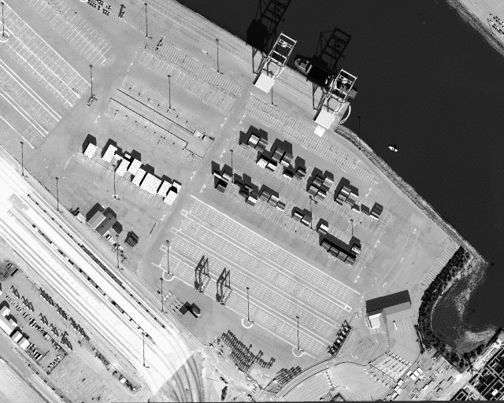

Slide 5
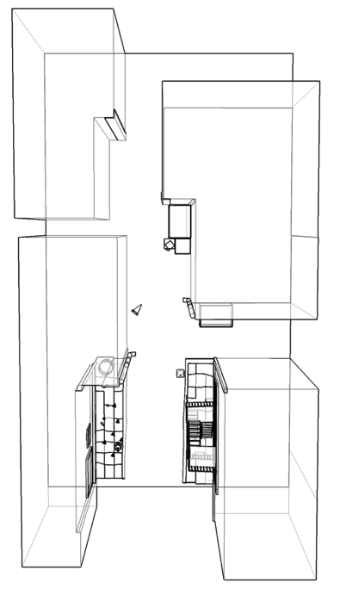
DIRSIG4 vs. DIRSIG5: Radiometry
...
...
A single sub-pixel ray spawns generations of new rays. Each sub-pixel ray triggers a lot of calculations that contribute a small fraction to the final result.
A single sub-pixel ray creates a path from the pixel to a source. Each sub-pixel ray contributes a large fraction to the final result.
DIRSIG4: Hierarchical Ray Tracing
A small number of sub-pixel rays contribute to the final result.
DIRSIG5: Path Tracing
A large number of sub-pixel rays contribute to the final result.

Slide 6
Surface Property Requirements
To implement efficient path tracing algorithms, we need to be able to perform basic tasks at each surface interaction:
Evaluate the reflectance for arbitrary source/view geometries.
Compute the directional hemispherical reflectance (DHR) for fate testing (reflect, transmit or absorb)
Generate reflected rays that follow the underlying PDF of the reflectance.
All of the above require a full BRDF definition, but these remain difficult tasks.

Slide 7
Goals
Create a single solution for non-trivial (hemi-)spherical weighting functions
Bi-directional distribution functions (BRDF & BTDF)
Scattering phase functions (BSDF)
Angular source distributions
Represent functions in a compact, efficient form
Digest regular/sparse measured data
Provide users with tools to drive the model
Performance is key – millions of queries/sec

Slide 8
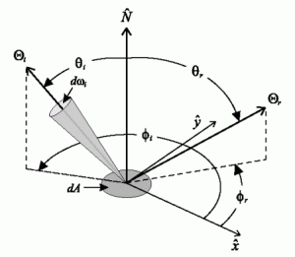
Requirements
Store
Store the function in a compact form.
Evaluate
Evaluate the function for an arbitrary incident and exitant geometry.
Integrate
Integrate the function across arbitrary solid angles.
Sample
Importance sample the function
Credit: math.nist.gov

Slide 9
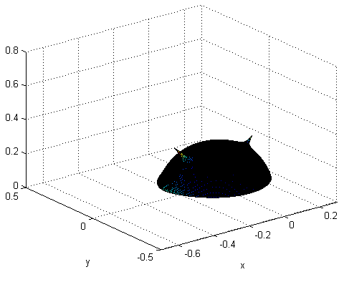
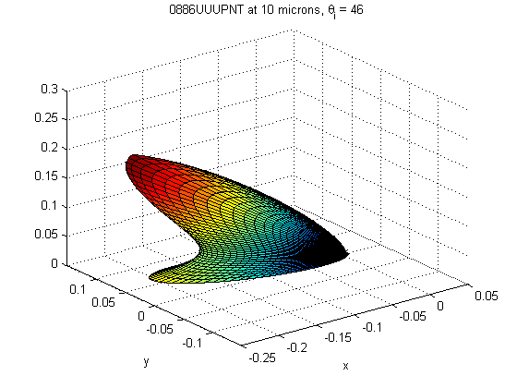
Sample
We need a way to efficiently importance sample these functions.
When drawing a large number of samples, the distribution should reflect the underlying PDF.
Diffuse materials should produce points that uniformly sample the hemisphere.
Specular materials should produce points that sample the specular lobe more than lower magnitude directions.

Slide 10
Review of Existing Approaches

Slide 11
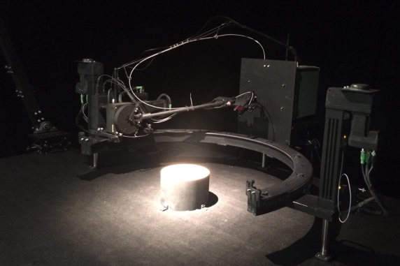
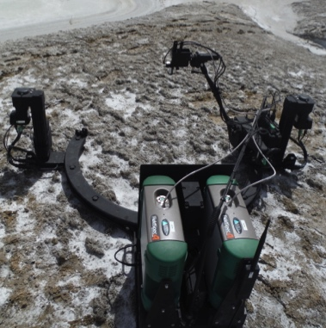
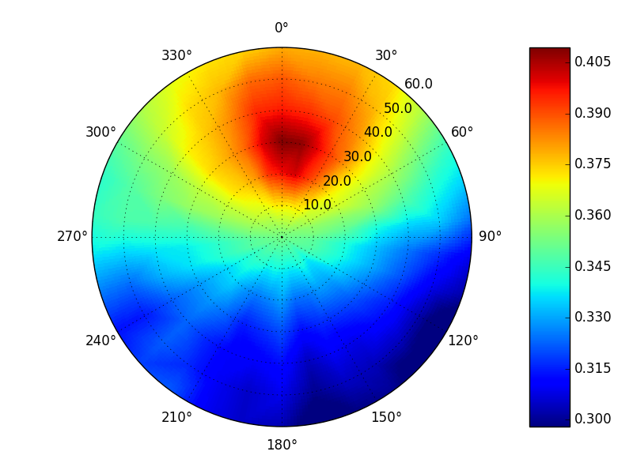
Measured BRDF Data
Each instrument measures and stores data differently, data can/will contain gaps due to mechanical constraints
Storage
High angular resolution, spectral data can quickly accumulate to 10s – 100s of GB per material.
Evaluate
Easy at measured geometries, but interpolation required for others.
Integrate
Easy for brute force solutions
Sample
Hard, requires some kind of acceleration structure to be efficient.
Goniometer of the RIT Two (GRIT-T)

Slide 12
Parametric BRDF Models
Dozens of empirical, physics-inspired, etc. parametric models exist.
Storage
Easy, small parameter set. Fits to real data can simplify shape.
Evaluate
Easy, but may involve evaluating a several trigonometric functions (expensive).
Integrate
Hard, direct or closed form solutions are model specific … if they exist at all.
Sample
A loosely fitted PDF is usually employed
Torrance-Sparrow pBRDF Model

Slide 13
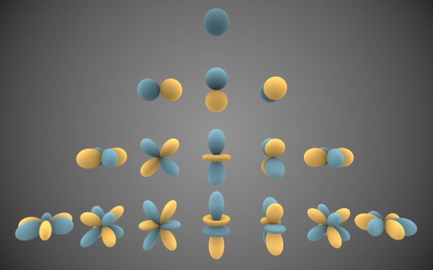
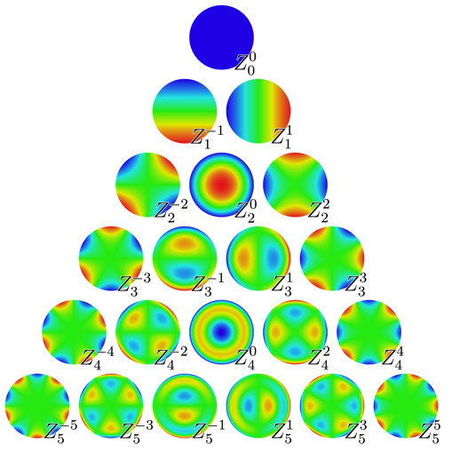
Basis Functions
Weighted basis function representations can be fit to data
A large number of weighted functions may be required for complex shapes.
Storage
Easy, store the set of weights.
Evaluate
Easy, but may involve evaluating a large number of expensive functions.
Integrate
Possible when functions have closed form integrals.
Sample
Possible when functions have compatible forms.
Spherical Harmonics
https://en.wikipedia.org/wiki/Spherical_harmonics
Zernike polynomials
https://en.wikipedia.org/wiki/Zernike_polynomials

Slide 14
Comparison
 | Evaluate | Integrate | Sample | Store
Measured | Hard, need interpolation | Depends on how data is sampled | No direct solution and usually requires approximate PDF | Can be very inefficient for large datasets
Parametric | Easy but usually involves expensive trig functions | Most functions don’t have closed-form integrals and must be sampled. | Rarely provides direct solution and usually requires approximate PDF | Very efficient since a small number of parameters are common.
Basis | Easy but may involve using a larger number of terms for complex functions. | Some basis functions have closed-form integrals, but terms must be combined | Some basis functions have direct solutions but terms must be combined. | Very efficient if function parameters are limited.
A single solution for evaluation, integrating, sampling and storing arbitrary hemispherical and spherical weighting functions is desired.

Slide 15
Data-Driven Approach
Convert any hemispherical or spherical data source into common raw data covering angular/spectral distributions
MeasuredBRDF
Data
Common Representation
Ward
model
Sampled Data
NEFDS
Beard-Maxwell
model
Sampled Data
MODIS Kernel Weights
Ross-Li
model
Sampled Data

Slide 16
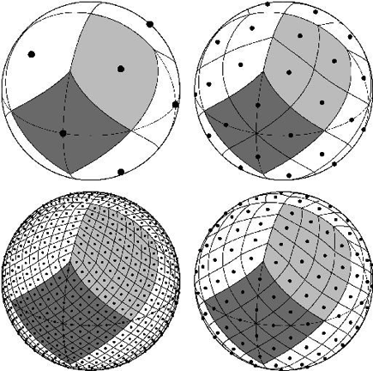
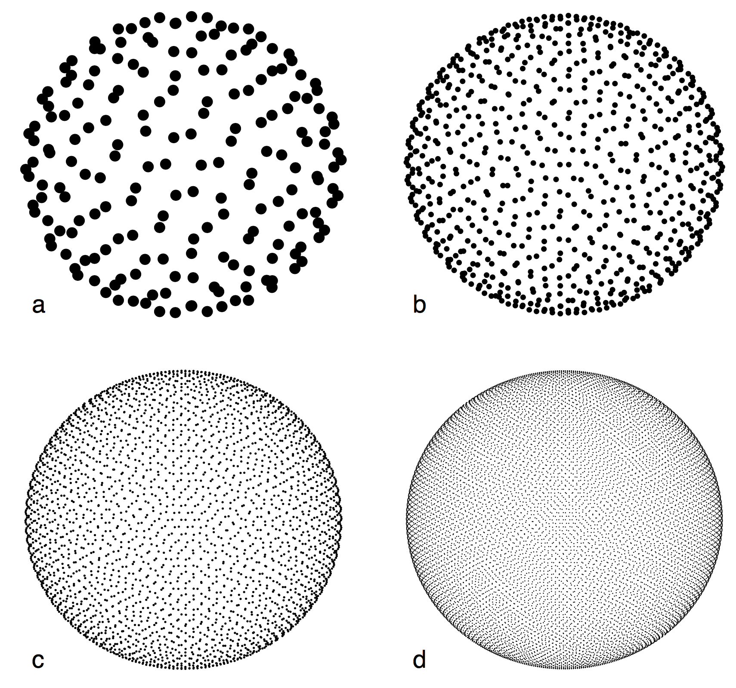
HEALPix-Based Sphere Partition
Equal area and equal shape cannot be maintained across a sphere
We use a custom implementation of the HEALPix (Hierarchical Equal Area isoLatitude Pixelization) partition designed for cosmic microwave background data (NASA/JPL)
Data is stored in twelve adaptively sub-divided "quad-trees”. We call this geometric data structure a Spherical Quad-Tree (SQT).
http://healpix.jpl.nasa.gov/healpixBackgroundPurpose.shtml

Slide 17
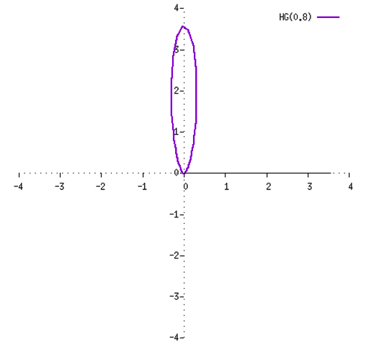
Demonstration #1: HG Phase Function
Use this data-driven representation to capture an analytical function. In this case, a SPF (Scattering Phase Function)
Single lobe, forward scattering Henyey-Greenstein function with an average cosine of 0.8
The three-dimensional function is sampled regularly at Δθ=0.0005 rad (zenith, from forward direction) and Δφ=0.05 rad (azimuth)
A moderately sized partition is used with 6 orders of subdivision per region (12 x 4⁶ = 49,152 cells); we end up having many more samples in the zenith dimension than we have cells, but that is important for capturing the lobe falloff

Slide 18
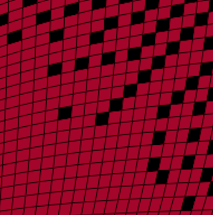
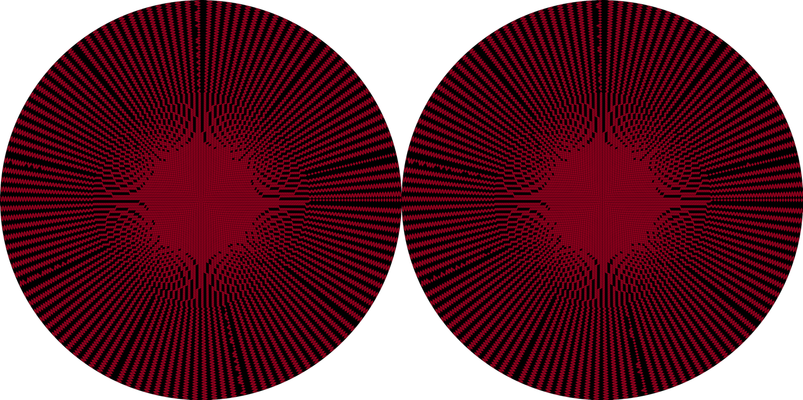
Step 1: Add data [cell count: 49,152]
Data is added in a vector/value value format
The "deepest" available cell is used to store the value (red)
Cells that don't receive data remain undefined (black)
forward hemisphere
backward hemisphere

Slide 19
Polar Samples onto Rectangular Grid
In this example, the scattering function was sampled on constant zenith and azimuth intervals.
The projection of these polar samples onto a orthogonal grid does not uniformly distribute the samples.
As a result, some grid cells have multiple samples and some have none.

Slide 20
Step 2: Aggregate and Average
If a child cell does not contain samples, collapse the cells into the parent partition.
Average samples within each partition cell to determine the value for that cell.

Slide 21
Step 2: Accumulate [cell count: 16,248]
Cells with multiple samples are averaged
Siblings cells with undefined values are aggregated into the parent cell
All cells are now defined, but may be in a different order partition
forward hemisphere
backward hemisphere

Slide 22
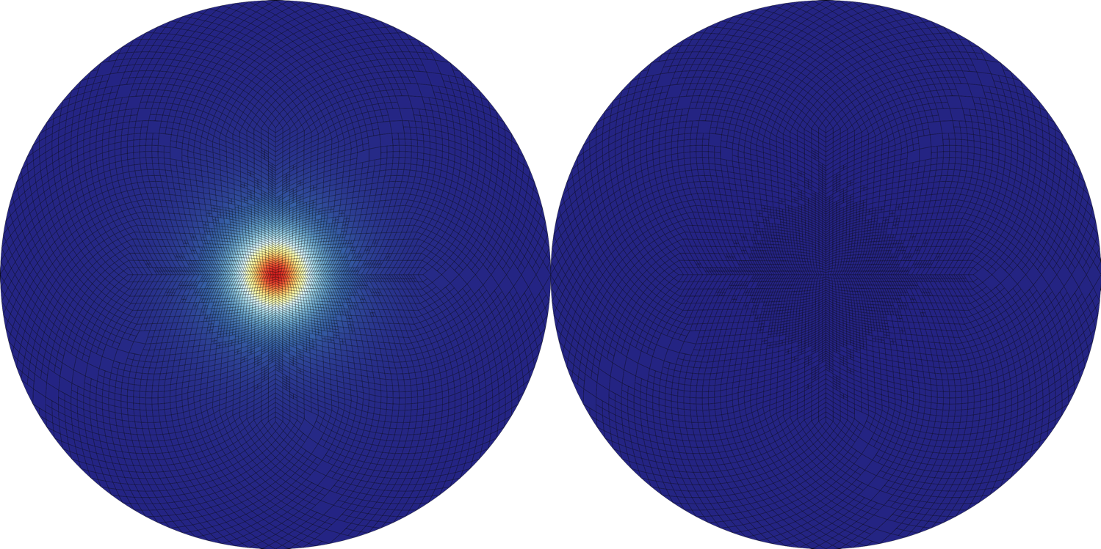
Step 3: Normalize [cell count: 16,248]
Cell values are scaled so that the integral over the sphere is one
The magnitude (integral of the sphere) prior to normalization is stored
We can now plot the relative contribution of each cell
forward hemisphere
backward hemisphere

Slide 23
Step 4: Collapse to compress
If all the child cells have the same value, then collapse into the parent.

Slide 24
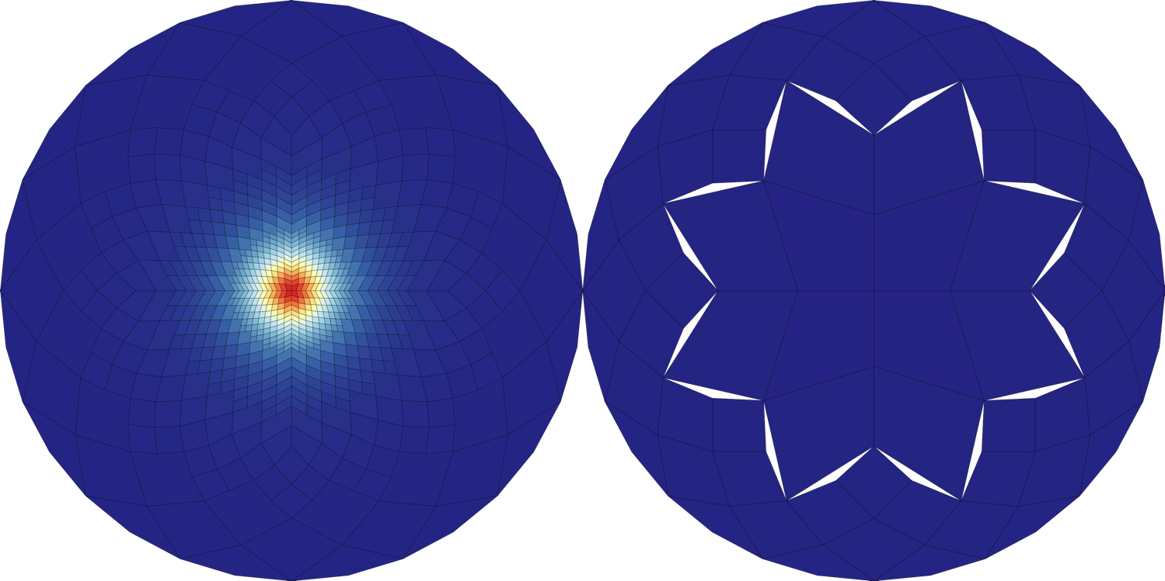
Step 4: Compress [cell count: variable]
Many neighboring cells in the normalized partition are very similar
As in accumulation we can combine those cells and store less data
The compression below uses only 828 cells
** the apparent gaps are due to the shape changing between different orders of the partition (a consequence of the equal area property); their presence here is an artifact of the visualization and the gaps do not exist in the data
forward hemisphere
backward hemisphere

Slide 25
Using the SQT Structure
The final SQT contains the normalized function (PDF) and each parent node contains the integrated value for it’s children.
The total magnitude of the entire function is stored at the “top”.
Store
The collapsed tree can be compactly stored in a binary form that can be quickly stored/loaded.
Lossless compression (currently LZMA) can further reduce storage size.
Evaluate
Map query angles to highest/deepest partition indexing, even if the quad-tree was collapsed and that cell no longer exists
Traverse the quad-tree from the top to find the deepest (closest) level to that index.
Integrate
Sum the PDF values across any desired partitions and weight by the total magnitude.

Slide 26
Sampling Approach
Random value = 0.22
Draw a uniform random from [0:1], starting at the root 12 nodes, traverse the tree by comparing the random value with the integral of the child PDFs at each node until a leaf node is reached.
0.2
0.1
0.5
0.2
0.5
0.2
0.2
0.1

Slide 27
Sampling Approach
Random value = 0.22
Draw a uniform random from [0:1], starting at the root 12 nodes, traverse the tree by comparing the random value with the integral of the child PDFs at each node until a leaf node is reached.
0.10
0.03
0.27
0.10
0.27
0.10
0.10
0.03

Slide 28
Sampling Approach
Random value = 0.22
Draw a uniform random from [0:1], starting at the root 12 nodes, traverse the tree by comparing the random value with the integral of the child PDFs at each node until a leaf node is reached.
Once the leaf node is found, a uniform sampling is performed within the solid angle defined by that node.

Slide 29
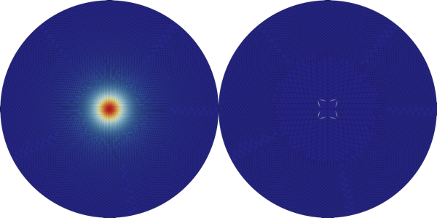
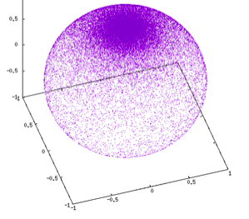
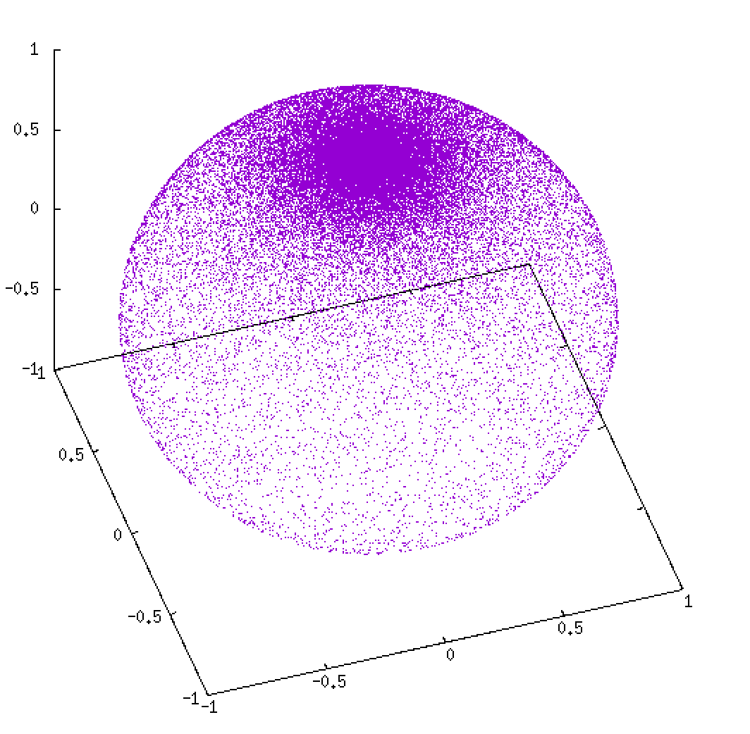
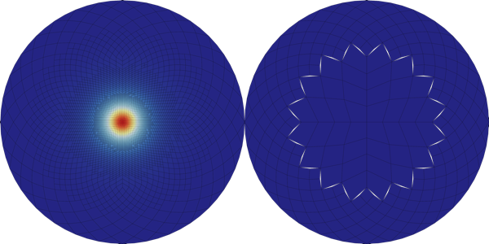
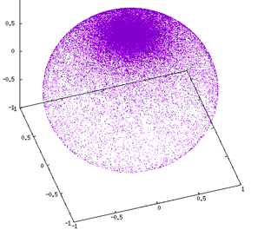
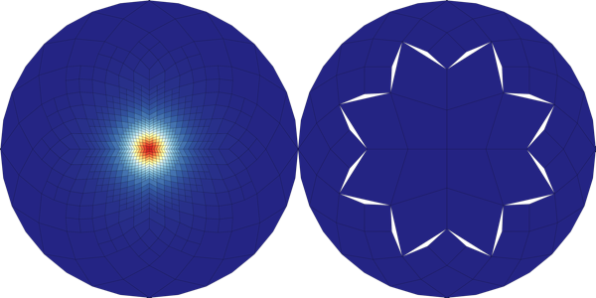
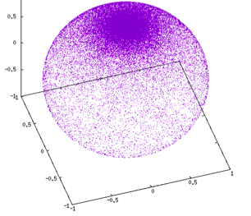
Compression and Sampling Examples: each set of samples consists of 5⁴ vectors
12,816 cells
3,798 cells
direct sampling of HG(0.8)
828 cells

Slide 30
Demonstration #2: MERL Database
The Mitsubishi Electric Research Laboratories (MERL) BRDF database includes measured data for 100 materials
Materials range from fabrics and woods to metals and plastics.
Only red, green and blue provided.
The BRDFs were extracted as “measurements” using code provided.
Extracted data converted into SQTs.
Original data was 3.3 GB (all 100 mats)
The SQT version is only 34 MB
1/100th of the original size
Summed RMSE 10⁻² 1/sr compared to peak BRDF values of 10⁺² 1/sr
The 100 MERL materials attached to a 10 x 10 grid of spheres.

Slide 31
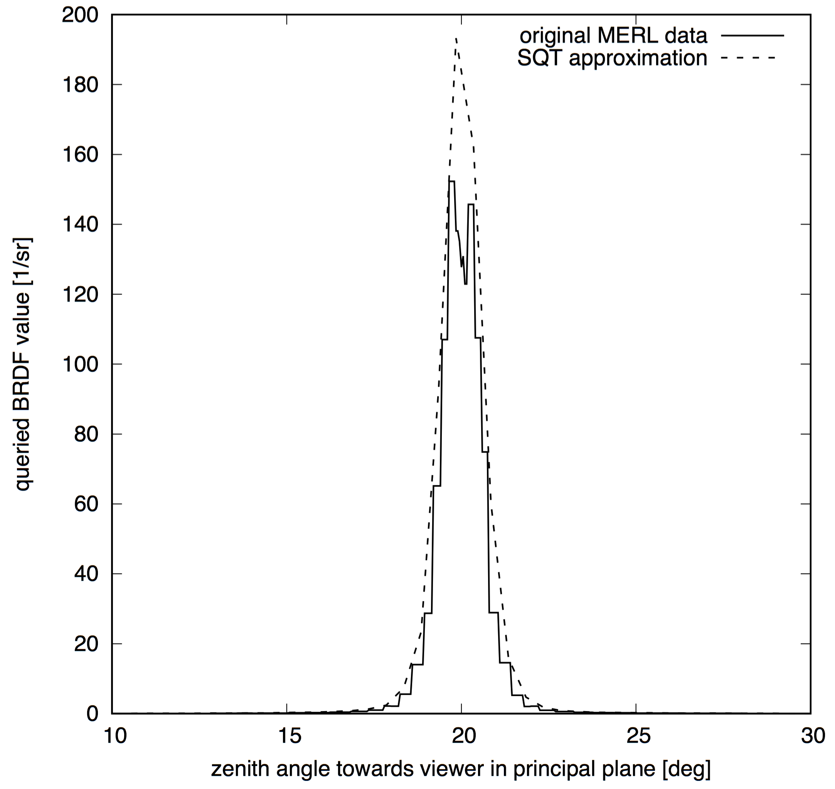
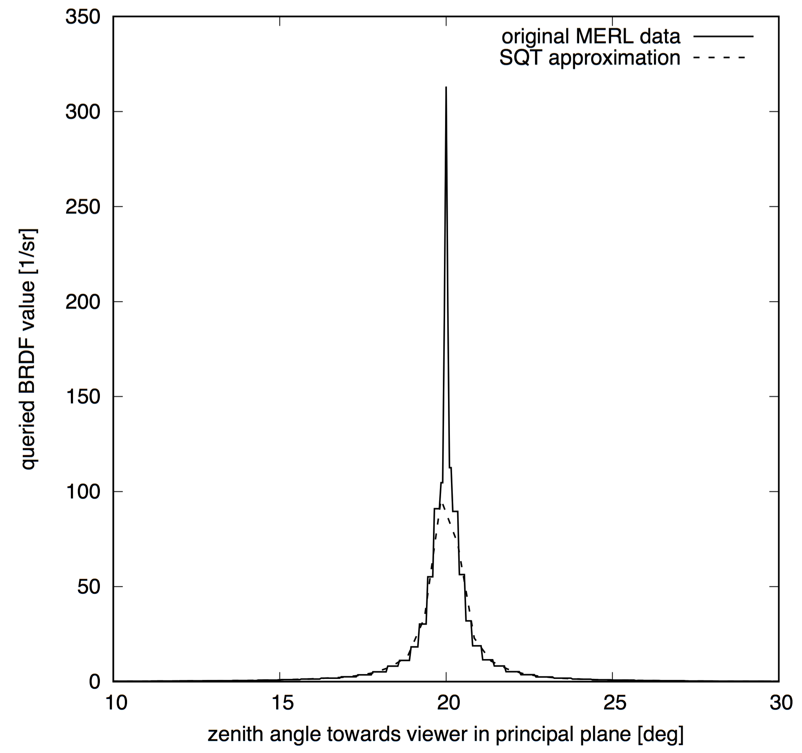

Slide 32
Parametric micro-facet based BRDF models

Slide 33
Summary
We have introduced a data-driven approach to representing hemispherical or spherical weighting functions using a geometric partitioning method.
This approach is efficient at storing, evaluating, integrating and sampling the data, which are critical tasks for Monte-Carlo methods including path tracing.
The approach has been demonstrated for spherical applications (scattering phase functions) and hemispherical applications (BRDFs).
Evaluating use for capturing angular source distributions
Angular source distributions

Slide 34
Future
DIRSIG5 only supports 3 type of materials
100% diffuse, 100% specular (delta) and SQT (everything else!)
All DIRSIG4 era BRDF models are converted to SQT automatically
Utilities to import raw data into SQTs are provided with DIRSIG5
Strongly considering providing an open source implementation of our SQT toolbox
That would include the core library, the command-line utilities (import, extract, etc.) and basic visualization methods.
Seeking feedback from community …
A GPU implementation of the “render-time” operations (evaluate, integrate and sample) is certainly possible.

Slide 35
