Slide 1
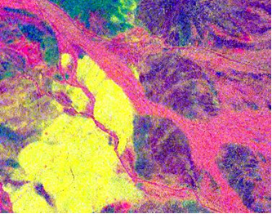
Atmospheric correction of commercial thermal infrared hyperspectral imagery using FLAASH-IR
Steven Adler-Golden, Nevzat Guler and Timothy Perkins
Spectral Sciences, Inc., Burlington, MA 01803
2018 Atmospheric Transmission Models – Modeling in Remote Sensing
4 – 6 June 2018, Boston College

Slide 2
Outline
Problem Definition
FLAASH-IR Method and Setup
Noise Suppression
Data and Results
Telops Hyper-Cam LW (see also our previous papers)
ITRES TASI-600
SPECIM AisaOWL
Summary and Conclusions

Slide 3
Problem Definition
Full exploitation of LWIR hyperspectral imagery (HSI) requires atmospheric correction processing
Retrieval and removal of atmospheric features
Temperature-emissivity separation (TES) to the extent possible
SSI has developed FLAASH-IR, a state-of-the-art algorithm based on MODTRAN
We can get good emissivity spectra from sensors like SEBASS and MAKO—what about commercial remote sensors?
Are the instrument characteristics compatible with FLAASH-IR?
Is the SNR good enough to yield clean spectra and images?
Mineral Classification Map (from SEBASS): Quartz Alunite Calcite

Slide 4
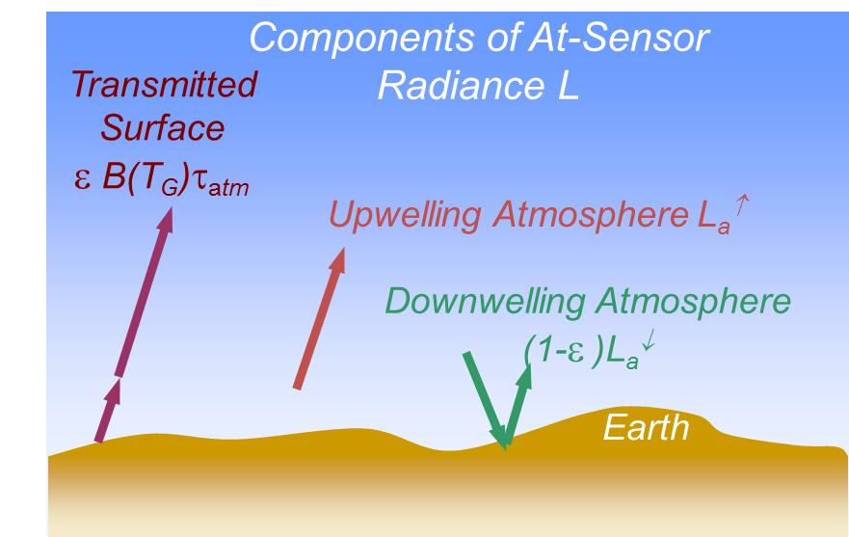
Phenomenology Overview
At-sensor radiance (at a given wavelength): L = L_{a}↑ + ε B(T_{G})τ_{atm} + (1-ε )L_{a}↓
Atmospheric Correction Procedure
Retrieve atmospheric parameters (water, ozone, temperature)
Solve for ε and T_{G} (temperature-emissivity separation)

Slide 5
FLAASH-IR Atmospheric Correction
Developed by SSI for automated thermal IR hyperspectral data processing
Constraint is spectrally smooth emissivity
Radiance error minimization drives the atmosphere and surface temperature solutions
Atmospheric spectral quantities are derived from a 3-D space of variations in air temperature, water vapor and ozone concentration
Look-up table (LUT) prepared using MODTRAN®
Atmospheric solution is a polynomial interpolate
Options:
Spectral polishing (refinement of atmospheric spectra)
Blackbody illumination component representing clouds, objects on the ground
Automated spectral calibration refinement

Slide 6
FLAASH-IR Configuration for Different Sensors
Wavelength range for retrievals
Typically start at 8.1 µm, end at longest wavelength clean band
Instrument resolution function
Gaussian for spectrographs and apodized FTIRs
Sinc function for unapodized FTIRs
If no FWHMs available, use critical sampling or multiple thereof
Spectral recalibration option
If wavelengths and FWHMs are not accurately known
Applies shift and stretch to wavelength scale, scaling to FWHMs
Alternative TES methods
Normalized Emissivity Method (NEM) and fast linear filter method
NEM sets maximum emissivity to 0.98; useful for natural materials, dry atmosphere, lower spectral resolution

Slide 7
Noise Suppression Algorithm
Background noise is prominent in commercial HSI sensors
Due to cost and size/weight limitations (FPA and cooling system)
Maximum Noise Fraction (MNF) transformation is the foundation of a number of de-noising methods
Equalizes the noise across wavelengths, transforms to principal component (PC) space
Noise-dominated “late” PCs are suppressed, then data are reconstructed
We have developed a patent-pending version of MNF denoising based on Bayesian Signal Estimation
Analytical “shrinkage functions” that shrink small values but preserve large values are applied to the PC eigenimages
In contrast to PC truncation, this method largely preserves anomalous spectra, while effectively aggregating abundant spectra
Algorithm is applied to the radiance data

Slide 8
Bayesian Signal Estimation (BSE) and Shrinkage Functions
The BSE formula uses assumed probability distributions for the signal and noise values to estimate the noise-free signal
The best-estimate signal is obtained by averaging over the continuum of noise models, weighted by Gaussian noise PDF (G) and signal prior PDF (P)
Result: Estimated x given observation y is a ratio of convolutions
x’(y) = (G * (x P(x)) )(y) / (G * P)(y)
The ratio S(y) = x’/y is < 1 and is called the shrinkage function
We use the expression S(y)=1/ [r exp(-y²)+1] where r is a function of the PC number
This is an analytical solution for a late-PC PDF consisting of a flat signal distribution (rare and anomalous spectra: large values) plus a delta function distribution (common material spectra: near zero values)

Slide 9
Outline
Problem Definition
FLAASH-IR Method and Setup
Noise Suppression
Data and Results
Telops Hyper-Cam LW (see also our previous papers)
ITRES TASI-600
SPECIM AisaOWL
Summary and Conclusions

Slide 10
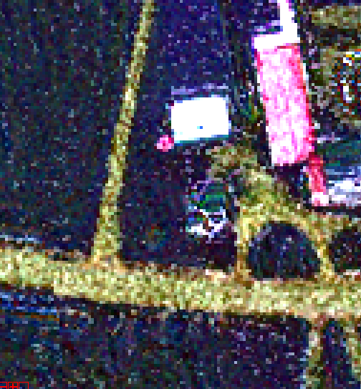
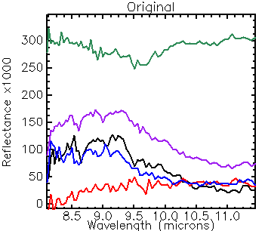
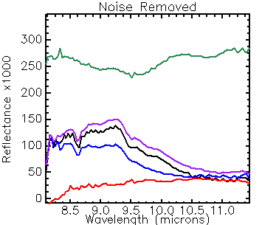
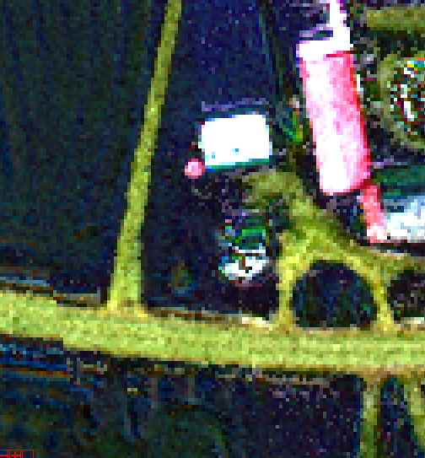
Telops Hyper-Cam LW
RGB = 8.5, 9.5, 10.5 µm
~8-11.5 µm imaging FTIR, Stirling-cooled MCT
Spectral resolution from 0.25-150 cm⁻¹
Georectified mosaics
Farmland south of Quebec City
De-noising cleans the spectra and stabilizes the TES
De-noised

Slide 11
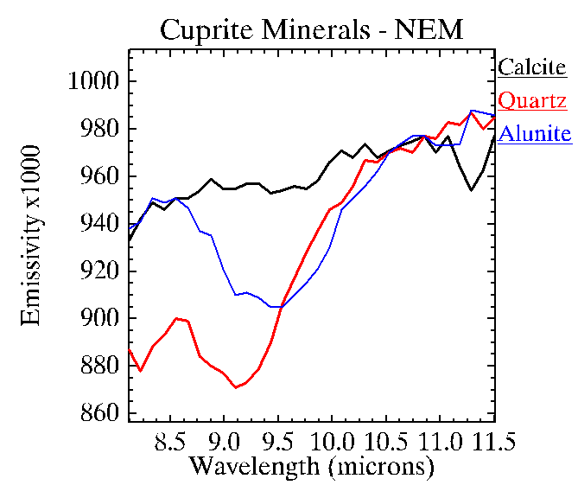
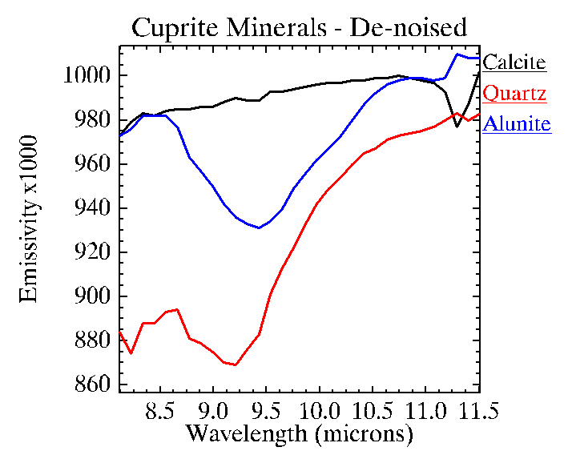
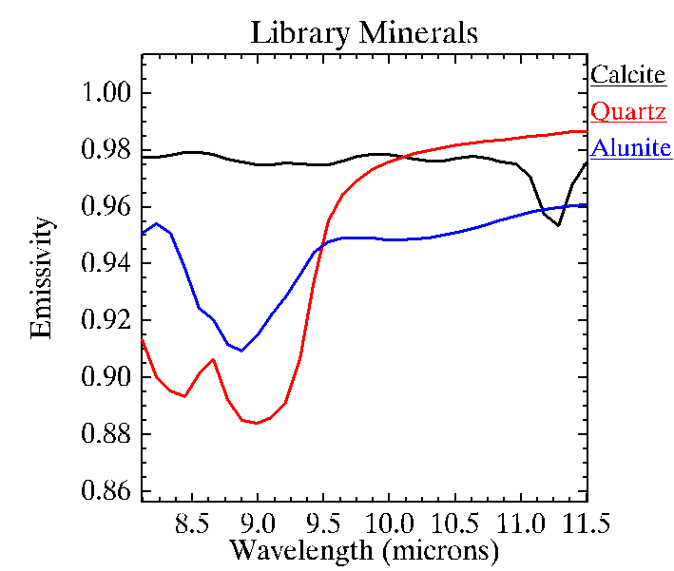
ITRES TASI-600
~8-11.5 µm refractive spectrometer, cryogenically cooled MCT
Spectral resolution ~0.13 µm
Georectified mosaics
Cuprite, NV
Absolute emissivities are slightly better with the NEM for this scene, sensor and atmosphere

Slide 12
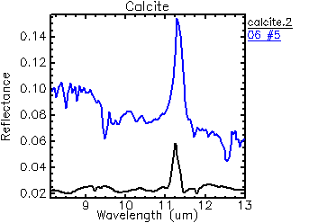
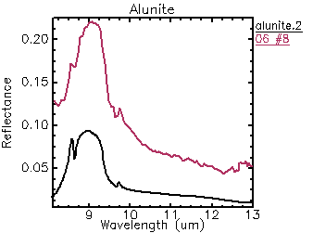
Adequacy of TASI Spectral Resolution for Mineral Mapping
SEBASS
JHU Library
TASI
SEBASS
JHU Library

Slide 13
Emissivity False Color Image Provides a Rough Mineral Map
Quartz
Alunite
Calcite
710 x 570 m, NEM, De-noised
RGB = 8.2, 10.0, 11.5 µm

Slide 14
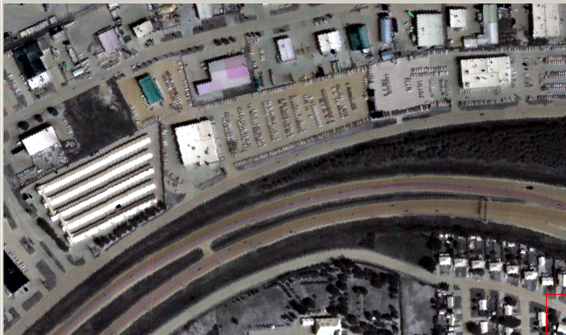
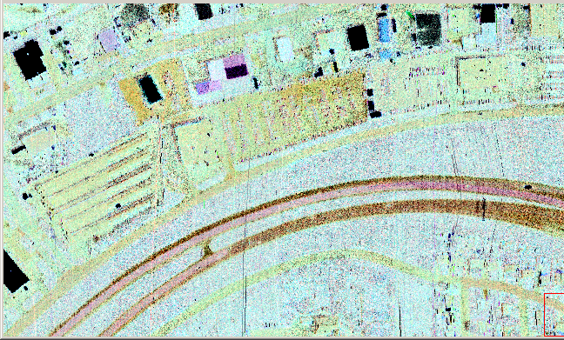
Urban TASI Data – Beauport
Google Maps
Radiance
FLAASH-IR Emissivity (no de-noising)
R=11.2µm G=10.4 µm B=9.1µm

Slide 15
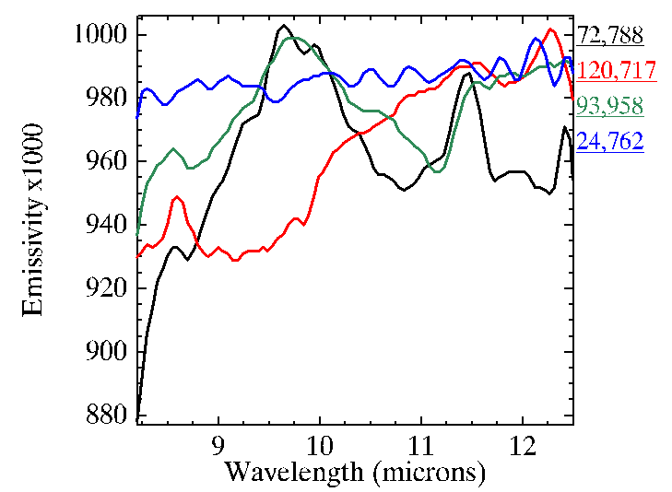
SPECIM AisaOWL
~8-12.3 µm grating spectrometer, Stirling-cooled MCT
Spectral resolution 0.10 µm
Georectified mosaics
Blackbody
Calcite?
Quartz
RGB = 8.5, 10.0, 11.5 µm
South Cornelly, UK stone quarry (de-noised)

Slide 16
Summary & Conclusions
FLAASH-IR works well with all three commercial sensors
The Hyper-Cam LW has the best SNR and spectral resolution
Good SNR likely due to the FTIR multiplex advantage
The AisaOWL has the widest spectral range
Usable response almost 1 µm beyond the other two sensors
All three sensors benefit from noise suppression
All three sensors should be useful for surface classification
These sensors may not have enough SNR and/or spectral range for stressing applications in rare-material and low-concentration gas detection
Noise suppression probably cannot help here
Acknowledgements: SSI IR&D; Martin Chamberland (Telops), Jason Howse (ITRES), Timo Hyvarinen (SPECIM)

