Slide 1
Real-time Aerosol Loading
Measurements at Two Separated Sites
11 April 2018
13 April 2018
17 April 2018

Slide 2
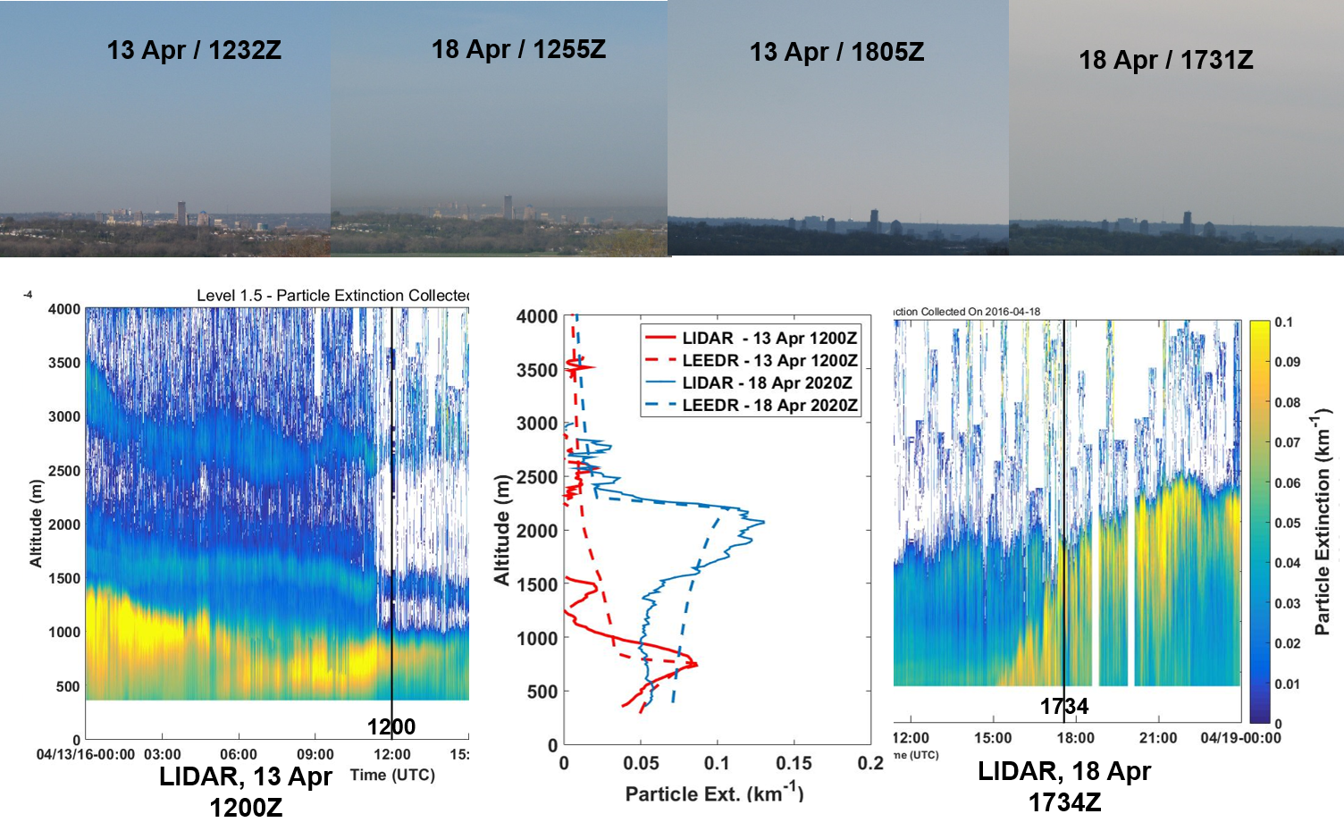
Real-time Aerosol Loading
Day and Night, Cloudy or Sunny
Sky and visibility conditions as seen from AFIT were collected in conjunction with surface aerosol concentrations, LIDAR, and AERONET (Dayton OH site) data over at five-day period. An increase in haze from 13 April to 18 April 2017 is evident in the visible imagery. A peak in LIDAR particle extinction is noted at 750m and 2000m on 13 and 18 April, respectively. Scaling surface aerosol loading within LEEDR using CPC measurements resulted in a very realistic, height resolved aerosol extinction profile, which closely matched the LIDAR measurement. These height-resolved aerosol extinction profiles are not retrievable using AERONET data.

Slide 3
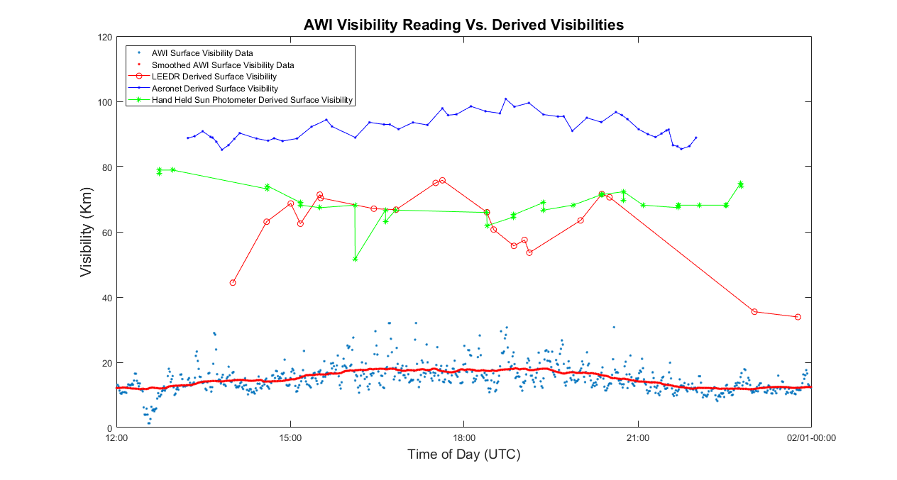
Visibility via Sunphotometer,
Particle Counter and Transmissometer

Slide 4
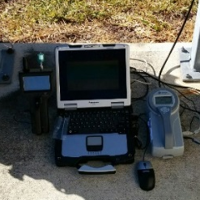
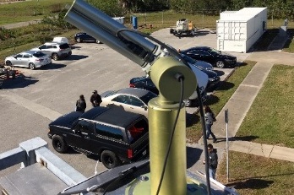
Sunphotometers, Particle Counters and Transmissometers
Condensation Particle
Counter
Alternatively, atmospheric extinction / transmission can be described with respect to scale height
MICROTOPS Handheld
Aeronet
DATE | TIME | AOT500 | B_{ext(mol)} | B_{ext(aer) _ Alt} | Surf Vis_{_Alt} (km)
1/31/2017 | 15:10:52 | 0.064 | 0.012 | 0.032 | 68.18181818
1/31/2017 | 15:30:44 | 0.065 | 0.012 | 0.0325 | 67.41573034
1/31/2017 | 16:06:53 | 0.064 | 0.012 | 0.032 | 68.18181818
1/31/2017 | 16:07:09 | 0.092 | 0.012 | 0.046 | 51.72413793
1/31/2017 | 16:38:30 | 0.066 | 0.012 | 0.033 | 66.66666667
1/31/2017 | 16:38:43 | 0.071 | 0.012 | 0.0355 | 63.15789474
1/31/2017 | 16:48:56 | 0.066 | 0.012 | 0.033 | 66.66666667
1/31/2017 | 18:23:29 | 0.067 | 0.012 | 0.0335 | 65.93406593
1/31/2017 | 18:23:43 | 0.073 | 0.012 | 0.0365 | 61.8556701
1/31/2017 | 18:50:53 | 0.069 | 0.012 | 0.0345 | 64.51612903
1/31/2017 | 18:51:08 | 0.068 | 0.012 | 0.034 | 65.2173913
DATE | TIME | AOT500 | B_{ext(mol)} | B_{ext(aer) _ Alt} | Surf Vis_{_Alt} (km)
1/31/2017 | 15:07:04 | 0.0437 | 0.012 | 0.02185 | 88.62629247
1/31/2017 | 15:22:04 | 0.04105 | 0.012 | 0.020527 | 92.23248736
1/31/2017 | 15:37:21 | 0.03959 | 0.012 | 0.019797 | 94.35000708
1/31/2017 | 15:43:16 | 0.04101 | 0.012 | 0.020503 | 92.30059226
1/31/2017 | 16:07:20 | 0.04347 | 0.012 | 0.021736 | 88.92577662
1/31/2017 | 16:22:04 | 0.04013 | 0.012 | 0.020063 | 93.56725146
1/31/2017 | 16:37:07 | 0.04057 | 0.012 | 0.020283 | 92.92816653
1/31/2017 | 16:43:04 | 0.04057 | 0.012 | 0.020284 | 92.92528807
1/31/2017 | 16:52:05 | 0.04159 | 0.012 | 0.020795 | 91.47875406
1/31/2017 | 17:07:04 | 0.04014 | 0.012 | 0.020072 | 93.53953604
1/31/2017 | 17:22:03 | 0.04069 | 0.012 | 0.020344 | 92.75434013
Std Atm
Realistic Atm
  Tomasi, C.: " Features of the Scale Height for Particulate Extinction in Hazy Atmospheres" J. Appl. Meteor. Vol 21, pp. 931-944 (1982) and embedded refs.
  Petty, G. 2004: A First Course in Atmospheric Radiation. Sundog Publishing, 444pp.
NASA Aeronet Sunphotometer

Slide 5
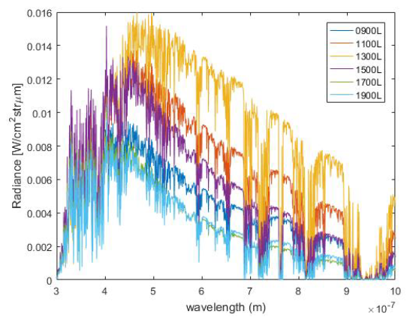
Daytime Sky Brightness Characterization
In terms of ease of obtaining the necessary data as well as the accuracy and speed of the analysis, what is optimal for evaluating daytime satellite detection and tracking?
Obtain sky radiance measurements from a telescope and UV to Near IR spectro-radiometers are beneficial
Compare those measurements with modeled comparisons using LEEDR with locally observed atmospheric and environmental observations
Determine what is necessary to properly quantify the background sky radiance during daylight.
Modeled spectral radiance from LEEDR of the GEO-belt taken over the course of the day on 8 Aug 2017 from Dayton, OH.

Slide 6
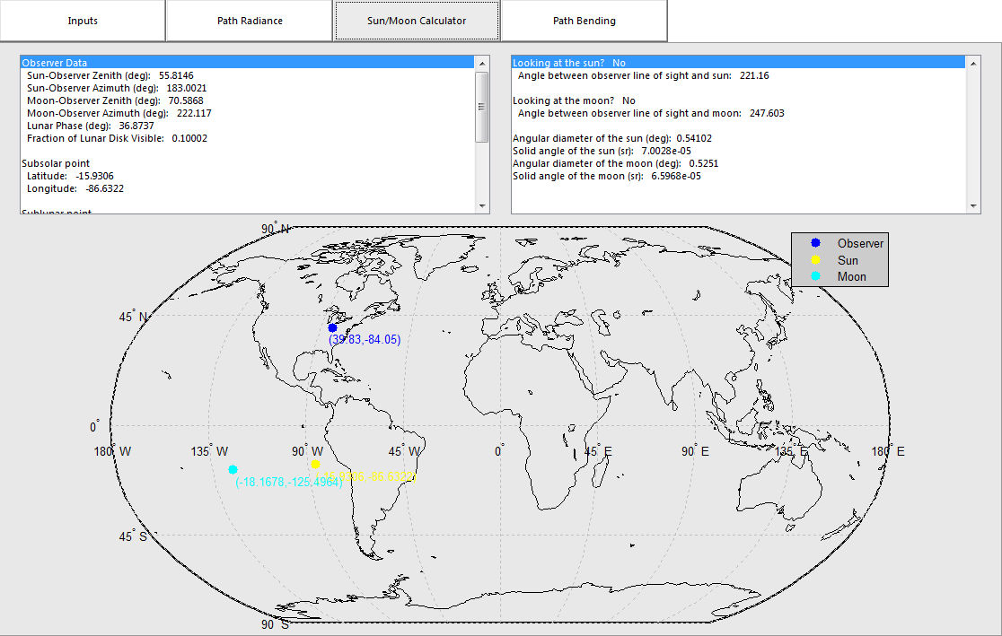
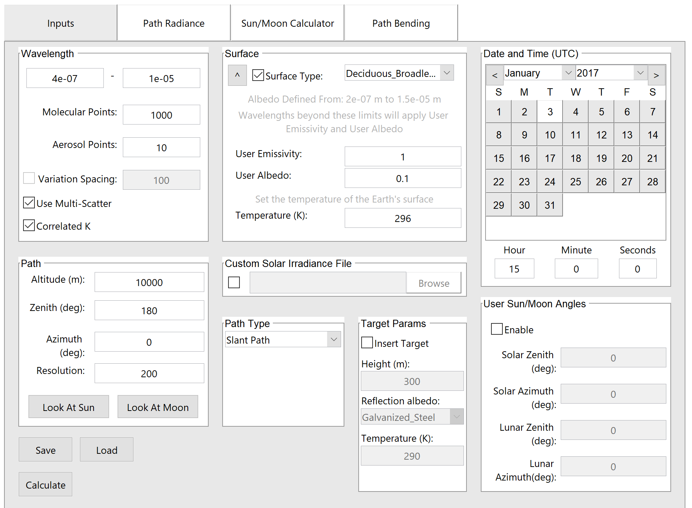
Daytime Sky Brightness Characterization
LEEDR Path Radiance
Important for Solar/Lunar Calculations!

Slide 7
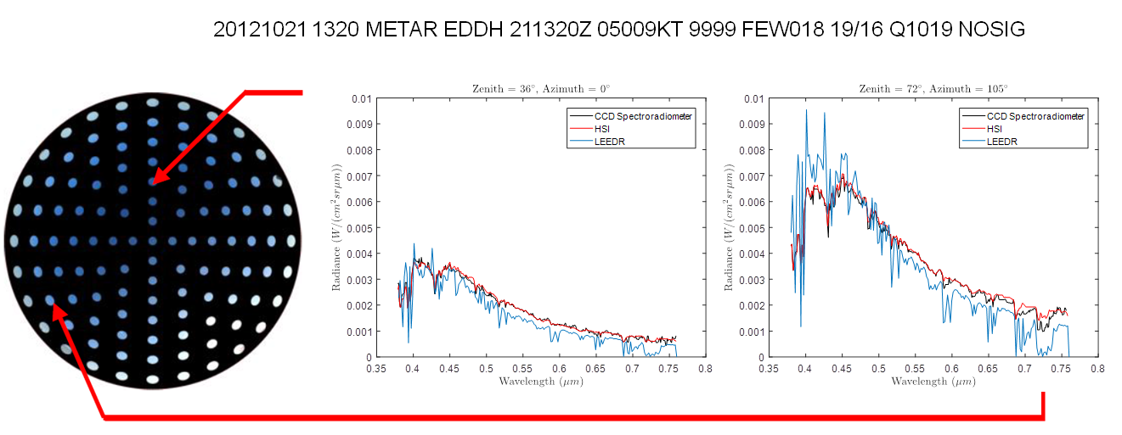
Radiance Validation – Clear Sky
HSI- and CCD-Radiance Comparisons
HSI- all sky image, CDD and HSI-measured (black and red lines) and LEEDR simulated spectral radiance (blue lines) on 21 October 2012 at 1312 UTC (clear sky). The HSI all sky image (reproduced from Tohsing et al. (2014)) is shown on the left while spectral radiance for two azimuthal and zenith angles of 0º and 36º and 105º and 72º are shown in the center and right respectively. A METAR weather observation for a nearby site is also provided noting observed temperature, dew point, wind speed, cloud cover, and precipitation conditions.
LEEDR radiance plot (blue) used the observed Hamburg surface weather conditions of unlimited visibility (aerosol concentration set to 40% GADS default), temperature = 19º C, and dew point = 16º C.
Burley, J.L., S.T. Fiorino, B. Elmore, and J. Schmidt, 2017:
“A Fast Calculating Two-Stream-Like Multiple Scattering Algorithm that
Captures Azimuthal and Elevation Variations” J. Appl. Meteor. Climatol. 56:11,
pp. 3049-3063. DOI:10.1175/JAMC-D-17-0044.1.
Validation of spectral sky radiance derived from all-sky camera images – a case study
K. Tohsing, M. Schrempf, S. Riechelmann, and G. Seckmeyer
Institut für Meteorologie und Klimatologie, Leibniz Universität Hannover, Herrenhäuser Straße 2, Hanover 30419, Germany

Slide 8
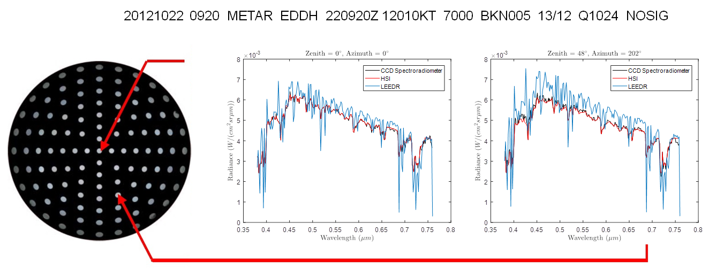
Radiance Validation – Low Overcast
HSI- and CCD-Radiance Comparisons
HSI- all sky image, CDD and HSI-measured (black and red lines) and LEEDR simulated spectral radiance (blue lines) on 22 October 2012 at 0929 UTC (overcast sky). The HSI all sky image (reproduced from Tohsing et al. (2014)) is shown on the left while spectral radiance for two azimuthal and zenith angles of 0º and 0º and 202º and 48º are shown in the center and right respectively. A METAR weather observation is also provided noting observed temperature, dew point, wind speed, cloud cover, and precipitation conditions.
LEEDR radiance plot (blue) used the observed Hamburg surface weather conditions of 7 km visibility (aerosol concentration 190% GADS default), temperature = 13º C, dew point = 12º C, and stratus continental overcast 150 m to 3000 m.
Burley, J.L., S.T. Fiorino, B. Elmore, and J. Schmidt, 2017:
“A Fast Calculating Two-Stream-Like Multiple Scattering Algorithm that
Captures Azimuthal and Elevation Variations” J. Appl. Meteor. Climatol. 56:11,
pp. 3049-3063. DOI:10.1175/JAMC-D-17-0044.1.
Validation of spectral sky radiance derived from all-sky camera images – a case study
K. Tohsing, M. Schrempf, S. Riechelmann, and G. Seckmeyer
Institut für Meteorologie und Klimatologie, Leibniz Universität Hannover, Herrenhäuser Straße 2, Hanover 30419, Germany

Slide 9
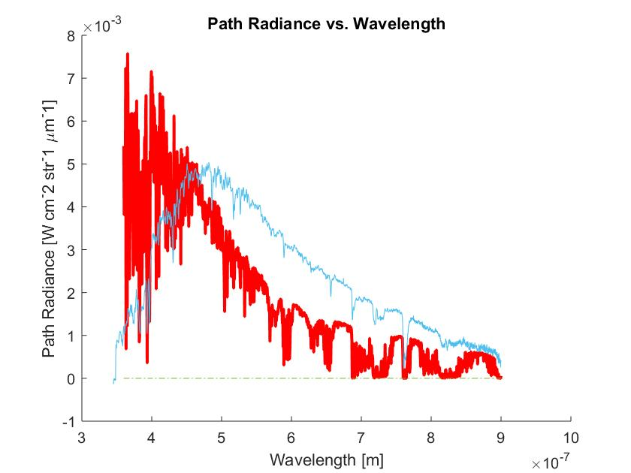
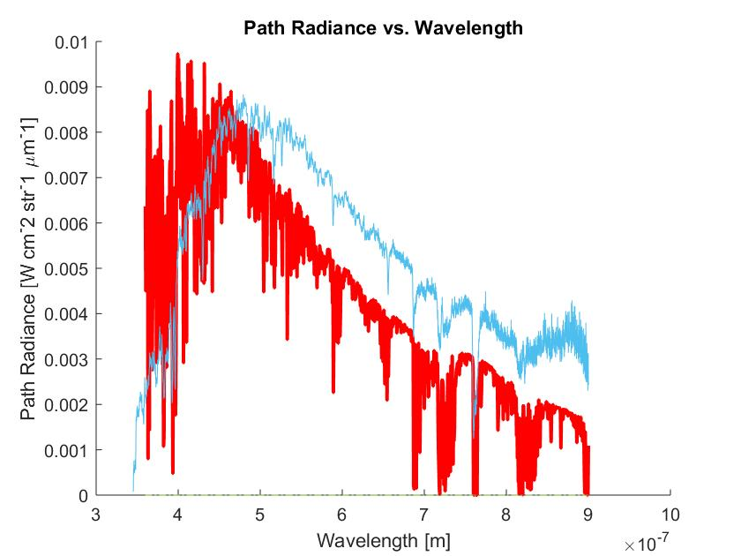
Sky Radiance Validation – Default Aerosol Conc
Capt Thomas Radiance Measurements
Blue=Measurement
Red=LEEDR
100 radiative layers
0.05 Aerosol multiplier
Blue=Measurement
Red=LEEDR
100 radiative layers
1.75 Aerosol multiplier
0900 Local 26 Aug 17
1700 Local 26 Aug 17

Slide 10


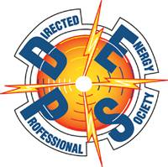
Summary
Laser Environmental Effects Definition and Reference (LEEDR) code
Real-time atmospheric and environmental data
Described methodology to characterize daytime sky brightness with LEEDR + locally observed meteorological and aerosol loading and compared to direct sky UV to near IR spectral imaging
Future work:
  Extend sky collections and LEEDR + local “met” / aerosol obs to validate approach’s utility for overcast, night time / twilight conditions
  Mature use of numerical weather inputs, including aerosol transport / chemistry (i.e. NOAA’s WFR-Chem)
  Develop day/night, any weather sensor decision aid

