Slide 1
IEEE Geoscience and Remote Sensing Society’s
2018 Atmospheric Transmission Models-Modeling in Remote Sensing Meeting
Coupled Surface Observations of Temperature, Pressure, and Humidity with
Surface Aerosol Particle Counts for
Daytime Sky Radiance Quantification
05 June 2018
Lt Scott Wolfmeyer¹, Capt Grant Thomas², and Dr Steven Fiorino¹
¹Department of Engineering Physics, Air Force Institute of Technology, 2950 Hobson Way,
Wright-Patterson AFB, OH 45433-7765
²Department of Aeronautical and Astronautical Engineering, Air Force Institute of Technology, 2950 Hobson Way, Wright-Patterson AFB, OH 45433-7765
Distribution A. Cleared for public release. Distribution unlimited

Slide 2



Overview
Abstract:
Daytime sky radiance can be characterized using the LEEDR code in any direction at any time as long as there is enough real-time observed information provided. The important questions to answer are how much real-time information is needed, how difficult is it to obtain, and would it be worthwhile to even try to measure or diagnose some of the inputs.
Laser Environmental Effects Definition and Reference (LEEDR) code
Real-time atmospheric and environmental data
Characterizing daytime sky brightness with LEEDR + real-time data measurements
Is more than surface data needed? How important is aerosol vertical extinction structure?
Summary

Slide 3

Laser Environmental Effects Definition and Reference
Atmospheric characterization and radiative transfer code that calculates line-by-line and spectral band solutions by creating correlated, physically realizable profiles of meteorological and environmental effects (e.g. gaseous and particle extinction, optical turbulence, and cloud free line of sight) data
Accesses terrestrial and marine atmospheric and particulate climatologies
  Graphical access to and export of probabilisitc data from the Extreme and Percentile Environmental Reference Tables (ExPERT)
Characterizes effects from 200 nm to 8.6 meters

Slide 4
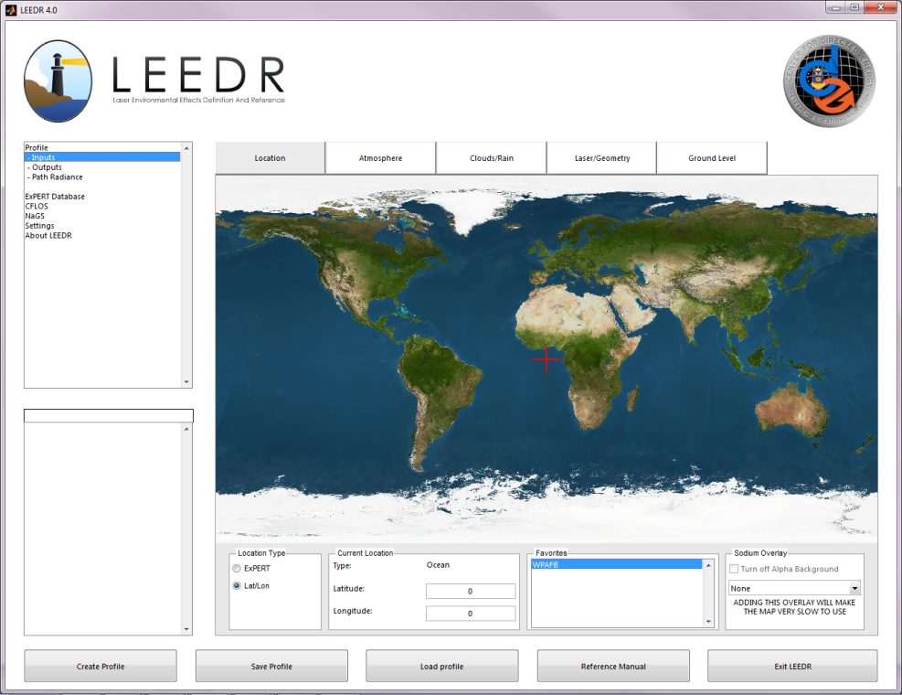
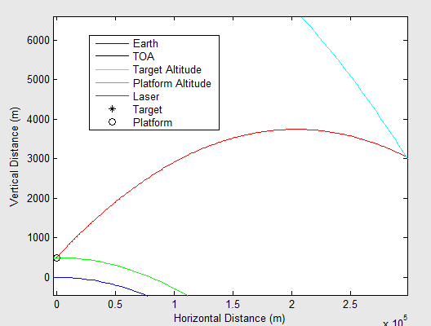
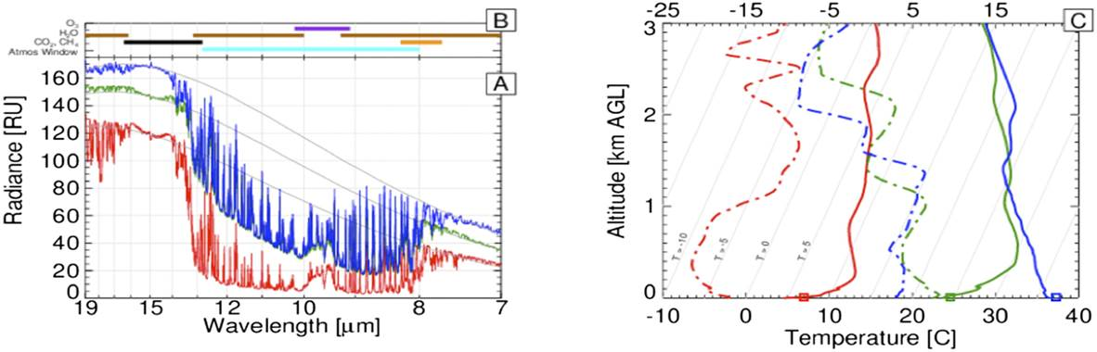
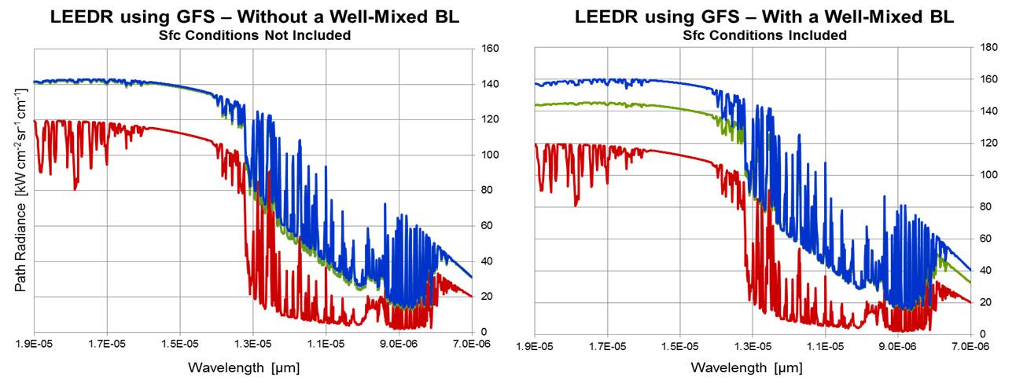
LEEDR Capabilities
Light Refraction: Path Bending
  Creates physically realizable horizontal / vertical profiles of meteorological and weather event data and associated radiative effects (e.g. optical extinction, path radiance):
  Aerosol and surface observation (i.e. T, P, RH) climatology at 573 ExPERT and 1° x 1° oceanic grid locations
  Numerical weather forecast, re-analysis data
  Profiles optical turbulence (i.e. C_{n}²)
  Accounts for light-refraction and single/multi-scatter
  Includes sun-moon calculator
*
Intended Path
Stray laser light
Path Radiance: Tracker SNR
Red: 7 Nov 2012 at 1125Z
Green: 27 June 2013 at 1132Z
Blue: 27 June 2013 at 1731Z
V&V’d Atmospheric Effects and Radiative Transfer Code for HEL
LEEDR and observed (LIDAR) extinction profiles
Boundary Layer - Aerosol Extinction Increasing with Height

Slide 5
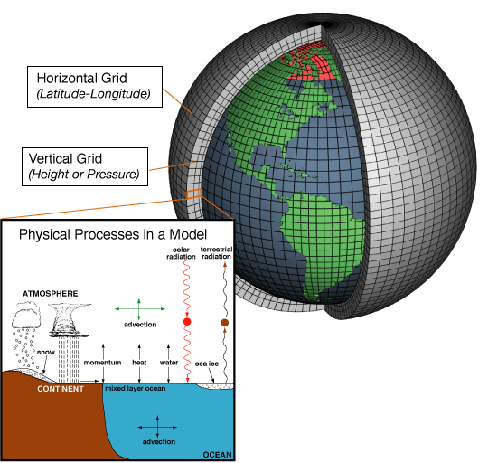
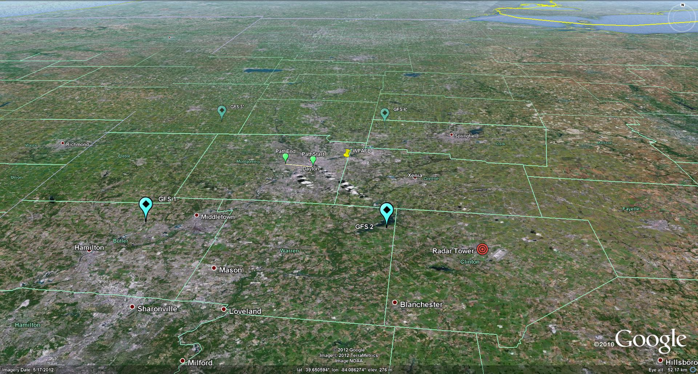
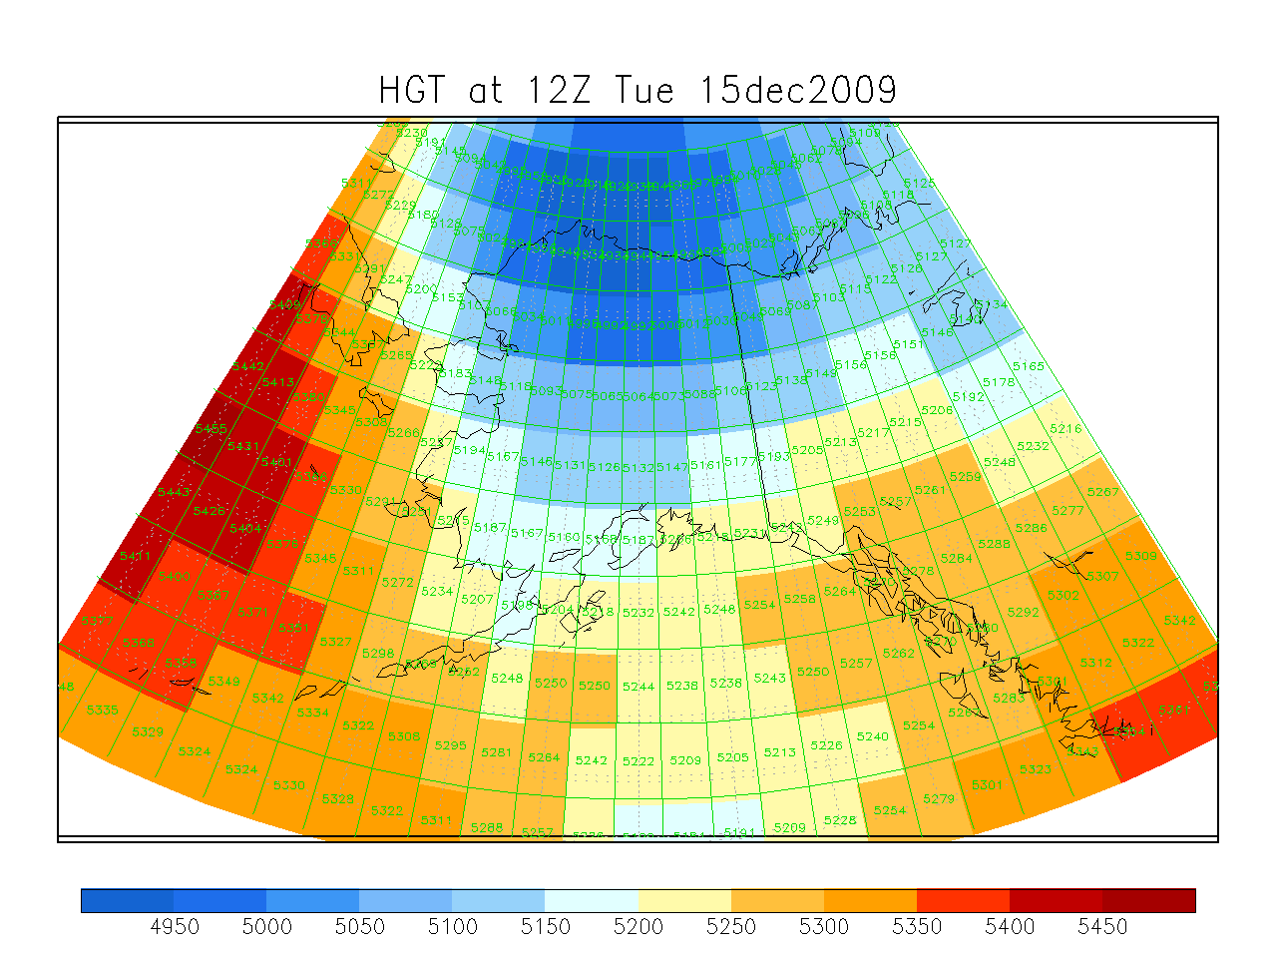
Numerical Weather Prediction Data
Current climo-based atmospheric / propagation sim
Evaluate / compare characterization methods
Supports V&V
Develop optimization analysis and tools (e.g. Path Bending, Deep Turbulence)
Integrate gridded numerical Wx forecast data and remote sensor profiles
Evaluate impact:
Dwell time analysis
Invest gridding, 3D NWP-derived nowcast, forecast, post-event atmosphere to verify / enhance simulation
Atmosphere for scenario’s propagation path interpolated from GFS grid data
GFS 3
GFS 4
Dayton OH
7 km path
GFS 1
Global Forecast System (GFS)
Global 3-D gridded GFS data available with 0.5 deg horizontal resolution, and 3-hour time increments

Slide 6

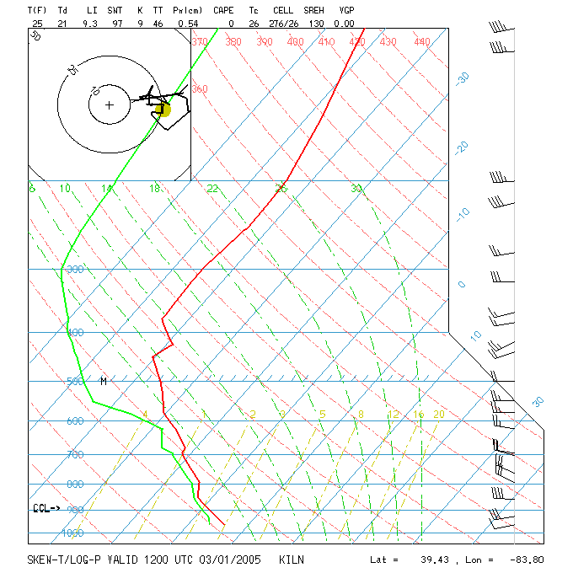
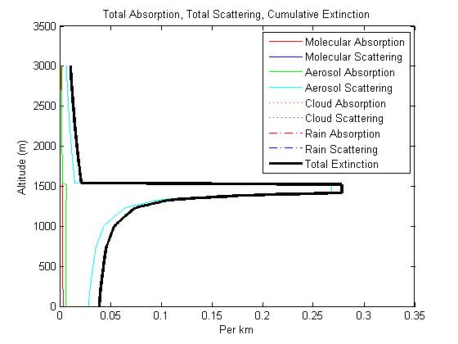
Atmospheric Boundary Layer
Description
  Well mixed layer up to 1.5-2.0 km thick
  Capped by temperature inversion
Effects
  Trap pollutants & aerosols
  Location of wind shear
  Atmospheric turbulence (surface layer)
  Increasing RH & extinction with height
WPAFB
Notes:
One of the most important aspects of the LEEDR is its boundary layer characterization. The lowest, most dense part of the atmosphere is quantified by the surface properties (climatologically we have lots of surface data, upper air data are much sparser in time and space). This can be done because the atmosphere is well mixed in the lowest layers where the wind interacts with terrain. Thus the boundary layer varies in depth based on wind speed and surface roughness. Over land the BL can be 1-2 km thick (~1.5 km) during the day when winds are typically strongest. At night the BL typically crashes to only a few hundred meters thick. Over the ocean the BL is always about 400-500 m thick due to the relative smoothness of the ocean surface. In the well mixed BL temperature decreases at a known adiabatic rate and every other parameter is relatively constant. So the relative humidity increases with height, allowing soluble (hygroscopic) aerosols to increase in size. Thus the “Fiorino Spike” in aerosol scattering near the top of the BL.

Slide 7
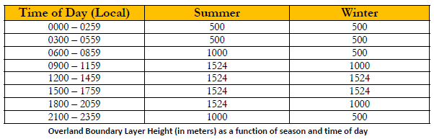
Boundary Layer Characterization
Variability by Time & Season
Dry adiabatic temperature lapse rate
Moist (saturated) lapse rate
Lapse rate of dewpoint temperature
NOTE: Ocean boundary layer is set at 500 meters for all times and seasons
Moist (saturated) lapse rate

Slide 8
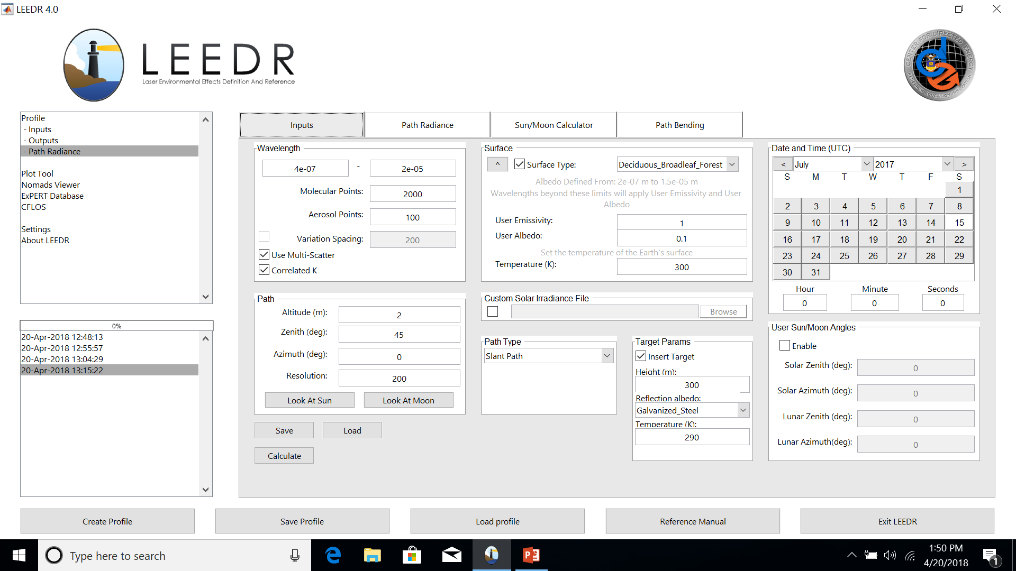
Full Atmospheric + Target Radiative Transfer for EO/IR & HEL Scene Generation

Slide 9
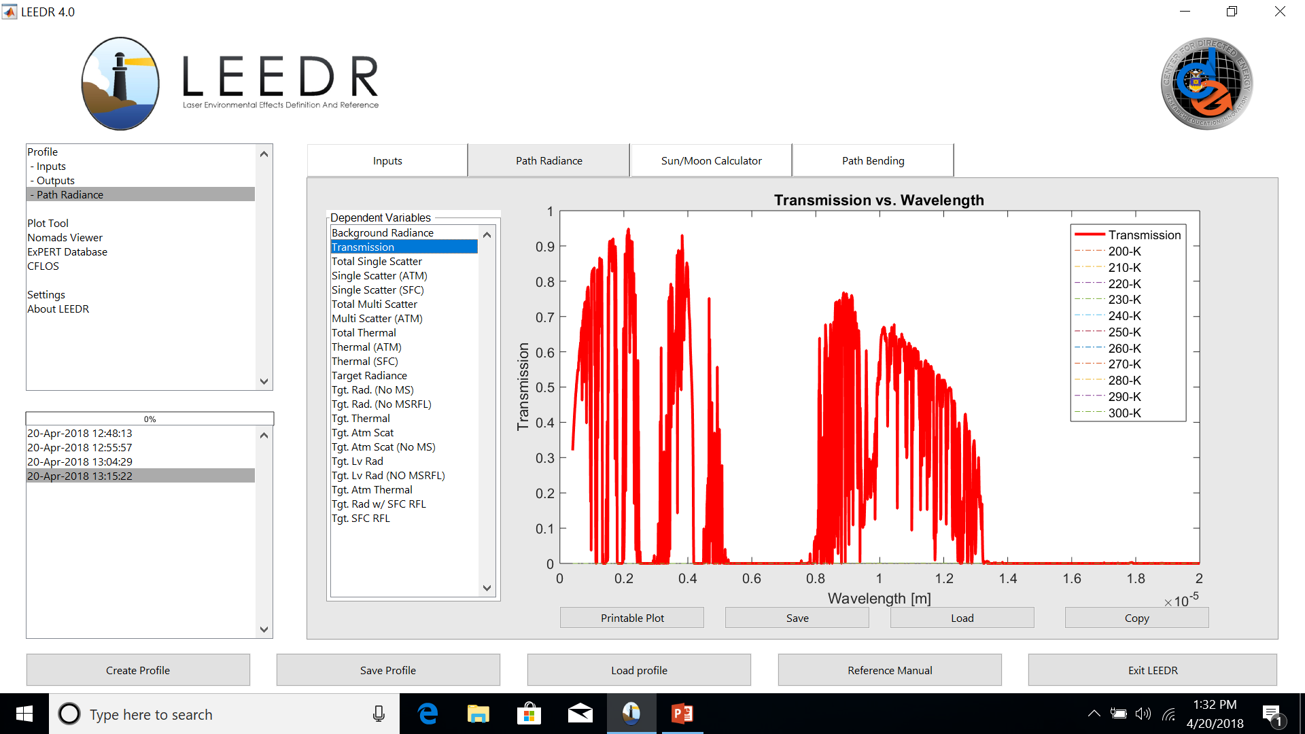
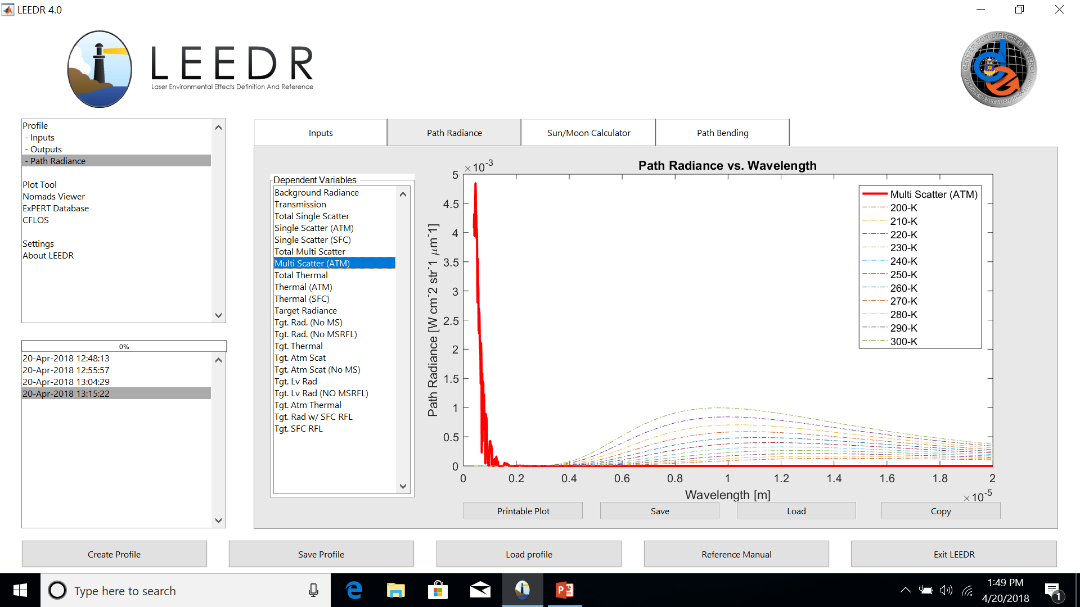
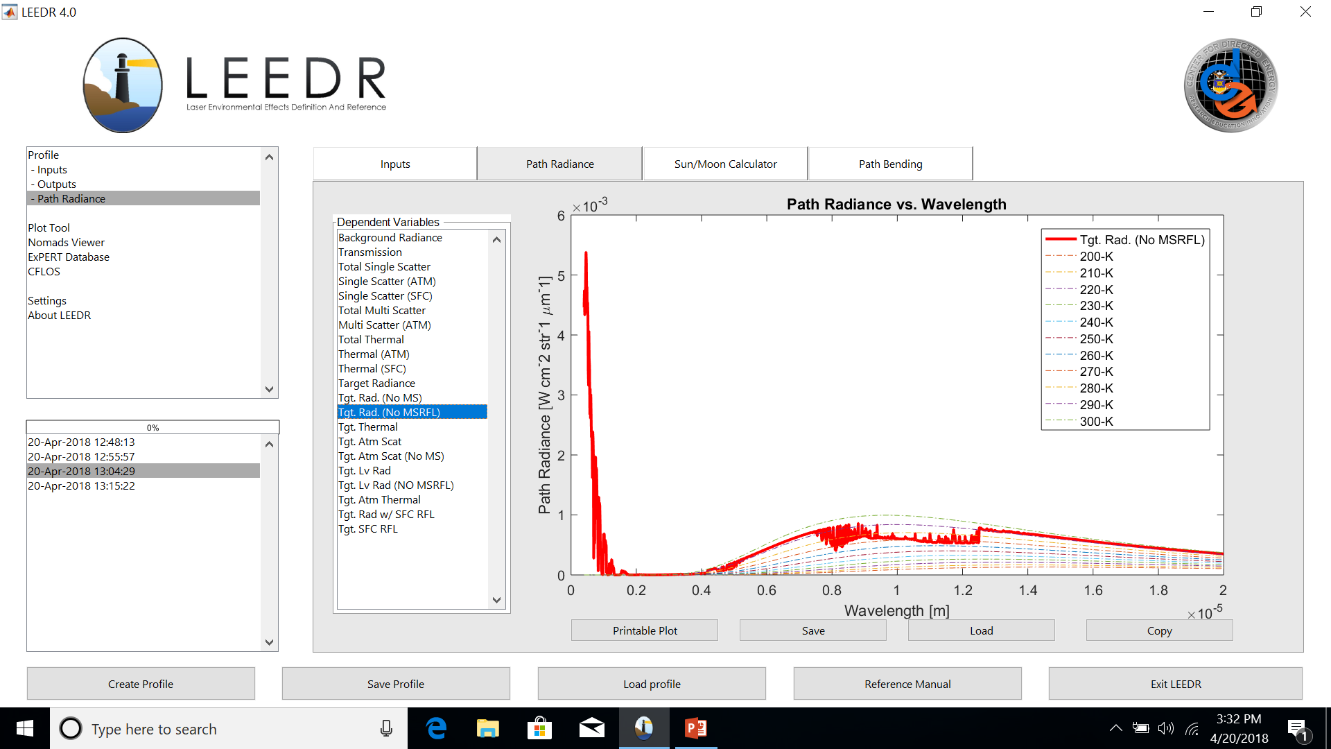
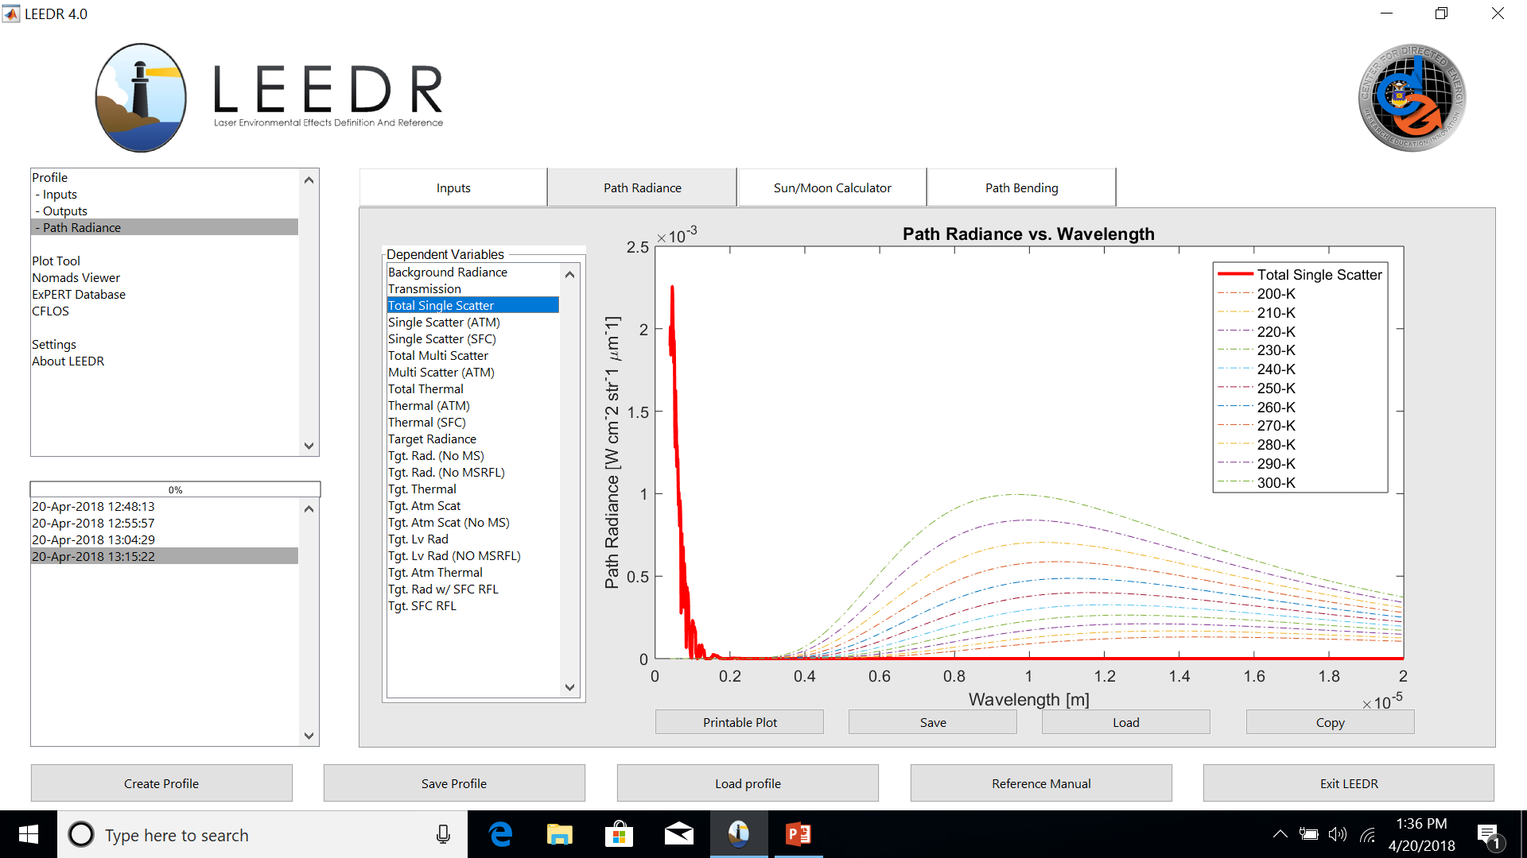
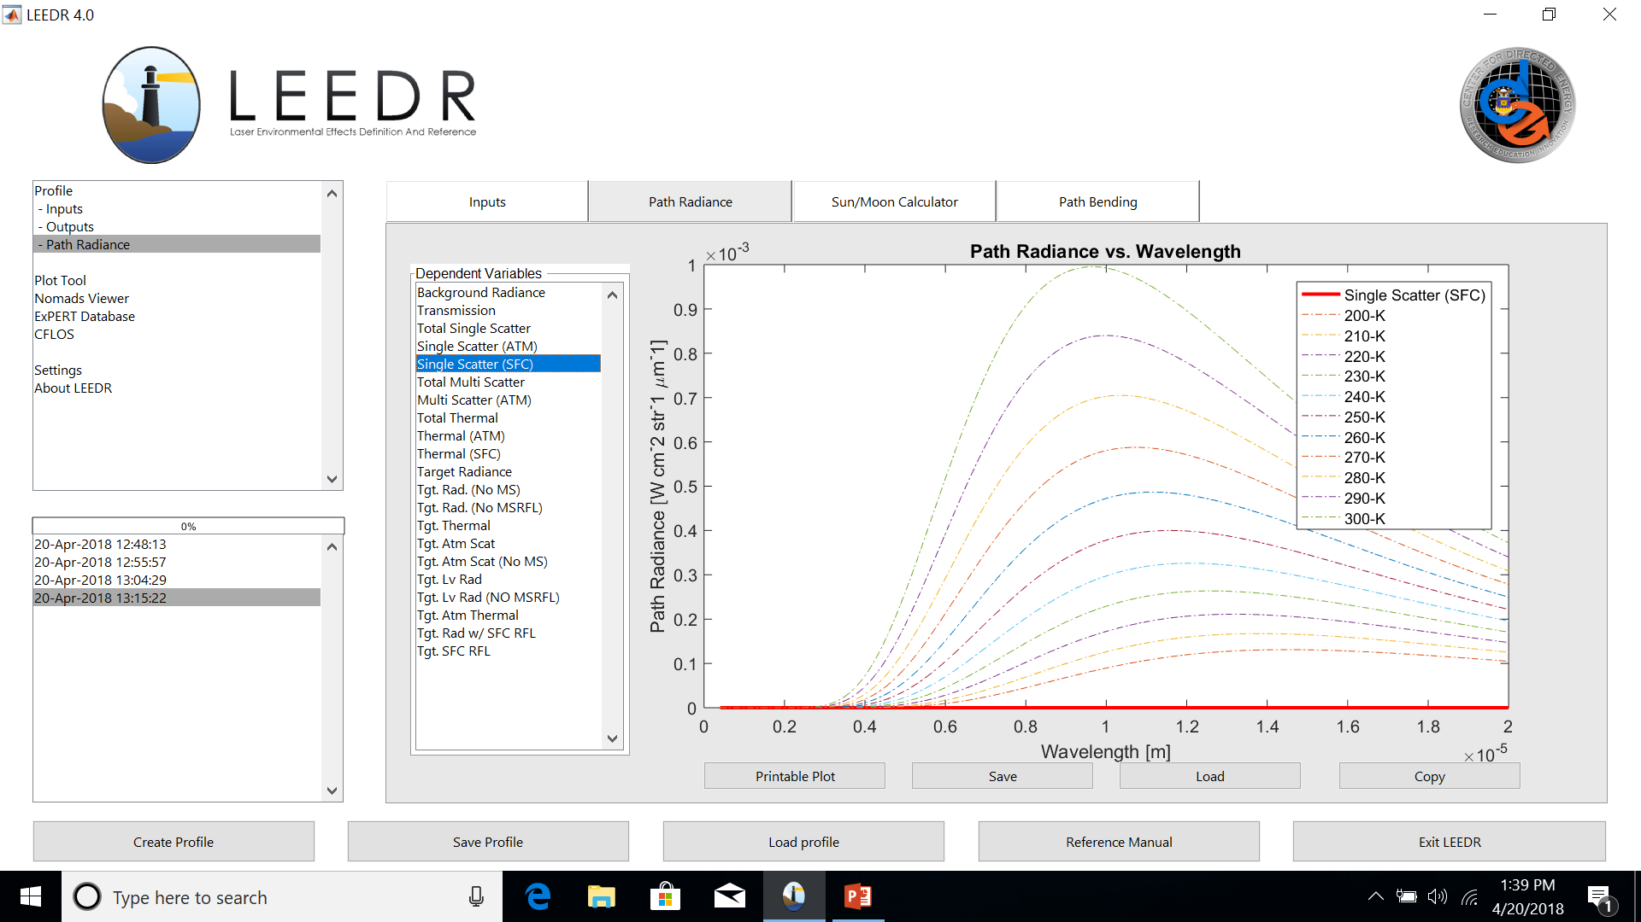
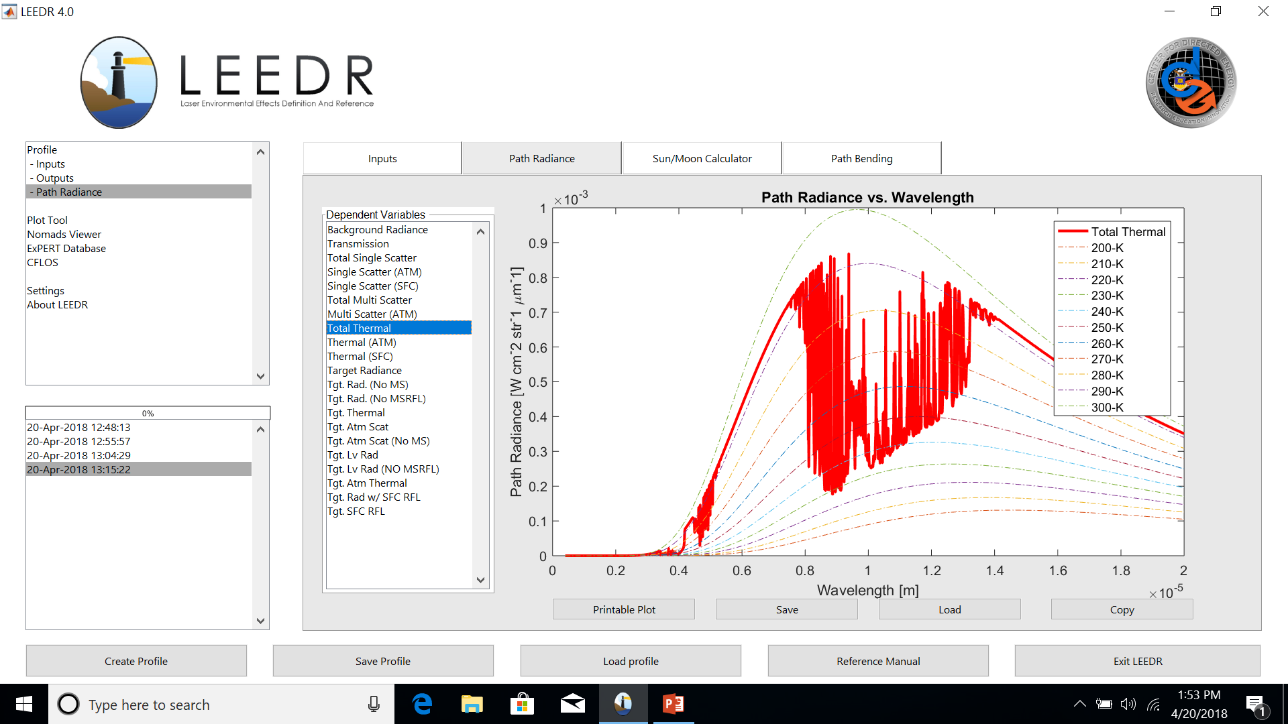
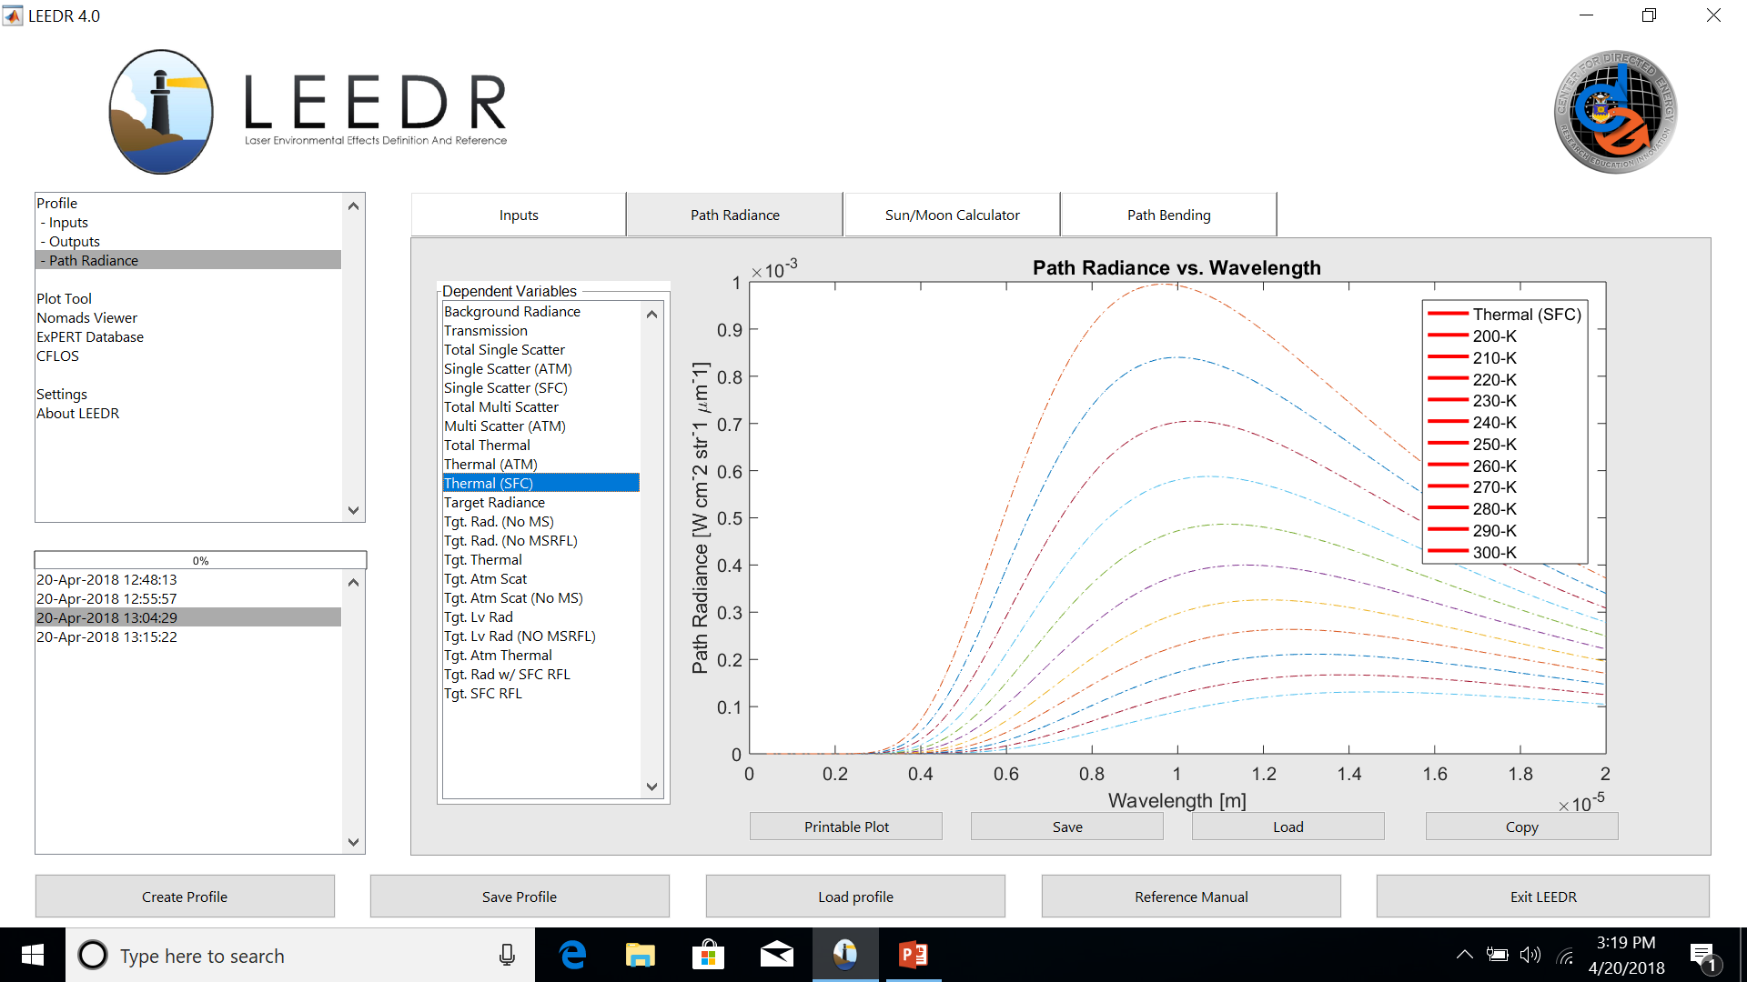
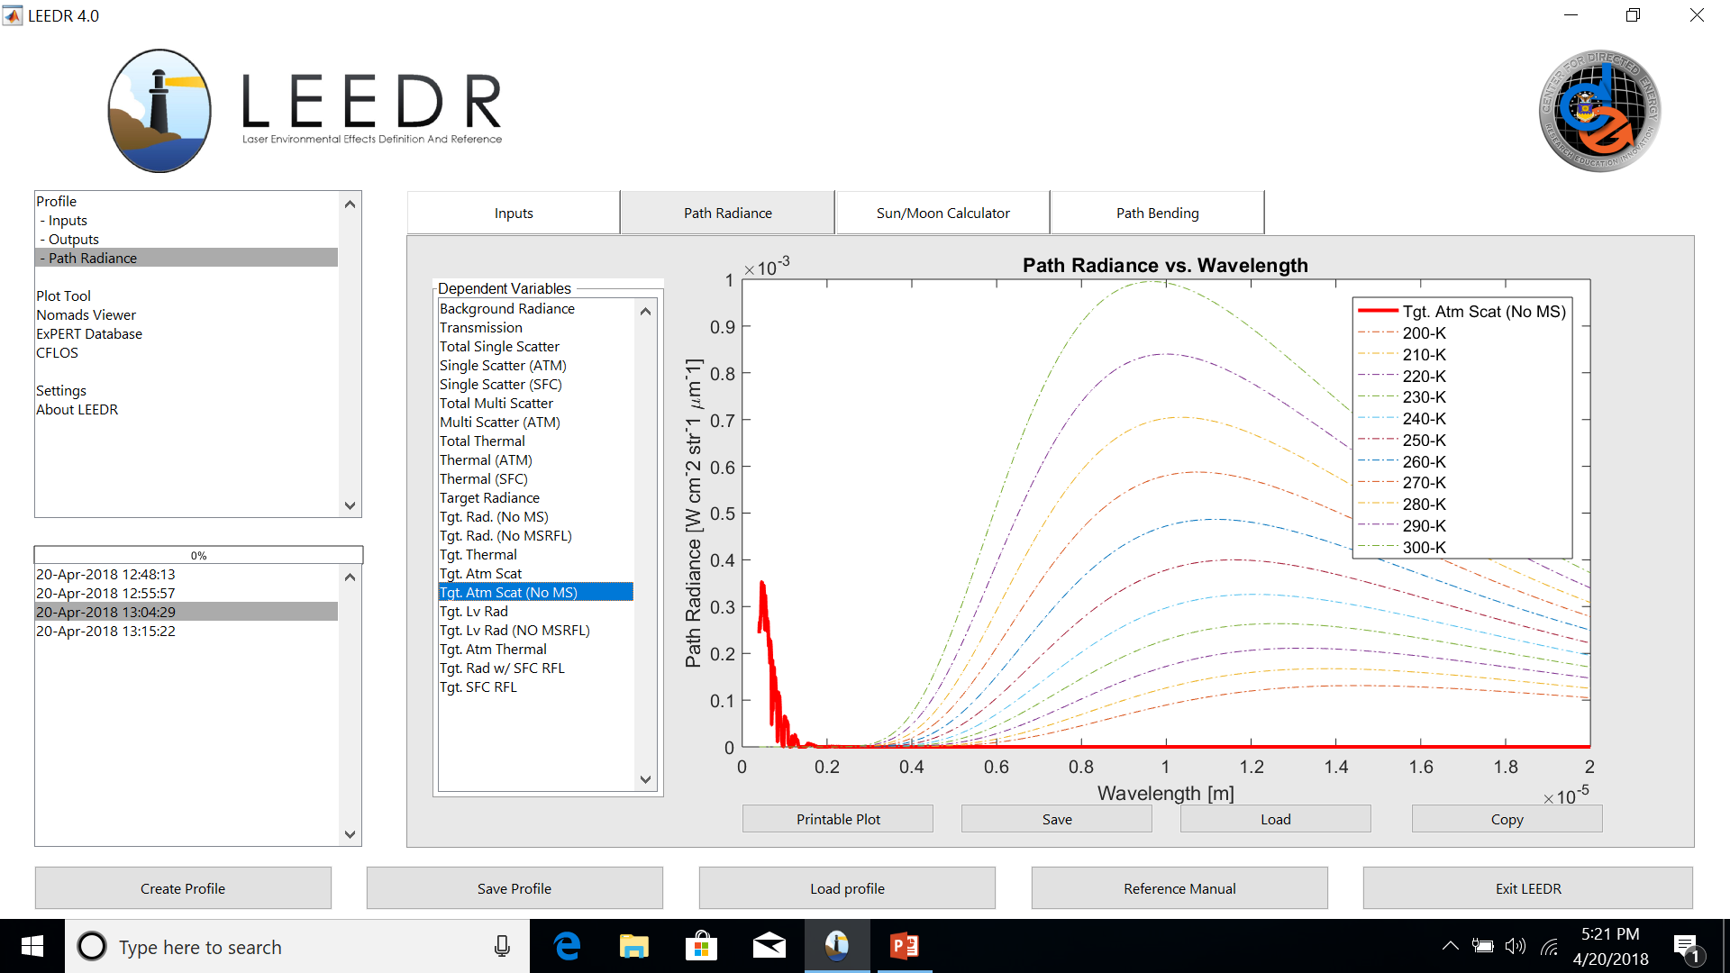
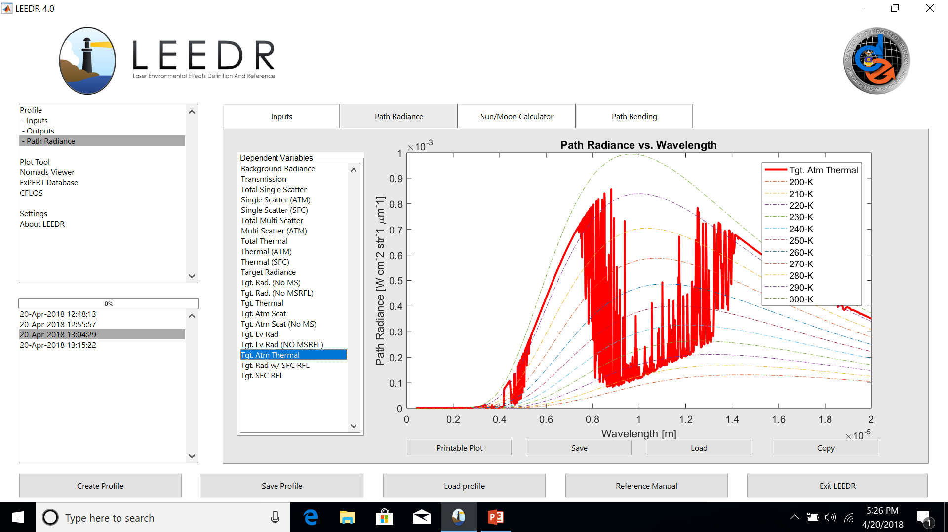
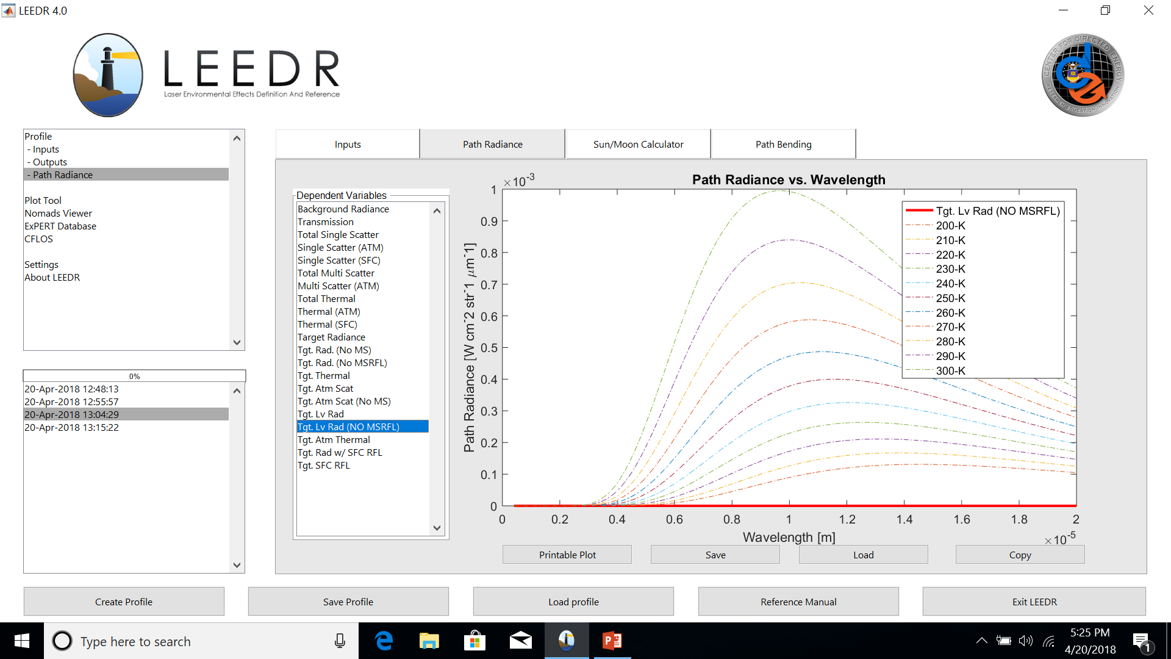
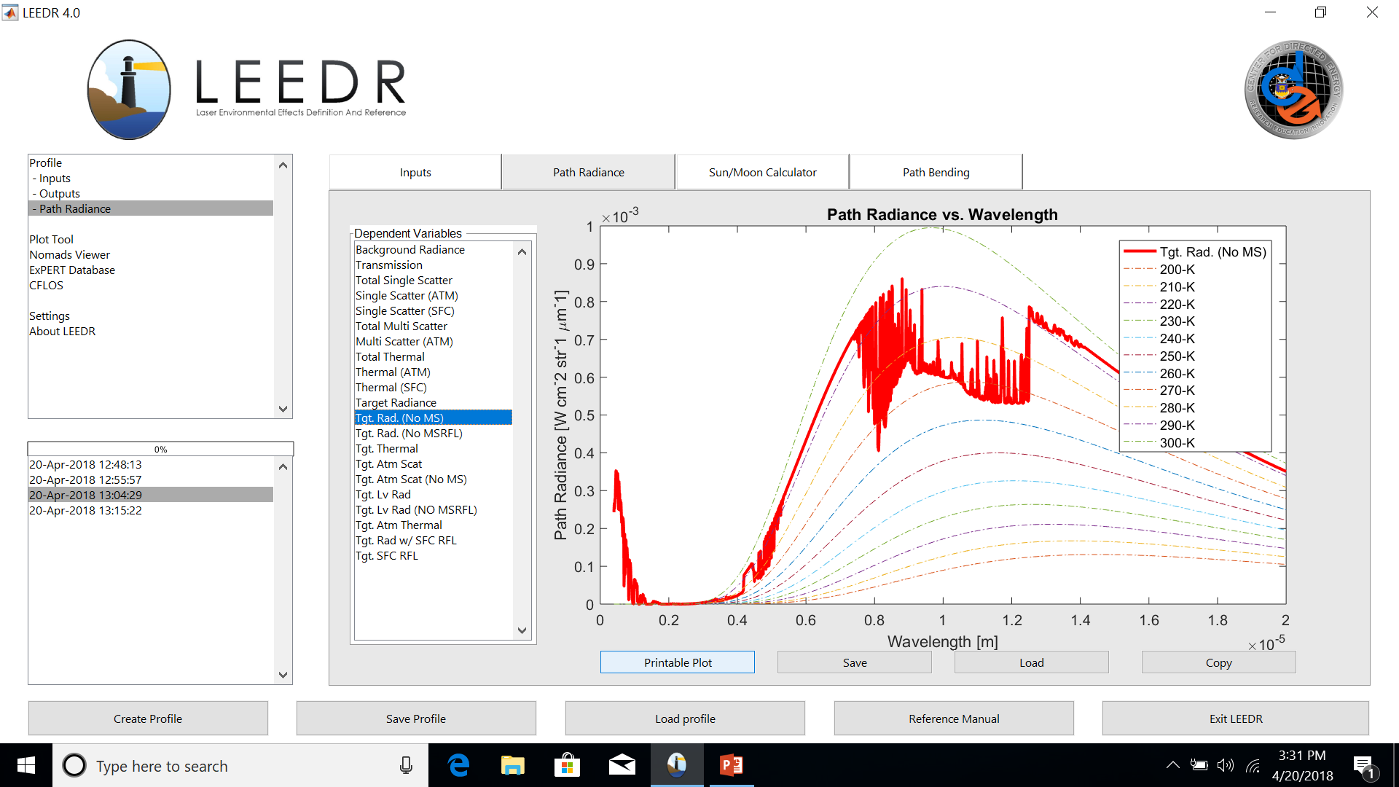

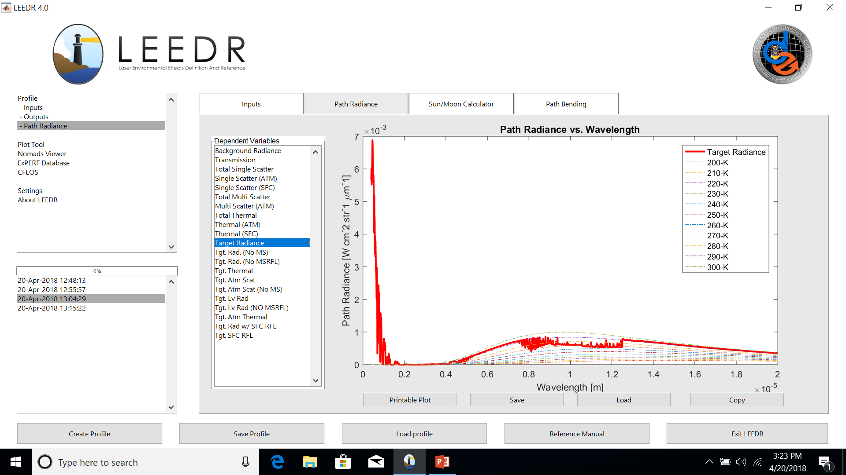

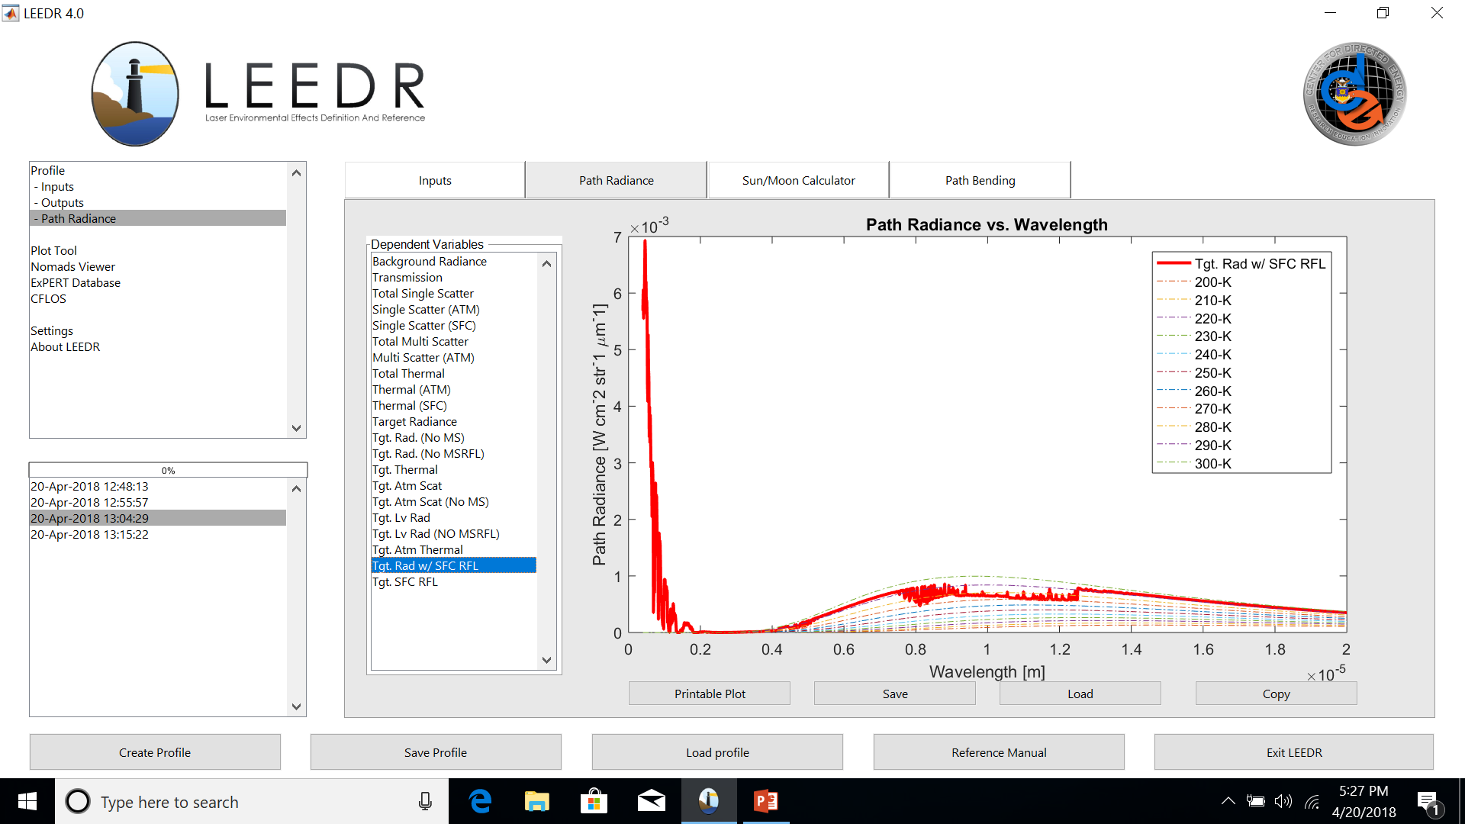

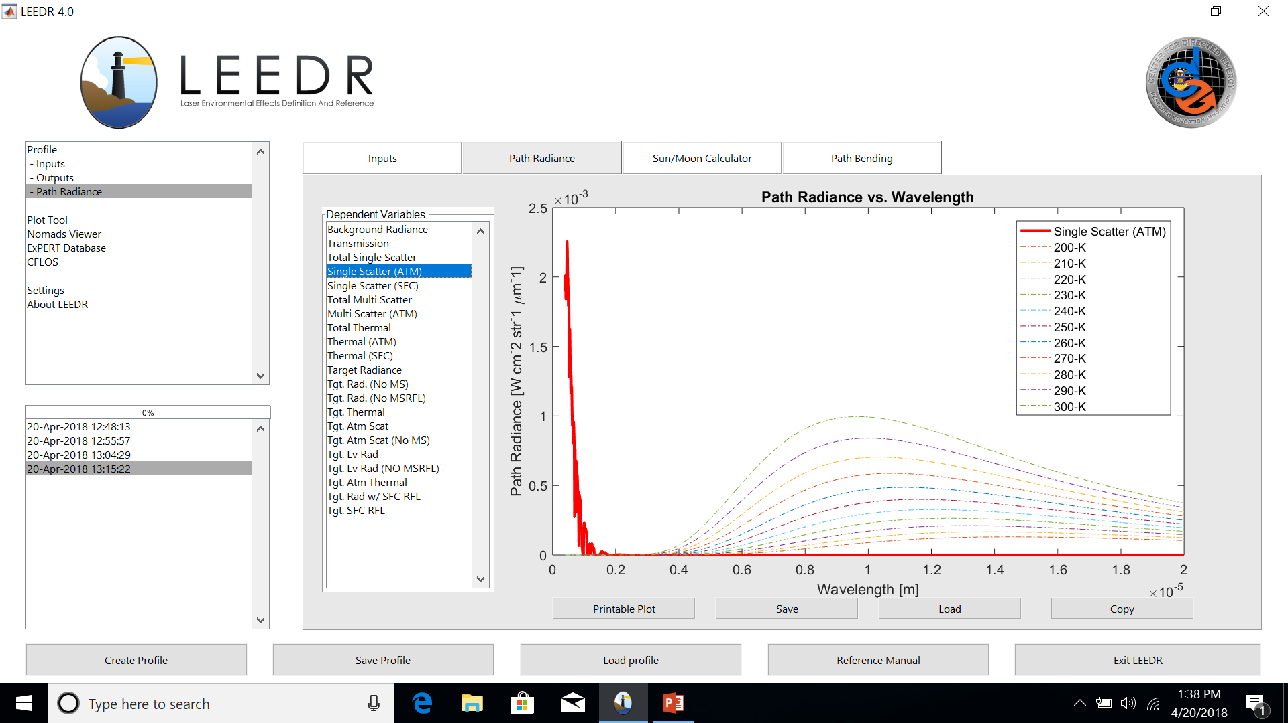


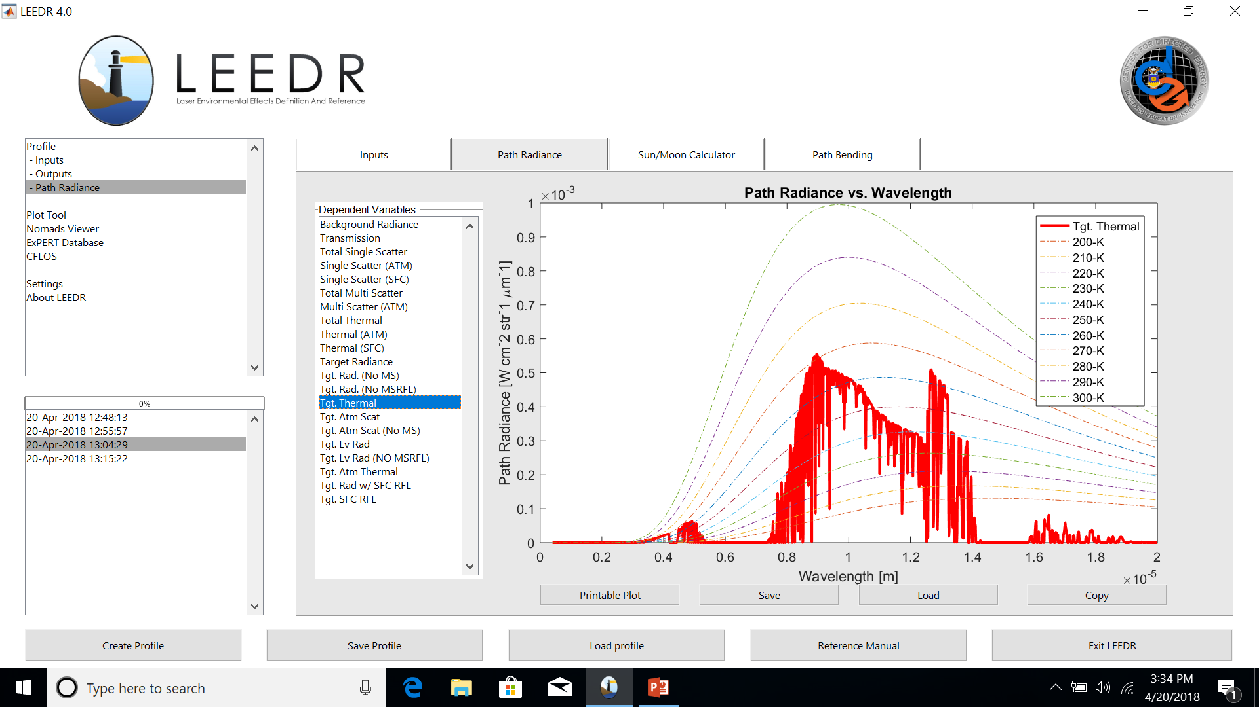
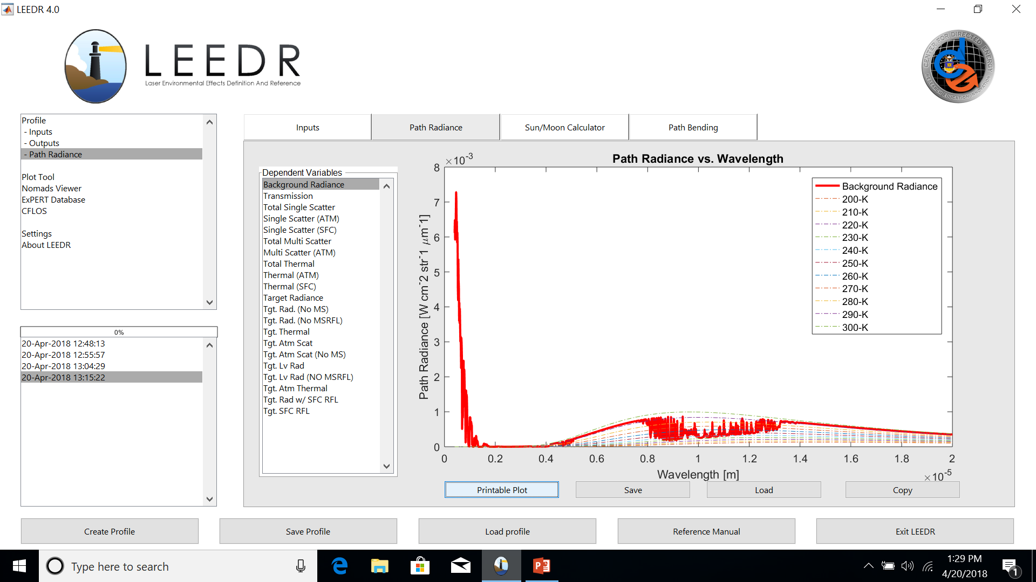
For a given sensor altitude, ground range to the target, and
visibility condition, radiance at the aperture is given by:
Target temperature
Wavelength
*
radiance at the aperture
Target directional reflectance
path thermal radiance
solar scattered radiance
Target database reflectance
blackbody radiance
transmission
target leaving radiance
*Daniel A. LeMaster, Michael T. Eismann, "pyBSM: A Python package for modeling imaging systems," Proc. SPIE 10204, Long-Range Imaging II, 1020405 (1 May 2017)

Slide 10
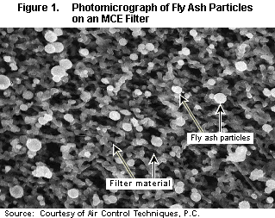
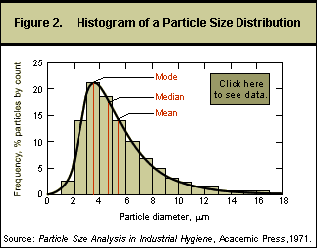
Atmospheric Scattering
LEEDR Aerosol Equations
The distribution (lognormal)
The Mie Extinction
The water uptake size adjustment
$$\log\left(a_{w}\right)={±\left[−\ln\left(ND\sqrt{2π}\log{σ}\right)2{\left(\log{σ}\right)}^{2}\right]}^{1/2}+\log{r_{M}}$$
The refractive index adjustment

Slide 11
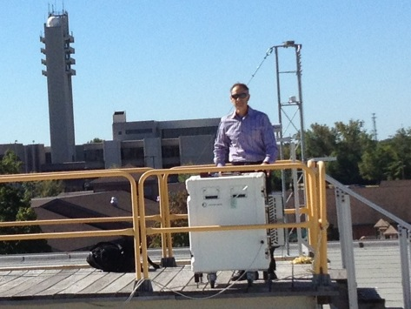
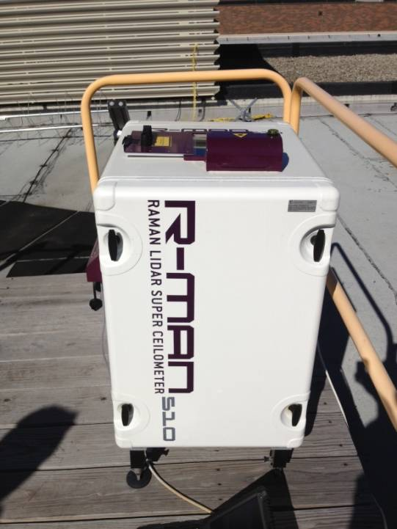
Measured Vertical Aerosol Extinction Plot
WPAFB Validation
Example LEEDR plot using a BL height of 1250 m at WPAFB ExPERT site, GADS summer aerosols, visibility of 60 km, and surface conditions for WPAFB
for 25 Jul 13 at 1400L (T = 23ºC, T_{d} = 13 ºC) vs. measurements from the roof of Bldg 640 conducted with a lidar operating at 355 nm

Slide 12
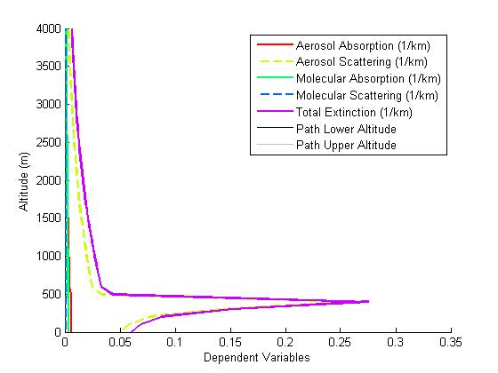
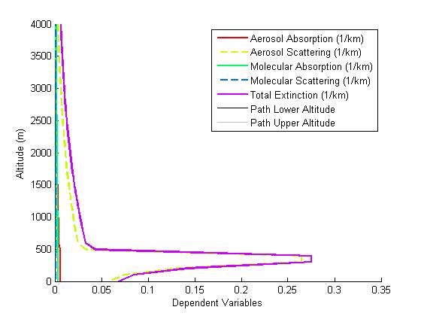
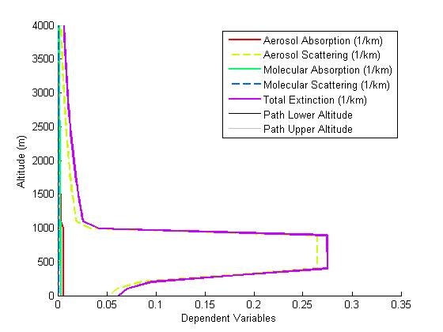
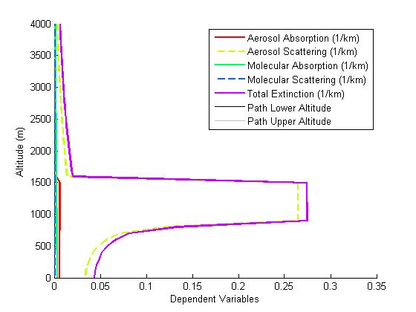
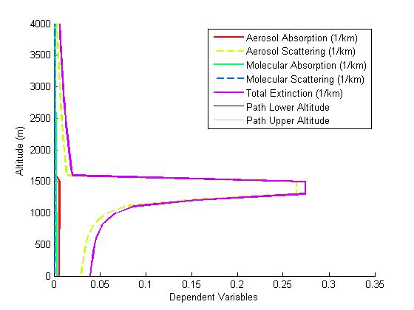
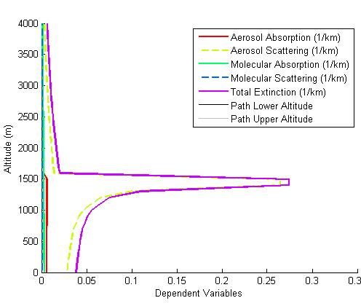
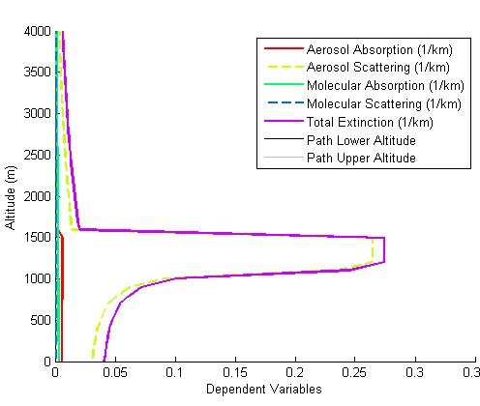
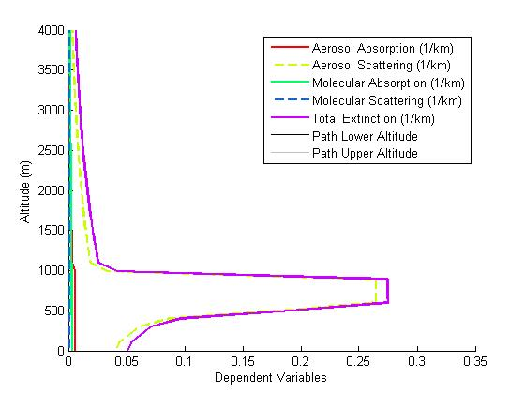
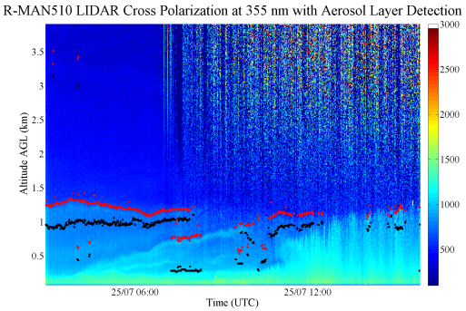
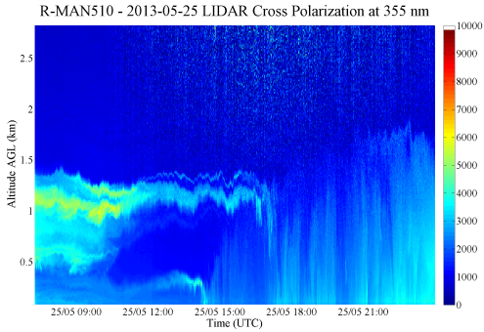
Vertical Aerosol Extinction
Diurnal Evolution of the Aerosol Spike
00-03L
03-06L
06-09L
09-12L
12-15L
15-18L
18-21L
21-00L
The aerosol extinction spike varies in thickness and height as the BL evolves throughout the day.

Slide 13
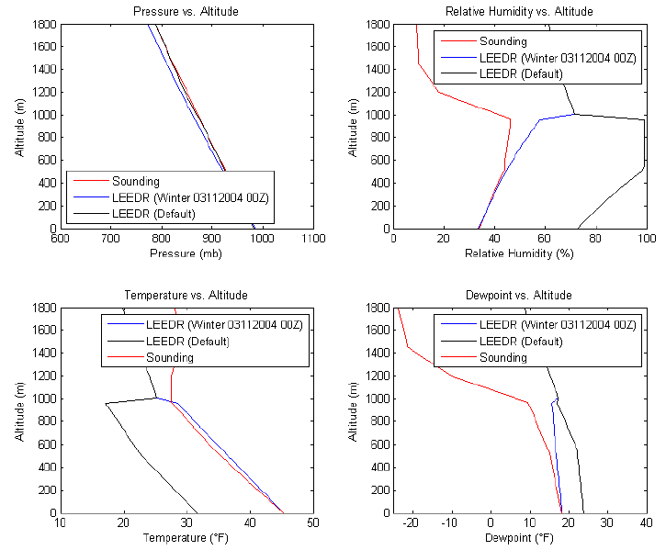
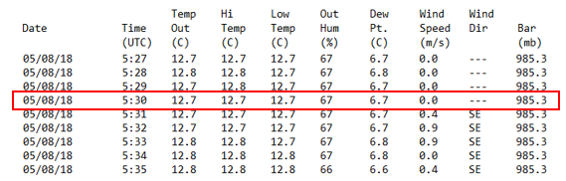
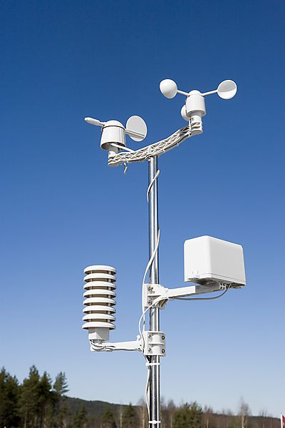
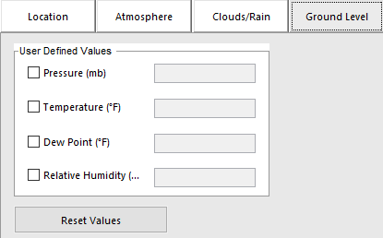
Real-time Surface Observations
Adiabatic Parameterization of Boundary Layer
Surface observations readily available!
Comparison to sounding shows how LEEDR can produce realistic boundary layer profiles that match measurements with only surface data input
Note actual boundary layer height matched through time of day selection

Slide 14
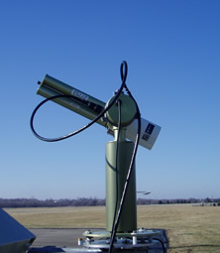
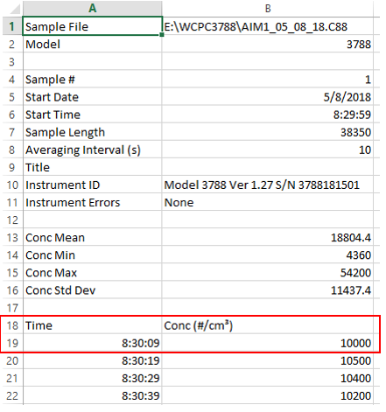
Real-time Aerosol Data
Only need apply a handful of passive techniques to largely describe actual aerosol loading / optical effects
  Sun Photometer
    Leads to multi-wavelength aerosol optical thickness using Beer-Bouguer law
    From visibility the aerosol loading can be computed
  Visibility
    Use Koschmeider and Beer-Lambert laws to deduce total aerosol extinction
    A more quantitative way to get aerosol loading
  Particle counter somewhere along path
    Day/night aerosol concentration (and size distribution)
    Surface measurement readily leads to vertical concentration profile throughout well-mixed boundary layer
GADS Aerosols Eglin Summer
Sea Salt (ACC) (cm^-3) Sea Salt (COA) Soot Water-soluble Insoluble
6.994 0.0008224 3599 4044 0
Continental Polluted
Sea Salt (ACC) (cm^-3) Sea Salt (COA) Soot Water-soluble Insoluble
0 0 34300 15700 0.6

Slide 15
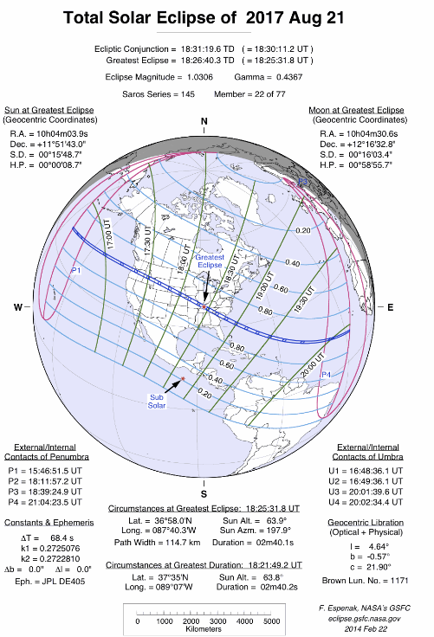
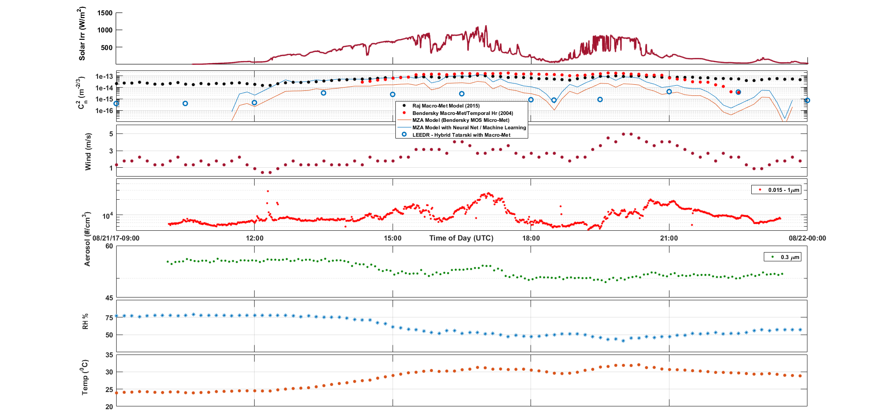
Real-time Aerosol Loading
Micro-meteorological & Aerosols Interactions
Partial Eclipse
(start)
Partial Eclipse
(Max)
Partial Eclipse
(end)

Slide 16
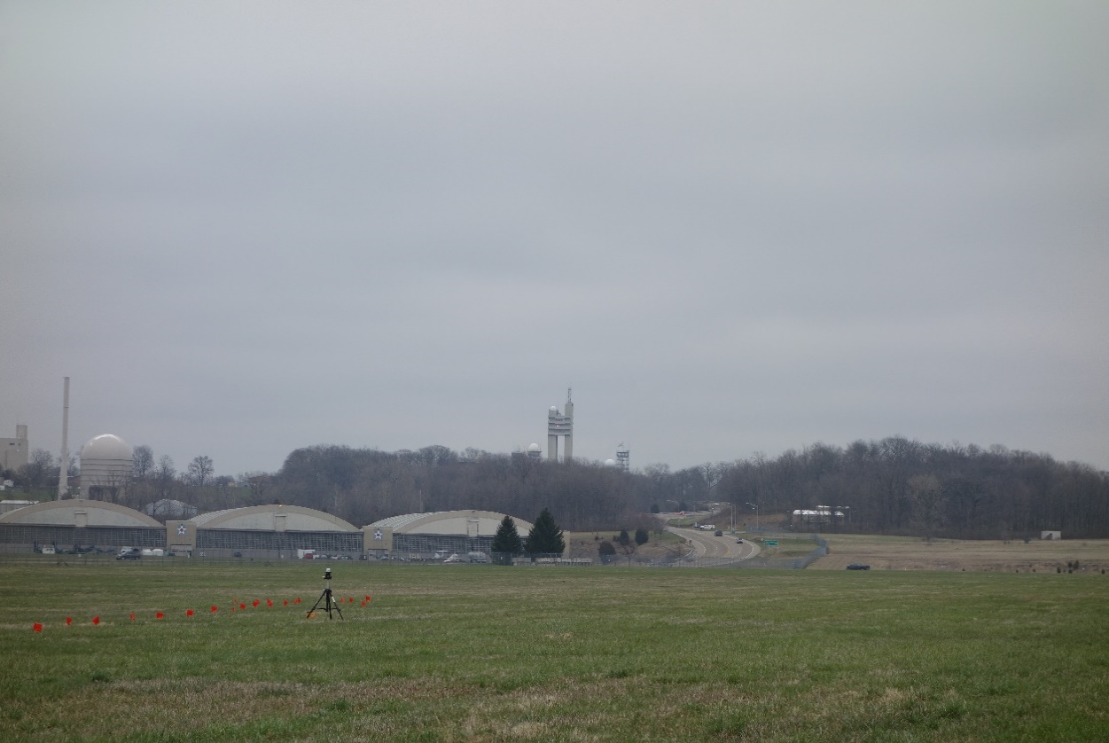
Real-time Aerosol Loading
Measurements at Two Separated Sites
Particle Counter #2
Particle Counter #1
Aerosol loading can be characterized by sparse particle counting network

