Slide 1
MODTRAN®6 Multiple Line-of-Sight (MLOS) Option
Alexander Berk (Lex@spectral.com)
Spectral Sciences, Inc. (SSI), Burlington, MA 01803-3304
Christopher Rice
Air Force Institute of Technology (AFIT), Center for Directed Energy, Wright-Patterson AFB, OH 45433
2018 Atmospheric Transmission Models – Modeling in Remote Sensing Meeting, Newton, MA
04 – 06 June 2018
The MODTRAN® trademark is being used with the express permission of the owner, the United States of America, as represented by the United States Air Force

Slide 2
Outline
Introduction/Background
MLOS Option
Applications
  Hemispherical vertical flux
  Wave boundary layer remote sensing
  Look-Up Table (LUT) generation
Final Remarks

Slide 3
MODTRAN6 Overview
Atmospheric Radiative Transfer Algorithm for computing IR / Vis / UV (> 0.2 μm) Transmittances, Radiances, Fluxes, …
  Line-By-Line (LBL) & Statistical Band Model/Correlated-k Algorithms
Arbitrarily fine, 0.2, 2.0, 10.0 or 30.0 cm⁻¹ Spectral Resolutions
  From LBL and 0.1, 1.0, 5.0 or 15.0 cm-1 Band Model Bins, respectively
Stratified Molecular / Aerosol / Cloud Atmosphere
  Standard and Auxiliary Molecular Species
  Built-in and User-Specified Particulate Optical Properties
  Localized chemical (gas) clouds
Spherical Refractive Geometry
Solar and Thermal Scattering
  Spherical DISORT Discrete Ordinate N-Stream Model
  Diffuse Transmittances and Spherical Albedo
Multiple Spectral Convolution and Filtering Options
Many Applications: Remote Sensing, Scene Simulation, Algorithm Development, Measurement / Data Analyses, Climate Forecasting, …
Introduction/Background

Slide 4
The Beauty of DISORT
The DISORT algorithm: Invokes the Discrete Ordinate method to solve the scalar radiative transfer equation (RTE) for a vertically inhomogeneous plane-parallel atmosphere
  Both thermal emission and solar illumination sources
  Rayleigh (molecular) and particulate (aerosol and cloud) scattering
  Method originally formulated by S. Chandrasekhar; DISORT model developed by Knut Stamnes and collaborators
Beauty of the method: The exact expansion for the general solution to the RTE enables one to specify the radiant intensity in all directions and at any location within the atmosphere!
  The solar position (solar zenith angle) must be fixed
  The DISORT general solution enabled MODTRAN to compute radiances along spherical-Earth refractive paths (next slide)
  Having a general solution also enables MODTRAN to rapidly compute path radiances for multiple lines-of-sight (the focus of this presentation)
Introduction/Background

Slide 5

Spherical DISORT
MODTRAN is a spherical refrac-tive geometry atmospheric model
DISORT is a plane – parallel model
DISORT within MODTRAN was modified to generate path zenith μ_{σ} and solar azimuth φ_{σ} depen-dent segment radiances:
ΔI_{σ}|| = ΔI_{σ}|| (μ_{σ} , φ_{σ})
Segment
Radiance
Line-Of-Sight
(LOS) Radiance
Transmittance
to boundary
Introduction/Background
Sum over
Segments
Sensor to
Segment
Transmittance
Boundary
Radiance

Slide 6
The Challenge Being Address
Running DISORT is computationally intensive, typically more than 90% of the processing budget at each spectral point
  The problem is exacerbated when solar scattering is modeled
  It is further exacerbated when fine spectral resolution (e.g. line-by-line processing) is required
If multiple lines-of-sight (LOS’s) are to be modeled for a fixed scene, then considerable computationally processing time can be saved by re-using the DISORT general solution:
  Typically, each LOS after the first only adds ~10% to processing time
  11 LOS’s can be processed in same time as 2 independent LOS’s
  A fixed scene is defined a one in which the solar zenith angle does not vary significantly, and the atmosphere definition is constant
  One can arbitrarily vary the sensor
  Location View Direction Relative Solar Azimuth Angle
  Imaged pixel spectral reflectance for down-looking LOS’s
MLOS Option

Slide 7
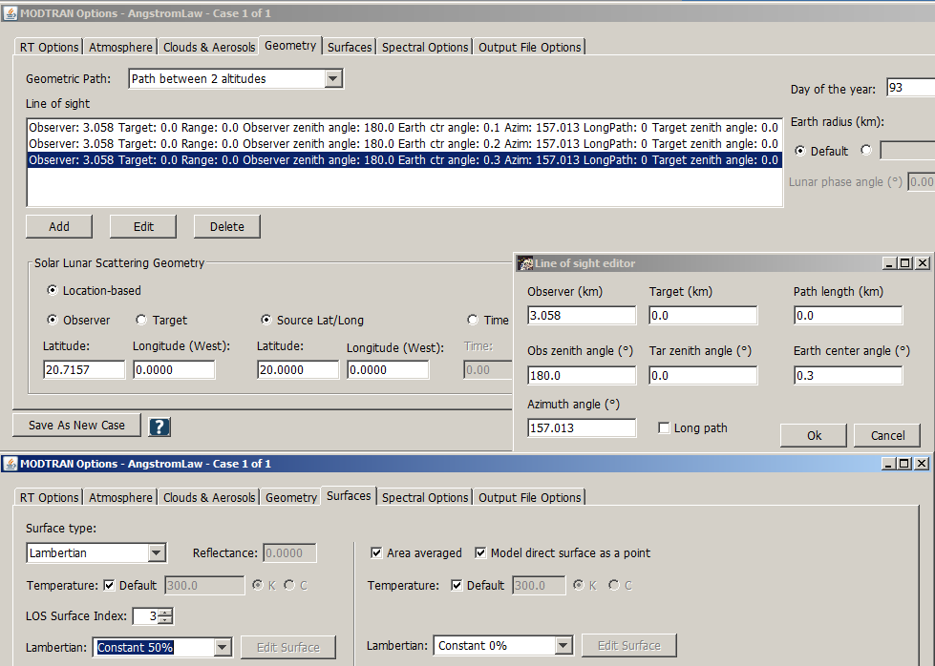
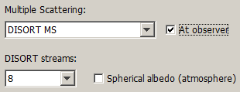
GUI Set Up
The MLOS option is relatively easy to set up with the MODTRAN6 GUI
MLOS Option

Slide 8
Application 1: Plane-parallel vs Spherical Earth Flux
DISORT within MODTRAN has been modified to generate segment radiances for spherical Earth refractive geometry paths
However, the MODTRAN spectral flux output are the DISORT plane parallel atmosphere solar and thermal values
Question: How large is the error introduced by ignoring the spherical Earth and refraction?
Thermal flux is defined by a hemispherical integration of path radiances
MODTRAN spherical Earth refractive path radiances were angu-larly integrated and compared to DISORT surface flux values
  MODTRAN line-by-line algorithm at 0.001 cm⁻¹
  4 to 30 μm with a 10 nm triangular slit
  16 stream DISORT; corresponding 8 upward viewing Gaussian angles and weights
  Mid-latitude summer atmosphere with 400 ppmV CO₂; desert aerosol with 15 m/sec wind speed (31.1 km visibility)
Hemispherical Vertical Flux

Slide 9
Application 1: Results
The 8 path MLOS radiance calculation ran in 96 minutes
  Without the MLOS option: > 7.5 hours
The plane-parallel atmosphere fluxes are too large, but residuals are universally less than 0.5%
Hemispherical Vertical Flux

Slide 10
Application 2: The WBL Retrieval Problem
Near surface marine boundary layer refractive effects are significant for EOIR and radar applications
The spectral refractive index depends on temperature (T), humidity (RH) and pressure (P)
In-situ T and RH measurements are difficult in the harsh WBL, the first few meters above the surface
Question: Can volumetric maps of T and RH be remotely retrieved using a wide field-of-view, down-looking imaging spectrometer placed just above the WBL, e.g. at 10 m ASL?
Unlike most remote sensing applications, the spectral channels need to be chosen in the center of the strongest absorption bands to provide enough atmospheric opacity over the short (10 to 30 m) line-of-sight paths
Wave Boundary Layer (WBL) Remote Sensing

Slide 11
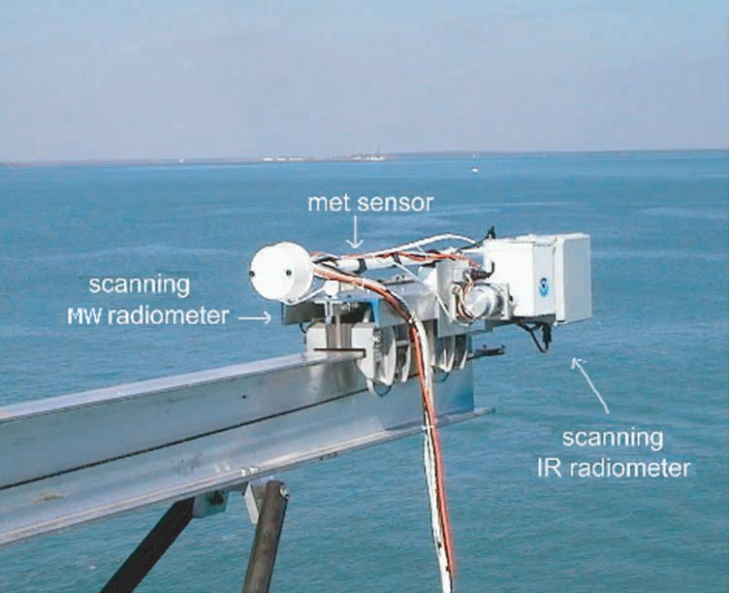
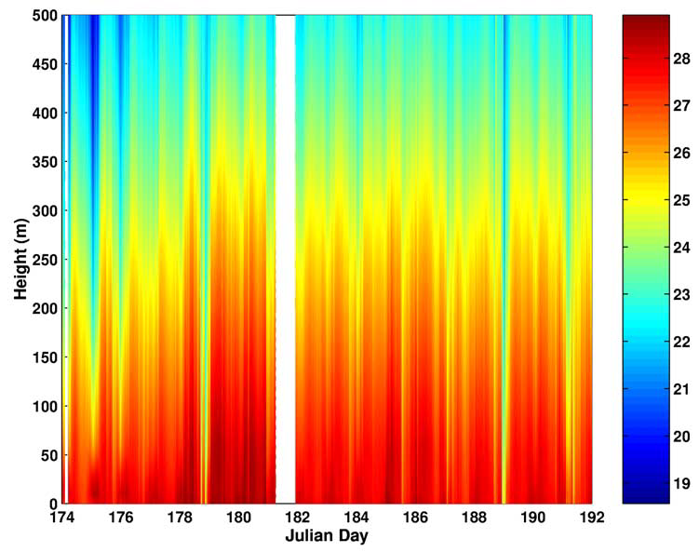
Application 2: Similar Measurement Concept
MW (60 GHz O₂) and IR (14.2 μm CO₂) Scanning Radiometers (MWSR/IRSR) deployed by NOAA/ETL on R/V Ronald H. Brown during Nauru99 cruise in tropical western pacific, June/July 1999
Vertically scanned from zenith to nadir
0.55 Hz (1.8 s) scans [400 angular points, i.e. 0.9° angular grid]
Only retrieved above sensor T profile (10 to 500 m)
Off-nadir data only used to retrieve air-sea temperature difference ASTD
Cimini, Shaw, et al., Radio Science, 38, 8045 (2003)
Wave Boundary Layer (WBL) Remote Sensing
Notes:
Follow up: Could such a system be used to characterize the WBL. Corresponding with Joe Shaw, a Co-I on the original effort, trying to locate the original data. Add a band to extract H2O profile. Add bands to improve retrieval algorithms.

Slide 12
Application 2: MODTRAN Simulations
Two rectangular spectral bandpasses were considered
  The 4.21 to 4.33 μm CO₂ absorption region for retrieving temperatures
  The 2.66 to 2.70 μm H₂O absorption region for retrieving humidity
NAVSLaM V2.0 temperature and humidity profiles
  Navy Atmospheric Vertical Surface Layer Model (Paul A. Frederickson)
  Stable atmosphere [+2 K ASTD, T_{air}(1 m) – SST], profiles up to 100 m
  Blended with MODTRAN tropical atmosphere
Wave Boundary Layer (WBL) Remote Sensing

Slide 13
Application 2: MODTRAN Simulations
MLOS option used to generate weighting function curves
  21 LOS’s from 10 m ASL to the ocean surface
  Path range was varied from 10 to 30 m in 1 m steps
  Weighting function: Negative change in transmittance with altitude
Wave Boundary Layer (WBL) Remote Sensing

Slide 14
Application 2: MODTRAN Simulations
Wave Boundary Layer (WBL) Remote Sensing
Discouraging results
  Maximum absorption always occurs at sensor altitude
  Suggests retrieval only possible with a constrained fit technique
  Use window band(s) to fix surface brightness temperature and altitude

Slide 15
Application 3: Low-flying AVIRIS classic
MLOS option initially developed to facilitate generation of MODTRAN look up tables (LUTs)
Simulations run for a visible through shortwave infrared sensor mounted on low flying airborne platform looking at a 10% reflecting ground tarp in a field of sandy loam soil
  Sensor altitudes: 1, 2 and 3 km
  Ground to sensor zenith angles: sec θ = 1, 1.25, 1.5, 1.75 and 2
  Relative solar azimuth angles: 0°, 45°, 90°, 135° and 180°
  Solar zenith angle: 40°
  Mid-latitude summer atmosphere with 380 ppm CO₂
  Rural 23 km visibility aerosol
Look-Up Table (LUT) Generation
  AVIRIS channels (~10 nm FWHM)
  63 LOS’s (3 nadir + 3×4×5 altitudes, zeniths and azimuths)
  1.0 cm⁻¹ correlated-k
  16 stream DISORT

Slide 16
Application 3: Low-flying AVIRIS classic
2 hour simulation: saved ~16 hours processing time
  Top (black) curve in each plot corresponds to 3 km altitude and 60° ground-to-sensor zenith
  Path radiance is dominant for wet atm with heavy aerosol loading
  Radiance decreases with relative azimuth long of 950 nm
  Rayleigh dominant < 950 nm
Look-Up Table (LUT) Generation

Slide 17
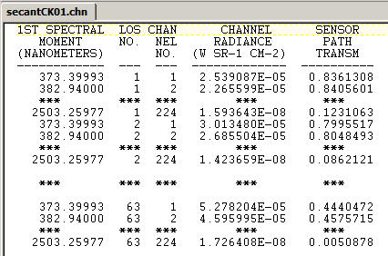
Application 3: Legacy Spectral Channel Output
Look-Up Table (LUT) Generation

Slide 18
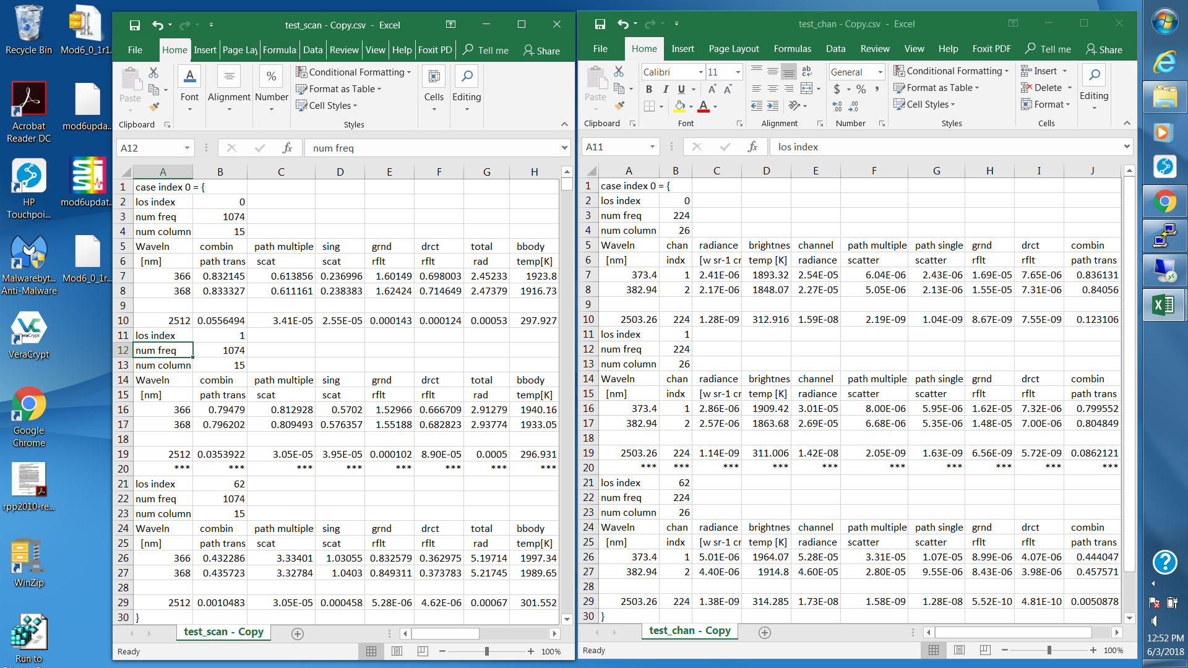
Application 3: CSV Spectral Channel Output
Look-Up Table (LUT) Generation

Slide 19
Application 3: CSV Scanned Spectral Output
Look-Up Table (LUT) Generation

Slide 20
Final Remarks
The MLOS option was first introduced into MODTRAN5.3 and is accessible both with the modern JSON (*.json) and the legacy text (*.tp5) input files
My objective in giving this presentation was to encourage more users to take advantage of this option. My colleague Tim Perkins and I respond to 100’s of MODTRAN inquiries each year. To date, we have yet to encounter a MODTRAN user who is taking advantage of this option. This includes many users who have used MODTRAN to generate LUT’s.
Are there any Questions?
Final Remarks

