Slide 1
Using MODTRAN 6 for Inter-comparisons of NOAA-20 and S-NPP CrIS Spectra
Joe Kristl, Kori Moore, Mark Esplin, Ben Esplin, Deron Scott
June 4, 2018
This work was sponsored by NOAA/STAR under NOAA contract GS23F0046P

Slide 2
Outline
Goals
Approach
Comparison Data Selection
Radiative Transfer Code inputs
Initial results
Next Steps

Slide 3
Goal of this Effort
Monitor CrIS interferometers by direct data comparison
  Both sensor datasets must be consistent for maximum value
  This allows early detection of any hardware issues that arise
S-NPP and N-20 are in same orbit, 50 minutes apart
  Simultaneous nadir overpasses (SNOs) never occur
  Views overlap with geometry and time difference
Current comparisons use SNO with intermediate reference
  (N20 – ref) – (SNPP – ref) = N20 – SNPP
  Currently used reference sources
    AIRS spectrometer (on Aqua satellite)
    IASI interferometers A and B (on Metop satellites)
This study investigates use of a radiative transfer code to create another reference for continuous comparisons
Notes:
Challenges facing the current comparisons:
both intermediate reference systems are old
AIRS = 2002
IASI-A = 2006, IASI-B 2012
Once these systems stop working, they are unavailable for intermediate comparisons
2. Both CrIS systems have significantly lower noise than these references
Comparisons can end up hitting the reference source noise floor first

Slide 4
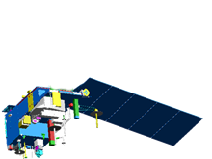
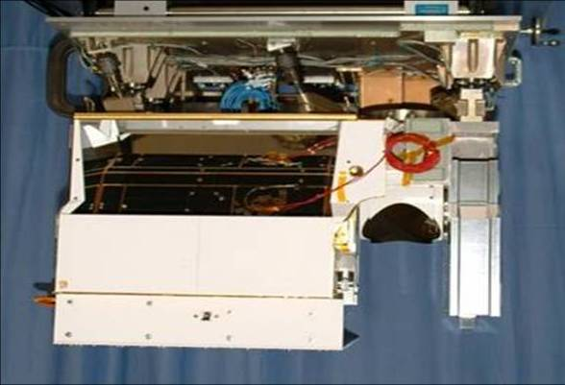
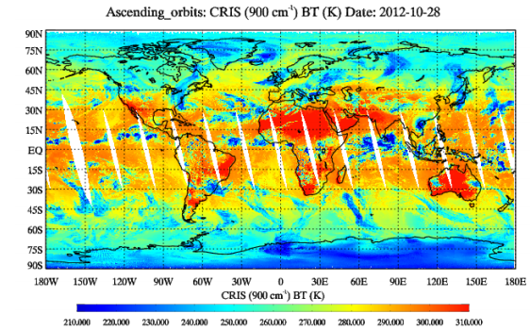
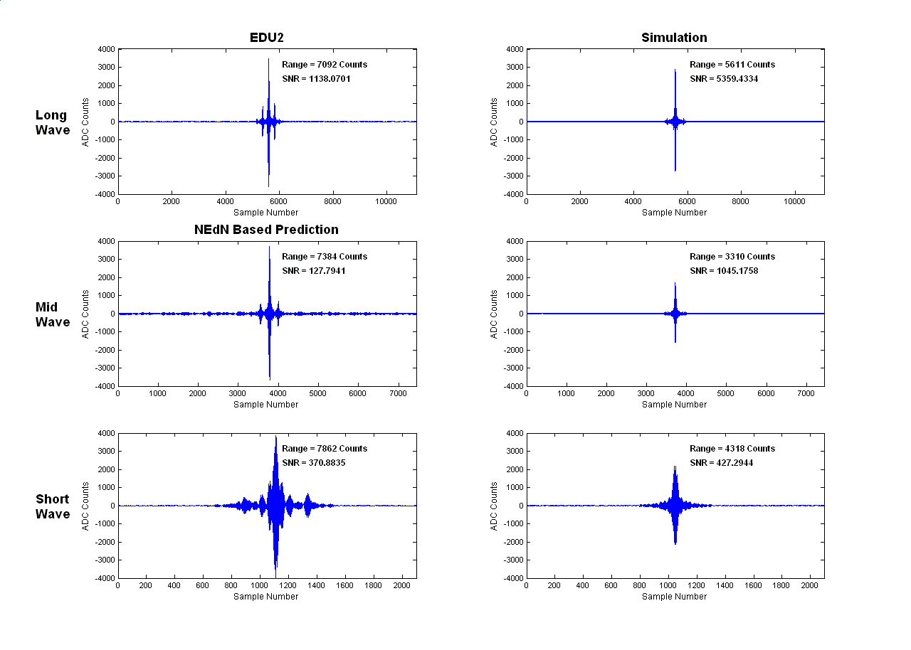
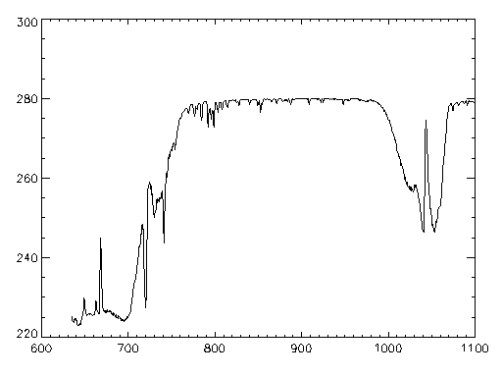
CrIS Interferometer on NOAA-20/S-NPP
S-NPP and NOAA-20
In Polar Orbit
±50°
Cross Track Scans
RDRs
RDRs
Decode Spacecraft Data
Central or Regional Ground Stations
CrIS Swath 2200km
SDRs
ATMS Swath 2500km
SDR Algorithms
3x3 Array of CrIS FOVs (each at
14-km diameter)
EDR Algorithms
0.1
EDRs
1
Pressure (mb)
10
100
1000
200
210
220
230
240
250
260
270
280
290
Temperature (K)
Cross-Track Infrared Spectrometer 2x Global Coverage Twice Daily
SDL/18-1035
Notes:
- CrIS and ATMS form the core instrument suite (aka CrIMSS – Crosstrack Infrared and Microwave Sounding Suite) on NPP that are used to produce accurate temperature, water vapor, and pressure profiles
- CrIS and ATMS are used in tandem for all weather atmospheric sounding, with ATMS specifically providing cloudy condition sounding capability.
CrIS, a Michelson interferometer, collects data in the interferogram mode which is converted back to atmospheric spectra on the ground. ATMS is a microwave radiometer.
The CrIS and ATMS instrument footprints are co-aligned and scanned in the cross track direction so as to map a joint swath approximately 2500 km wide. The ATMS scan is a bit wider than that of CrIS to ensure that there are no measurement gaps between successive passes at the equator.
-The raw CrIS and ATMS instrument data from the spacecraft are packaged into RDRs. These RDRs are then processed into calibrated radiance spectra, or SDRs, by ground software. The SDRs are then combined and further processed into atmospheric temperature, pressure, and water vapor profile EDRs.

Slide 5
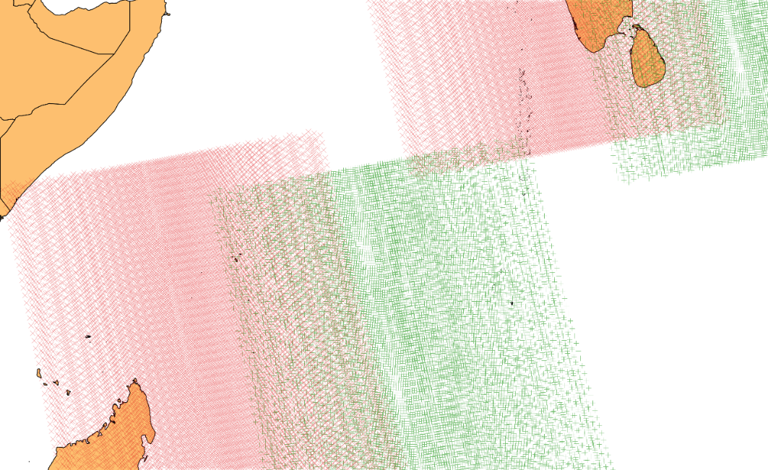
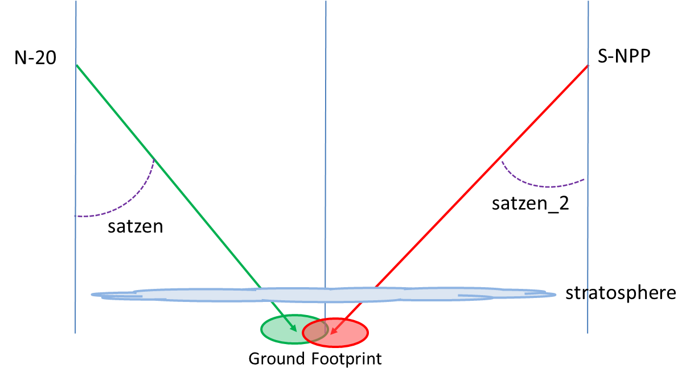
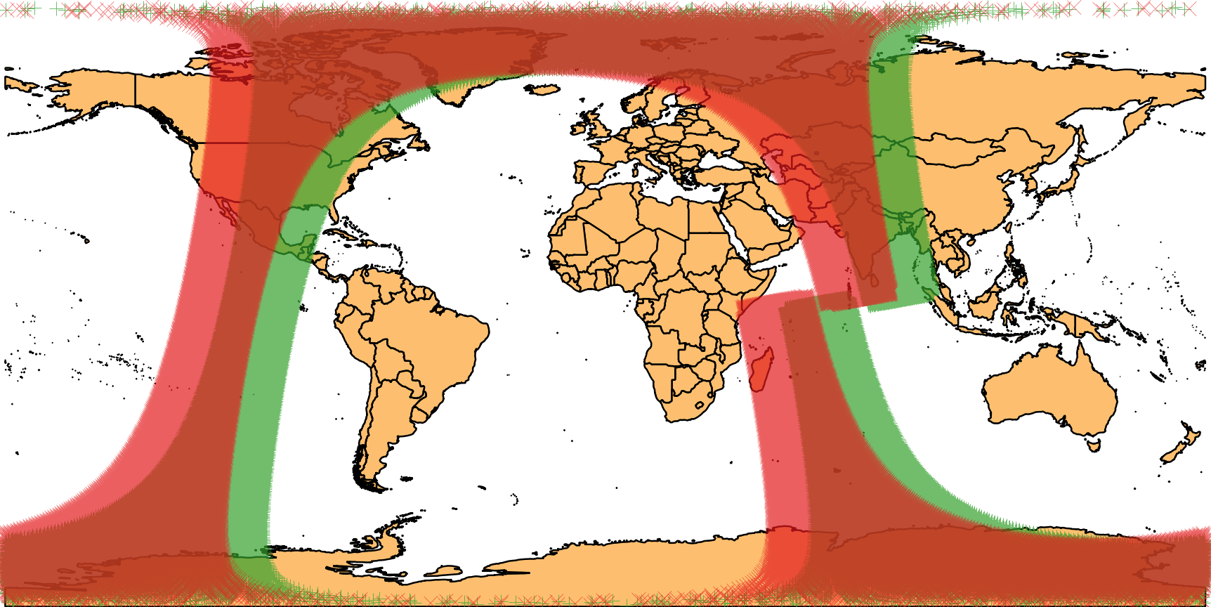
Temporal and Spatial Separation
Schematic viewing geometry
2018-02-18 Orbits
Red = SNPP 32702
Grn = N-20 01305
View geometry: zenith (nadir) angles 10°to 60°
  azimuth angles: ~ 180 different
Time separation: 50 minutes
  Changing weather conditions
  Solar effects (heating/cooling)
Spatial resolution: comparable to CrIS footprint (14 km nadir)

Slide 6
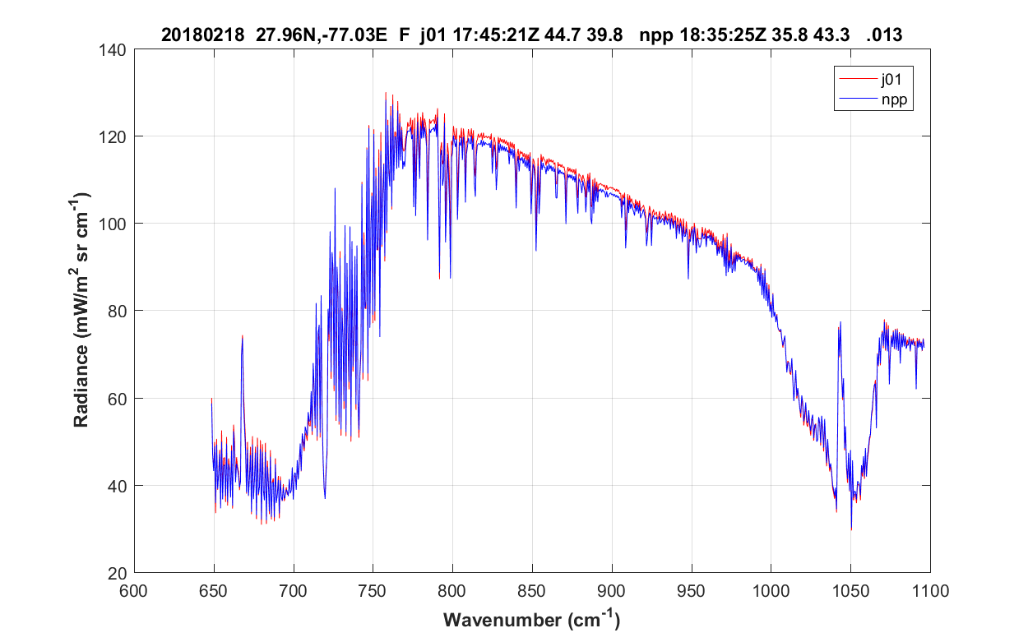
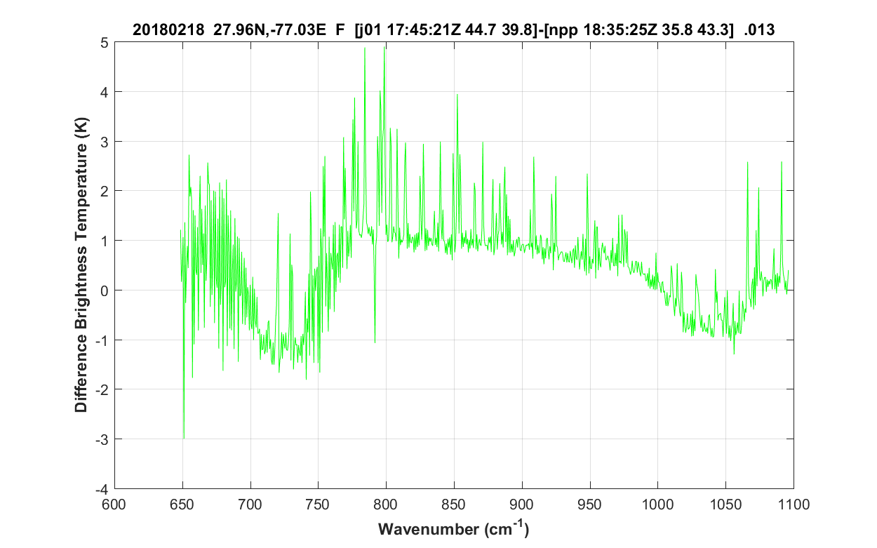
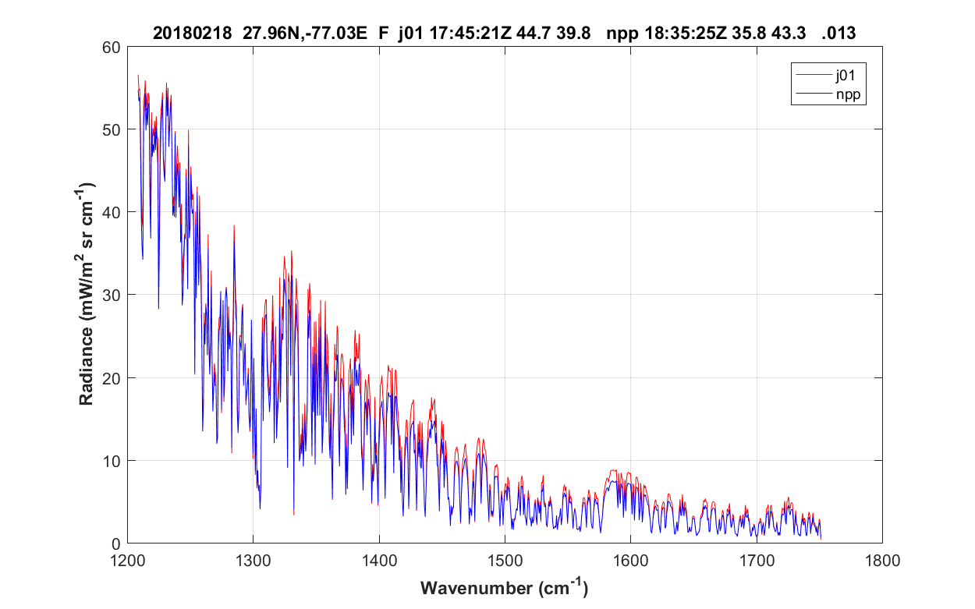
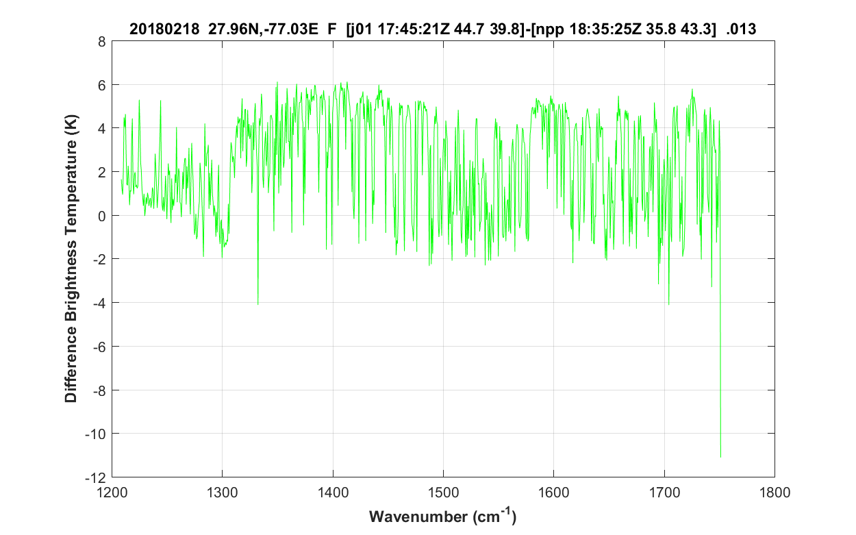
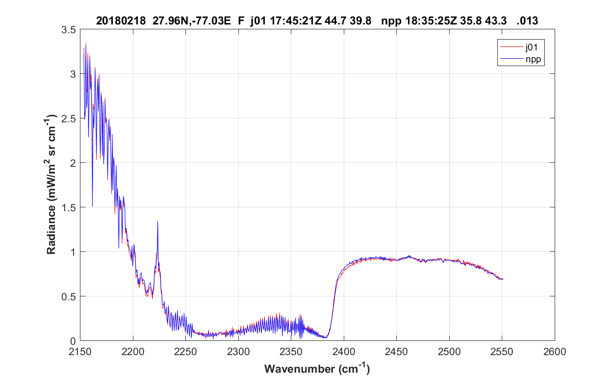
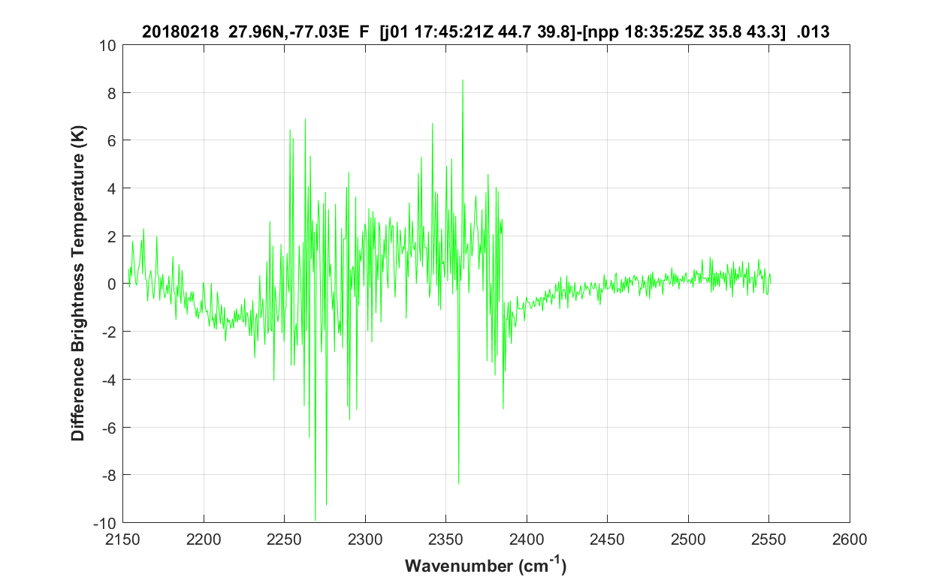
Clear Conditions Comparison Example
Spectral Radiance
Brightness Temperature Difference
LWIR
MWIR
SWIR
Notes:
These charts show that using well designed comparison case selection criteria (minimize weather variation over the 50 minute time delta) gets reasonably close. The residuals are still unacceptably high for establishing the relationship between the two datasets. The RT code approach was a solution that promised to significantly reduce the residuals (plots in right column).
We are trying to go from discrepancies of a couple of degrees brightness temperature to a fraction of a degree, via a process that can be automated and works over a statistical sample.
AA case 013 afternoon clear ocean scene
Location: Atlantic ocean east of Florida, north of Bahamas

Slide 7
Approach
N20(ν) – SNPP(ν) = ΔL_{atm}(ν) + L_{error}(ν)
    ΔL_{atm}(ν) = radiance difference due to ΔWX (atm, surface T)
    L_{error}(ν) = error discrepancy of interest
Use atmospheric radiative transfer code to calculate ΔL_{atm}(ν)
  ΔL_{atm}(ν) = RTcalc(ν)_{N20} - RTcalc(ν)_{SNPP}
  Then N20(ν) – SNPP(ν) - ΔL_{atm}(ν) = L_{error}(ν)
This study uses MODTRAN 6 as the radiative transfer code (RTcalc)
  0.1 cm⁻¹ band models, CorK, and line-by-line option
  Convolved with sinc function to match CrIS resolution
The real challenge lies in determining model inputs
  Atmospheric profiles that match each CrIS measurement to compensate for weather condition differences
Notes:
Note: examples in this presentation use: + (RTcalc(ν)_{SNPP} - RTcalc(ν)_{N20}), which is the same

Slide 8
Comparison Selection Criteria
Clear sky conditions
  Clouds are too variable over 50 minute time scale
For initial testing: clear sky ocean conditions
Forecast models include cloud cover outputs that support automatic detection of clear areas
  Combine results from all models for a robust result
  Effective initial filter of CrIS data
Currently use GIS software to create clear sky mask from weather model cloud cover, then extract CrIS view intersections within this clear area
Plan to extend this to include clear sky land conditions
  Eventual goal of automated selection for hands-off operation

Slide 9
Radiative Transfer Model Inputs
The difficult part is not the model, but rather the inputs to the model
Atmospheric inputs with sufficient fidelity to distinguish differences on scales that matter to a CrIS comparison
  Temporal: 50 minutes
  Spatial: 20 km or less
Regional models have needed temporal and spatial resolution
  Global models are developing in same direction
Primary data needed for CrIS bands
  Altitude profiles of T, H₂O, O₃, CO₂, CO, CH₄, N₂O
  Surface temperature + emissivity

Slide 10
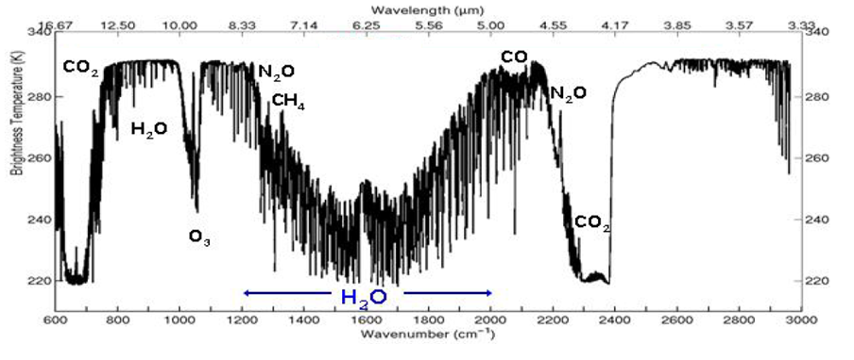
Molecular Contributions to Spectrum
CrIS
Bands
LWIR
MWIR
SWIR

Slide 11
Sources of Atmospheric Profile Data
Global and regional numerical weather models used in this study
Regional models meet resolution requirements but are incomplete
  Daily forecast products (not archives) must be used
  Missing ozone, end above the troposphere
  Hybrid profiles necessary to fill in missing pieces
The forecast models are steadily advancing in coverage/resolution
Anticipate global coverage with this resolution within a year or two
 | Temporal |  | Spatial
Model | Update | TimeStep | Lat x Lon | Footprint | Coverage
GFS | 6 hr | 1 hr | 0.25 | 28 km | global
GEOS-FP | 6 hr | 1 hr, 3 hr | 0.25 x 0.32 | 28 km | global
RAP | 1 hr | 1 hr | 0.11 | 11 km | regional
HRRR | 1 hr | 1 hr | 0.05 | 3 km | regional
NAM | 6 hr | 1 hr | 0.05 | 3 km | regional

Slide 12
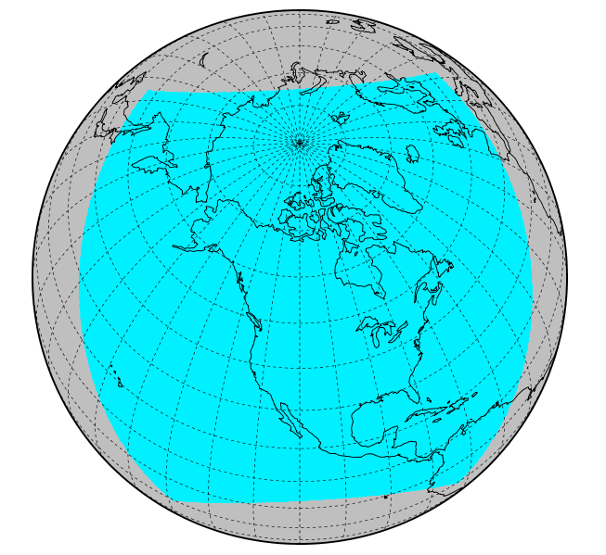
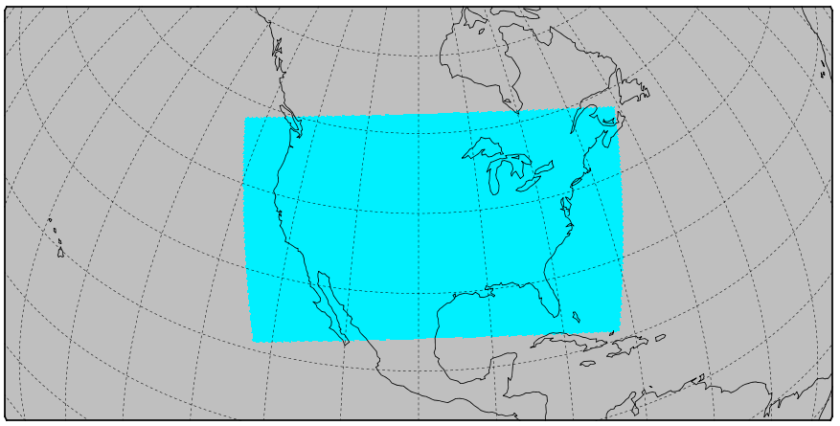
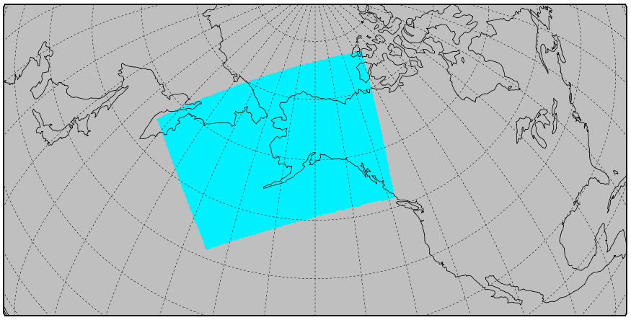
Coverage of Regional Models Used
NAM and HRRR CONUS
~3 km resolution
Rapid Refresh (RAP)
~11 km resolution
NAM and HRRRv3 Alaska
~3 km resolution
GFS and GEOS-FP have global coverage ~0.25°

Slide 13
Additional Sources (not yet used)
Trace gas vertical profiles
  ECMWF – CAMS Near-Real-Time
    O₃, CH₄, some NOx (but not N₂O)
  NASA GEOS-FP
    CO₂ and CO
Ocean surface temperatures
GFS high-resolution global skin temperature
  Hourly, ~11 km resolution
ECMWF 3 hr weather forecasts
ECMWF Hires
Re-analysis datasets (ERA-5)

Slide 14
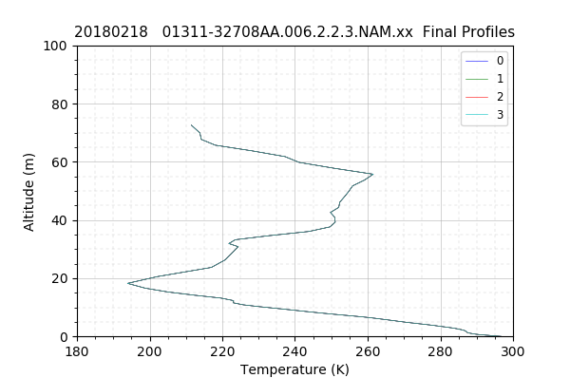
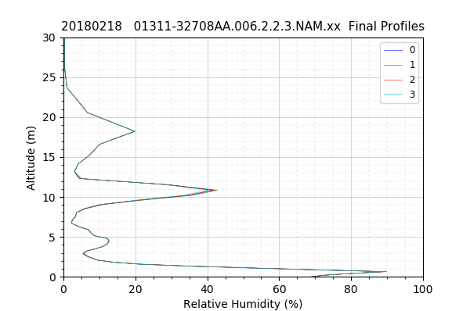
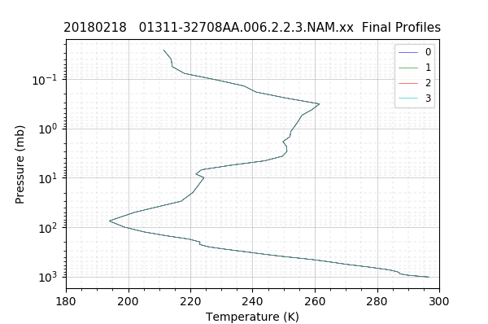
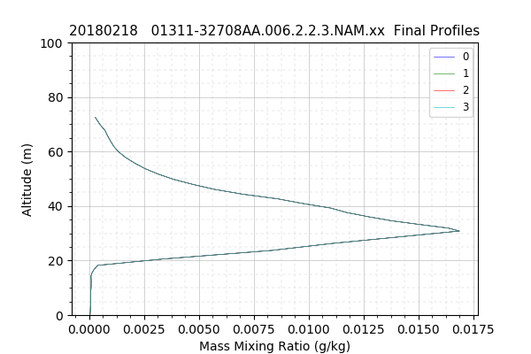
Sample Atmospheric Profiles
H2O
O3
Composite profiles
  Global models fill gaps and upper atmosphere

Slide 15
Creating MODTRAN Inputs
Profile data obtained through database queries of weather data near spatial location of ground footprint and time
User-defined atmosphere profile inputs generated from this data
  Pressure, temperature, altitude, water, and ozone
When profiles are incomplete, the global models are searched and provide data used to fill gaps and upper atmosphere
Surface temperature obtained from weather model
Additional inputs obtained from models that include them
  Visibility
  Aerosol inputs
Geometry created from satellite location and view angle

Slide 16
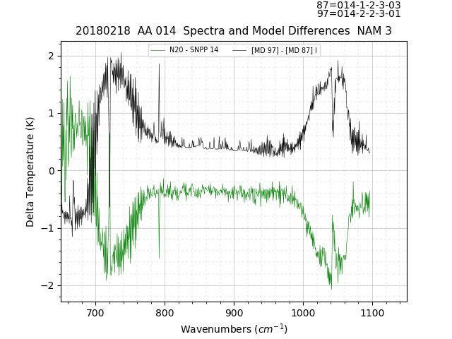
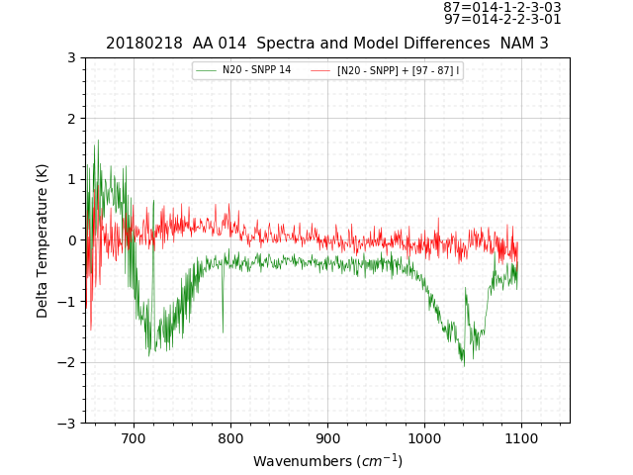
Examples of Correction Improvement LWIR
green is the residual from N20 – SNPP
black is the MODTRAN correction (M_{SNPP} – M_{N20})
green is the same residual N20 – SNPP
red is the residual after our correction

Slide 17
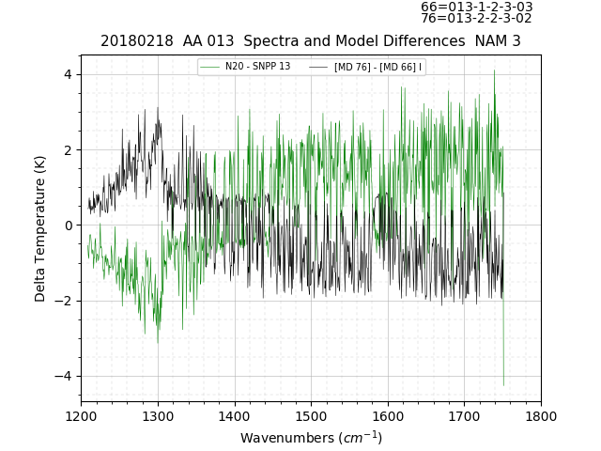
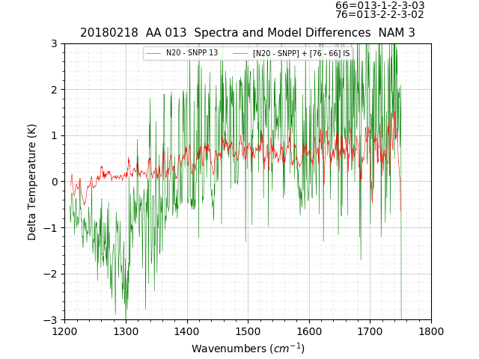
MWIR Full Resolution Band
green is the residual from N20 – SNPP
black is the MODTRAN correction (M_{SNPP} – M_{N20})
green is the same residual N20 – SNPP
red is the residual after our correction

Slide 18
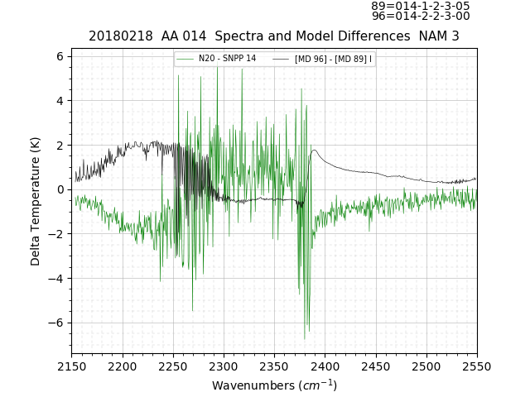
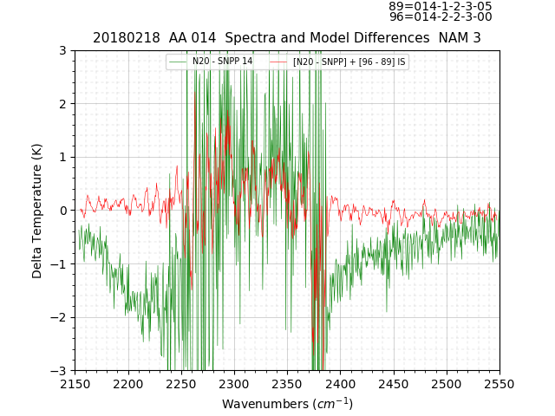
SWIR – Full Resolution Band
green is the residual from N20 – SNPP
black is the MODTRAN correction (M_{SNPP} – M_{N20})
green is the same residual N20 – SNPP
red is the residual after our correction

Slide 19
Comparisons in Progress
 |  | RAP |  | NAM |  | HRRR
LWIR | AboveProf=3
BNum | Ref | New | Chg | New | Chg | New | Chg
0 | 0.775 | 0.097 | 0.678 | 0.079 | 0.695 | 0.157 | 0.618
1 | 0.814 | 0.261 | 0.553 | 0.137 | 0.677 | 0.236 | 0.578
2 | 1.660 | 0.071 | 1.588 | 0.184 | 1.475 | 0.082 | 1.577
3 | 0.560 | 0.210 | 0.350 | 0.123 | 0.437 | 0.280 | 0.280
4 | 0.567 | 0.233 | 0.334 | 0.136 | 0.431 | 0.292 | 0.275
5 | 1.870 | 0.042 | 1.828 | 0.075 | 1.795 | 0.161 | 1.708
6 | 2.063 | 0.029 | 2.034 | 0.100 | 1.963 | 0.065 | 1.999
 | 1.187 | 0.135 |  | 0.119 |  | 0.182
MWIR | AboveProf=3
BNum | Ref | New | Chg | New | Chg | New | Chg
0 | 0.750 | 0.081 | 0.670 | 0.343 | 0.407 | 0.204 | 0.546
1 | 1.656 | 0.020 | 1.636 | 0.147 | 1.509 | 0.051 | 1.605
2 | 0.719 | 0.095 | 0.624 | 0.300 | 0.418 | 0.159 | 0.560
3 | 0.738 | 0.101 | 0.637 | 0.399 | 0.339 | 0.216 | 0.522
4 | 0.903 | 0.112 | 0.792 | 0.477 | 0.427 | 0.209 | 0.694
5 | 0.860 | 0.100 | 0.760 | 0.528 | 0.331 | 0.324 | 0.535
6 | 0.813 | 0.108 | 0.704 | 0.469 | 0.344 | 0.284 | 0.529
 | 0.920 | 0.088 |  | 0.380 |  | 0.207
SWIR | AboveProf=3
BNum | Ref | New | Chg | New | Chg | New | Chg
0 | 0.679 | 0.053 | 0.625 | 0.080 | 0.599 | 0.075 | 0.603
1 | 1.090 | 0.071 | 1.019 | 0.096 | 0.994 | 0.117 | 0.973
2 | 2.259 | 0.030 | 2.229 | 0.070 | 2.189 | 0.046 | 2.213
3 | 0.662 | 0.4342 | 0.228 | 0.4341 | 0.228 | 0.439 | 0.222
4 | 1.025 | 0.382 | 0.643 | 0.428 | 0.597 | 0.391 | 0.635
5 | 1.558 | 0.117 | 1.441 | 0.097 | 1.460 | 0.149 | 1.409
6 | 0.714 | 0.170 | 0.544 | 0.175 | 0.539 | 0.188 | 0.527
 | 1.141 | 0.180 |  | 0.197 |  | 0.201
Initial Results (BT)
  Reduce discrepancy from ~ 1 K down to the 0.1 K range
  Compensates for nadir angle differences well
  RAP and NAM model results performing better than HRRR
Small sample size

Slide 20
MODTRAN Comments
Due to the resolution of CrIS spectra, no significant differences observed between 0.1 cm⁻¹ band model, correlated-K, and line-by-line options in MODTRAN 6
  Significant run-time differences observed
MODTRAN interpretation of geometry caused initial problems
  Slant path from space at satellite altitude resulted in incorrect zenith angle
  MODTRAN adjusts altitude down to top of atmosphere and then adjusts geometry to hit same point on earth
    Angle error of several degrees obvious in absorption bands
  Solution was to set satellite altitude to 100 km and then correct zenith (off-nadir) angle was used

Slide 21
Next Steps
Initial results show encouraging trends
  WX model data appears to have adequate temporal and spatial resolution to capture changes over the 50 minute interval between CrIS spectra
  Current sample too small for any statistical conclusions yet
MODTRAN 0.1 cm⁻¹ band model option provides rapid answers at required fidelity
SDL will work to refine these results and improve the profile selection
  Additional profile and surface data sources will be added
  Additional test cases to be added for comparisons over more of the sensor background signal range (near equator to poles)

