Slide 1
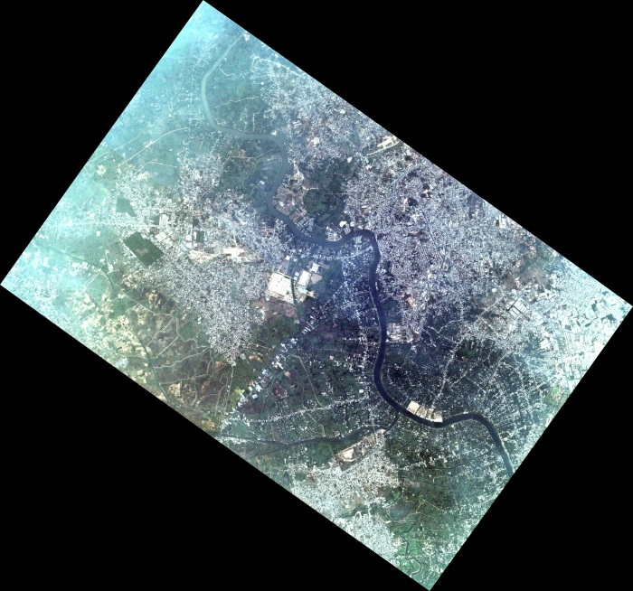
Seeing through heavily polluted satellite imagery using QUAC
Steven Adler-Golden, Lawrence Bernstein, Benjamin St. Peter and Bridget Tannian
Spectral Sciences, Inc., Burlington, MA 01803
2018 Atmospheric Transmission Models – Modeling in Remote Sensing
4 – 6 June 2018, Boston College

Slide 2
Outline
Problem Definition
QUAC Method Overview
Upgrade for Non-uniform Haze
Results and Conclusions

Slide 3
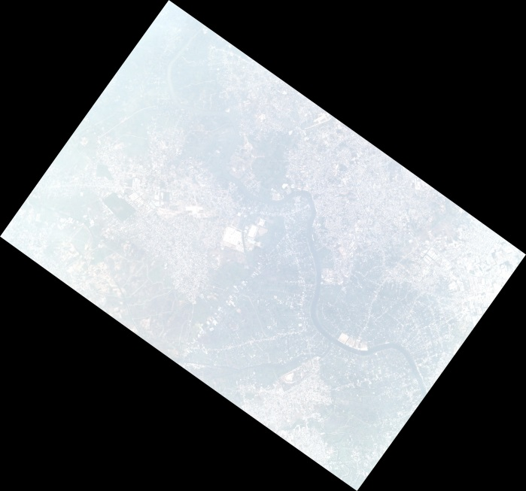
Problem Definition: Atmospheric Correction
Full exploitation of spectral imagery (MSI or HSI) requires atmospheric correction (AC) processing
Removes atmospheric interference, retrieves reflectance spectra
Enables identification via matching with library spectra
Providing uniformity for mosaic assembly
Thick haze creates problems for AC
Need to accurately remove a large proportion of the signal to see the ground
Haze variation within the image requires a non-uniform correction
Very few AC methods are capable of doing a good job with thick, variable haze
Planet Dove RGB Image
March 2016 - Southeastern China Heavy Pollution

Slide 4
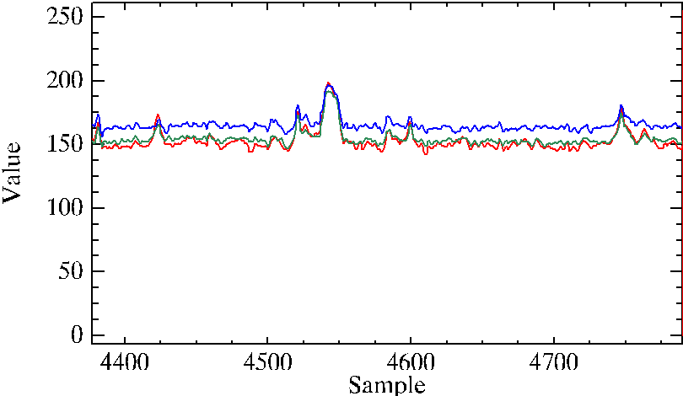
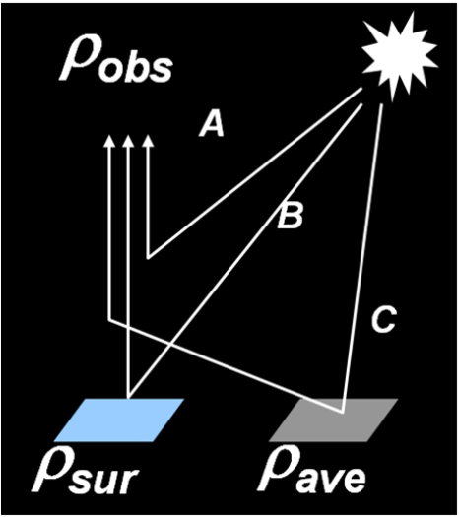
Surface vs. Atmospheric Components of the Signal
In extremely hazy scenes, the atmospherically scattered radiance is larger than the radiance from the ground
Atmospheric scattering components A + Cρ_{ave}
Horizontal slice through Planet Dove RGB image in a least hazy area

Slide 5
Problem Definition: Visualization and Classification
AC may not always be needed, but contrast uniformity is needed for:
Visualization (cannot be compensated by auto-scaling displays)
In-scene material classification
Mosaic assembly
A method is needed for determining and subtracting spatially varying haze
True haze variation (weather)
Atmospheric path differences due to variation in viewing geometry (e.g., angular subtense of the FOV)
Image after auto-scaling to a least hazy area

Slide 6
Potential Solution: the QUick Atmospheric Correction (QUAC)
Empirical method developed by SSI for fast, approximate AC for MSI and HSI
Does not require radiometric calibration, metadata or ground data
Absolute reflectance accuracy within typically 25%, as long as there is a minimal amount of material or terrain diversity in the scene
Previously demonstrated accuracy for spatially uniform long atmospheric paths and thick haze
QUAC doesn’t affect image visualization since it’s a linear transformation
Here we describe an adaptation of QUAC for non-uniform haze
Improves atmospheric correction and visualization

Slide 7
The QUAC Linear Correction
ρ_{obs}
Observed Spectrum:
ρ_{obs} = (A + Cρ_{ave}) + Bρ_{sur}
A
Offset
Gain = 1/B
B
C
Corrected Spectrum:
ρ_{sur} = Gain x (ρ_{obs} – Offset)
ρ_{sur}
ρ_{ave}
QUAC determines Gain and Offset directly from in-scene spectra:
Offset = Lowest channel values in scene (i.e., Dark Object Subtraction)
Gain = Mean of Reference Library Endmembers
Mean of (Data-Offset) Endmembers

Slide 8
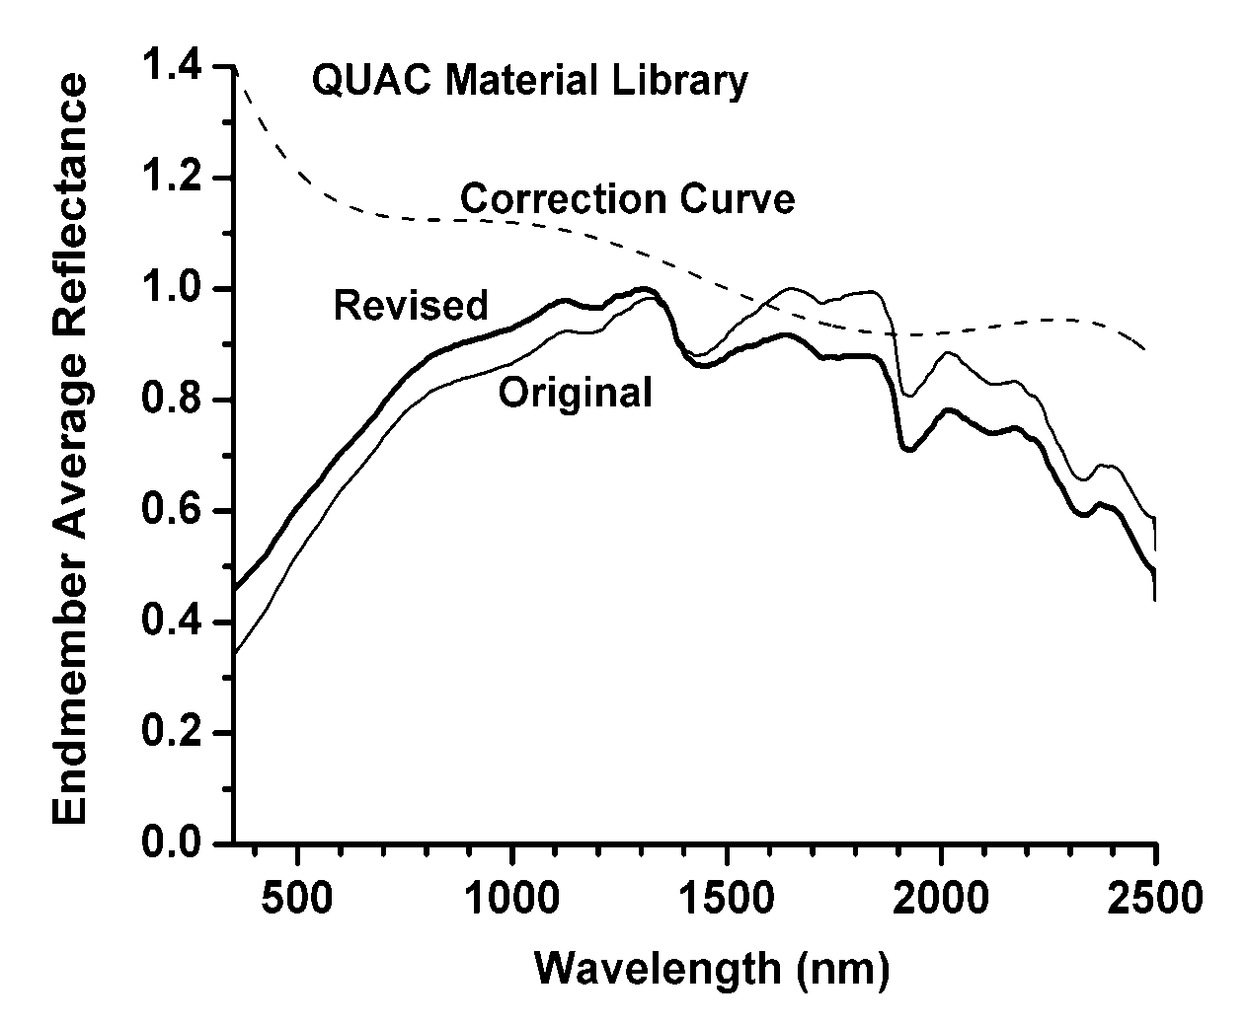
Empirical QUAC Assumption
The mean reflectance for a collection of diverse scene materials (i.e., endmembers) is scene independent!
Endmembers are chosen using the SMACC method
Fast, non-least-squares convex cone method
Arbitrary number of endmembers can be extracted
The mean is relatively insensitive to the number of SMACC endmembers and the specific spectral channels used to find them
Original Curve Based on 195 Natural & Manmade Materials from the JHU Reference Spectral Library

Slide 9
QUAC Upgrade for Non-Uniform Haze
Define a spatially dependent offset (image cube):
Divide image into 150x150-pixel tiles.
For valid tiles (sufficient amount of valid data), find offsets.
Remove anomalous offsets (more than 3σ from mean offset).
Extend the offset array beyond the image boundaries.
Fill in missing offsets by local 3x3 averaging.
Resample offset to the image pixels by linear interpolation.
Finally, subtract offset and derive QUAC gain from the full scene.

Slide 10
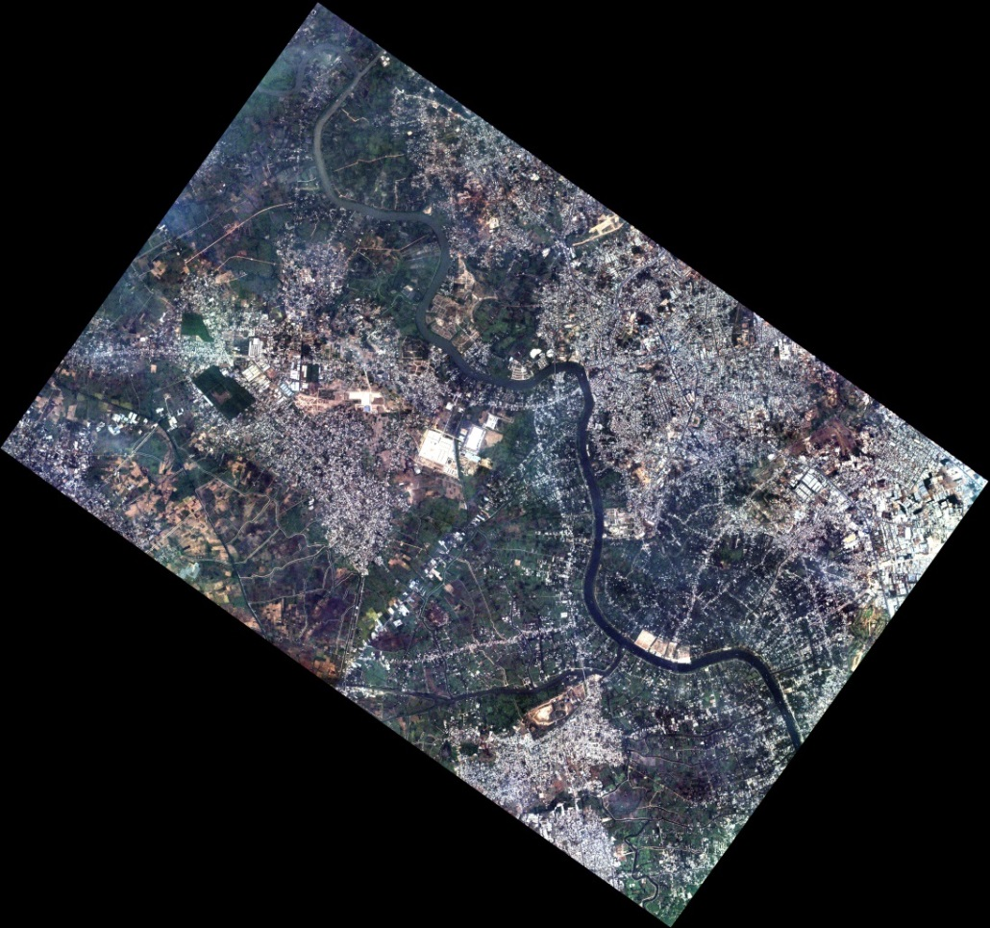
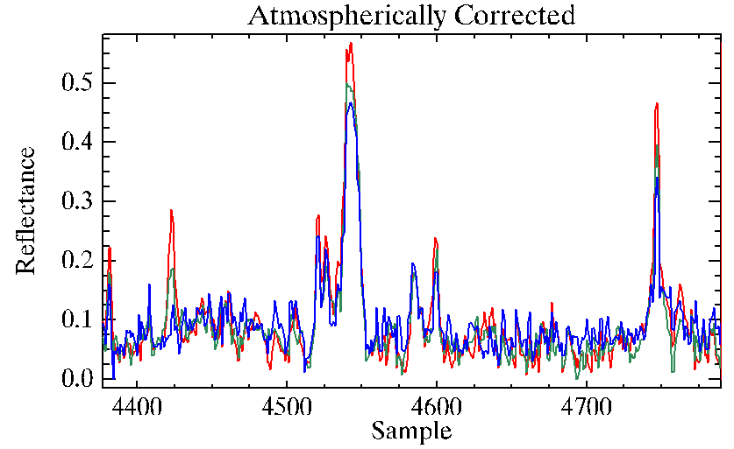
Results
Horizontal slice
Before
After

Slide 11
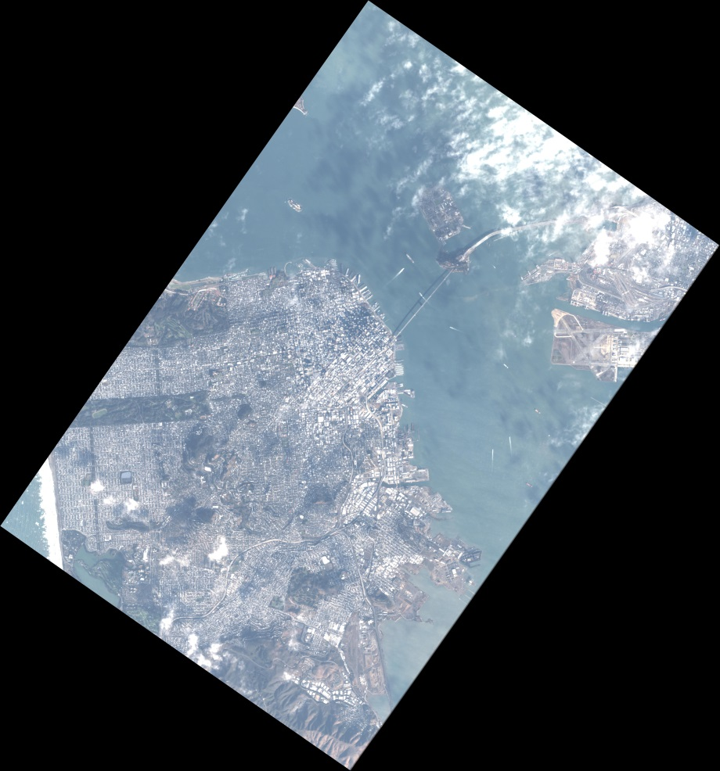
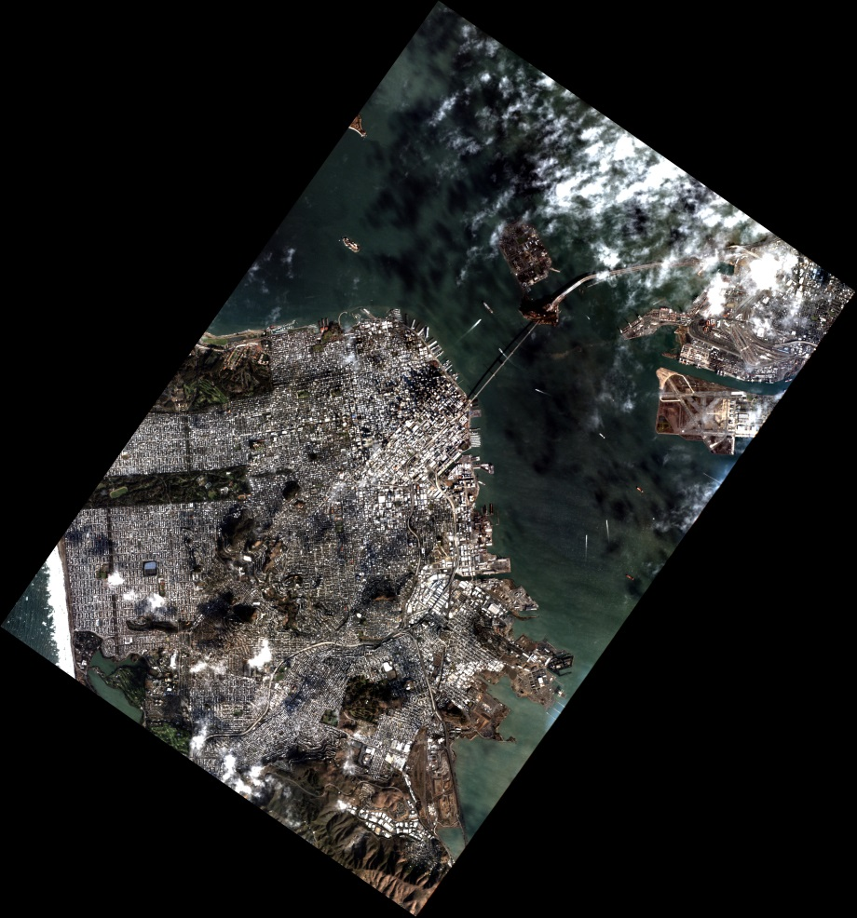
More Pretty Pictures
Planet Dove RGB Image - November 2015
Before
After

Slide 12
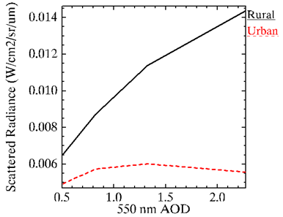
What about first-principles atmospheric correction?
For example, ATCOR can correct for spatially varying haze
However, reflectance results are highly dependent on the haze optical properties
Inference of AOD relies on atmospheric scattering signal
But this signal is insensitive to AOD when haze is dark (urban)
This signal is very sensitive to single-scattering albedo
With plausible models, this scattered radiance level would be consistent with any AOD above 0.5!
MODTRAN aerosol calculations

Slide 13
Conclusions
We have upgraded QUAC to atmospherically correct imagery with in-scene haze variation
Very good results with Planet Dove RGB imagery (several dozen images of southeastern China with heavy pollution)
Method works with all VNIR-SWIR imagery, no metadata or radiometric calibration required
Method is likely superior to first-principles correction algorithms at high AOD
Method could be combined with first-principles (e.g., MODTRAN) calculations to estimate aerosol properties (AOD, Angstrom coefficient, single-scattering albedo) for the scene
Acknowledgements: Planet Labs, Inc., and especially Ignacio Zuleta and Alan Collison, for providing SSI with the image data and for technical discussions

