Slide 1

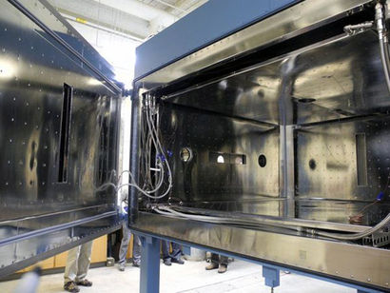
Corey D. Packard,^{a,b,*} Raymond A. Shaw,^{b} Will H. Cantrell,^{b} Greg M. Kinney,^{b} Michael C. Roggemann,^{c} John R. Valenzuela^{d}
ATM-MIRS Meeting
Atmospheric Transmission Models
Modeling in Remote Sensing
June 4, 2018
Measuring the detector-observed impact of optical blurring due to aerosols in a laboratory cloud chamber
ª ThermoAnalytics, Inc., 23440 Airpark Blvd., Calumet, MI 49913, USA
^{b} Department of Physics and Atmospheric Sciences Program, Michigan Technological University
^{c} Department of Electrical and Computer Engineering, Michigan Technological University
^{b,c} 1400 Townsend Drive, Houghton, MI 49931, USA
^{d} Integrity Applications, Inc., 15020 Conference Center Drive Suite 100, Chantilly, VA 20151, USA

Slide 2
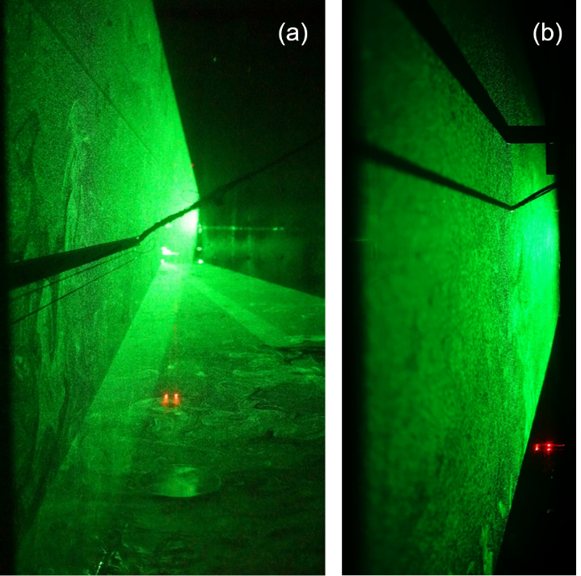
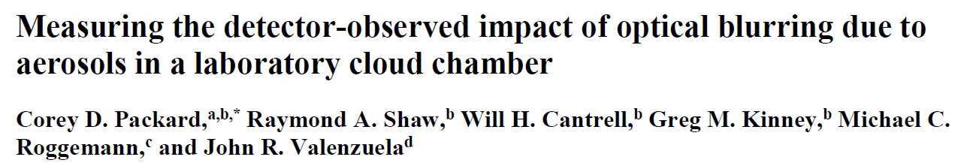
Agenda
Summary of remote sensing degradation sources
Point spread function and Modulation transfer function
Aerosol PSF and MTF expressions
MTU Cloud Chamber measurements of aerosol MTF through expansion clouds
Comparison with predicted aerosol MTFs
  Paper has been accepted; pending publication
Future work: Monte Carlo scattering simulations

Slide 3
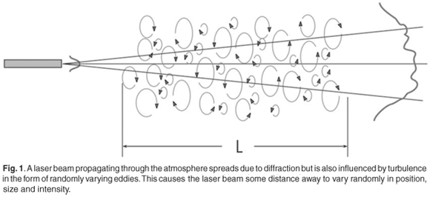
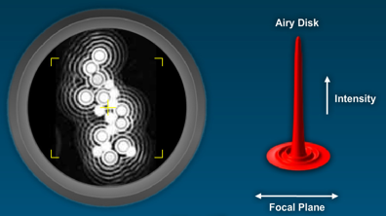
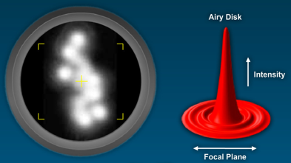
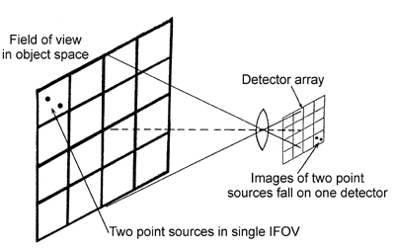
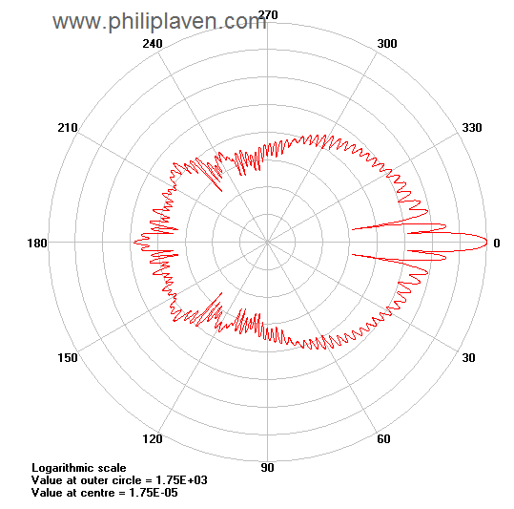
Summary: Sources of remote sensing degradation
Atmospheric (optical) Turbulence
  Blurring due to random atmospheric fluid motion and temperature-driven fluctuations in refractive index
Aperture/Lens
  Finite-sized apertures of optical systems cause diffractive blurring in measured imagery
Detector pixels
  Finite detector pixel footprint leads to blurring as well
Aerosol scattering
  Potential blurring due to scattering of light by cloud/fog aerosol droplets
Notes:
http://www.scielo.org.za/scielo.php?pid=S0038-23532008000200011&script=sci_arttext
http://www.damianpeach.com/seeing1.htm
http://www.zeiss.com/microscopy/en_de/campus/all-tutorials/basic-microscopy/numerical-aperture-and-image-resolution.html
https://spie.org/x34358.xml

Slide 4
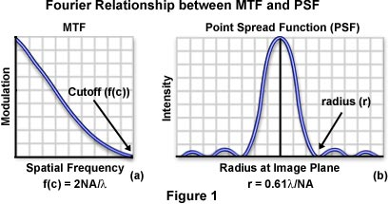
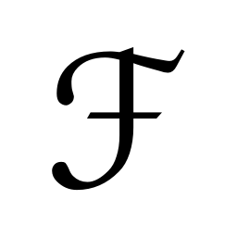
Point Spread Function & Modulation Transfer Function (MTF)
Point spread function (PSF) describes, in the spatial domain, how well optics are able to focus incident light on a detector or focal plane
Modulation transfer function (MTF) is the spatial frequency response of an optical system which describes which spatial frequencies are passed
PSF superimposed on a detector array
Impact of PSF
on point sources of light
Fourier relationship between PSF and MTF
Notes:
http://www.zeiss.com/microscopy/en_de/campus/all-tutorials/basic-microscopy/numerical-aperture-and-image-resolution.html
http://olympusmicro.com/primer/java/mtf/airydisksize/index.html

Slide 5
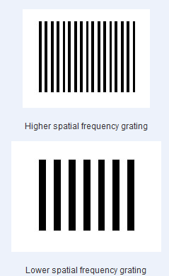
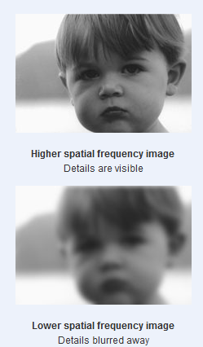
Impact of MTF Spatial Frequency Response
Spatial frequency can be expressed as the number of “cycles” per mm (or per degree of visual angle )
  A “cycle” is a complete light-dark bar repetition
  Units of cy/mm [or cy/mrad]
Images without high spatial frequencies are limited in their ability to capture fine detail
  Sending an image through a low-pass filter removes higher spatial frequencies, resulting in a loss of detail (blurring)
Can we develop and verify an aerosol MTF in a laboratory setting?
Detail is preserved
Detail is blurred

Slide 6
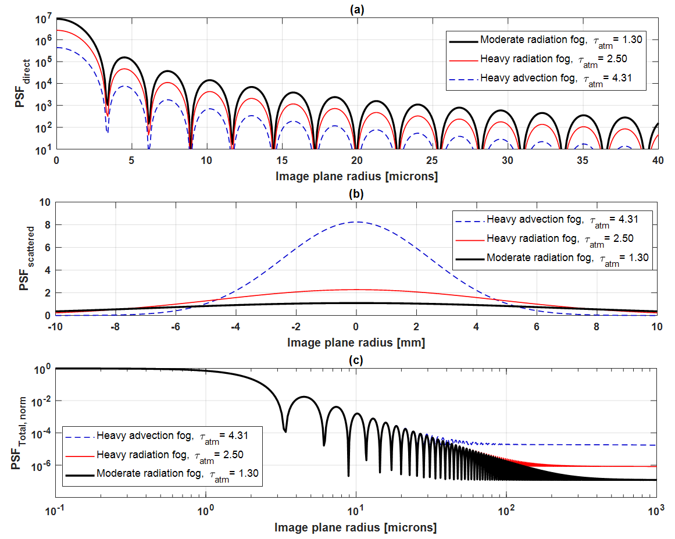
Theoretical PSFs with aerosol scattering
Direct
Diffuse
Total
Notes:
Point spread function at the image plane is taken as a combination of direct (attenuated, unscattered) and diffuse (scattered)

Slide 7
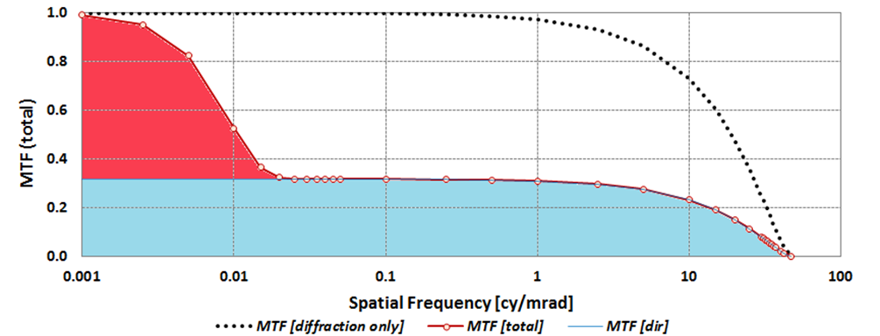
Aerosol Modulation Transfer Function
Aerosol MTF, with aperture diffraction:
Attenuated, direct component
Blurring due to aerosol scattering
Q: Can we measure an aerosol MTF with an optical sensor?

Slide 8
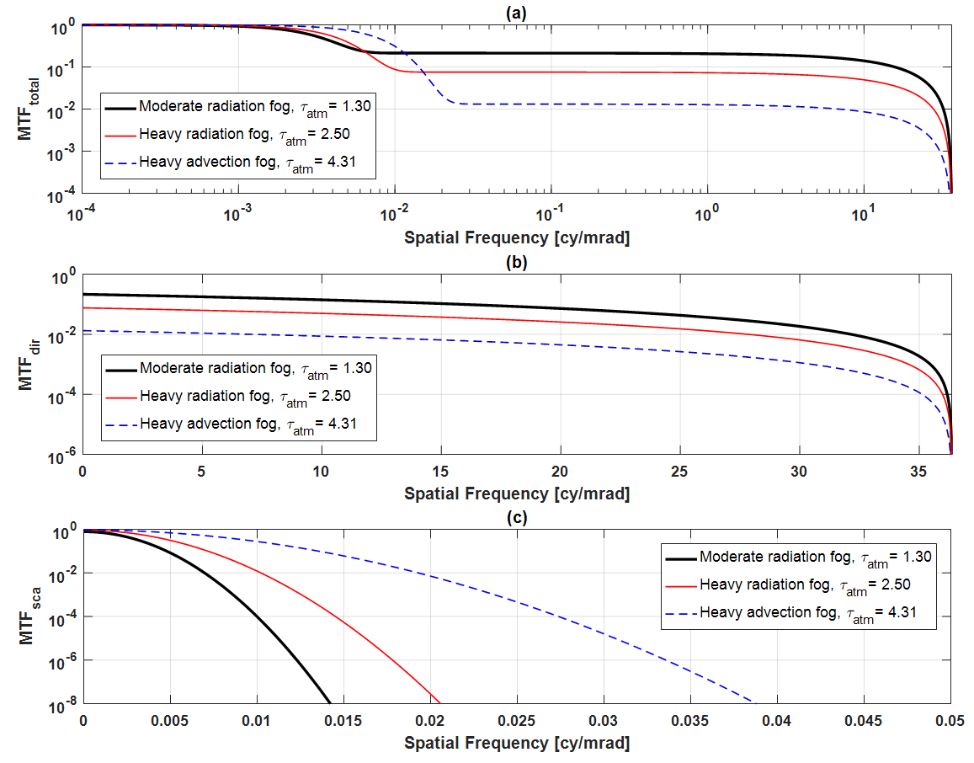

Theoretical MTFs with aerosol scattering
amode
Total
$$τ$$
Direct
Diffuse
Notes:
Optical depth governs height of plateau, falloff is governed by aerosol size
Scattered component (bottom) occurs at lowest spatial frequencies

Slide 9
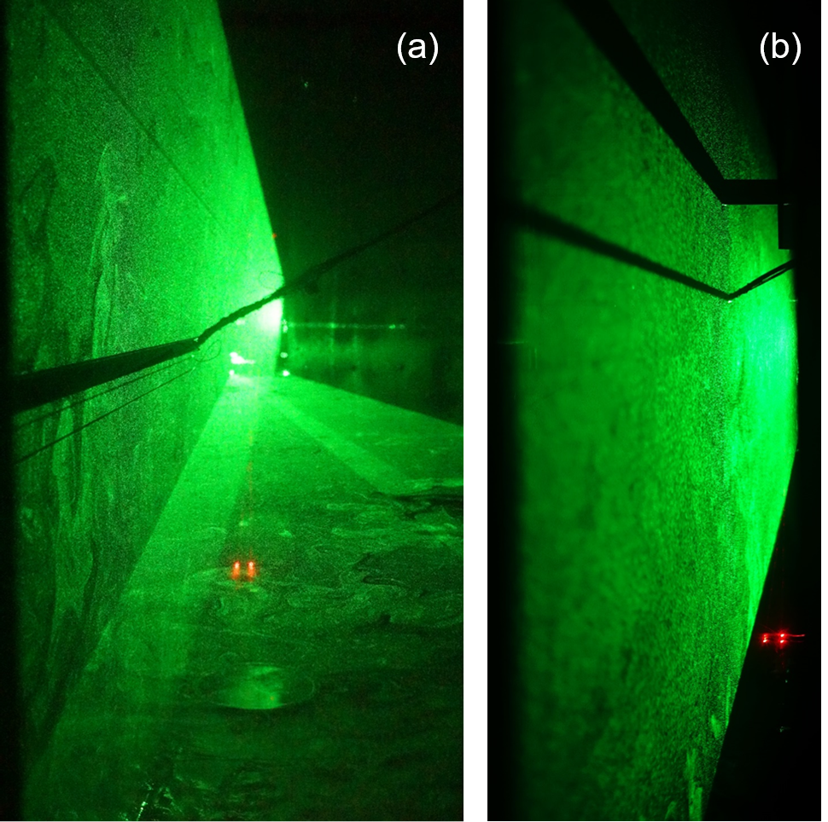
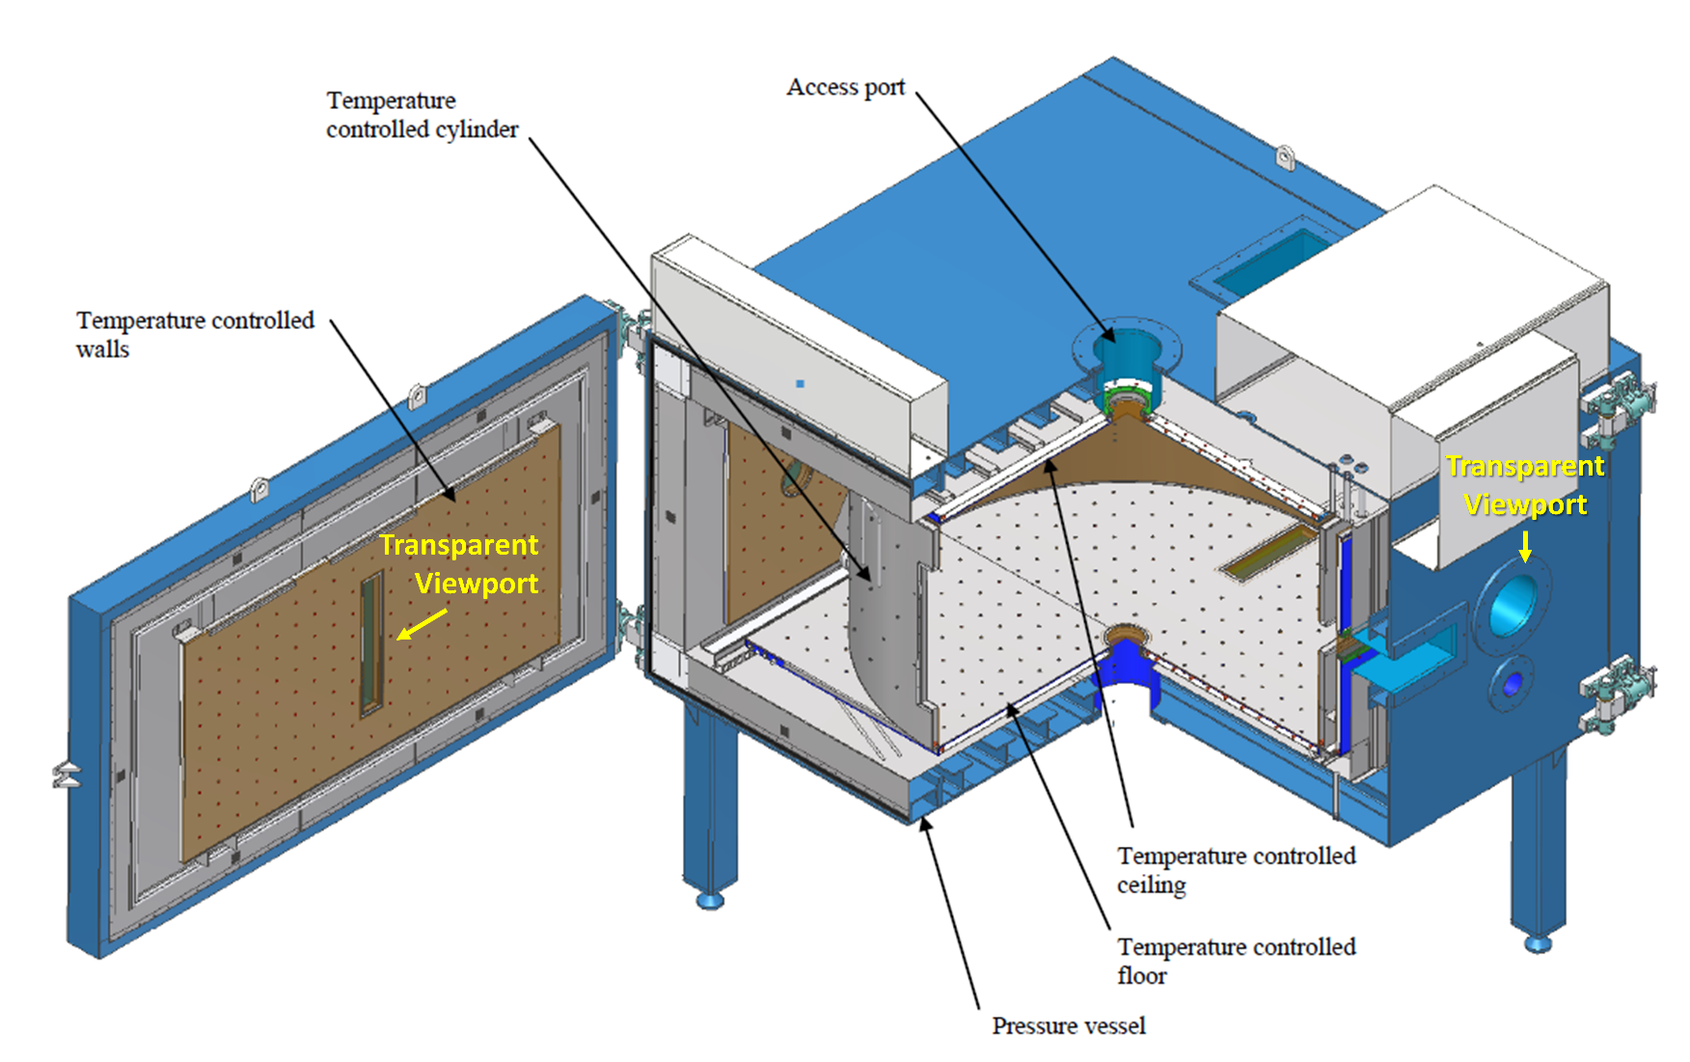
MTU Pi Chamber: Expansion Cloud Tests
Michigan Technological University has a novel Cloud Chamber
  T_{air}: -55 to 55C, P ≥ 100 hPa
  Salt-based aerosols for cloud condensation
  Several optical viewports
  2 meter propagation path
Atmospheric conditions can be controlled & measured
  Mixing & expansion clouds can be generated & sustained
Mixing Cloud
Expansion Cloud

Slide 10
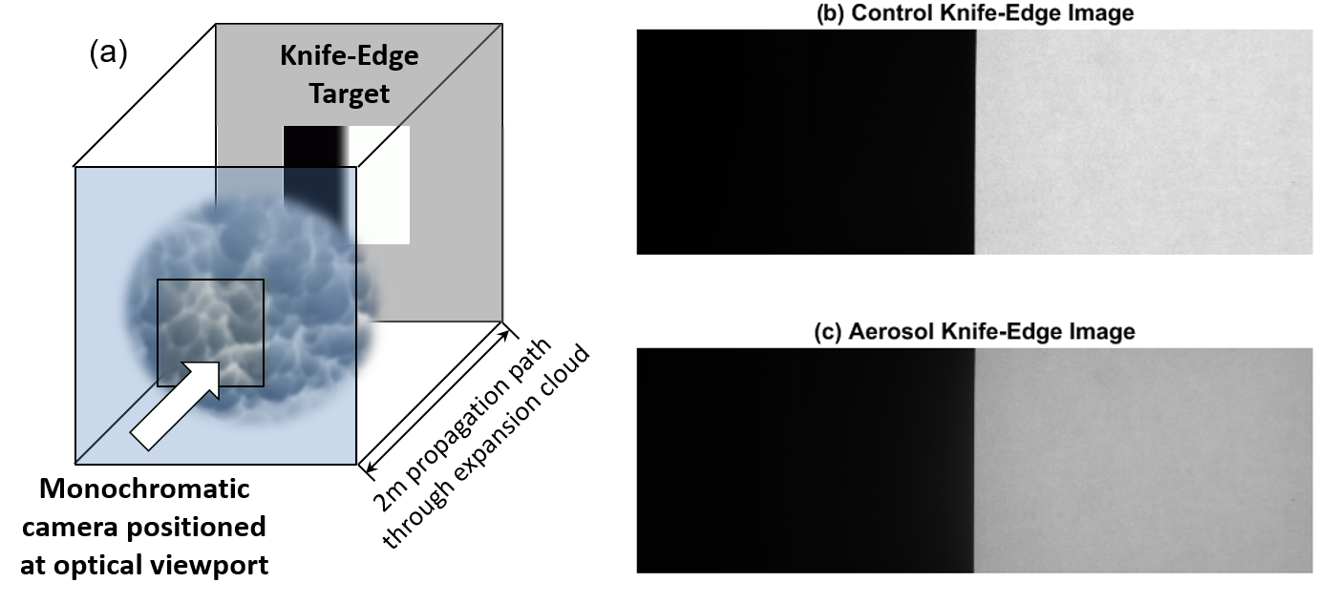
MTU Pi Chamber: Expansion Cloud Tests
Binary knife-edge images were photographed through expansion clouds (and empty chamber for control)
  Aerosol MTFs were calculated from these images
Notes:
Figure 4. (a) Illustration of experimental setup with monochromatic camera, positioned outside cloud chamber near an optical viewport, focused through the expansion cloud on binary knife-edge target located just outside opposite viewport. (b) Representative example of measured control image. (c) Example of knife-edge image taken through expansion cloud, demonstrating attenuation due to aerosol scattering in the visible band.

Slide 11
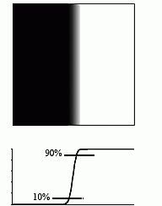
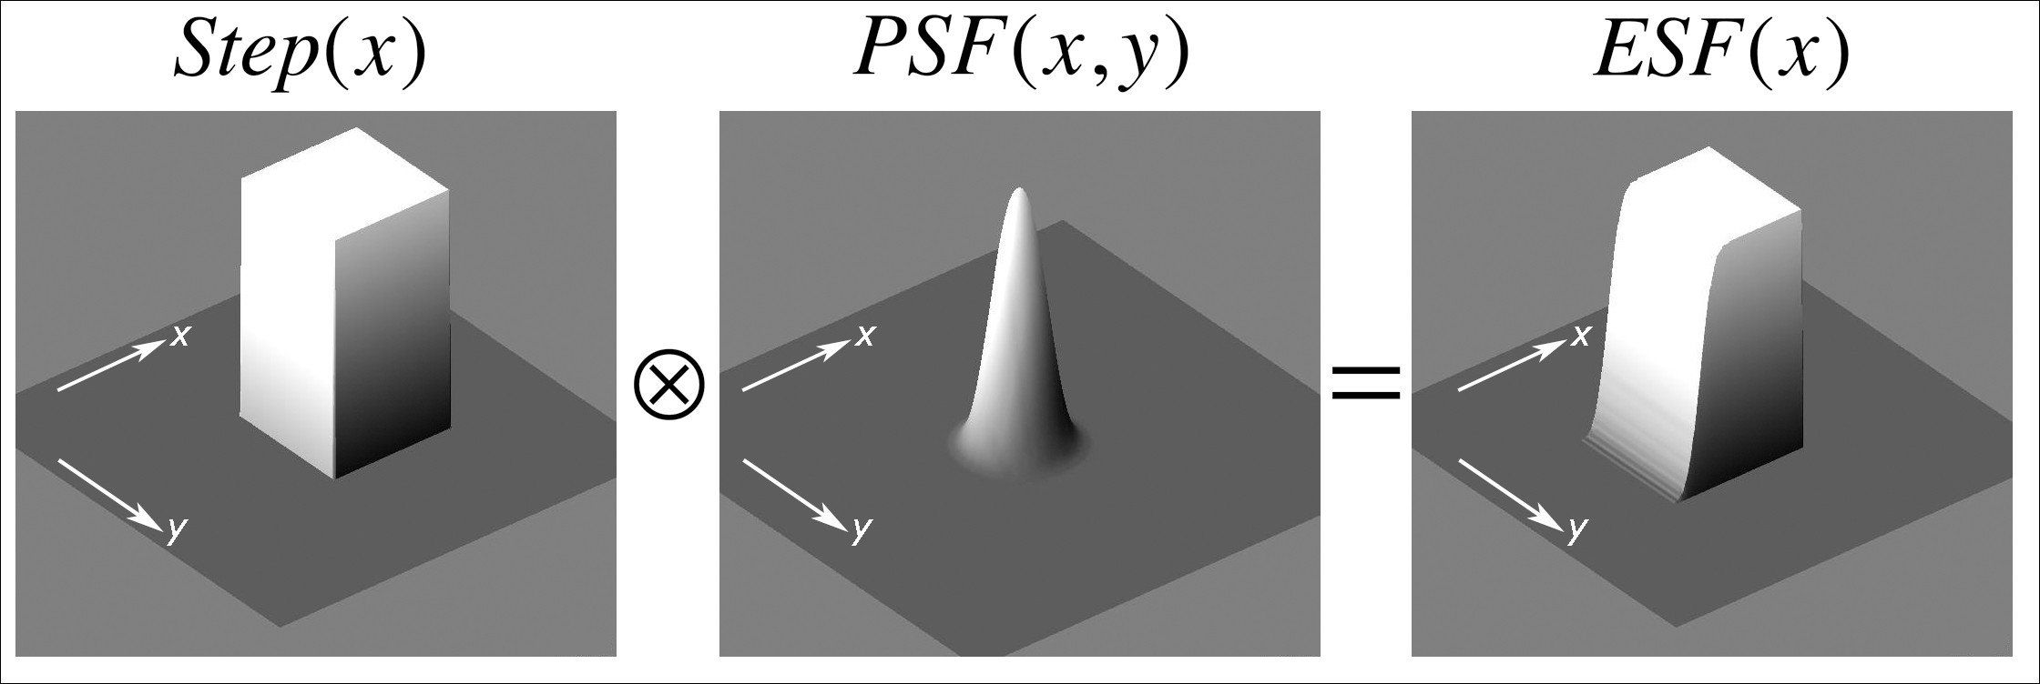
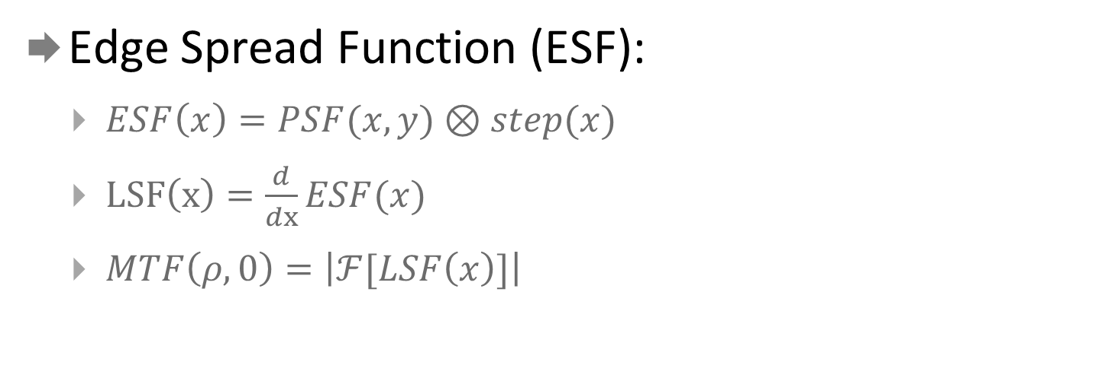
Edge Spread Function Method: Binary Knife-Edge
Edge Spread Function (ESF):
  $ESF\left(x\right)=PSF(x,y)⊗step(x)$
  $LSF\left(x\right)=\frac{d}{dx}ESF(x)$
  $MTF\left(ρ,0\right)=\left|ℱ[LSF\left(x\right)]\right|$
Notes:
Edge Spread Function (described by Boreman)

Slide 12
Experimental MTF Calculation: CONTROL
Measured control MTF deviated from ideal response
What is the explanation for this?
Notes:
Figure 6. (a) Diffraction-limited LSF comparison between ideal (floating point) and quantized to simulate various finite bit-depth detectors. (b) Family of MTF curves computed from the diffraction-limited LSFs shown in (a).

Slide 13
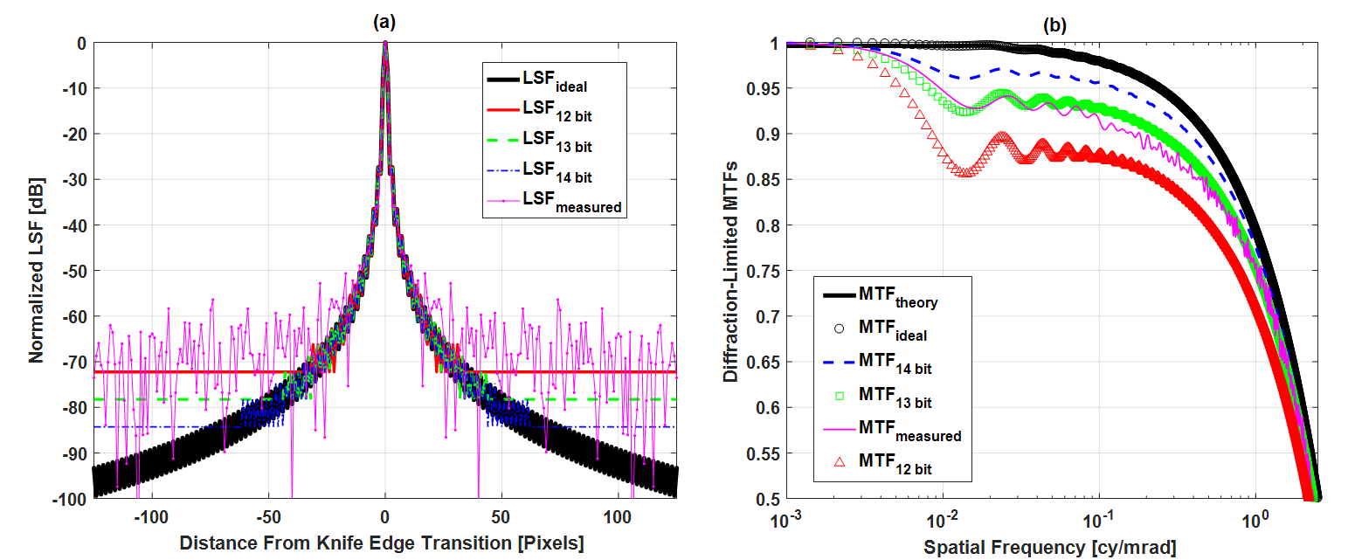
Experimental MTF Calculation: CONTROL
Quantization (due to detector dynamic range) appears to be a necessary consideration
Diffraction-limited LSF comparison between ideal (floating point) and quantized to simulate various finite bit-depth detectors.
Family of MTF curves computed from the diffraction-limited LSFs shown in (a).
Notes:
Figure 6. (a) Diffraction-limited LSF comparison between ideal (floating point) and quantized to simulate various finite bit-depth detectors. (b) Family of MTF curves computed from the diffraction-limited LSFs shown in (a).

Slide 14
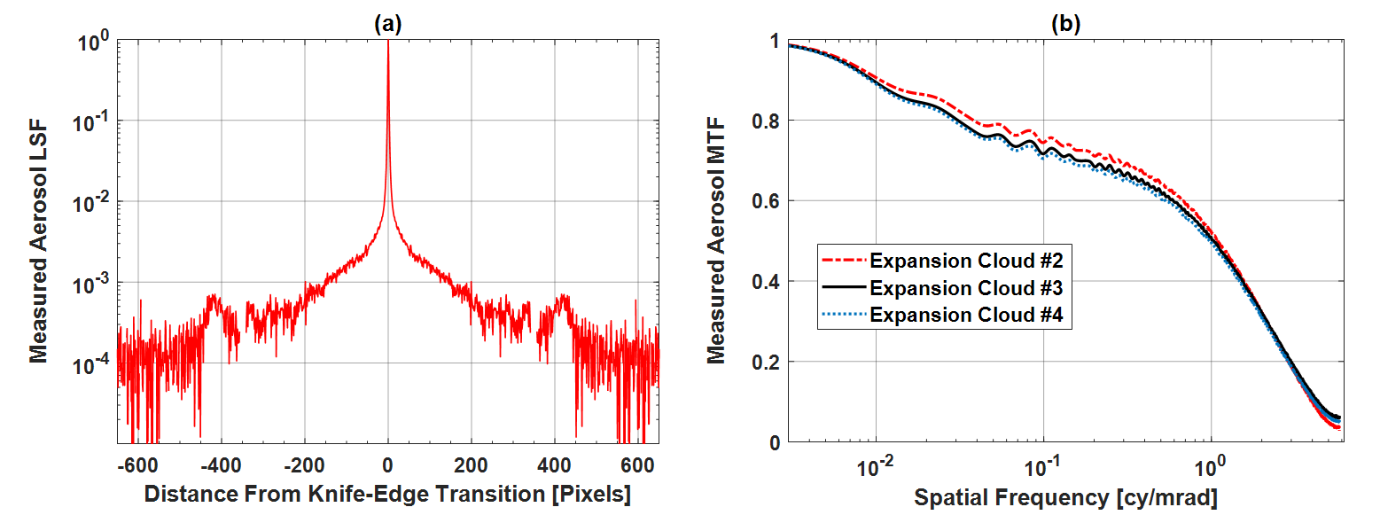
Experimental Aerosol MTFs
Normalized line spread function measured during Expansion Cloud #3 through the MTU cloud chamber.
Measured aerosol MTFs obtained from imagery captured through expansion clouds.

Slide 15

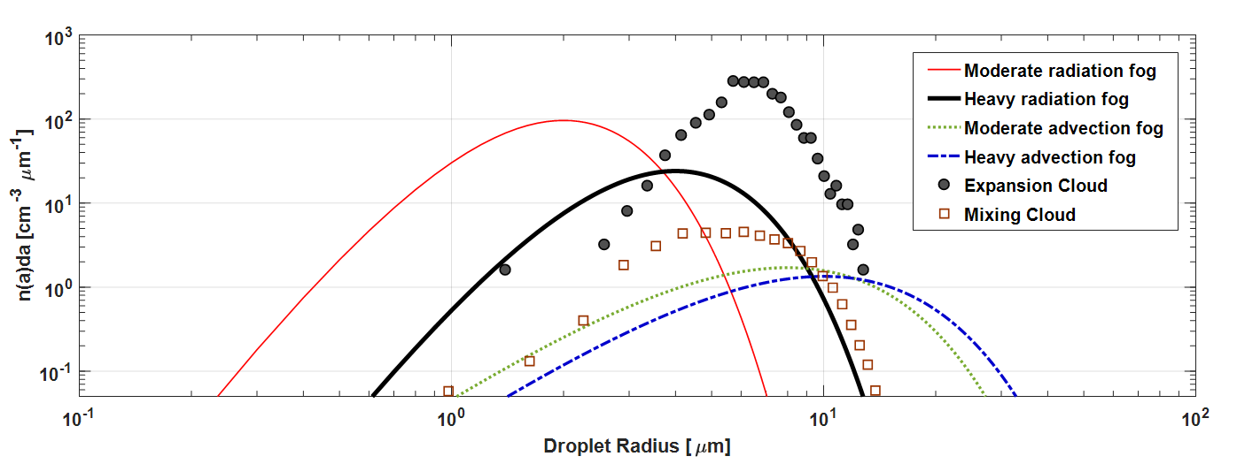
Measured and Theoretical Distributions
Particle Size Distribution Functions
  Theoretical fog models (MODTRAN)
  Chamber-measured expansion cloud
  Chamber-measured mixing cloud
Notes:
Figure 5. Measured expansion cloud and mixing cloud droplet size distributions shown along with four theoretical fog model distributions. Note that the range of measured droplet radii is comparable to theoretical models, but measured number concentrations in the expansion cloud are significantly higher (peak of 450 cm⁻³μm⁻¹ vs 25 cm⁻³μm⁻¹ for heavy radiation fog model). This results in a much larger optical depth, τ over the short propagation distance of the chamber. Mixing cloud data supplied by Kamal Chandrakar (MTU).

Slide 16
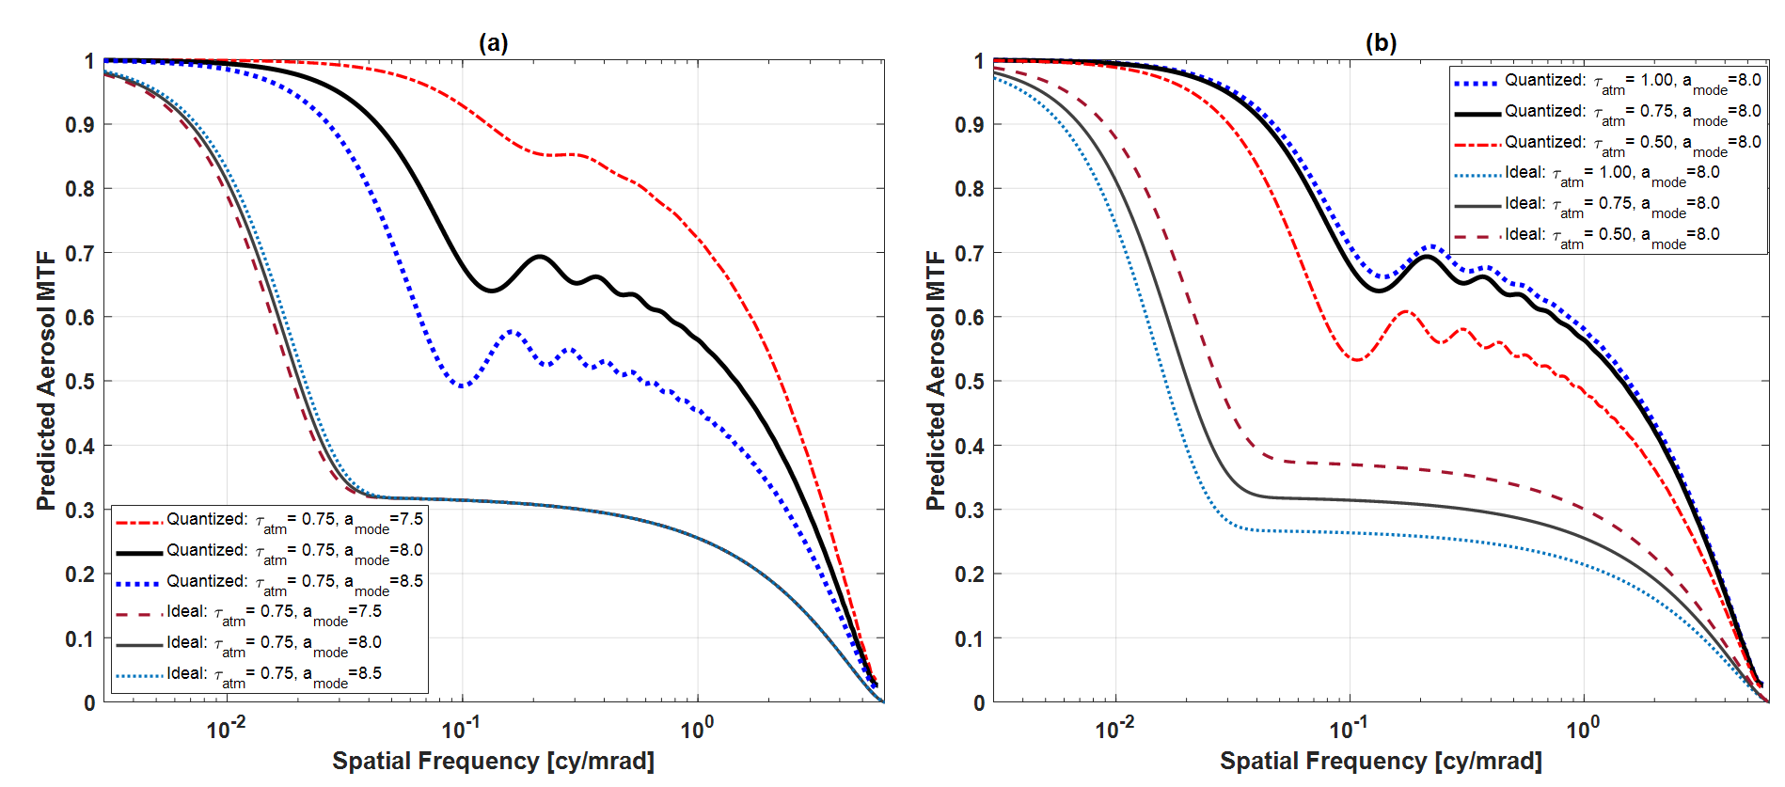
Impact of Quantization on Predicted Aerosol MTFs
(a) Impact of varying dominant droplet radius on [quantized] aerosol MTF, assuming constant optical depth. (b) Variations in [quantized] aerosol MTF due to various optical depths, assuming the same dominant droplet radius.
Notes:
(a) Impact of varying dominant droplet radius on [quantized] aerosol MTF, assuming constant optical depth. (b) Variations in [quantized] aerosol MTF due to various optical depths, assuming the same dominant droplet radius.

Slide 17
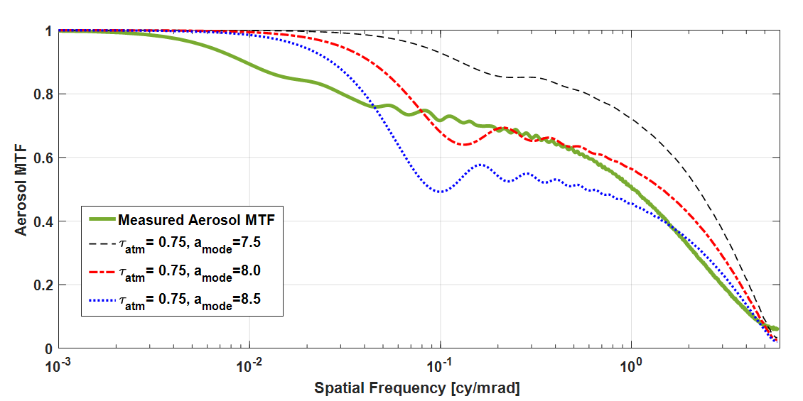
Aerosol MTF Comparison: Measured vs (Quantized) Theory
Predicted aerosol MTF vs Image-derived aerosol MTF
  Theoretical MTF expressions, measured cloud conditions and optical sensor system dynamic range limitations are combined; compared to image-derived aerosol MTF

Slide 18
Monte Carlo Photon Scattering Simulation
Motivation for Monte Carlo simulation:
  Aerosol scattering theory is being experimentally verified in the cloud chamber
  Cloud chamber is critical for ground truth but has physical limitations (e.g., cloud density, propagation length)
  Monte Carlo serves as an efficient “bridge” between theoretical and experimental approaches
    MC can be scaled up to explore longer propagation lengths, etc.
  Simulations allow complex scenarios (which would be difficult for mathematical examination) to be analyzed and visualized
    Heterogeneous particle distributions with any (reasonable) cloud density
    Longer propagation distances
MC simulations can be used to improve experimental design
  How to illuminate, sensor type and location, etc.

Slide 19
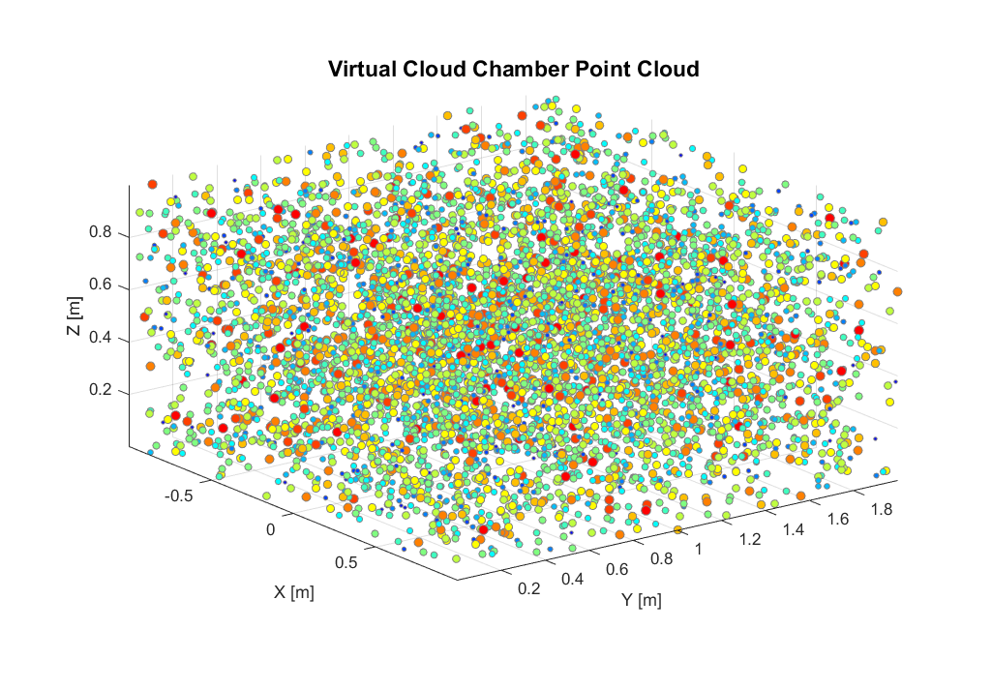
Monte Carlo Photon Scattering Simulation
Monte Carlo simulations allow complex aerosol scattering scenarios to be analyzed (and visualized)
  Heterogeneous particle distributions (e.g. polydisperse)
  Non-uniform spatial distributions

Slide 20
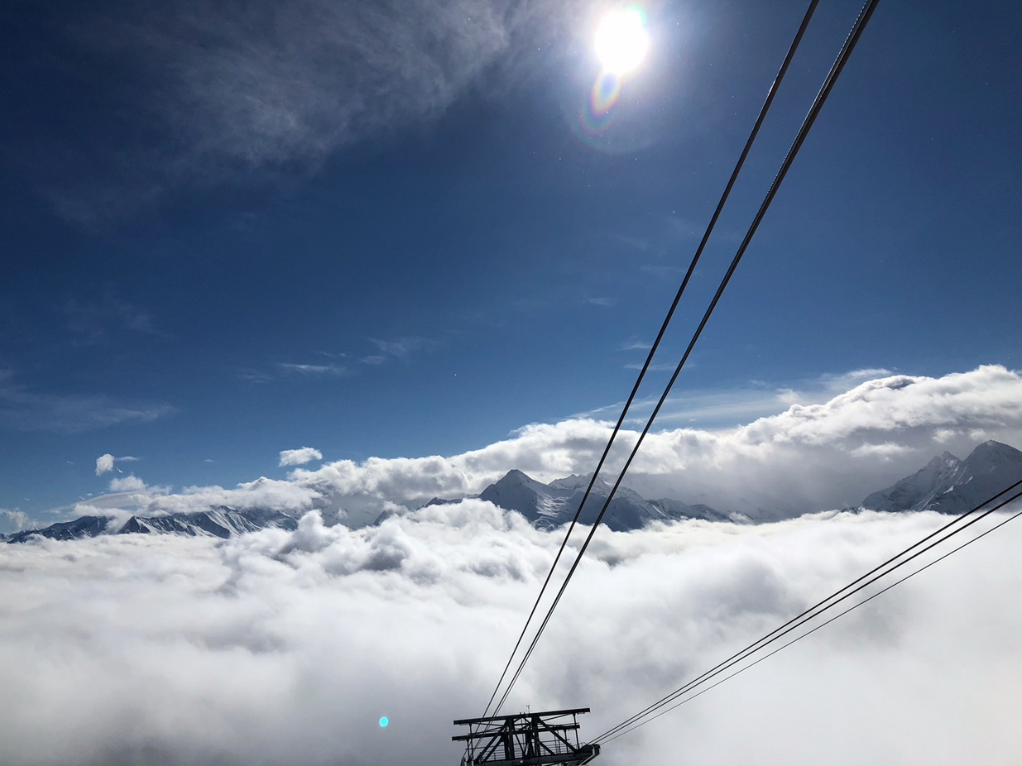
Thanks for your attention!
Questions?

