Slide 1
Welcome from IEEE GRSS and MIRS TC
John Kerekes
GRSS Chief Financial Officer
MIRS TC Co-Chair
ATM-MIRS Meeting
4 June 2018
Newton, MA, USA

Slide 2
IEEE Geoscience and Remote Sensing Society: IEEE GRSS
What is IEEE?
Institute of Electrical and Electronics Engineers
World’s largest technical professional society: Over 430,000 members in 160 countries
What is GRSS?
One of 39 Societies of IEEE
Global: Over 3500 members in 94 countries
What does it do?
Remote Sensing and Geospatial Information
Science, Engineering, Applications, Education
Optical & hyperspectral imaging systems
Lidar & radar altimetry and applications
Active and passive microwave imaging systems
Geospatial information processing & data fusion

Slide 3
Key Elements of GRSS
Conferences
Information
Services
Publications
Professional
Activities
Technical
Activities
www.grss-ieee.org

Slide 4
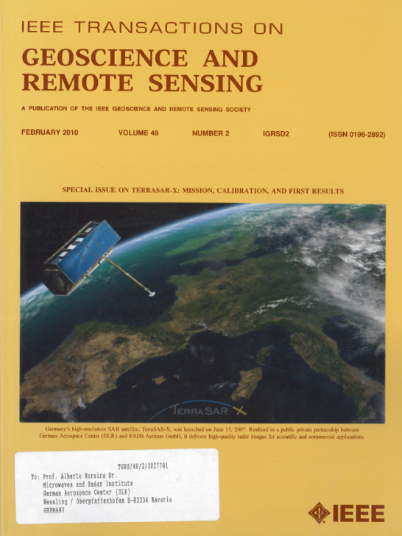
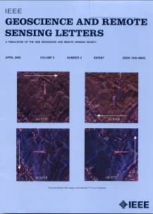
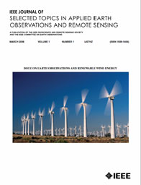
IEEE GRSS Journals
High Quality
High Impact
Fully Edited
TGRS - Transactions
First Published in 1963
599 papers last year
GRSL - Letters
First Published 2004
564 papers last year
J-STARS
First Published in 2008
571 papers last year

Slide 5
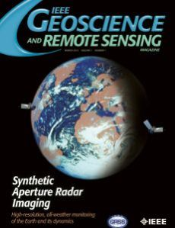
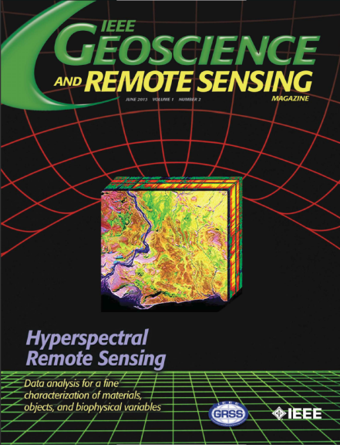
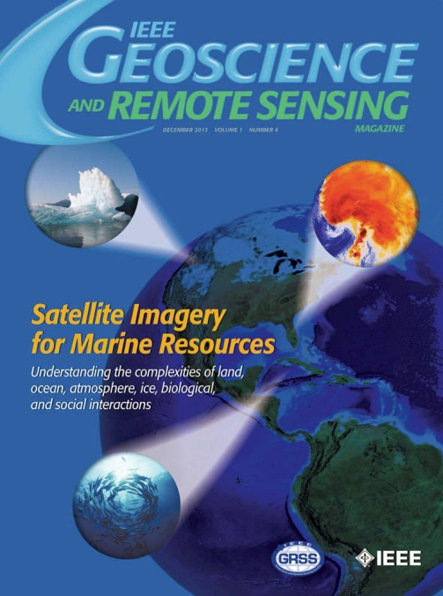
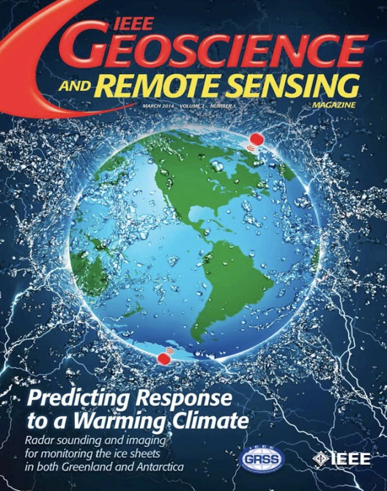
IEEE GRSS Magazine (quarterly) and e-Newsletter (monthly)

Slide 6
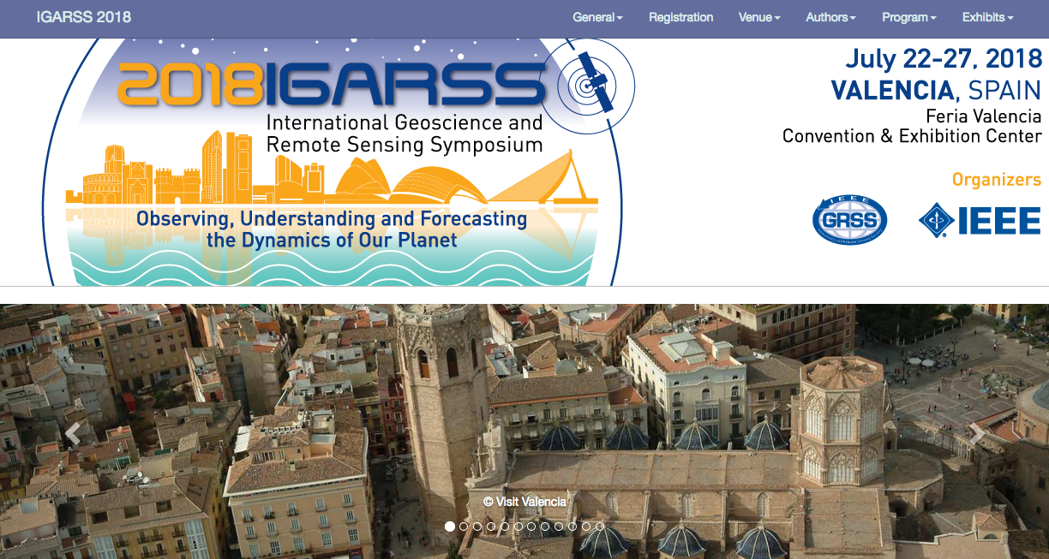
GRSS Conferences
IGARSS: International Geoscience and Remote Sensing Symposium – GRSS Flagship Conference
Microrad, ATM-MIRS + other small conferences and symposia
2000-3000 attendees
Venue rotates: Europe, Asia, Americas
2018 – Spain
2019 – Japan
2020 - Hawaii

Slide 7
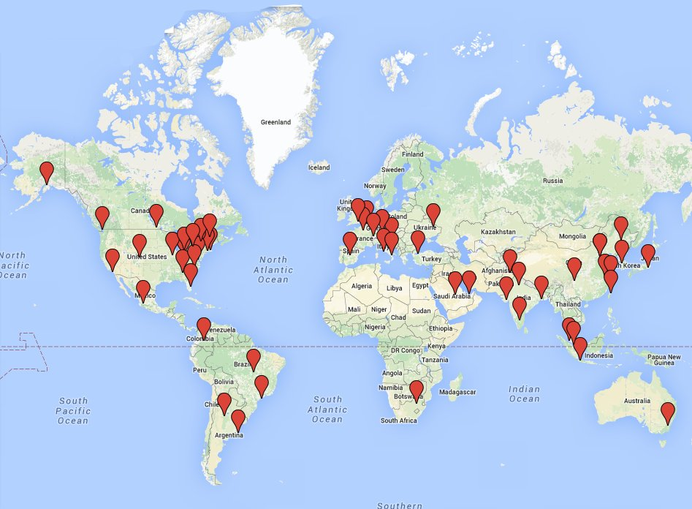
GRSS Chapters
Boston Chapter Chair:
Francesca Scire Scapuzzo
fscire@alum.mit.edu
63 Chapters

Slide 8
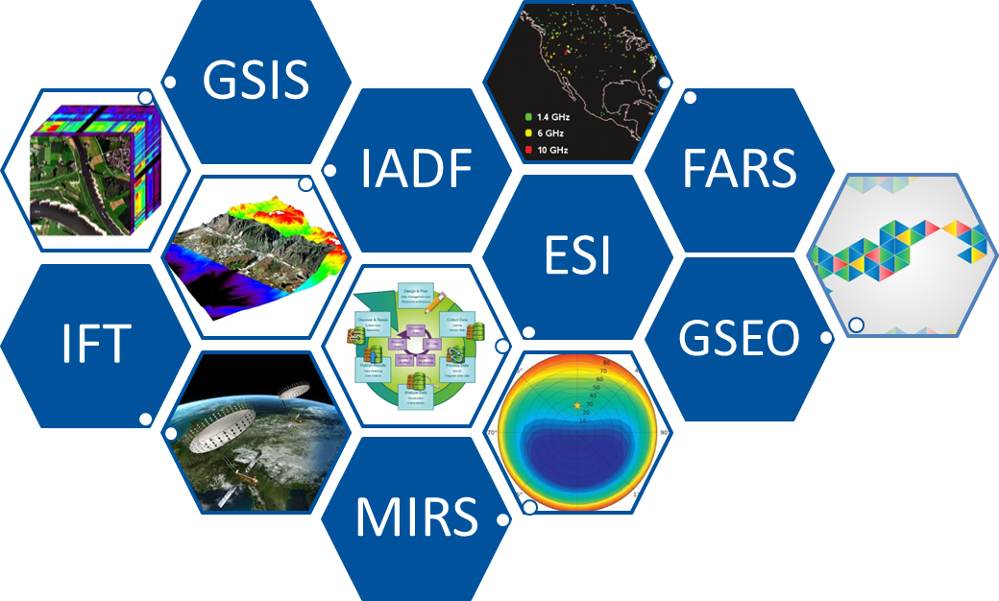
Technical Committees of the Geoscience and Remote Sensing Society (GRSS)
Irena Hajnsek (ETH/DLR)
VP of Technical Activities

Slide 9
GRSS Technical Committees
ID | TC Name | Chair /Co-Chair
ESI | Earth Science Informatics | Peter Baumann (Jacobs Uni) Peng Yue (Wuhan Uni) Rahul Ramachandran (NASA MSFC)
FARS | Frequency Allocations in Remote Sensing | Paolo de Matthaeis (NASA GSFC) Roger Oliva Balague (ESA) Yan Soldo (NASA GSFC)
IADF | Image Analysis and Data Fusion | Bertrand Le Saux (ONERA) Ronny Hänsch (TUB) Naoto Yokoya (Uni Tokyo)
IFT | Instrumentation and Future Technologies | Upendra N. Singh (NASA Langley) Georgios Tzeremes (ESA ESTEC) Marwan Younis (DLR)
GSIS | Geoscience Spaceborne Imaging Spectroscopy | Cindy Ong (CSIRO) Uta Heiden (DLR) Andreas Mueller (DLR)
MIRS | Modeling in Remote Sensing | Jiancheng Shi (RADI) John Kerekes (RIT) Joel Johnson (Ohio State Uni)
GSEO | GRSS Standards for Earth Observation | Siri-Jodha Singh KHALSA (Uni Colorado) Kevin Romero (Northrop Grumman)

Slide 10
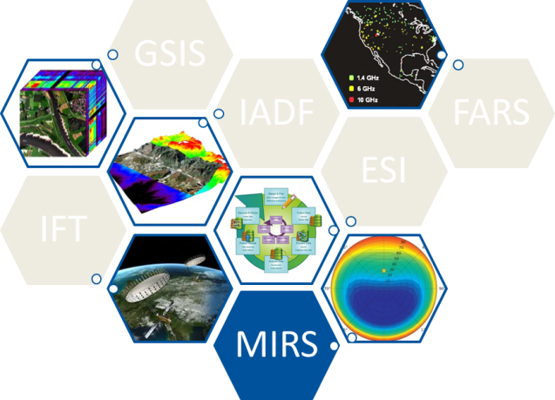
Modeling in Remote Sensing TC
Established in 2015
Chairs:
Jiancheng Shi (RADI)
John Kerekes (RIT)
Joel Johnson (OSU)
Contact: mirs_chairs@ieee-grss.org
Mission
The mission of the Modeling in Remote Sensing Technical Committee (MIRS TC) is to serve as a technical and professional forum for advancing the science of predicting remotely sensed observations from first principles theory.
The MIRS TC addresses the technical space between basic electromagnetic theory and data collected by remote sensing instruments. It focuses on models and techniques used to take geometric, volumetric and material composition descriptions of a scene along with their EM (e.g., scattering, absorption, emission, optical BRDF, dielectric properties, etc.) attributes and then predict for a given remote sensing instrument the resulting observation.

Slide 11
MIRS Membership
Currently: 55 Members from 14 different countries
MIRS Activity
JSTARS Special Issue on “Modeling and Simulation in Remote Sensing” published in November 2017 with 15 papers
Two invited sessions at IGARSS’18
Physical Modeling in Microwave Remote Sensing
Optical Modeling in Remote Sensing
MIRS TC Meeting to be held at IGARSS’18
ATM-MIRS Meeting June 2018
http://www.grss-ieee.org/community/technical-committees/modeling-in-remote-sensing/

Slide 12
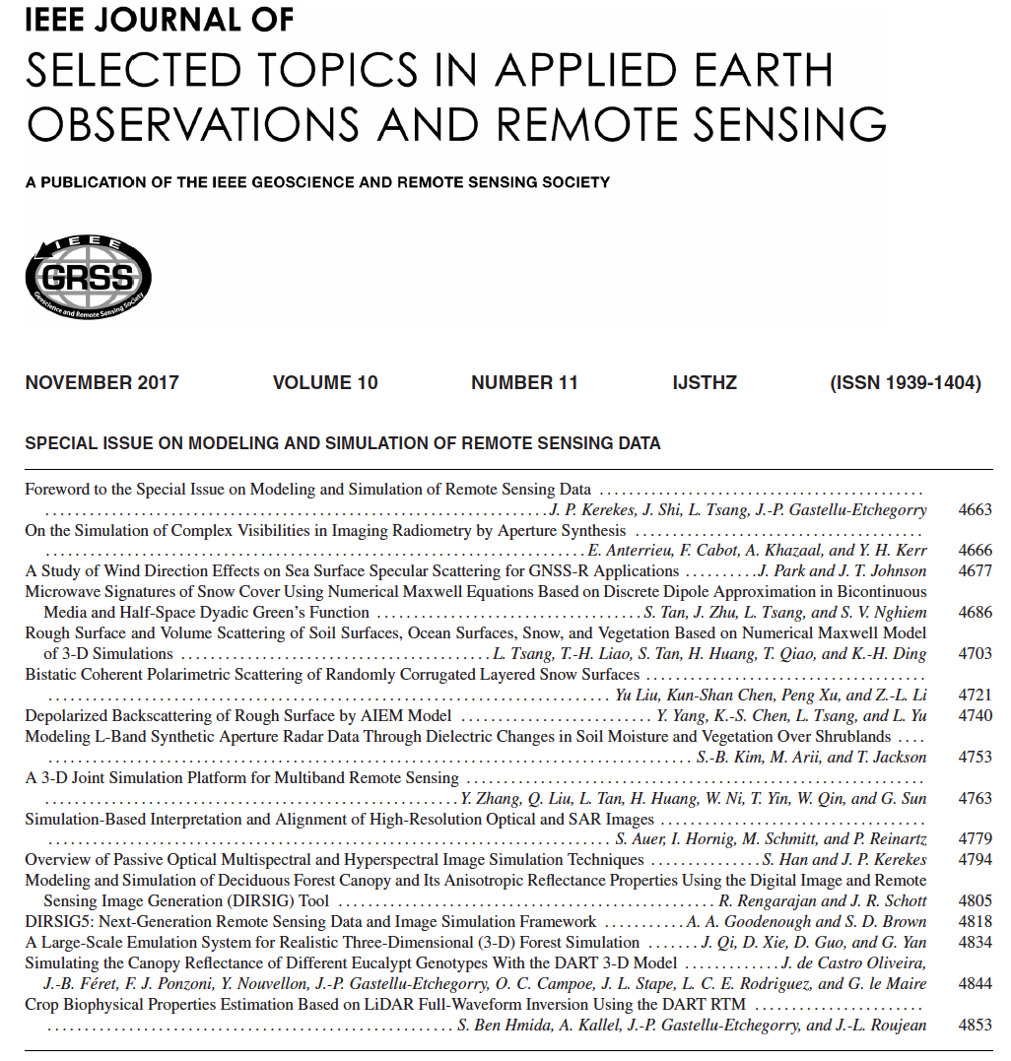

Slide 13
IGARSS’18 MIRS Invited Session: Physical Modeling in Microwave Remote Sensing
PHYSICAL MODELING OF THE UPWIND-DOWNWIND ASYMMETRY IN MICROWAVE RETURN FROM THE SEA SURFACE
Zaynab Guerraou, Sébastien Angelliaume, Charles-Antoine Guérin
MODELING L-BAND SAR OBSERVATIONS THROUGH DIELECTRIC CHANGES IN SOIL MOISTURE AND VEGETATION OVER SHRUBLANDS
Seungbum kim, Motofumi Arii, Thomas Jackson
MODELING SIGNALS OF OPPORTUNITY SCATTERING FROM EARTH’S SURFACE WITH AN IMPROVED BISTATIC RADAR EQUATION
Valery Zavorotny, Alexander Voronovich
PHYSICS-BASED MODELING OF ACTIVE-PASSIVE MICROWAVE COVARIATIONS FOR GEOPHYSICAL RETRIEVAL
Thomas Jagdhuber, Dara Entekhabi, Narendra N. Das, Moritz Link, Martin Baur, R. Akbar, C. Montzka, S. Kim, Simon Yueh, I. Baris
BISTATIC SCATTERING FROM INHOMOGENEOUS ROUGH SURFACE WITH CONTINUOUS DIELECTRIC PROFILE
Ying Yang, Kun-Shan Chen
BISTATIC SCATTERING MODELING FOR DYNAMIC MAPPING OF TROPICAL WETLANDS WITH CYGNSS
Marco Lavalle, Rashmi Shah, Mary Morris, Cinzia Zuffada, Son V. Nghiem, Clara Chew, Valery Zavorotny
FIRST-ORDER SSA MODELING OF THE ANISOTROPIC ROUGH-SOIL BISTATIC SCATTERING
Davide Comite, Nazzareno Pierdicca
NMM3D FULL WAVE SIMULATIONS OF VEGETATION AND FOREST EFFECTS IN MICROWAVE REMOTE SENSING
Huanting Huang, Leung Tsang, Andreas Colliander, Rashmi Shah, Simon Yueh
ROUGH SURFACE EFFECTS IN BACKSCATTER RETURNS FROM FORESTS
Roger Lang, Can Suer
AN ANALYSIS OF BISTATIC SEA CLUTTER STATISTICS
Ahmed M. Balakhder, Joel T. Johnson, Hongkun Li

Slide 14
IGARSS’18 MIRS Invited Session: Optical Modeling in Remote Sensing
PROGRESS IN EMULATION FOR RADIATIVE TRANSFER MODELING AND MAPPING
Jochem Verrelst, Juan Pablo Rivera Caicedo, Jose Moreno
DART: A TOOL FOR STUDYING EARTH SUFACES-TIME SERIES OF URBAN RADIATIVE BUDGET FROM EO SATELLITES
Jean-Philippe Gastellu-Etchgorry, Lucas Landier, Ahmad Albitar, Nicolas Lauret, Tiangang Yin, Jianbo Qi
RECENT PROGRESS ON OPTICAL REMOTE SENSING MODELLING OVER COMPLEX LAND SURFACES
Qinhuo Liu, Jing Li, Yelu Zeng, Wentao Yu, Jing Zhao
STATISTICAL LEARNING FOR END-TO-END SIMULATIONS
Jorge Vicent, Jochem Verrelst, Juan Pablo Rivera Caicedo, Neus Sabater, Jordi Munoz-Mari, Gustau Camps Valls
MODTRAN®6 MULTIPLE LINE OF SIGHT OPTION
Alexander Berk, Christopher Rice
FORWARD MODELING OF CLOUD SHADOWS AND THE IMPACT OF CLOUD SHADOWS ON REMOTE SENSING DATA PRODUCTS
Robert Sundberg
SPECTRAL INVARIANT APPROACH TO MODELLING RADIATIVE TRANSFER OF SUN-INDUCED CHLOROPHYLL FLUORESCENCE
Peiqi Yang, Christiaan van der Tol
A METHOD TO ENHANCE THE GEOMETRIC-OPTICAL KERNEL FOR FURTHER IMPROVING HOTSPOT EFFECT IN MODIS BRDF MODEL
Ziti Jiao, Yadong Dong
METHANE DETECTION IN THE LONGWAVE INFRARED
John Kerekes, Cody Webber, Rolando Raqueno

Slide 15
Atmospheric Transmission Models – Modeling in Remote Sensing Collaboration
GRSS has been sponsor of ATM Meeting since 2005
Technical Co-sponsorship in 2005 and 2006
Financial sponsorship since 2007
Interest in renewing and expanding ATM meeting
Decreasing participation over time
Important event in modeling community
Collaborative opportunity for joint meeting
Discussions began in fall of 2016
Explored possible venues and interest
Formed partnership with hosting organization: Boston College Institute of Scientific Research
Enjoy the meeting!

Slide 16
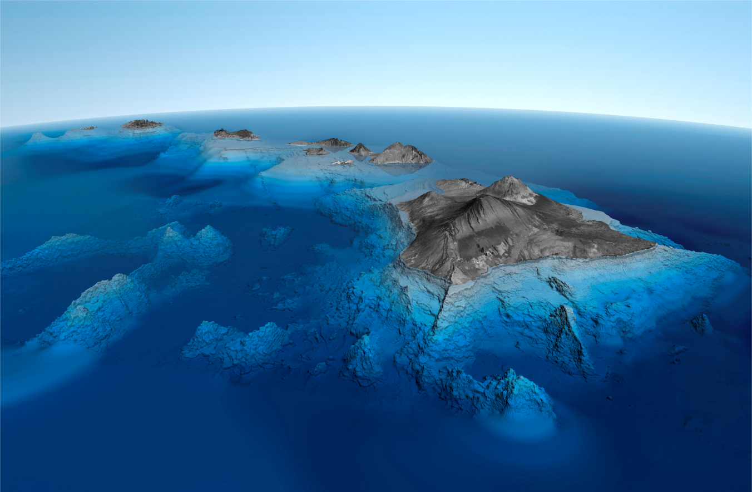
IEEE
Geoscience and
Remote Sensing Society ( IEEE GRSS )

